Slide 1
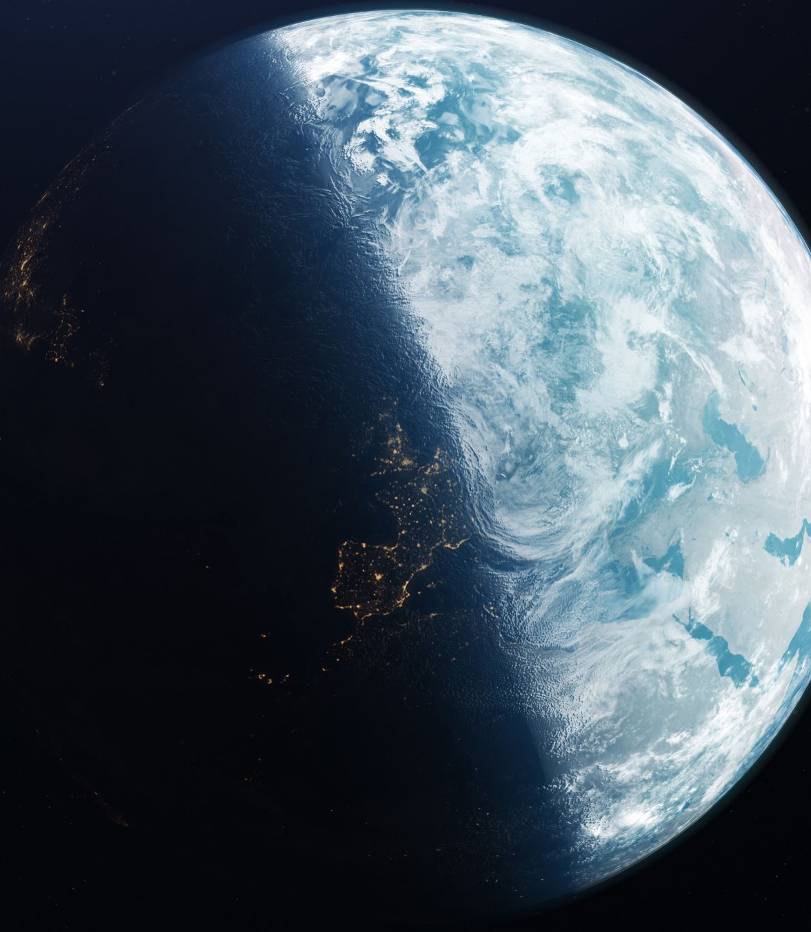
A New Interior Structure Model & The Importance of Solar System Validation
Bennett Neil Skinner, Ralph Pudritz, Ryan Cloutier
McMaster University
Revision Submitted to MNRAS
Layers of Understanding:
Model Intercomparisons of Exoplanet Interiors
Heidelberg, Germany
16 April 2026

Slide 2
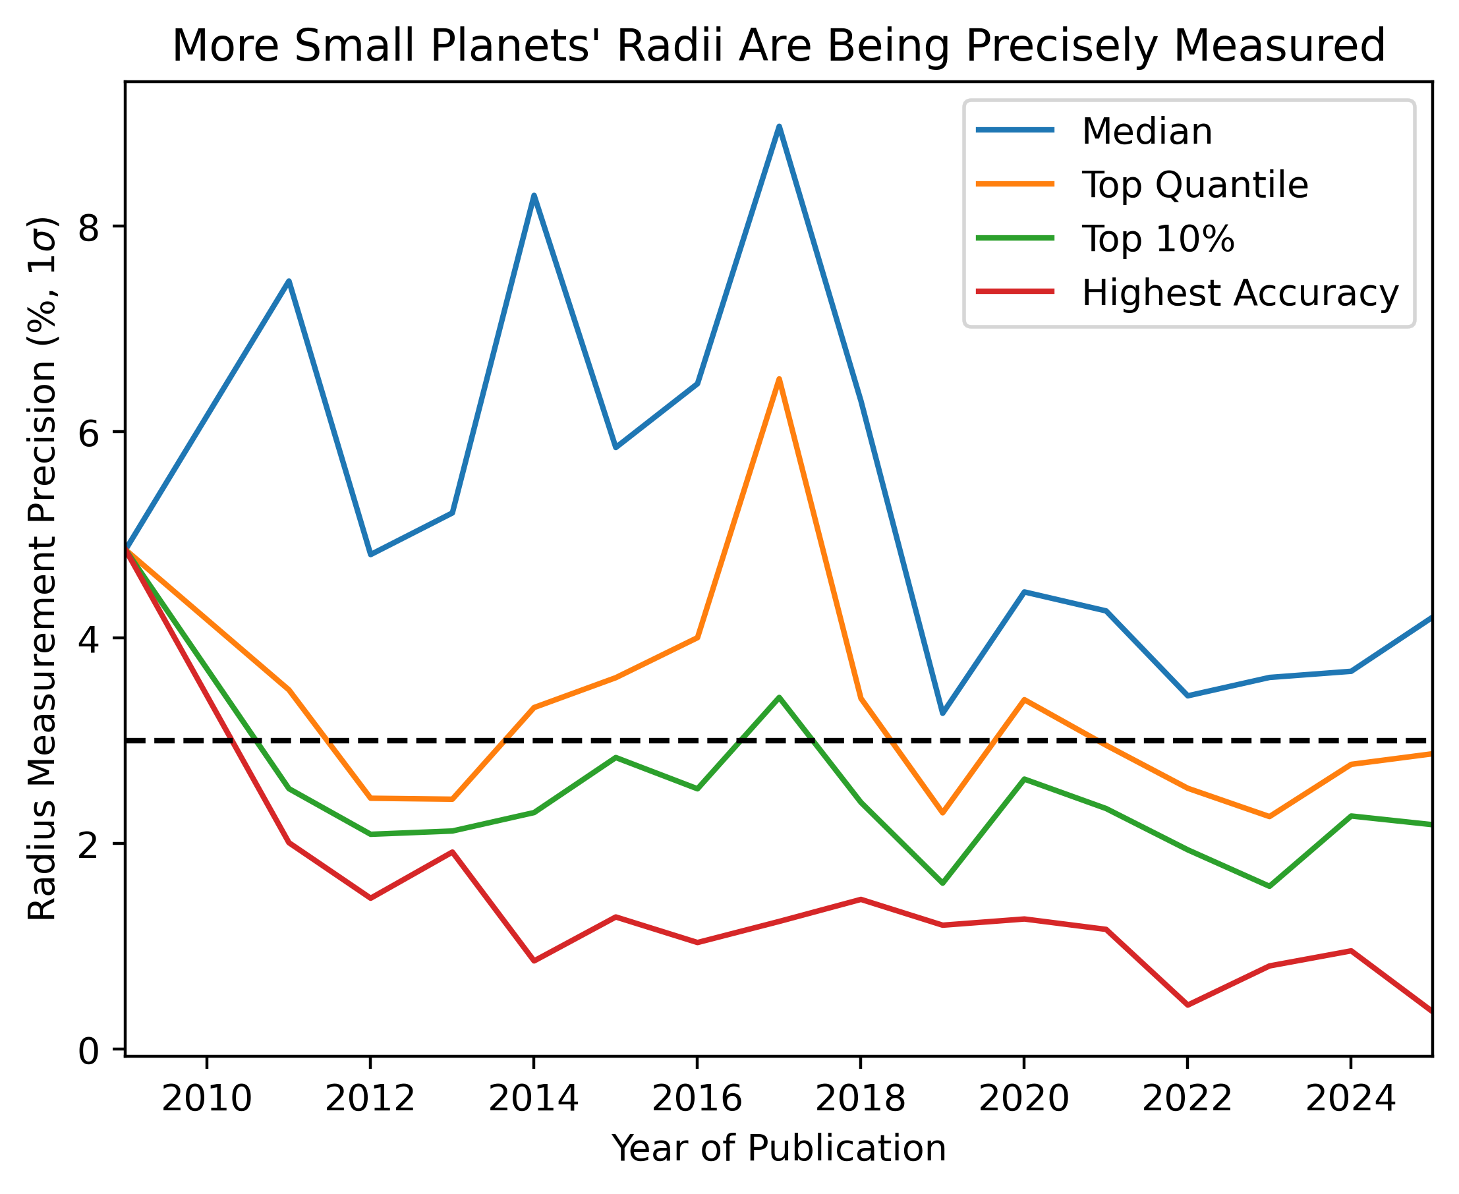
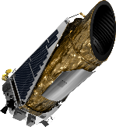
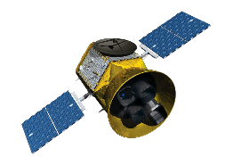
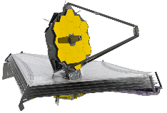
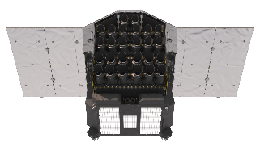
Observation data from the Exoplanet Archive
skinnb1@mcmaster.ca

Slide 3
Observation data from the Exoplanet Archive
skinnb1@mcmaster.ca

Slide 4
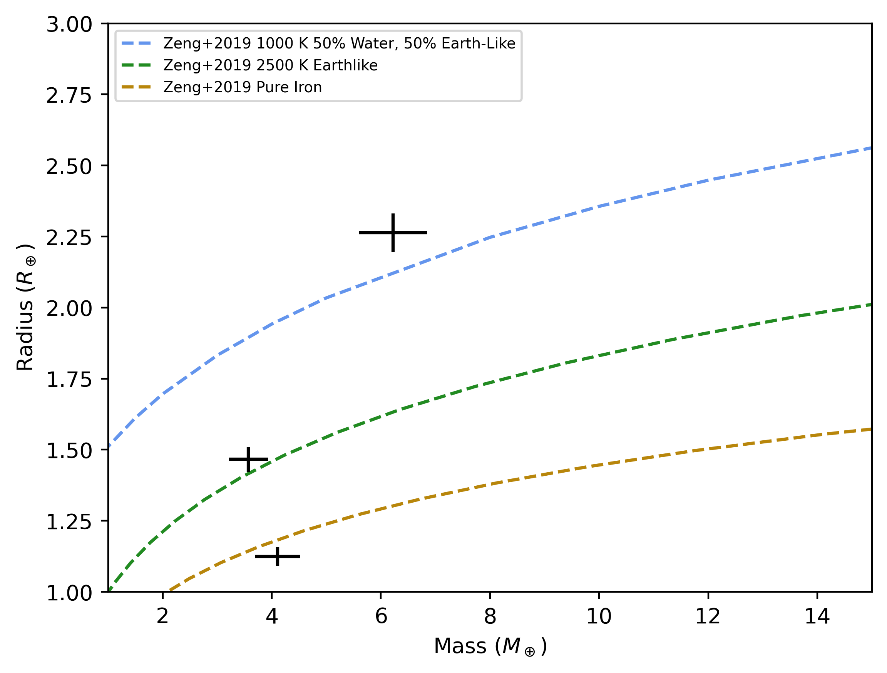
skinnb1@mcmaster.ca

Slide 5
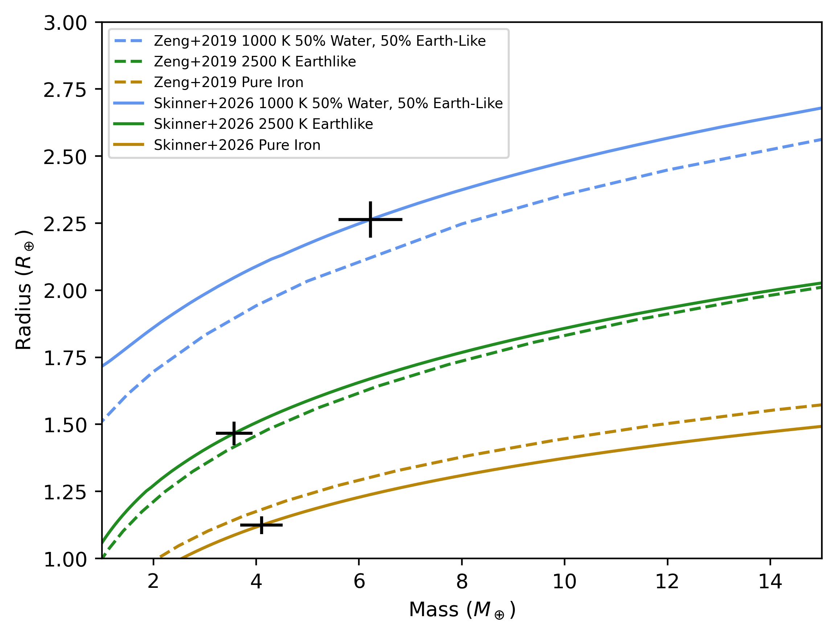
skinnb1@mcmaster.ca

Slide 6
Old: H/He-enveloped
New: Steam Atmosphere
skinnb1@mcmaster.ca

Slide 7
Old: H/He-enveloped
New: Steam Atmosphere
Old: Volatile-enhanced
New: Molten Mantle
skinnb1@mcmaster.ca

Slide 8
Old: H/He-enveloped
New: Steam Atmosphere
Old: Volatile-enhanced
New: Molten Mantle
Old: Impossible
New: Iron core
skinnb1@mcmaster.ca

Slide 9
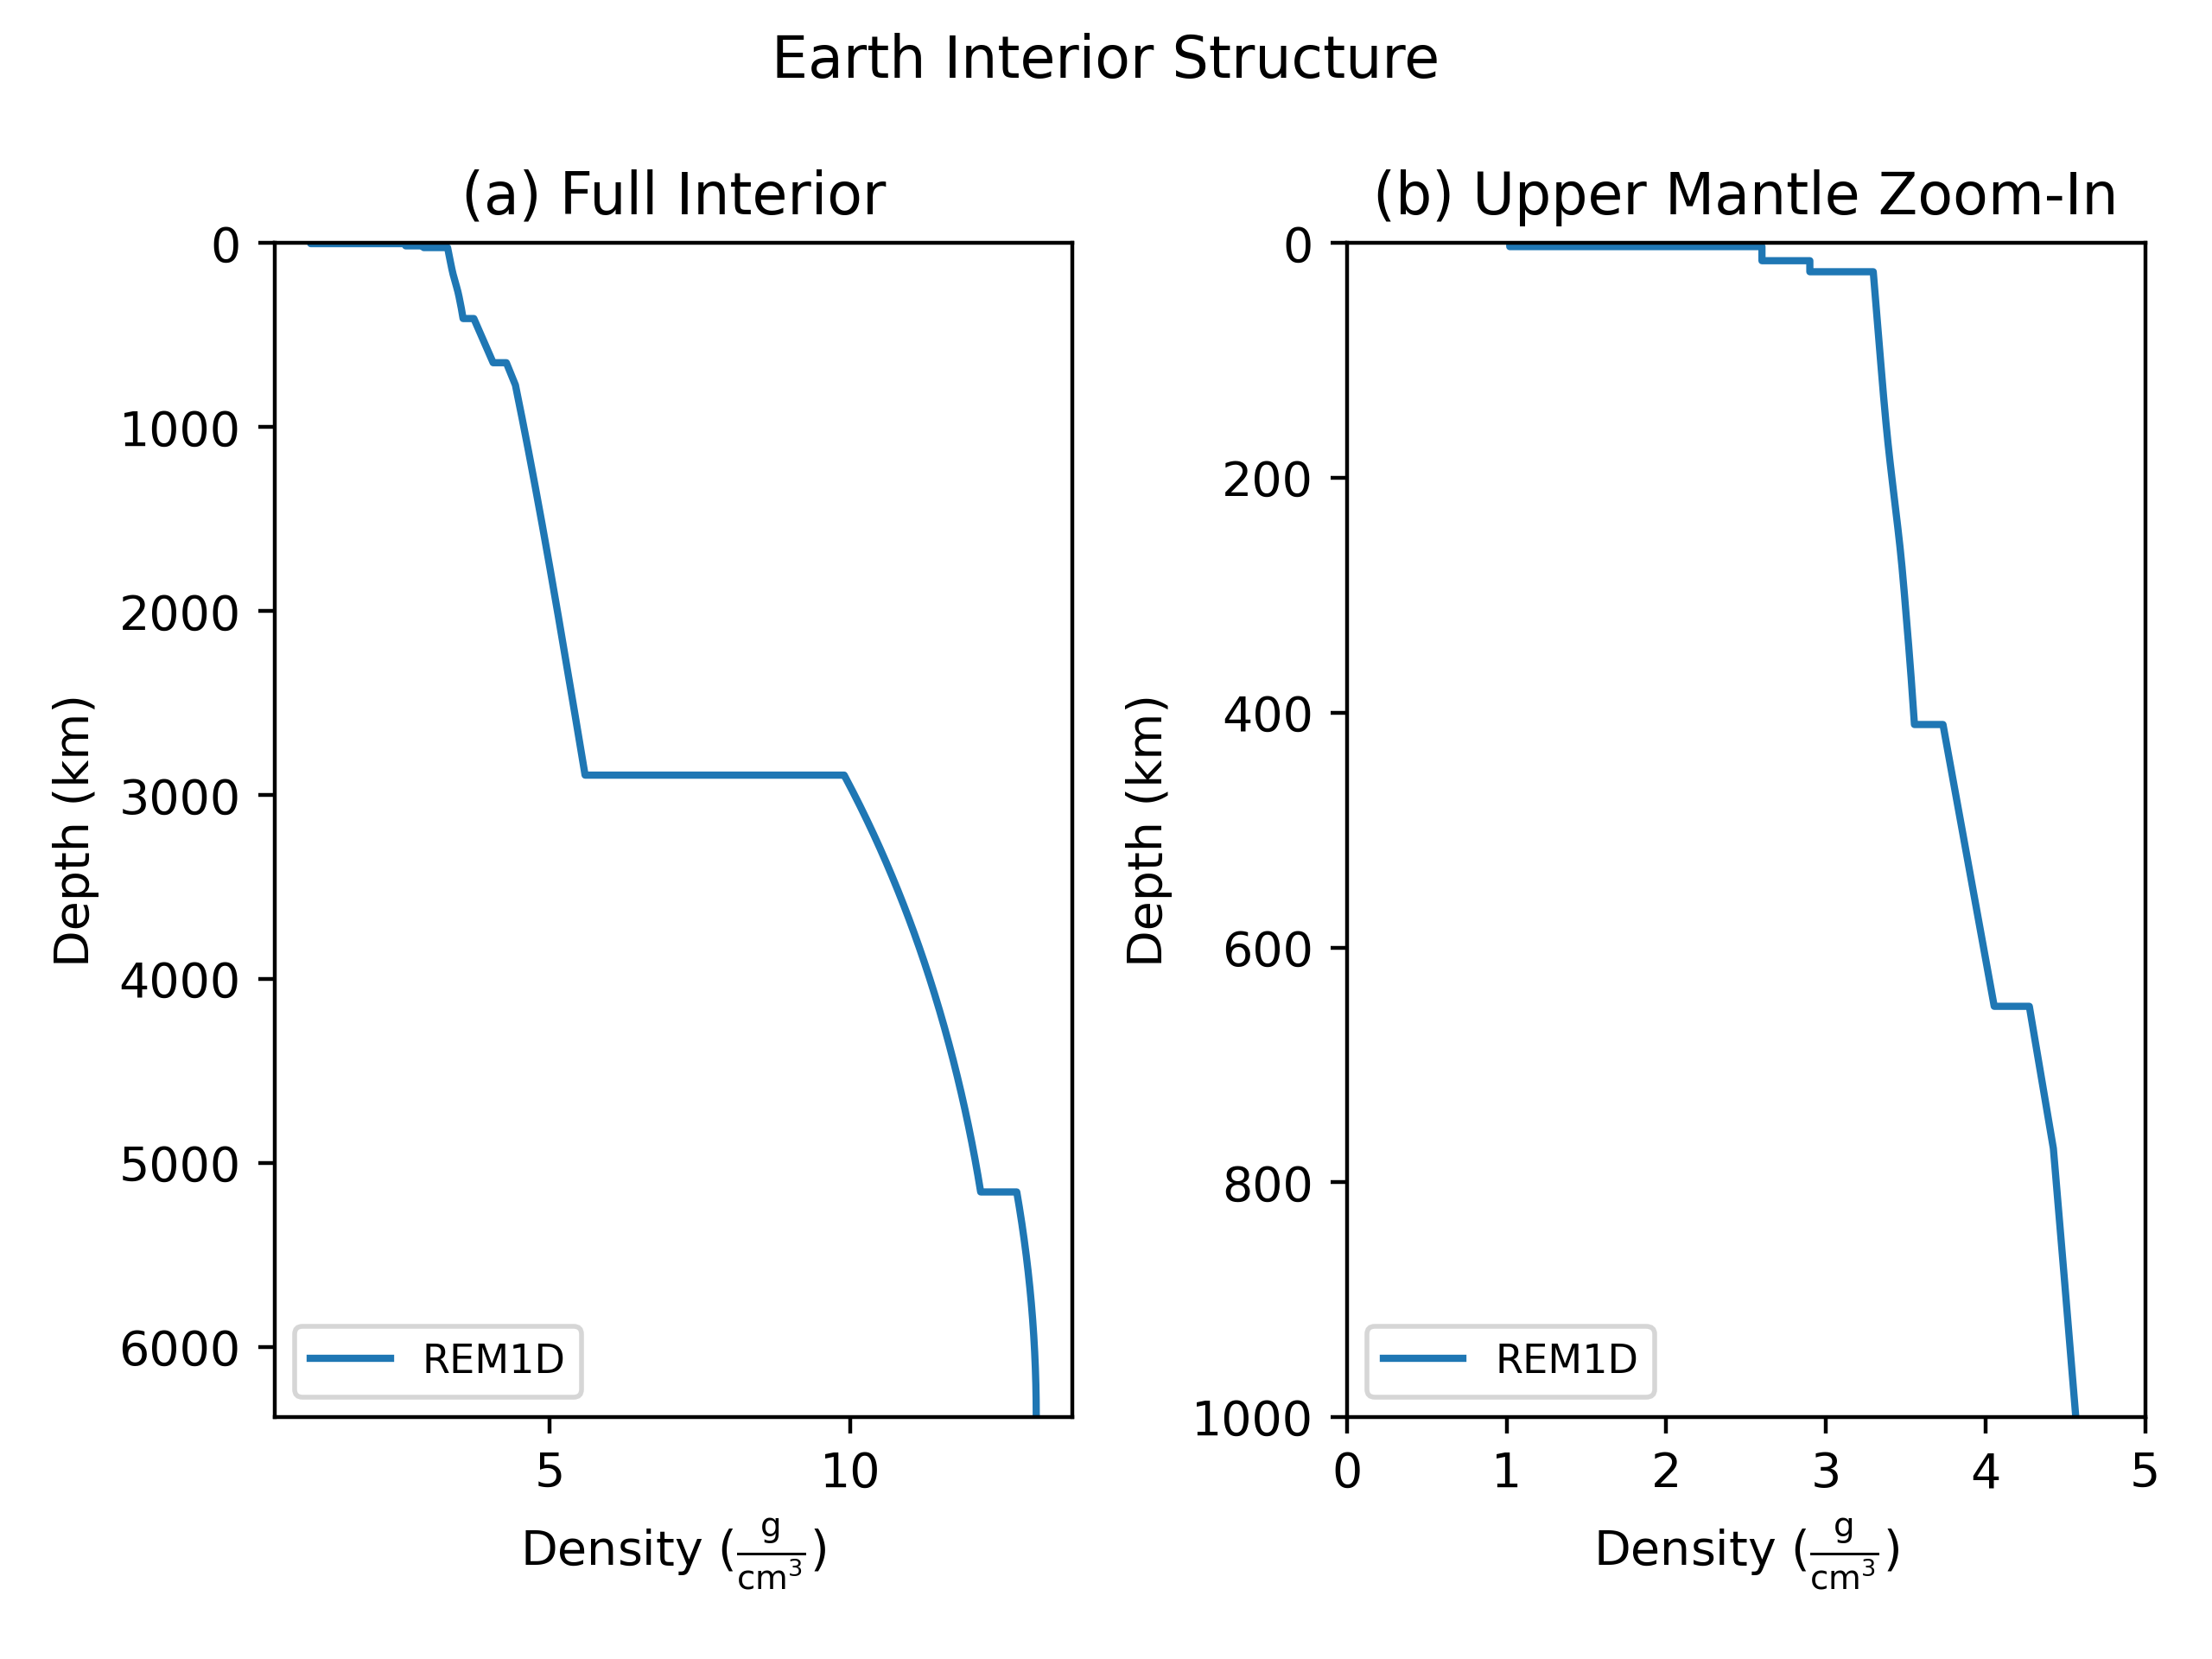
skinnb1@mcmaster.ca

Slide 10
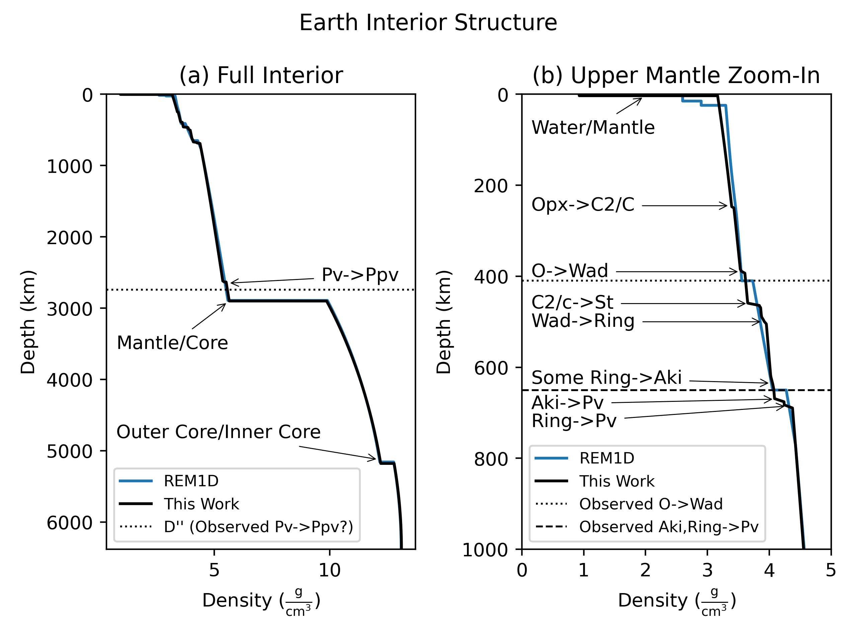
-0.16% Moment of Inertia Coefficient
Error
0.15% Radius Error
skinnb1@mcmaster.ca

Slide 11
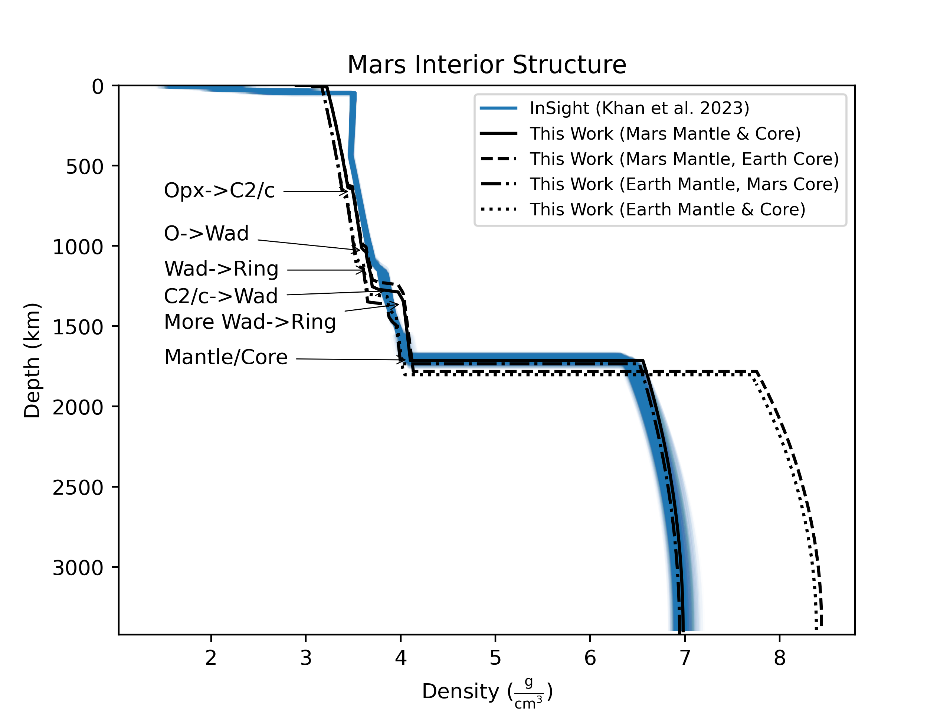
0.24% Radius Error
-0.36% MoI Coeff Error
skinnb1@mcmaster.ca

Slide 12
0.24% Radius Error
-0.36% MoI Coeff Error
This composition has the lowest radius error
skinnb1@mcmaster.ca

Slide 13
Because an underestimate here…
0.24% Radius Error
-0.36% MoI Coeff Error
This composition has the lowest radius error
skinnb1@mcmaster.ca

Slide 14
Because an underestimate here…
0.24% Radius Error
-0.36% MoI Coeff Error
This composition has the lowest radius error
…Is offset by an overestimate here
skinnb1@mcmaster.ca

Slide 15
This composition has the lowest MoI Coeff error
0.24% Radius Error
-0.36% MoI Coeff Error
This composition has the lowest radius error
skinnb1@mcmaster.ca

Slide 16
This composition has the lowest MoI Coeff error
This composition has the lowest COMBINED error
0.24% Radius Error
-0.36% MoI Coeff Error
This composition has the lowest radius error
skinnb1@mcmaster.ca

Slide 17
Martian
Lithosphere
0.24% Radius Error
-0.36% MoI Coeff Error
skinnb1@mcmaster.ca

Slide 18
Accuracy of Solar System Forward Models
Object | Radius Error | MoI Coefficient Error
Mercury | -0.17% | 0.83%/1.7σ
Venus | -0.02% | -0.62%/-0.087σ
Earth | 0.15% | -0.05%
The Moon | 0.49% | 0.29%
Mars | 0.24% | -0.36%
Europa | 0.89% | 1.53%/2.3σ
Seismologically-derived
skinnb1@mcmaster.ca

Slide 19
Advances in Interior Structure Modelling
Equations of State:
More complete chemical inventories
New phases
New Equations of State from new experiments & simulations
  Diamond anvil cells (e.g Sakai+2016, Ye+2017, Kuwayama+2020)
  Shock compression (e.g Fei+2021, Zhang+2025)
  Density functional theory (e.g. Musella+2018, Hakim+2018, Xie+2025)
  Molecular dynamics (e.g Chabrier+2019, Ichikawa & Tsuchiya 2020, Zhang+2023)
Additional Physics:
Internal Luminosity
Realistic temperature profiles
Accounting for transit geometry
Rotation
skinnb1@mcmaster.ca

Slide 20
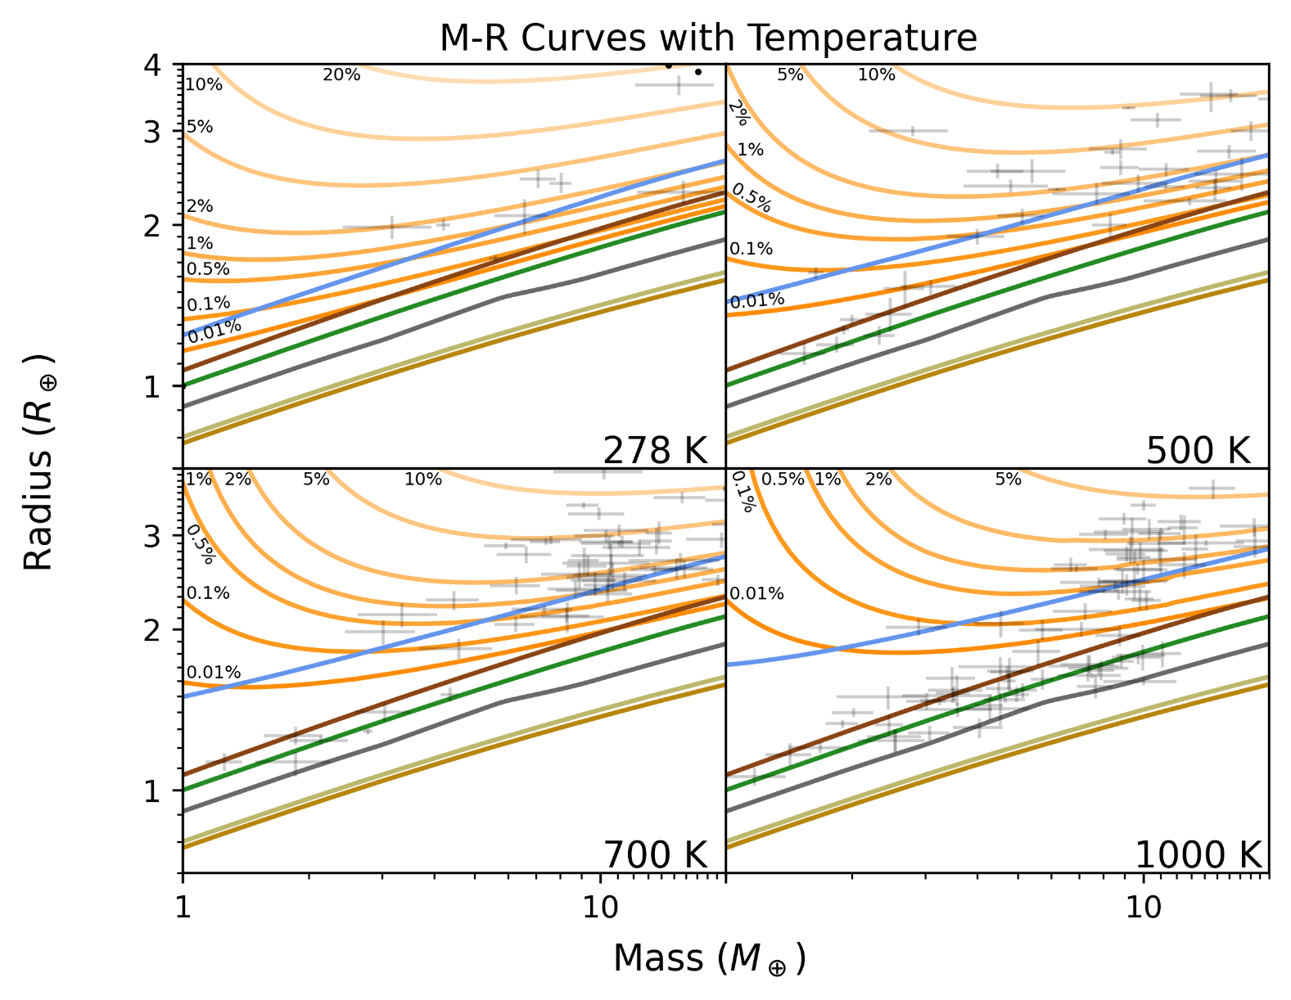
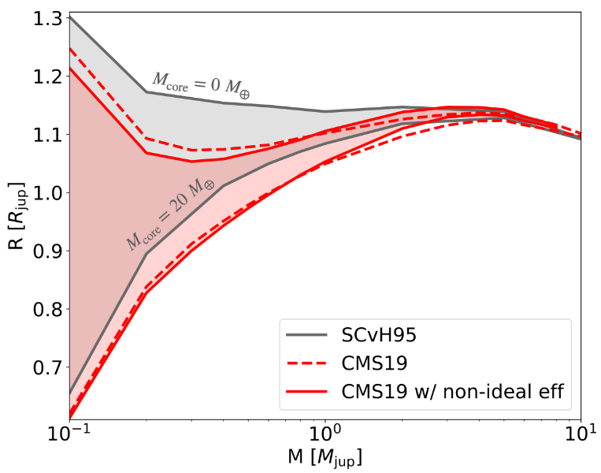
Envelope
EOS simulated for high P (Chabrier+2019)
Hydrogen & Helium (Chabrier+2019)
Non-ideal mixing (Chabrier+Debras 2021,
Howard+Guillot 2023)
  Systematically increases density (for low mases)
Reproduced from Howard & Guillot (2023) Figure 6
skinnb1@mcmaster.ca

Slide 21
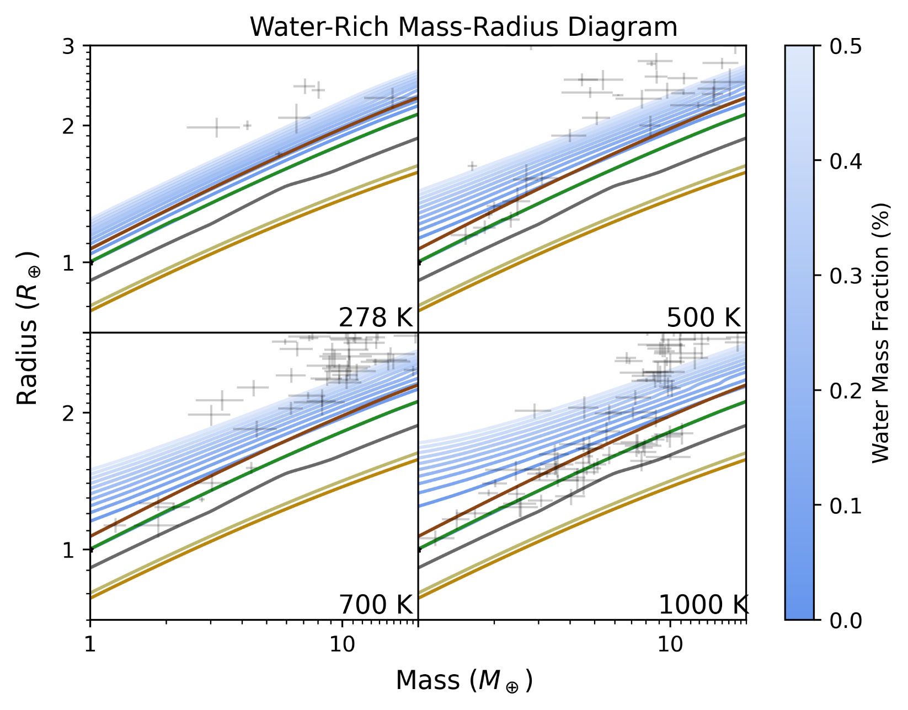
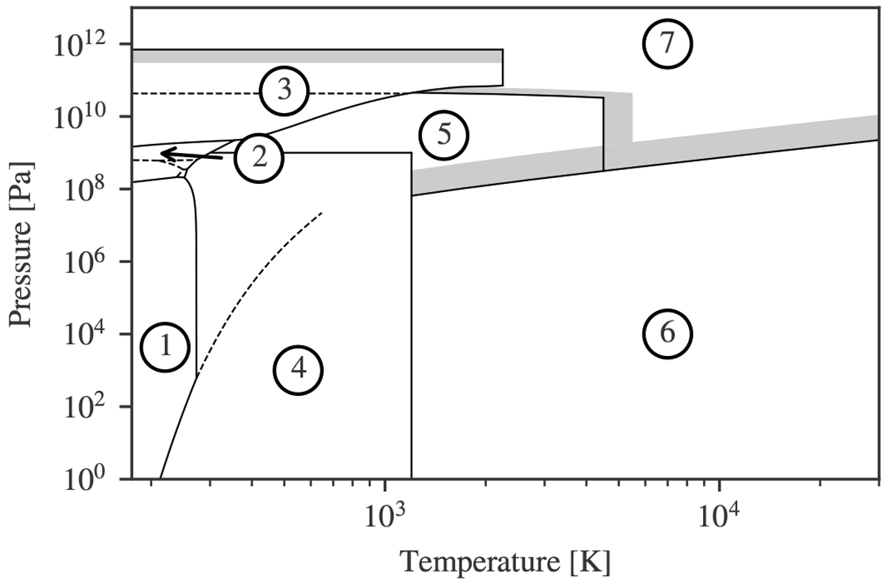
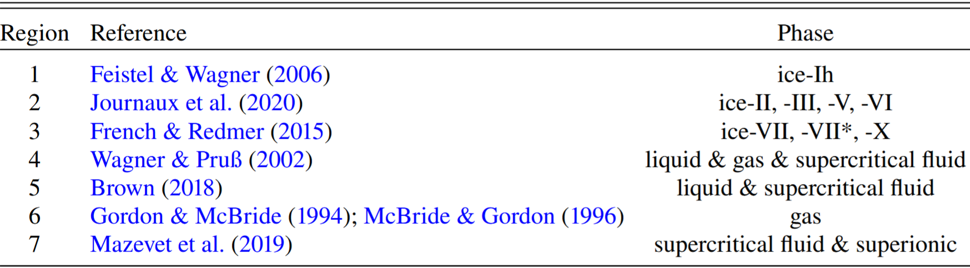
Water
AQUA model (Haldemann+2020)
  Steam → systematically lower density
Figure 2 & Table 1 Reproduced from Haldemann+2020
skinnb1@mcmaster.ca

Slide 22
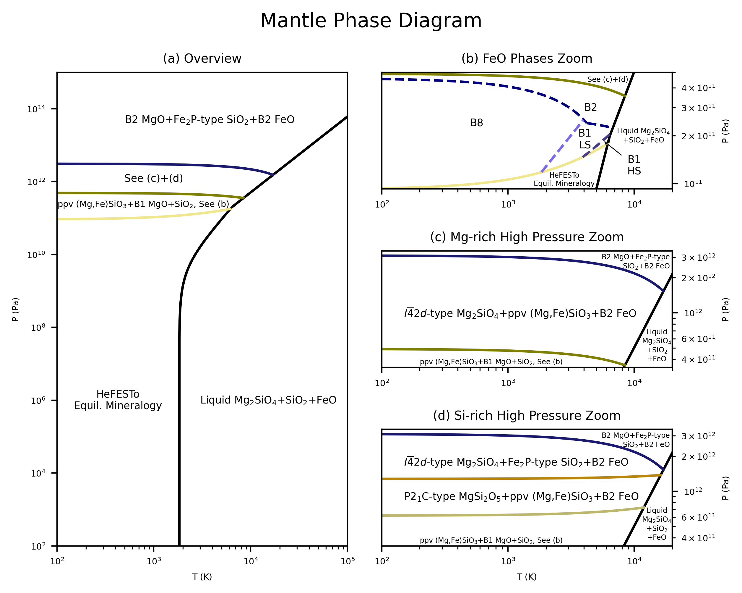
Mantle
Iron (Faik+2011, Morard+2022, Greenberg+2023)
  Increased density
High-pressure phases (Tsuchiya+Tsuchiya 2011, Umemoto+Wentzcovitch 2011, Umemoto+2017)
  Increased density
Molten mantle (Faik+2018, Stewart+2020, Morard+2022)
  Decreased density
skinnb1@mcmaster.ca

Slide 23
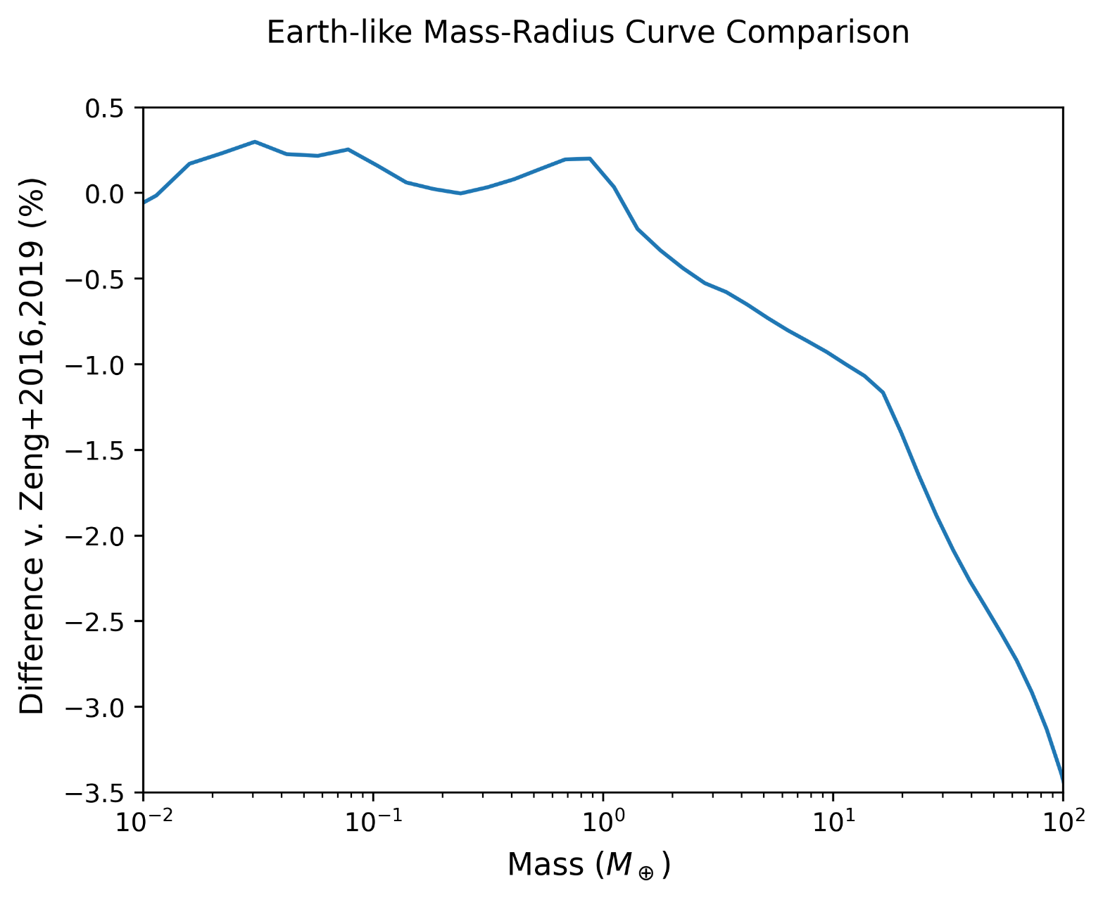
Mantle
skinnb1@mcmaster.ca

Slide 24
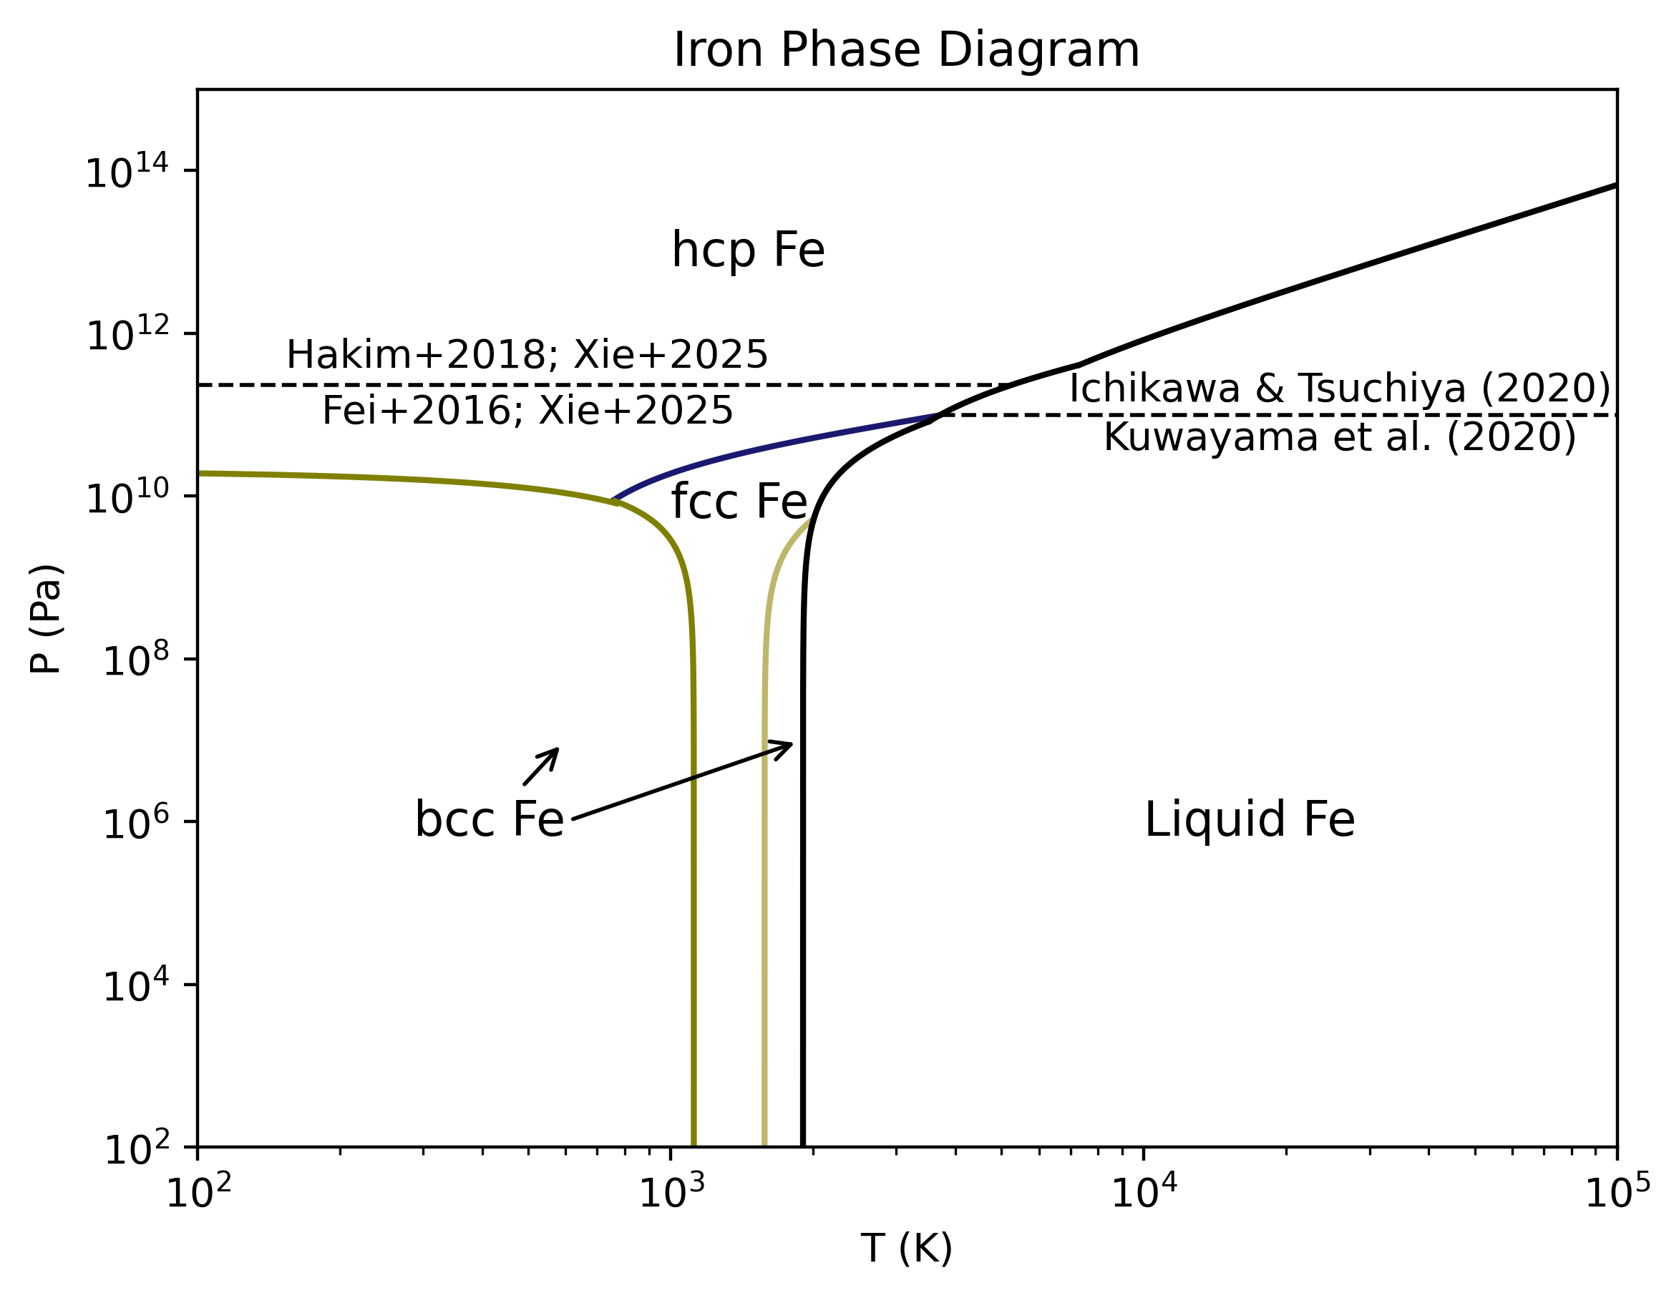
Core
EOS more suited to Tpa+ pressures (Hakim+2018, Holzapfel+2002)
  Increased density
Solid & liquid (Fei+2016, Dorogokupets+2017, Ichikawa+Tsuchiya 2020, Kuwayama+2020)
  Light elements reduce melting T
Sulfur and oxygen
  Decreased density
skinnb1@mcmaster.ca

Slide 25
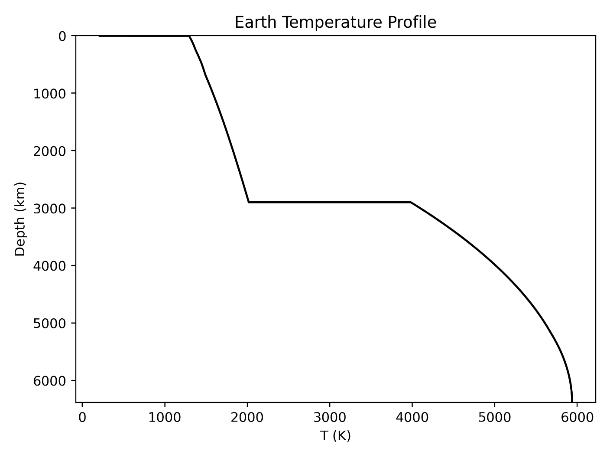
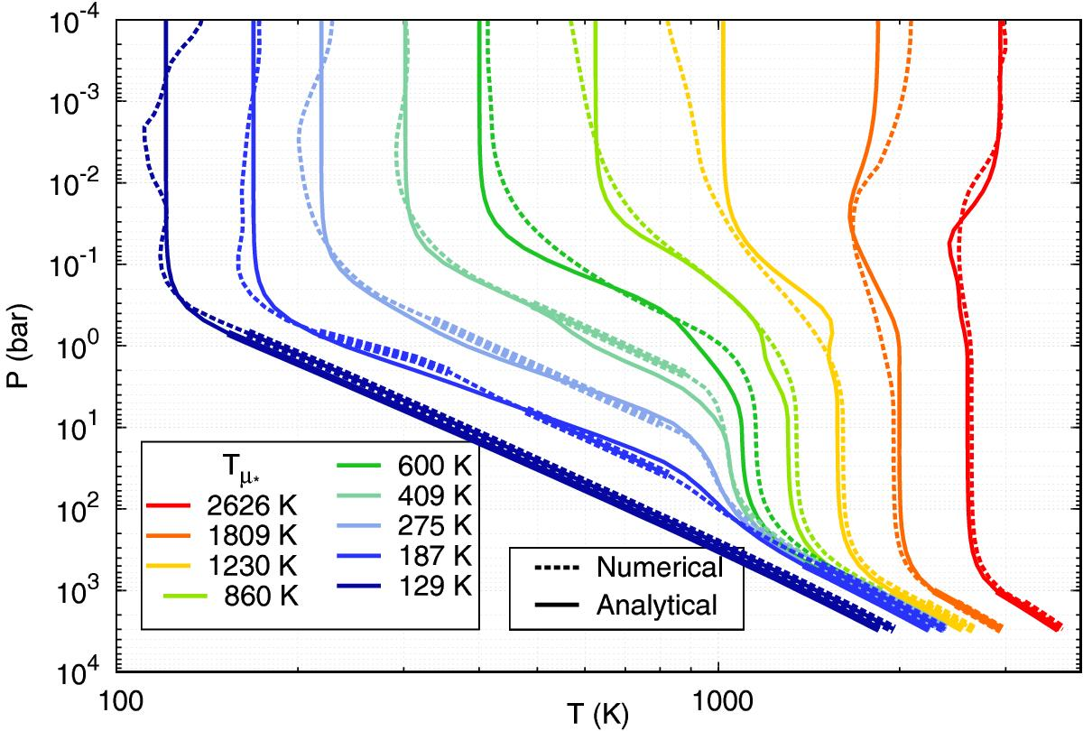
More Realistic Temperature Profile
T Jump at mantle top/bottom
Radiative Transfer in Atmosphere
Reproduced from Parmentier et al. (2015) Figure 12
skinnb1@mcmaster.ca

Slide 26
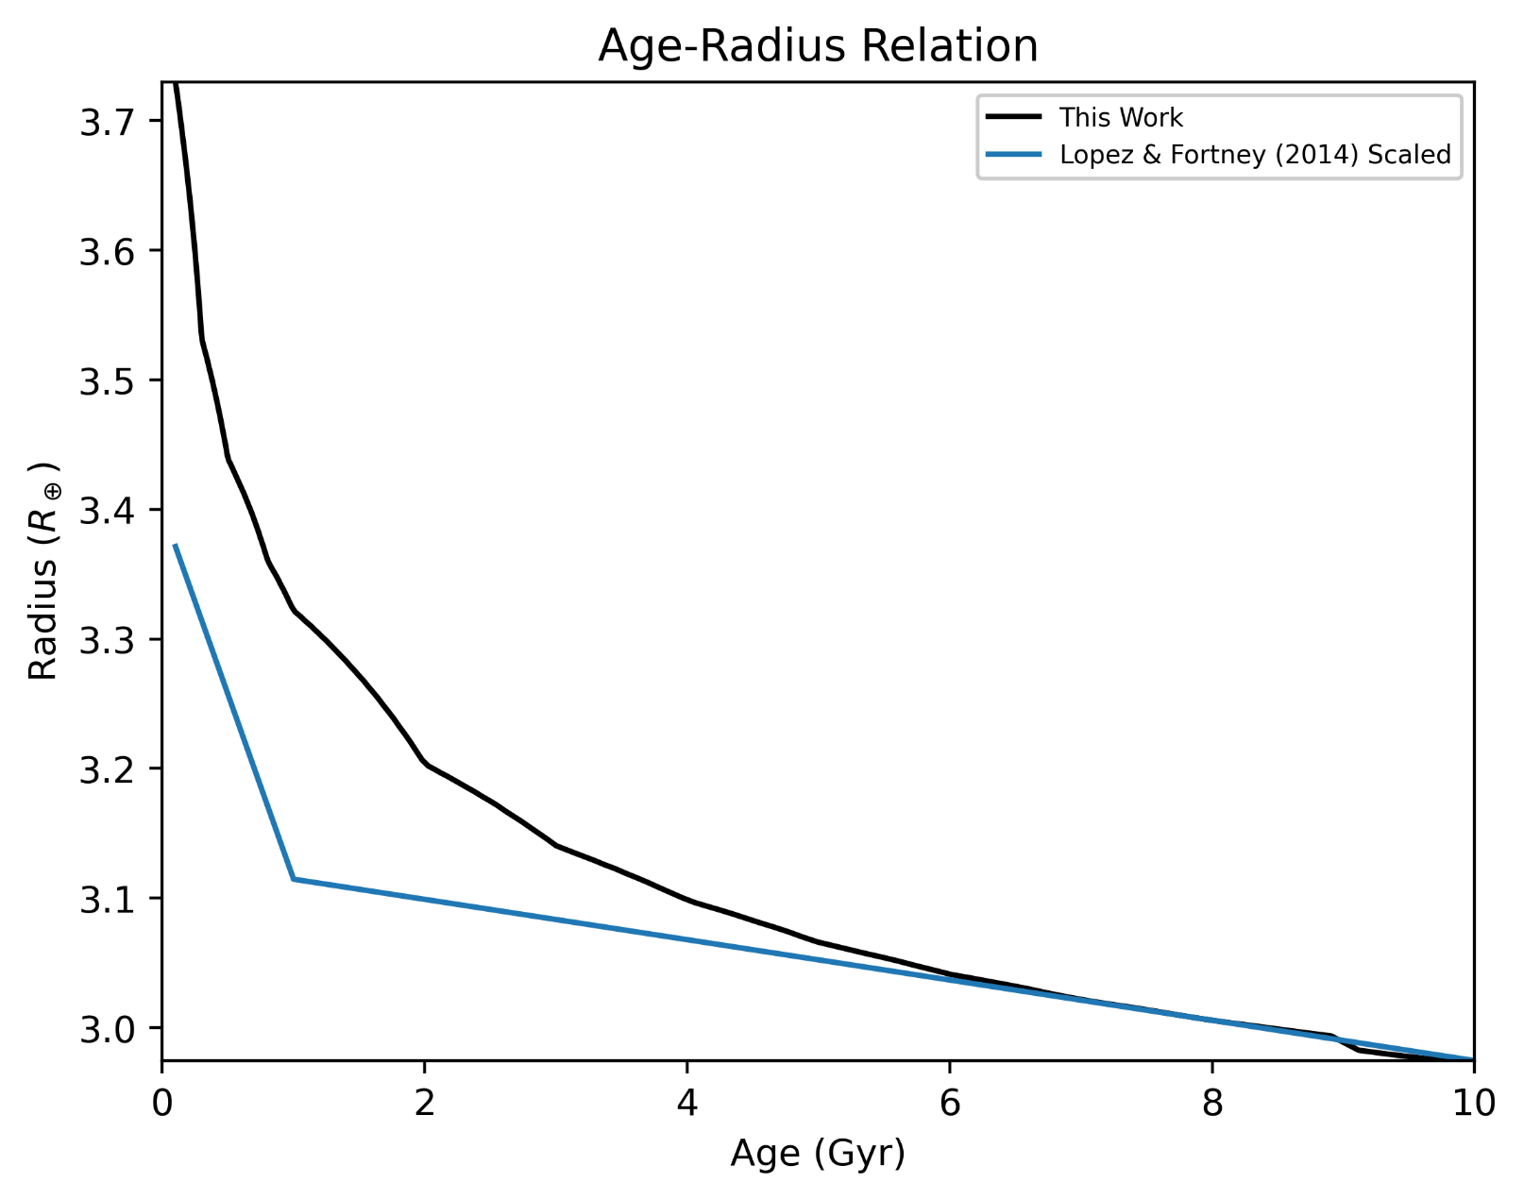
Internal
Luminosity
Luminosity from fit to evolution models (Mordasini 2020)
  Can expand radius by 25%+ at young ages
  ~Consistent with full dynamics models @ 4.5 Gyr+
    Different set of EOS from Lopez & Fortney (2014), not directly comparable
skinnb1@mcmaster.ca
Example Planet: 13 Earth Masses, 99% Earthlike-1% H/He Composition, 1565 K Equilibrium Temperature
Notes:
Ours agrees w/ Mark Eberlein’s result decently

Slide 27
Planetary Transit Radii
Planetary Radius
Transit Radius
skinnb1@mcmaster.ca

Slide 28
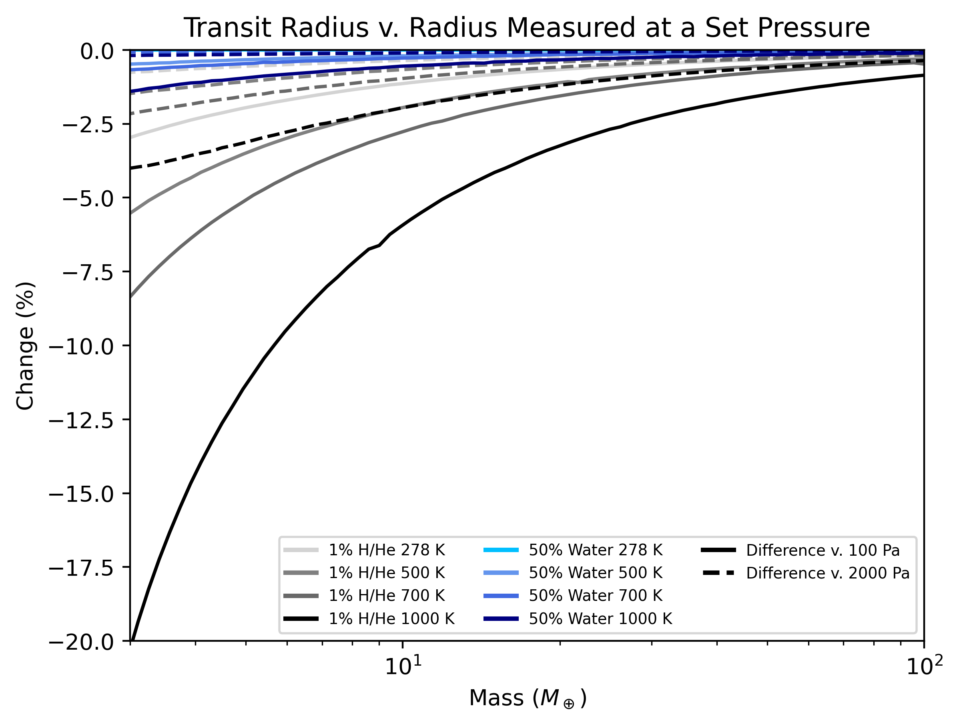
Planetary Transit Radii
At level of observation error!
skinnb1@mcmaster.ca

Slide 29
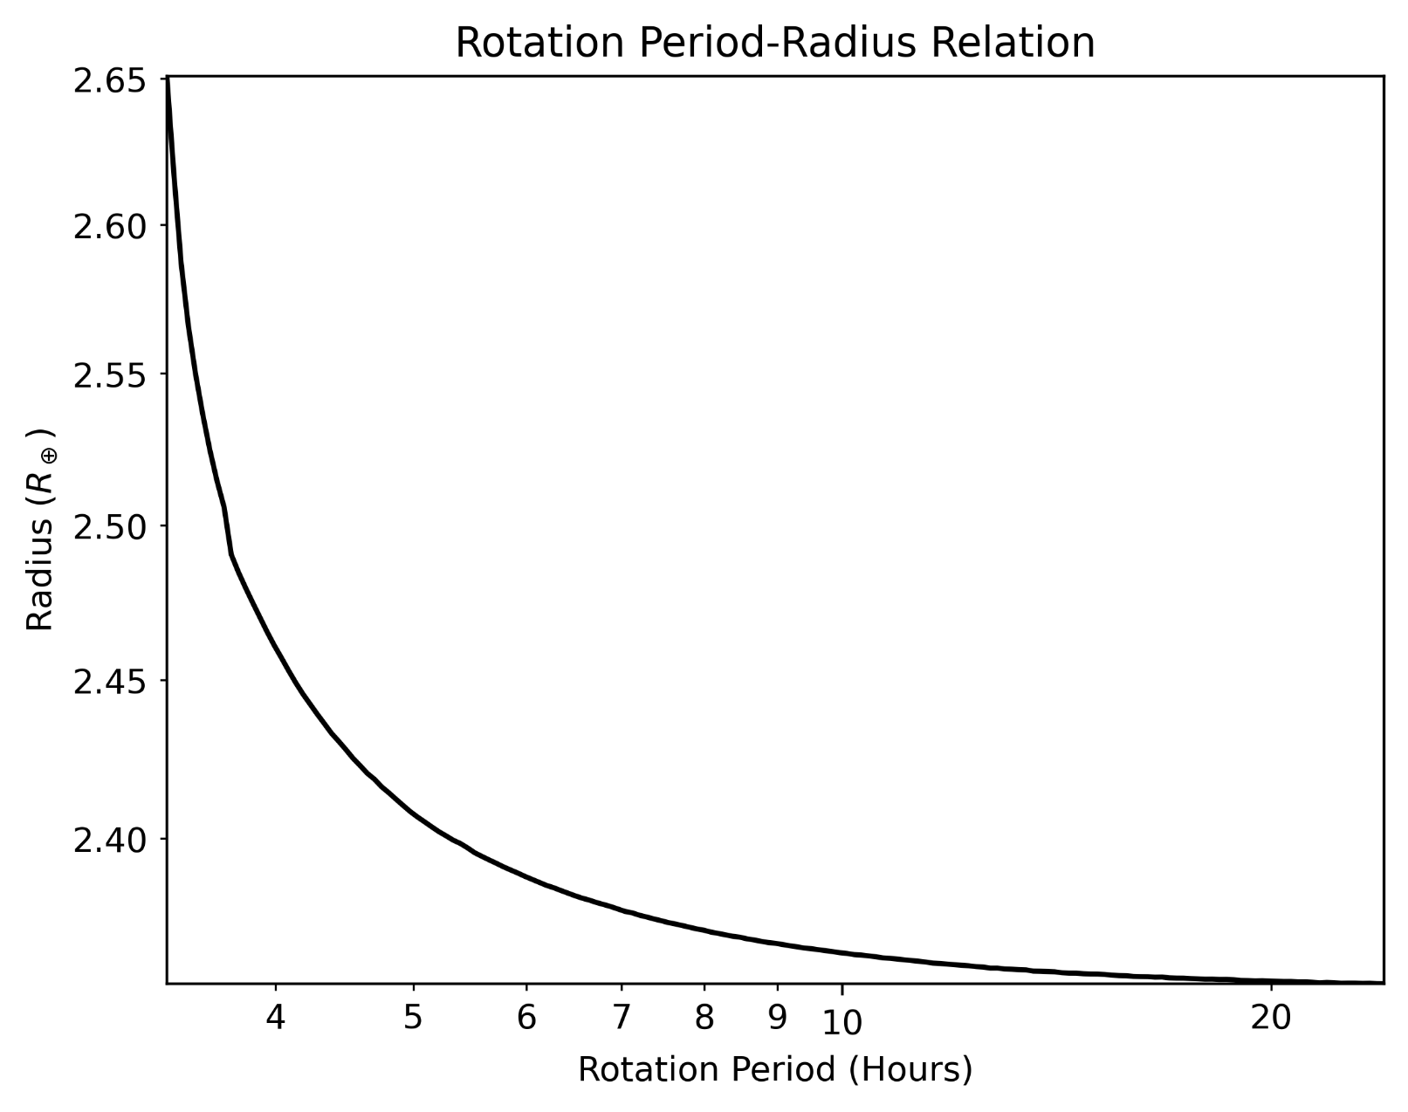
Rotation
MESA Rotation Prescription (Paxton+2019)
  Can expand radius by 10%+ at fast rotation rates
  Minor for tidally locked objects
  …but could result from giant impacts
  Non-negligible (0.02%) impact on Earth’s radius
skinnb1@mcmaster.ca
Example Planet: 10 Earth Masses, 99% Earthlike-1% H/He Composition, 700 K Equilibrium Temperature

Slide 30
Rotation
MESA Rotation Prescription (Paxton+2019)
  Can expand radius by 10%+ at fast rotation rates
  Minor for tidally locked objects
  …but could result from giant impacts
  Non-negligible (0.02%) impact on Earth’s radius
Mantle solidifies!
skinnb1@mcmaster.ca
Example Planet: 10 Earth Masses, 99% Earthlike-1% H/He Composition, 700 K Equilibrium Temperature

Slide 31
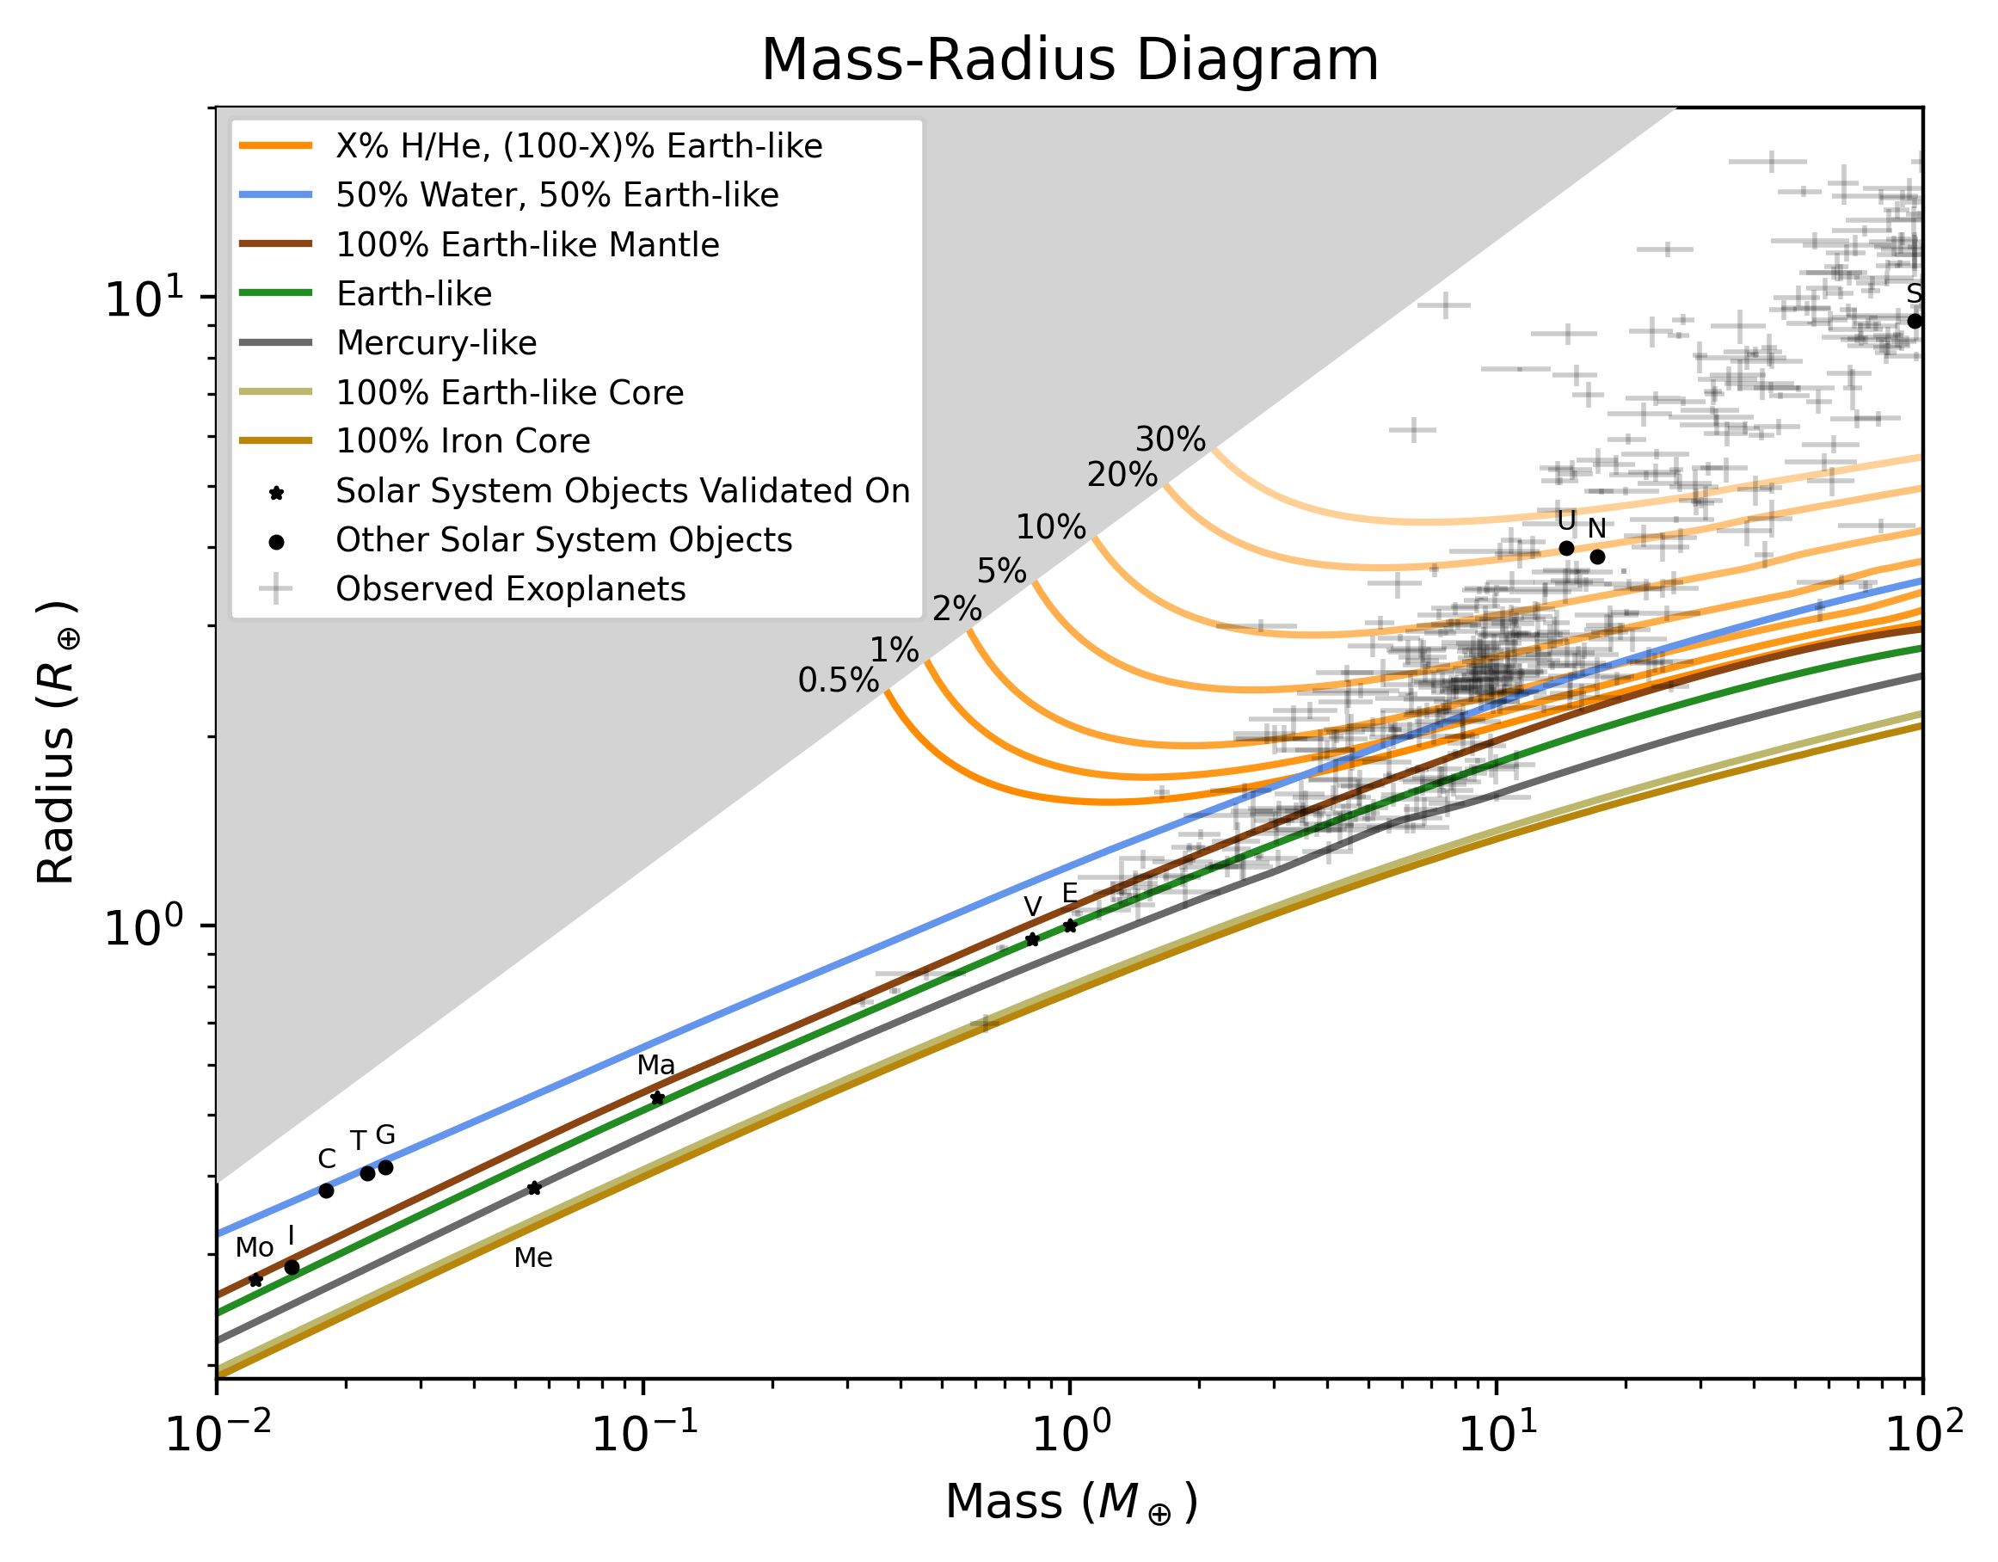
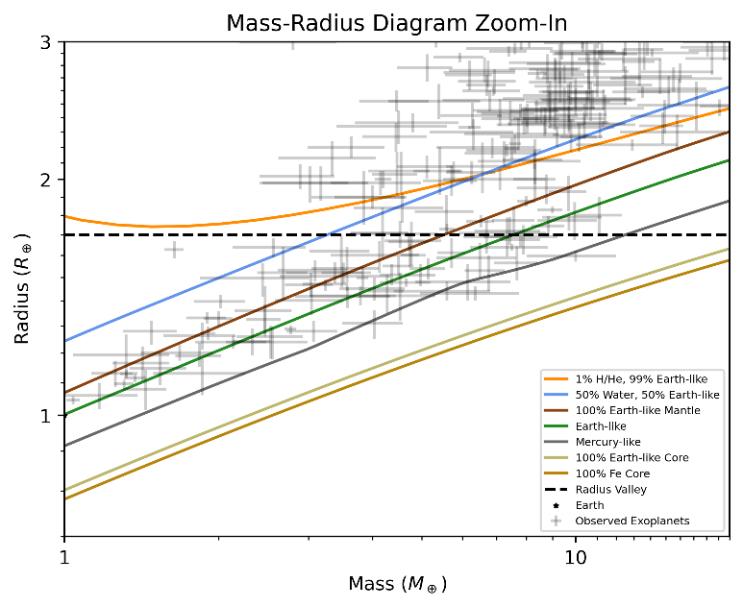
Observation data from the Exoplanet Archive
skinnb1@mcmaster.ca

Slide 32
Super-Earths
are Earth-like
Observation data from the Exoplanet Archive
skinnb1@mcmaster.ca

Slide 33
Super-Earths
are Earth-like
Mercury is Iron-enhanced
Observation data from the Exoplanet Archive
skinnb1@mcmaster.ca

Slide 34
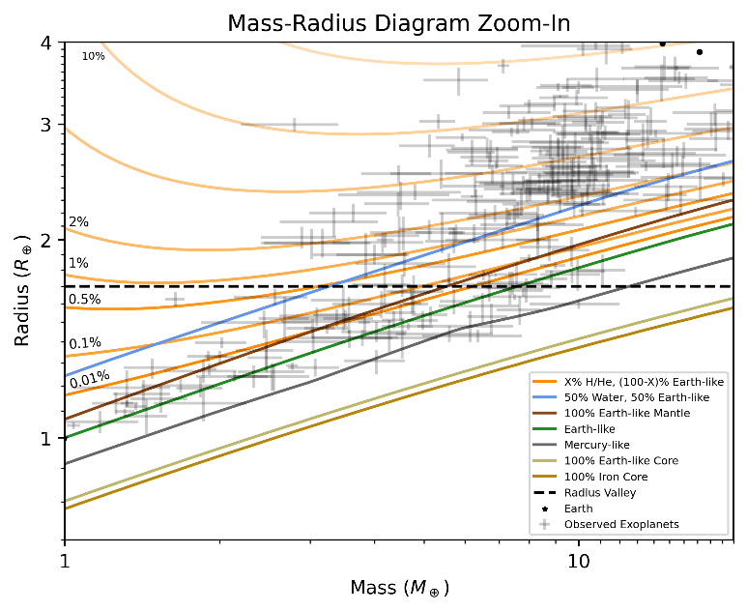
Super-Earths
are Earth-like
Water-rich moons
Mercury is Iron-enhanced
Observation data from the Exoplanet Archive
skinnb1@mcmaster.ca

Slide 35
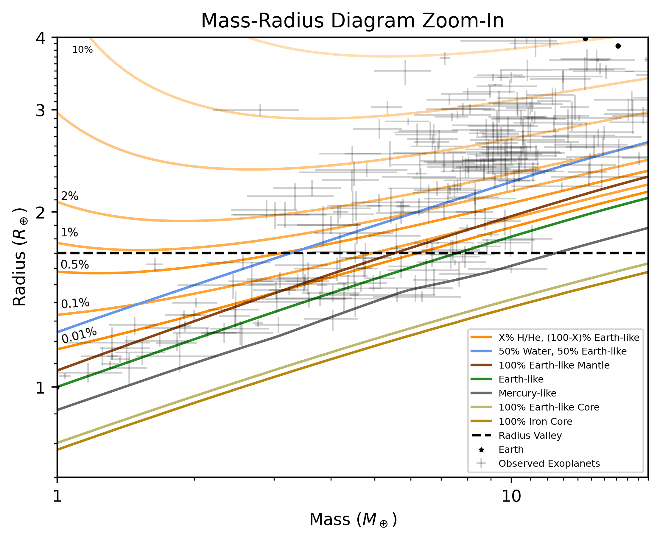
Sub-Neptunes could be water-rich OR gas dwarfs
Observation data from the Exoplanet Archive
skinnb1@mcmaster.ca

Slide 36

Summary & Conclusion
We have created an interior model incorporating state-of-the-art physics
  Up-to-date EOS
    H/He: Non-ideal mixing -> increase density
    Iron: AP2 fit -> increase density
  Comprehensive phase diagram
    Water: Steam -> decrease density
    Mantle: High-pressure phases -> increase density
    Mantle: Melting -> decrease density
    Core: Melting -> decrease density
    Solidifying > increase density
  Physical mineralogy
    Mantle: Iron -> increase density
    Core: Sulfur -> decrease density
  More physics
    Internal luminosity -> decrease density
    Rotation -> decrease density
    Transit radii -> increase density
Use seismographic profiles of Earth, Mars, and the Moon to validate interior structure models
Report moments of inertia
Error from interior structure model simplifications O(observational error)
Solar system objects reproduced to extremely high (<0.5%) accuracy
Future direction: Water mixing into H/He envelope, sequestration into interior – Talk to me about it!
Read the paper!
https://github.com/Bennett-Skinner/SkinnerPudritzCloutier2026-MR-curves/

Slide 37
Bonus Slides

Slide 38
Simplifications in literature interior structure models lead to incorrect inferences about the nature of planets

Slide 39
Considering full interior profiles over a range of solar system objects tells you missing physics!
…and it validates the physics you do have
skinnb1@mcmaster.ca

Slide 40
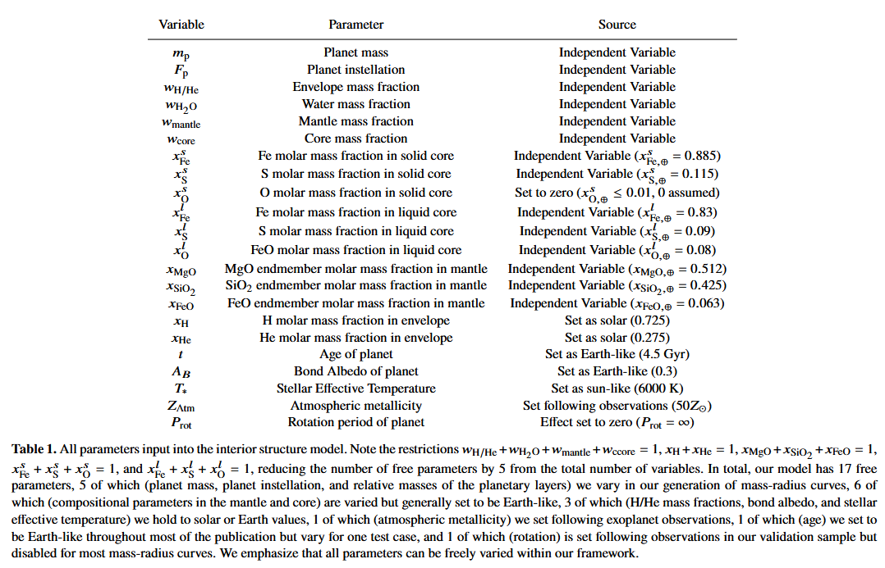
Input Parameters

Slide 41
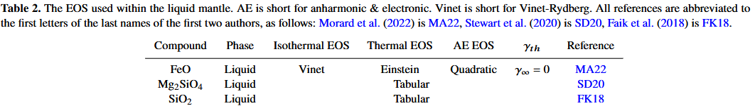
Liquid Mantle EOS

Slide 42
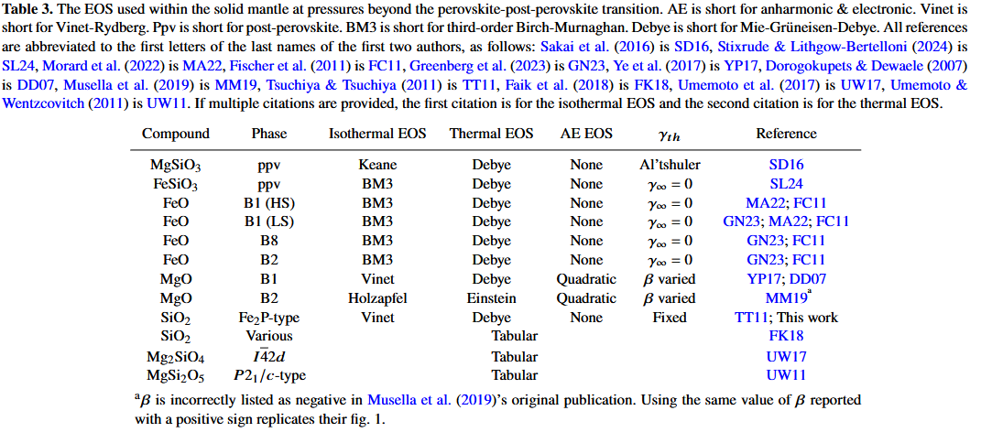
Solid Mantle EOS

Slide 43
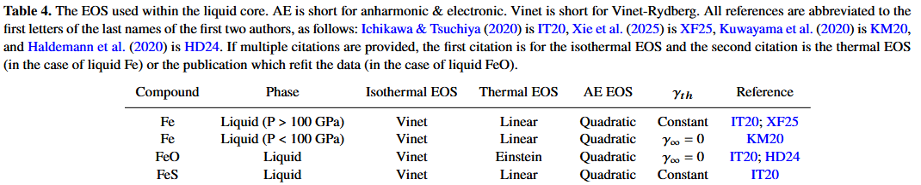
Liquid Core EOS

Slide 44
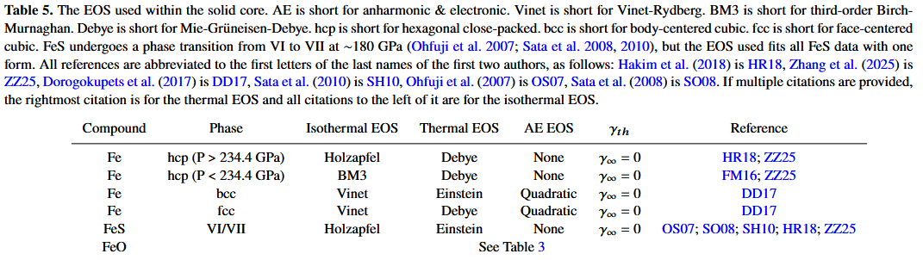
Solid Core EOS

Slide 45
Improvements v. BICEPS (Haldemann et al. 2024)
Layer | Chemical Inventory | Phases | Equations of State | Thermal Structure
Envelope | NO H/He-water mixing | - | Non-ideal mixing | -
Water | NO H/He-water mixing | - | - | -
Mantle | - | High pressure phases; more phases of oxides | HeFESTo update (2021 ->2024) | New melting curve
Core | Oxygen | - | New thermal pressure terms | New melting curve

Slide 46
Improvements v. MAGRATHEA v2 (Rice et al. submitted)
Layer | Chemical Inventory | Phases | Equations of State | Thermal Structure
Envelope | - | - | Non-ideal mixing for diverse H/He ratios | Fit to radiative temperature profile
Water | - | - | - | -
Mantle | Fe, NO C | High pressure phases; Gibbs free energy | HeFESTo update (2021 ->2024) | Temperature jumps at top, bottom, new melting curve
Core | Sulphur, Oxygen | - | EOS that extrapolates better than Vinet | New melting curve

Slide 47
Improvements v. ExoPlex (As of Unterborn et al. 2023)
Layer | Chemical Inventory | Phases | Equations of State | Thermal Structure
Envelope | Not in ExoPlex
Water | - | - | Ice X, water vapor | -
Mantle | NO Ca and Al | High pressure phases; more phases of oxides | HeFESTo update (2011 ->2024) | Temperature jumps at top, bottom
Core | Oxygen, Sulphur EOS used, not a density reduction | Solid phases (bcc, fcc, and hcp) | Modern experiments with temperature sampling | -

Slide 48
Improvements v. ExoPie (Plotnykov & Valencia 2024)
Layer | Chemical Inventory | Phases | Equations of State | Thermal Structure
Envelope | Not in ExoPie
Water | - | - | Ice X, water vapor | -
Mantle |  | High pressure phases; more phases of oxides | Gibbs Free Energy Minimization (Wadsleyite and Ringwoodite separated) | Temperature jumps at top, bottom
Core | Oxygen, Sulphur EOS used, not a density reduction | Solid phases (bcc, fcc, and hcp) | Modern experiments with temperature sampling | -
Notes:
Main Gibbs Free Energy effect: wadsleyite and ringwoodite separated

Slide 49
Improvements v. Zalmoxis (Pascal et al. 2025)
Layer | Chemical Inventory | Phases | Equations of State | Thermal Structure
Envelope | Not in Zalmoxis (included in different PROTEUS module)
Water | - | Liquid water, water vapor, Ice II-VII | Modern high-pressure theoretical results, thermal effects | Convective interior w/ temperature jumps at top, bottom of mantle
Mantle | Iron | High pressure phases; more phases of oxides; liquid; Gibbs free energy minimization
Core | Oxygen, Sulphur | Low-pressure phases, liquid

Slide 50
Improvements v. Zeng et al. (2016,2019)
Layer | Chemical Inventory | Phases | Equations of State | Thermal Structure
Envelope | Helium | Dissociation | Non-ideal mixing | Fit to radiative temperature profile
Water | - | Water vapor, Ice II | AQUA | Convective interior w/ temperature jumps at top, bottom of mantle
Mantle | Physically motivated rather than fit to Earth, allowing phase transitions not encountered for Earth’s interior pressures/temperatures and for non-Earth chemical ratios
Core | Oxygen, Sulphur | Low-pressure phases | EOS that extrapolates better than BM2

Slide 51
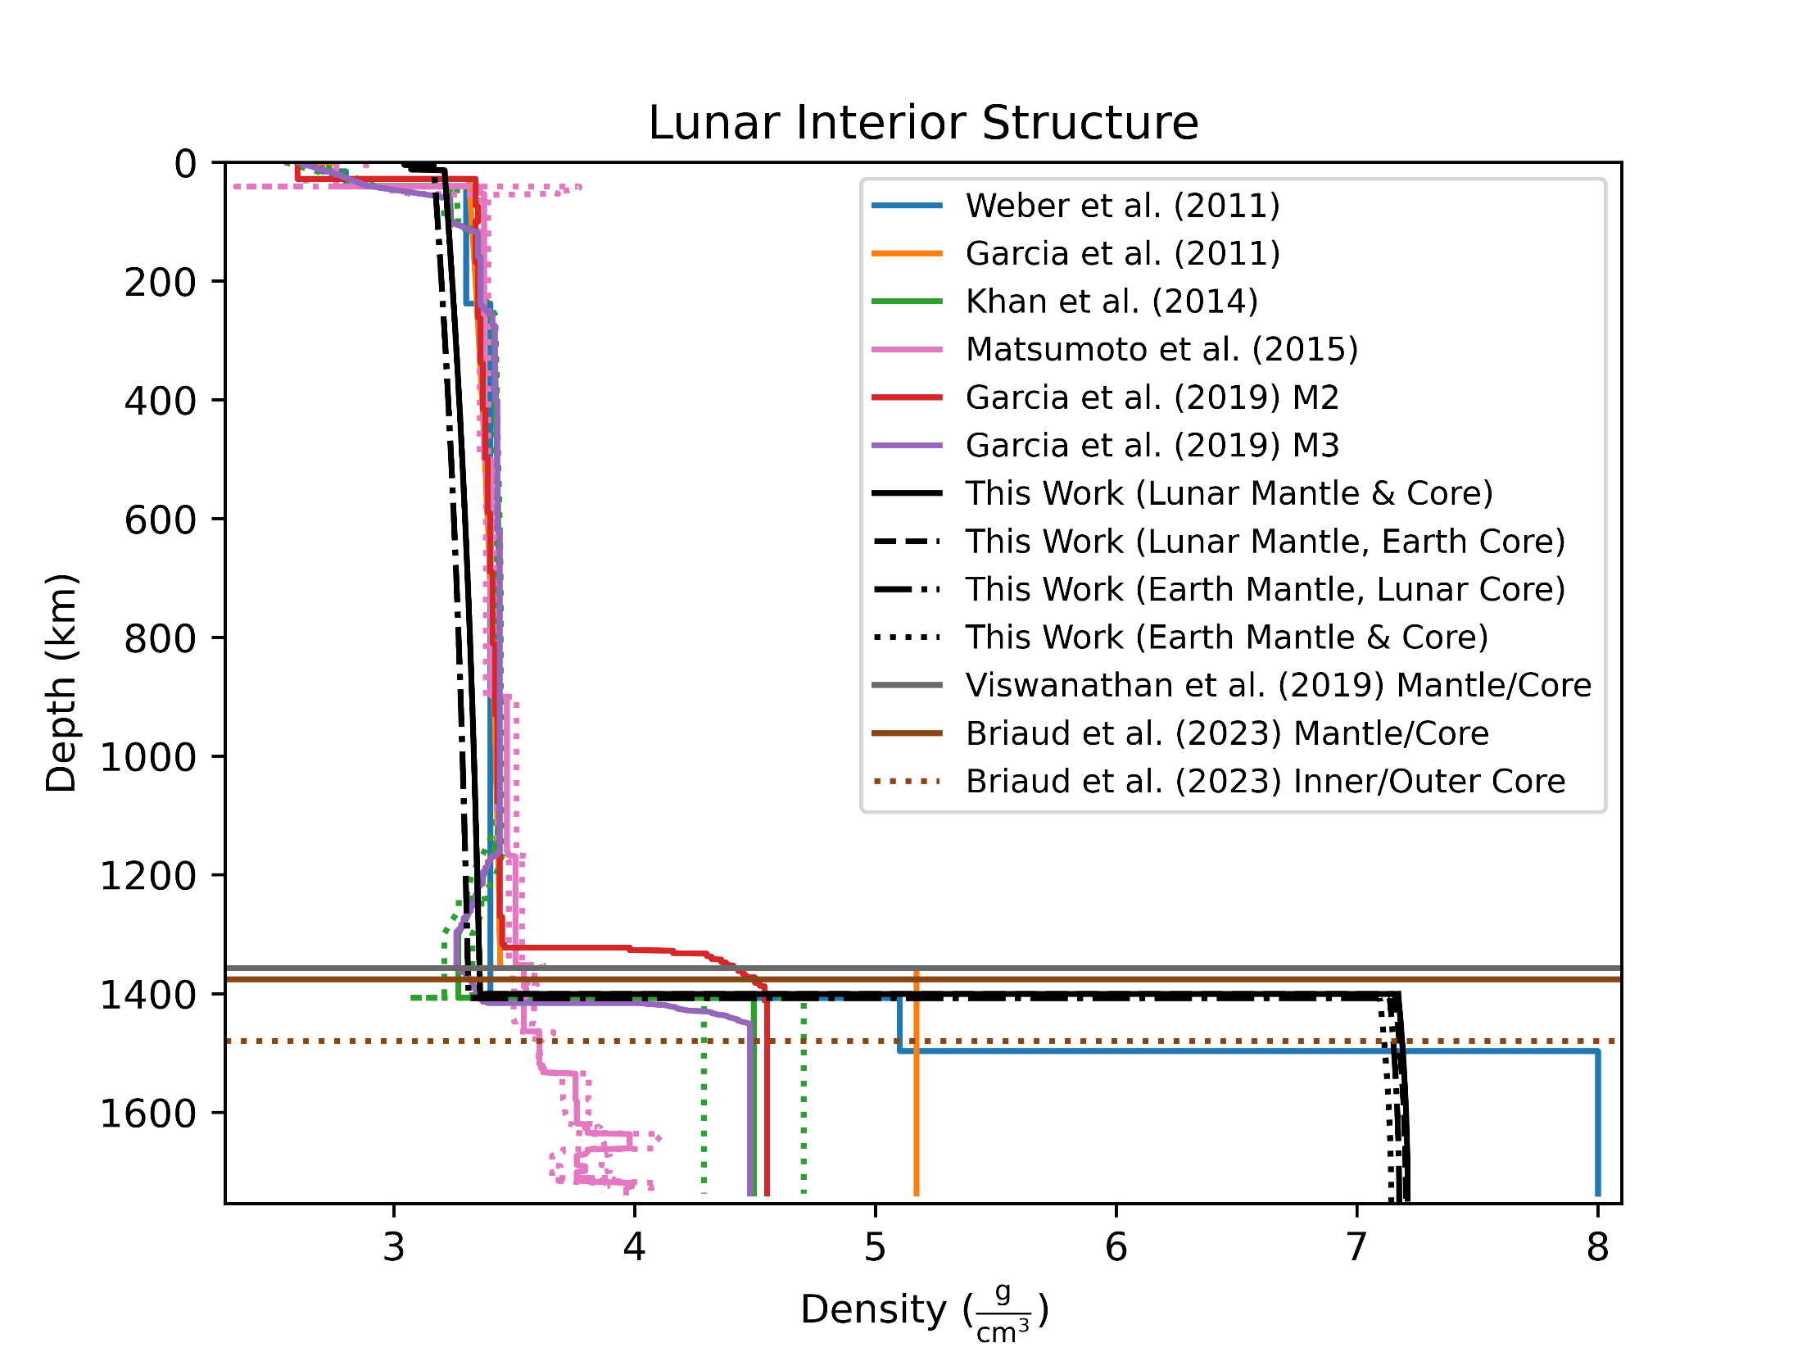
0.44% Radius Error
0.29% MoI Coeff Error

Slide 52
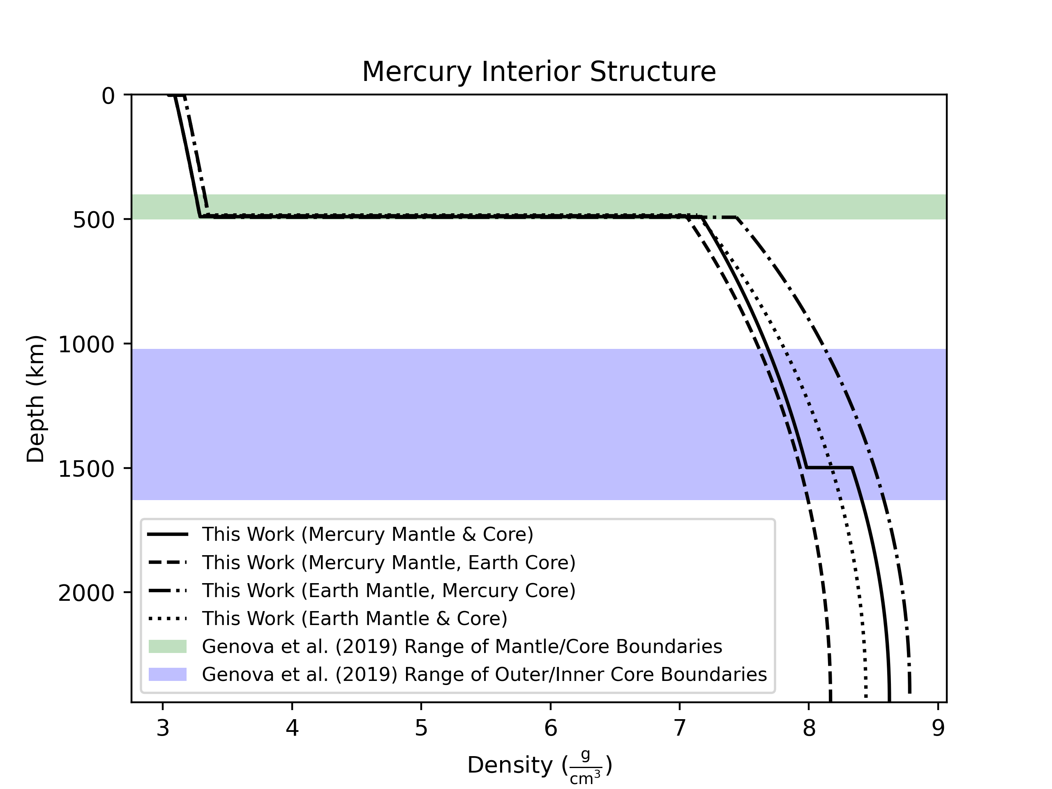
-0.17% Radius Error
0.83% MoI Coeff Error

Slide 53
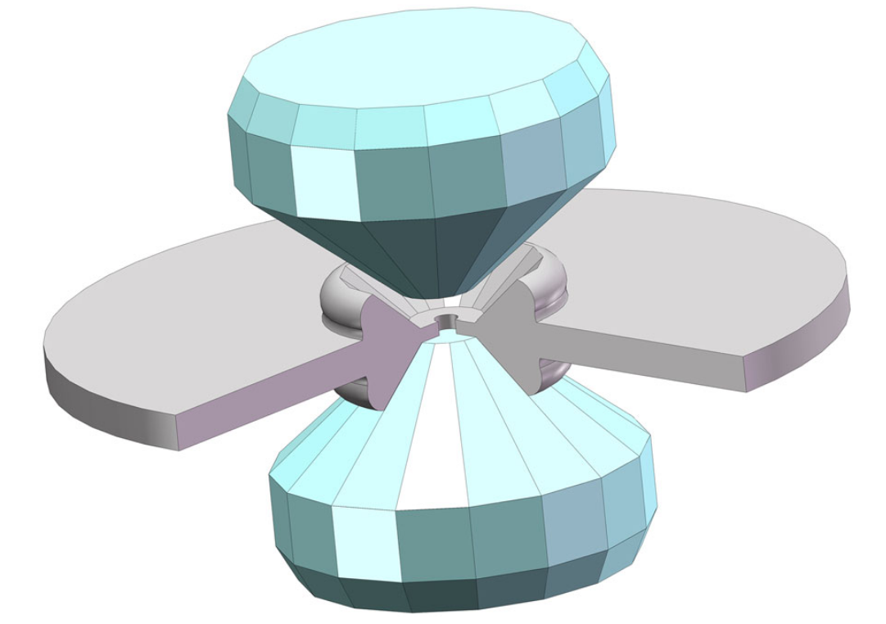

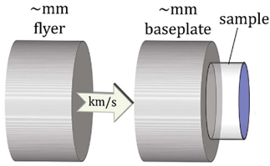

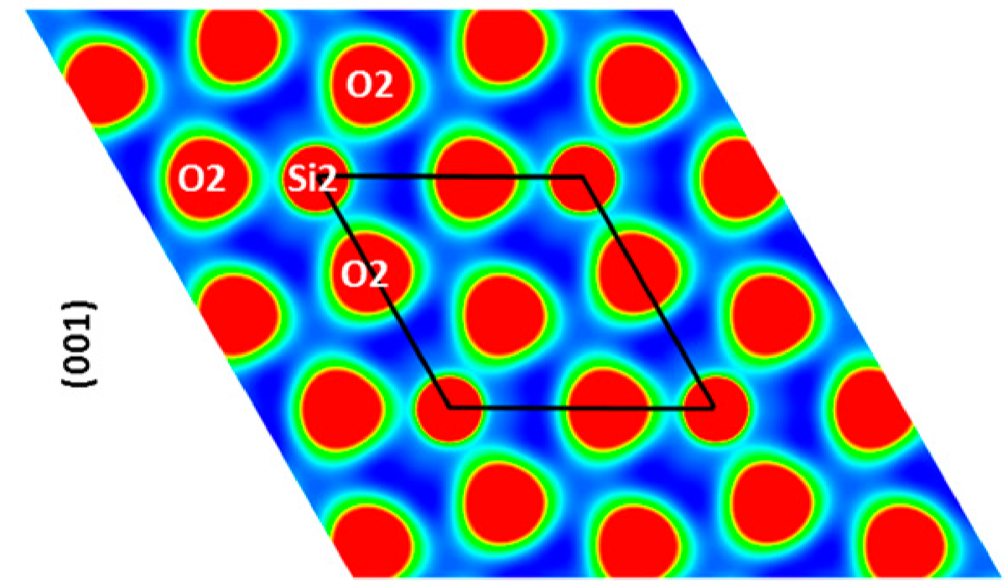
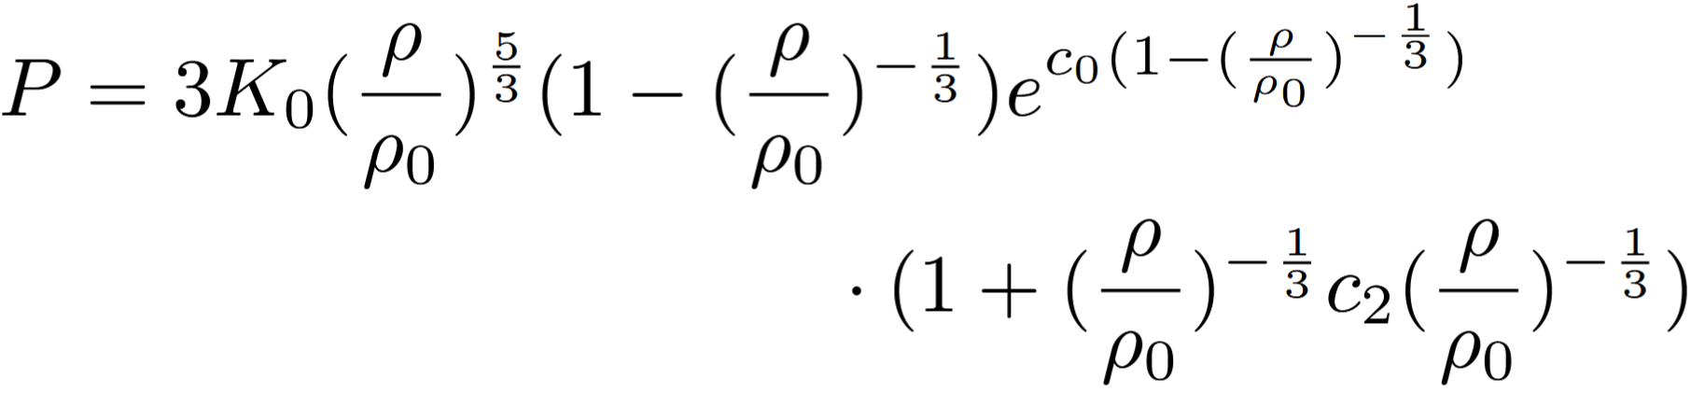
Determining Equations of State
Pressure
Experiment
Function
<100s of GPa
~TPa
>TPa
Top to bottom: Mao et al. (2018), Duffy & Smith (2019), Tsuchiya & Tsuchiya (2011)

Slide 54
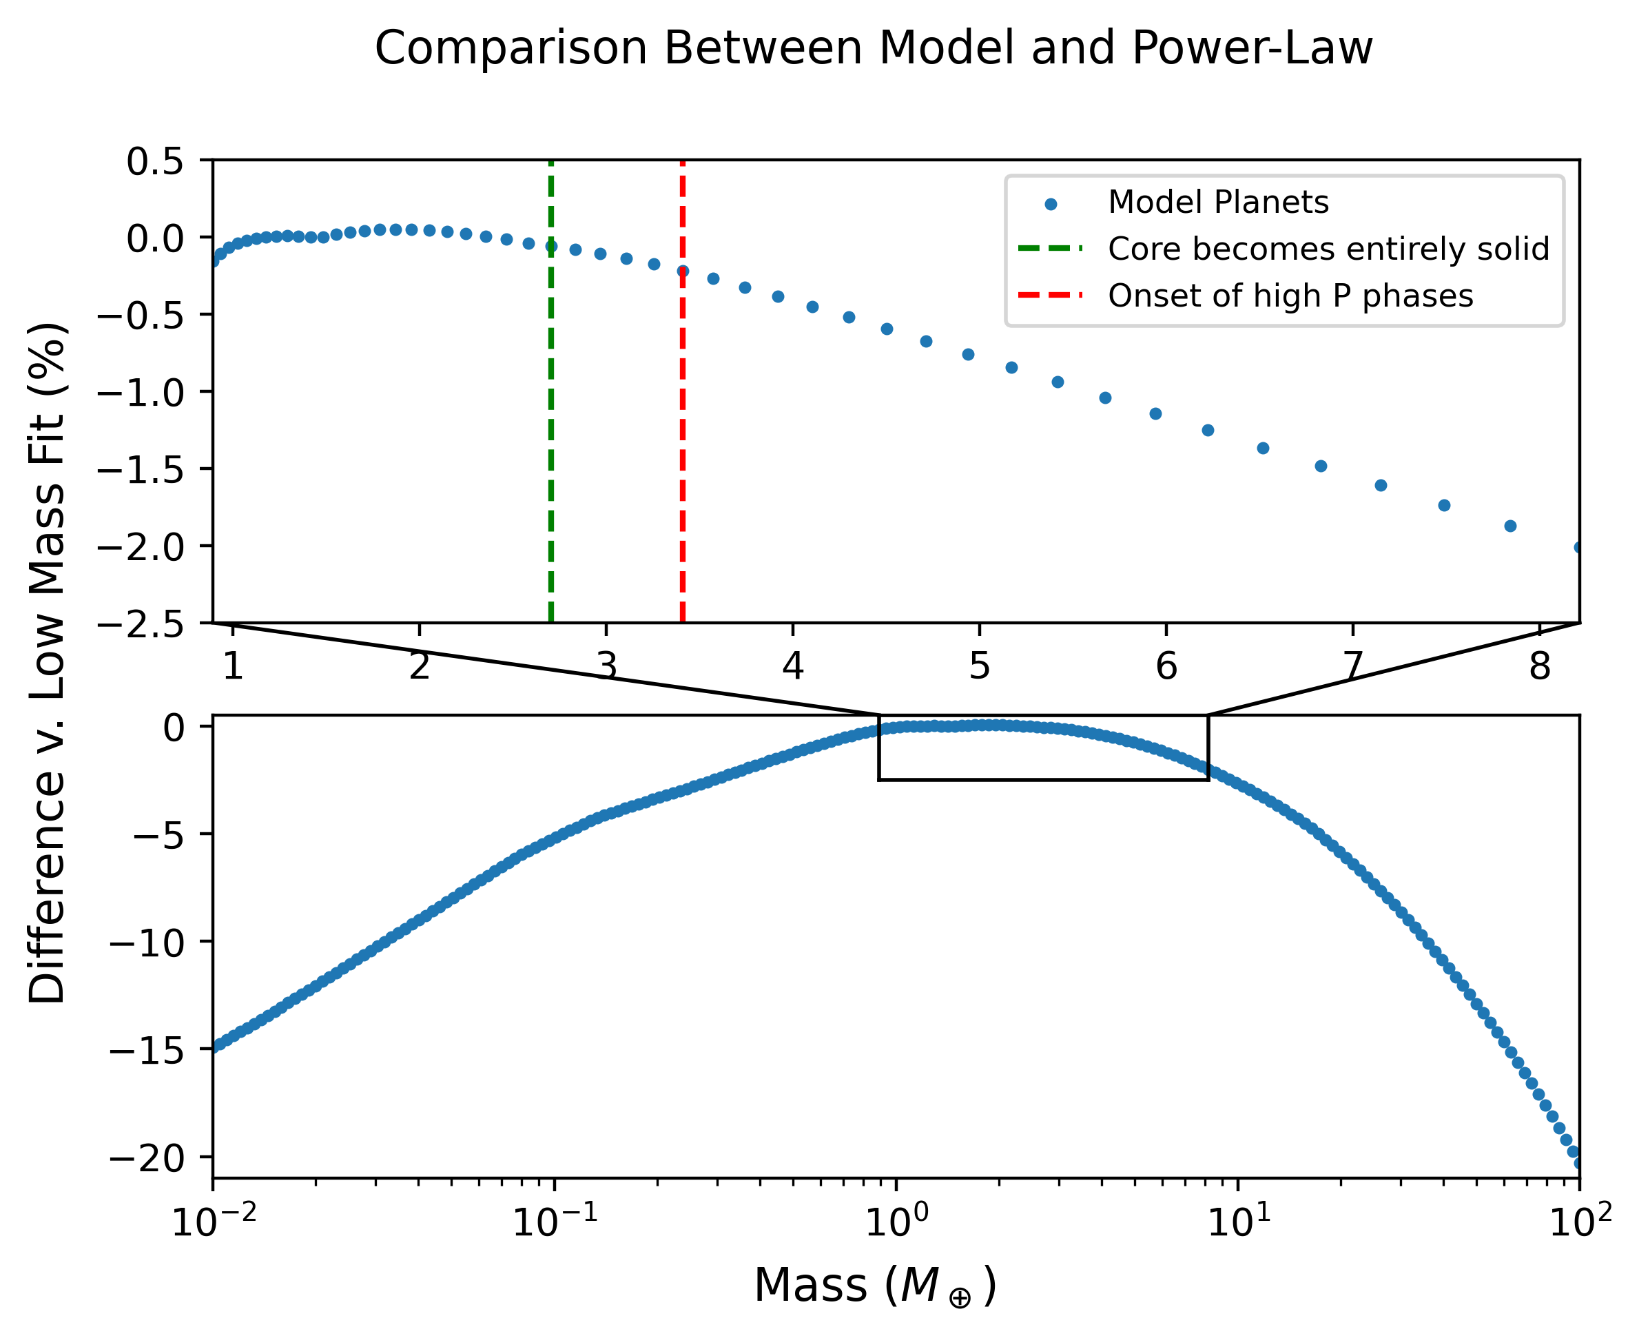

Slide 55
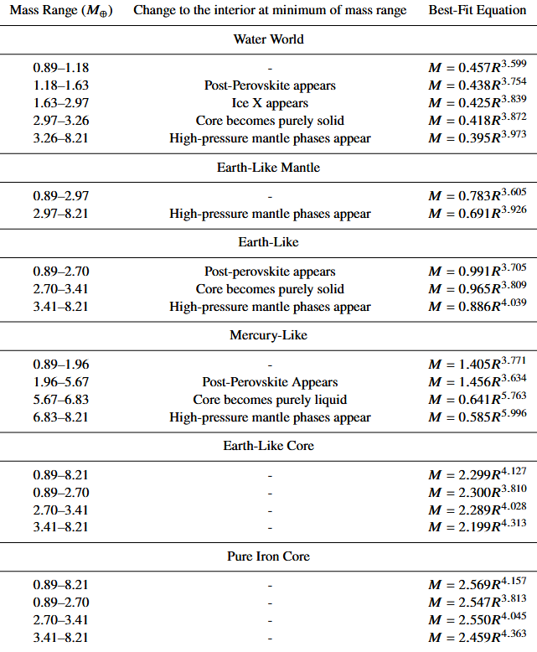
Mass-Radius Power Laws

Slide 56
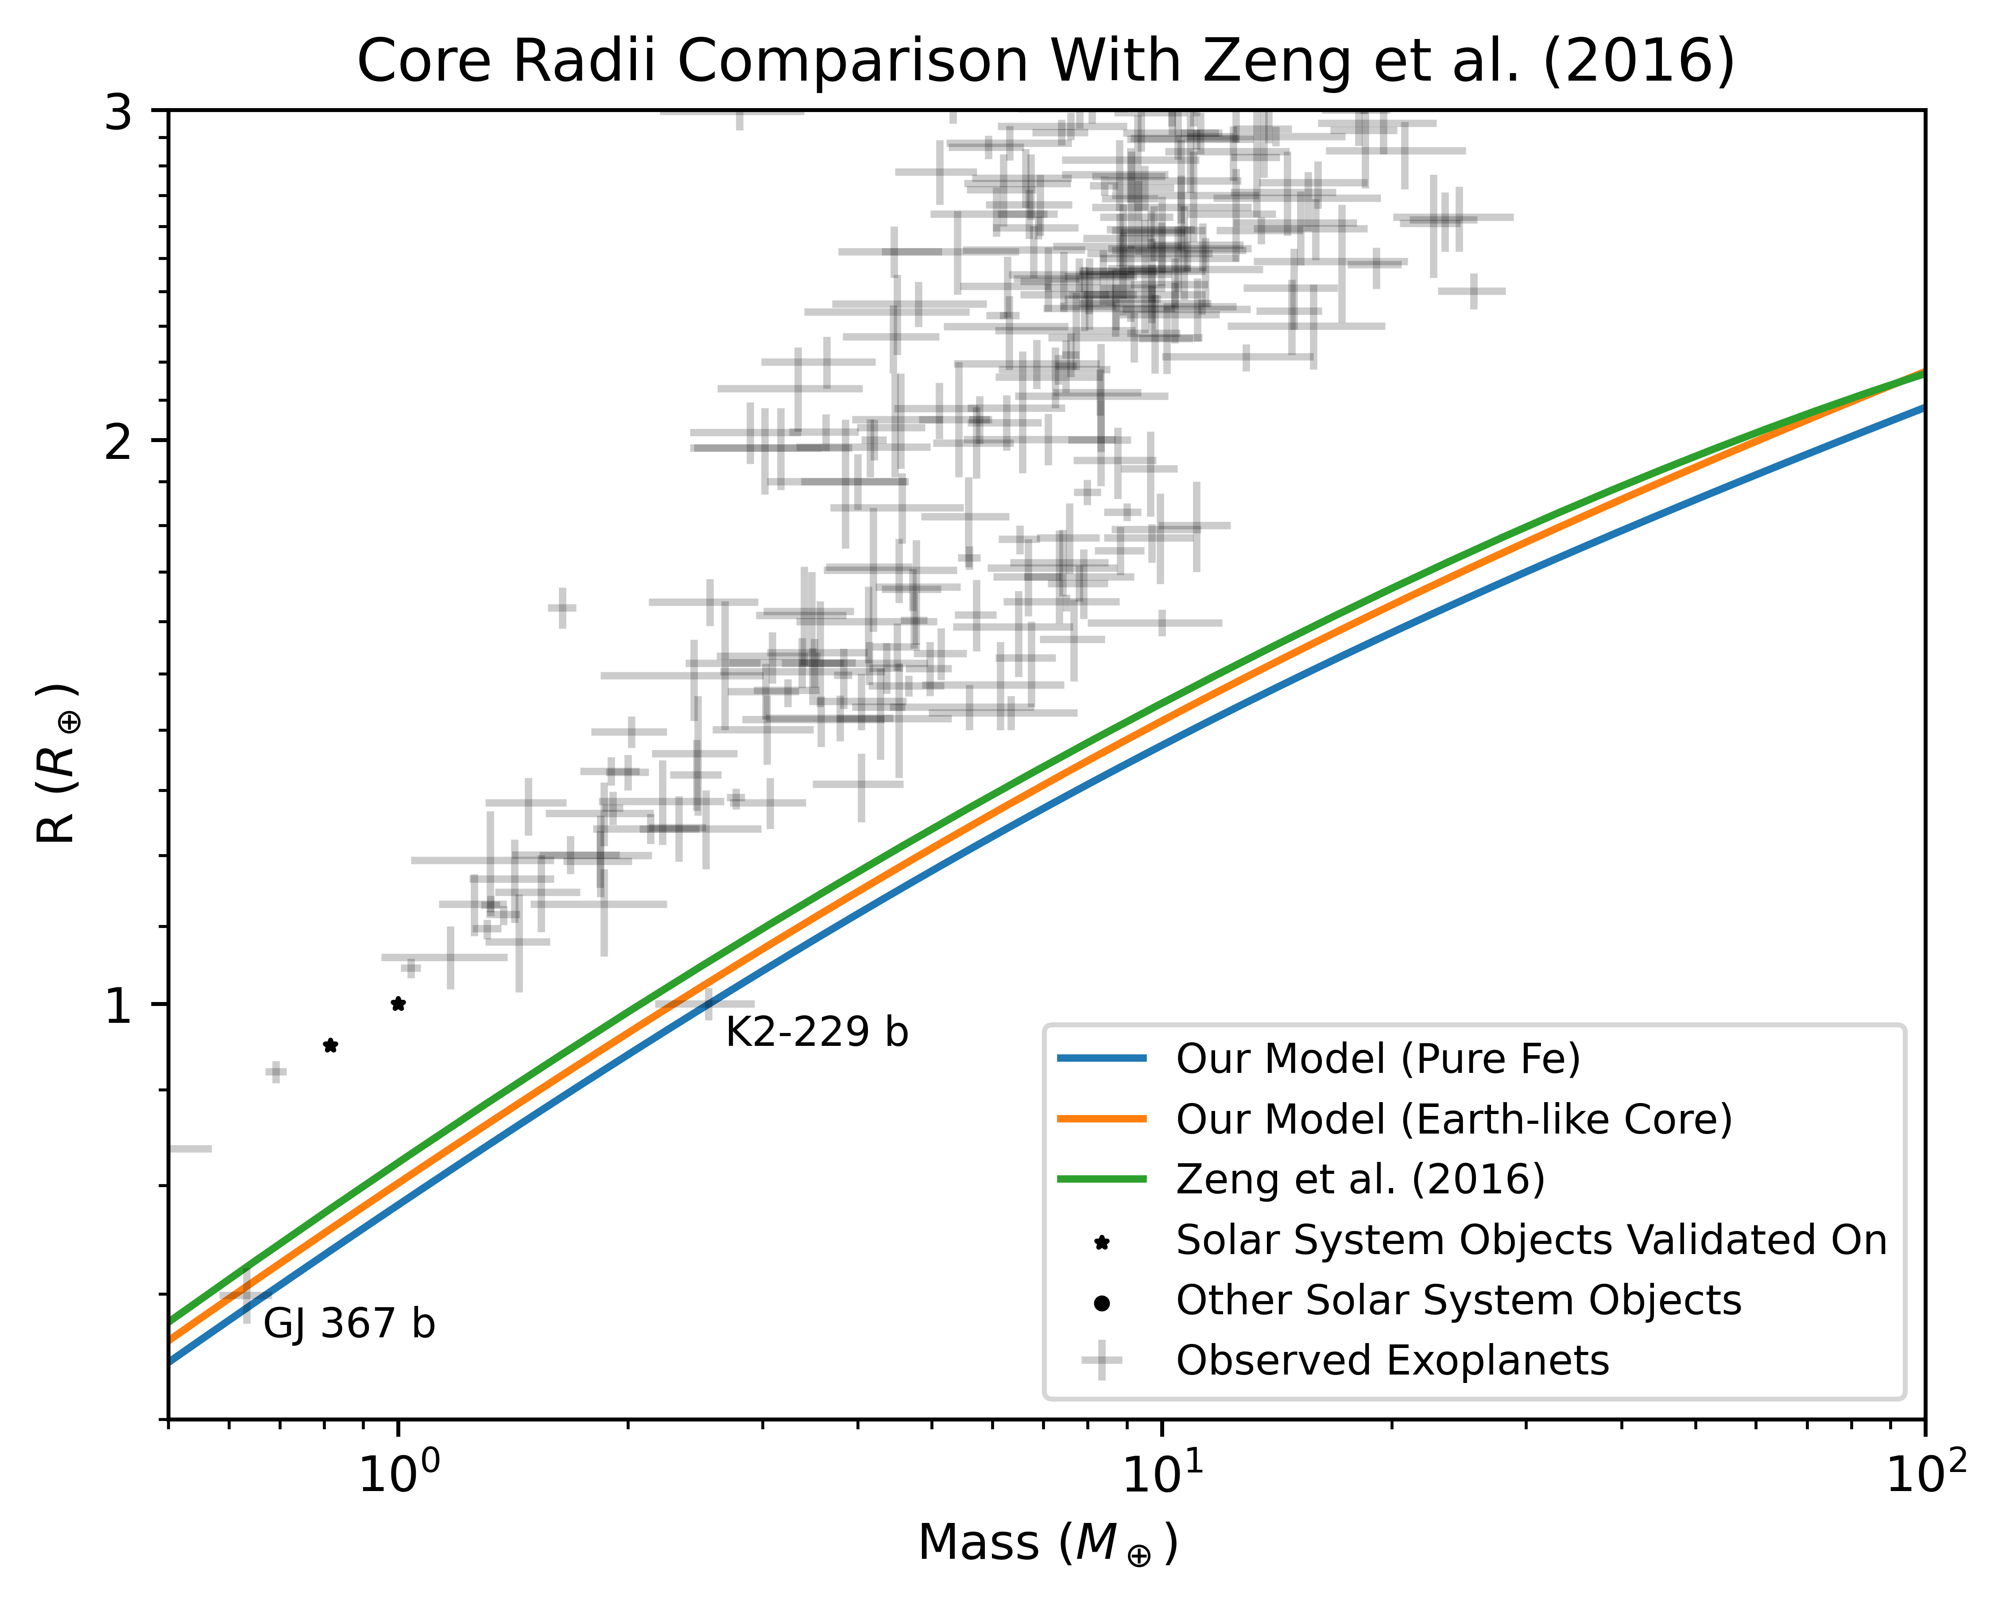

Slide 57
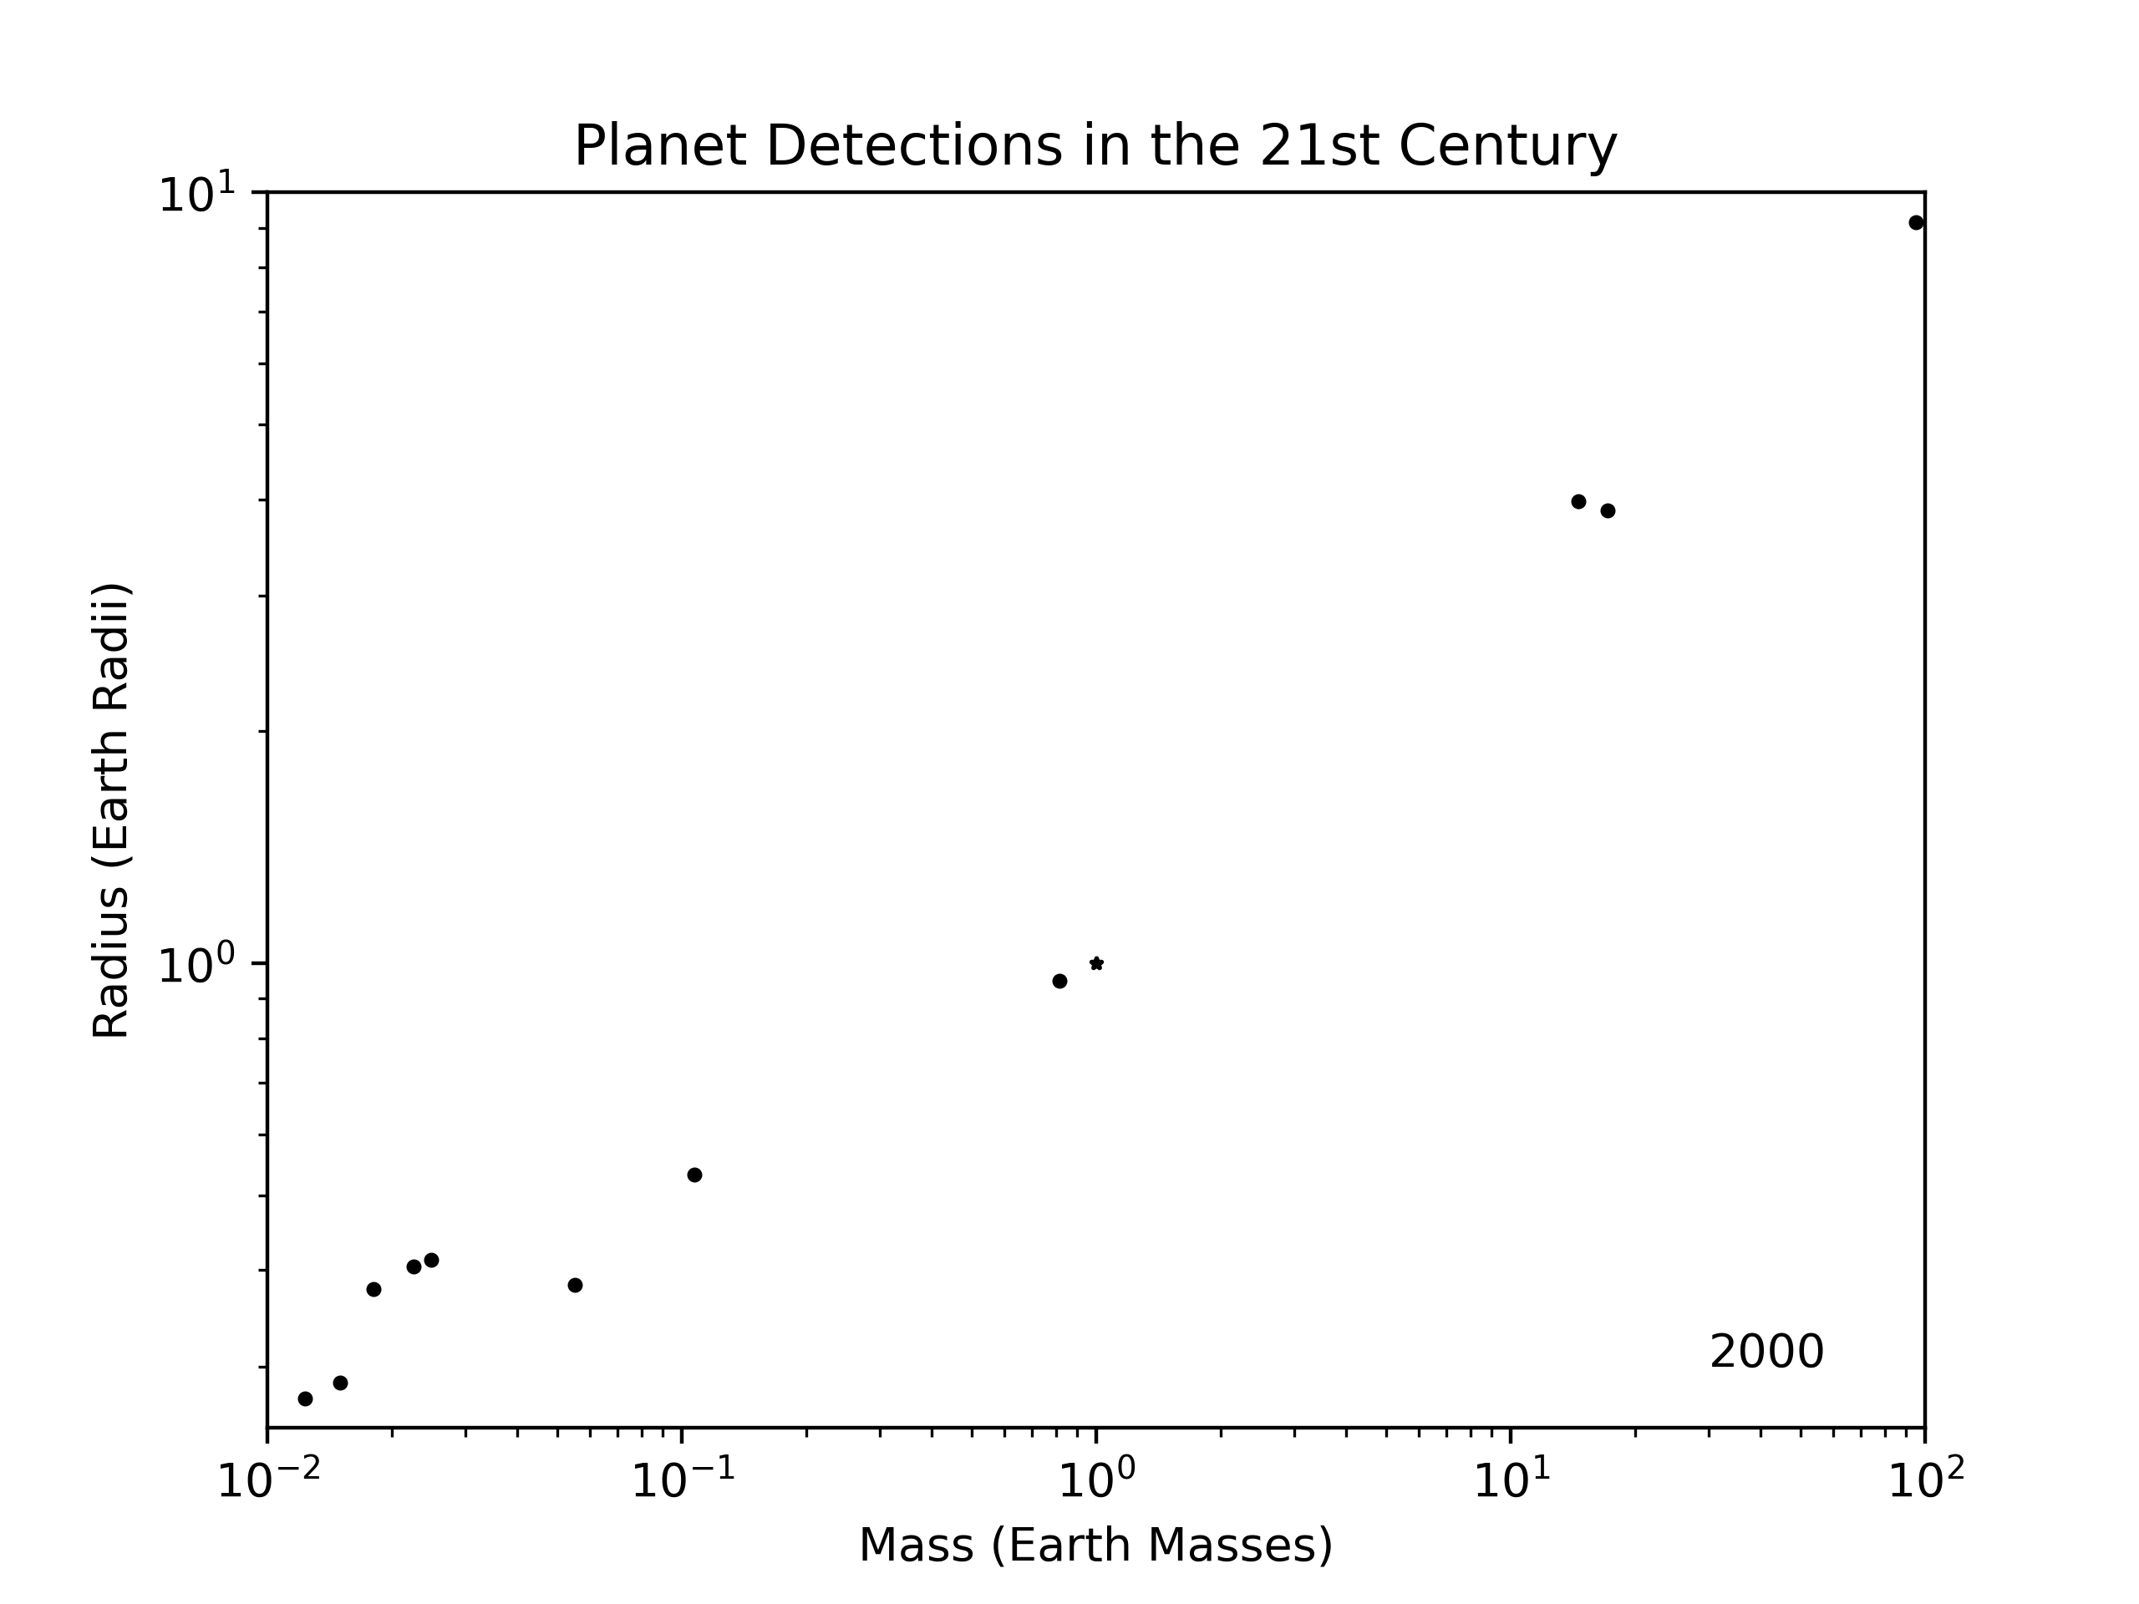

Slide 58
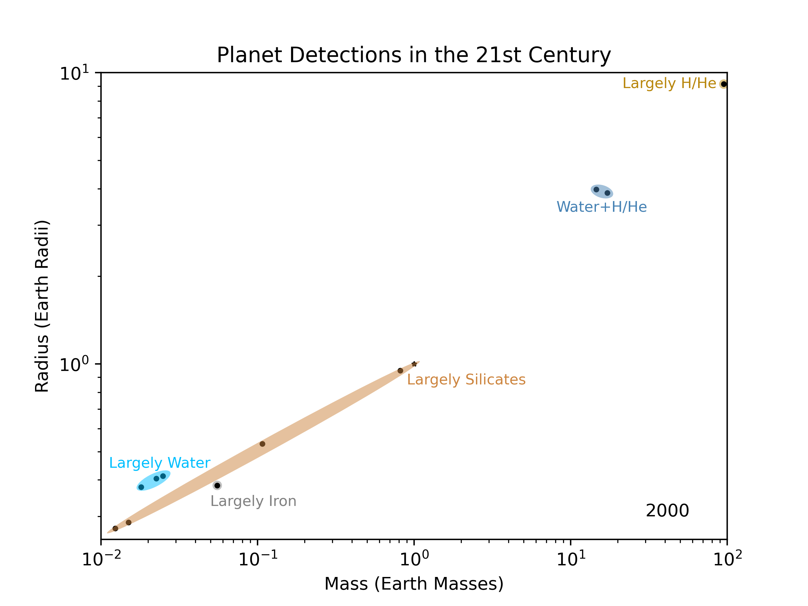

Slide 59
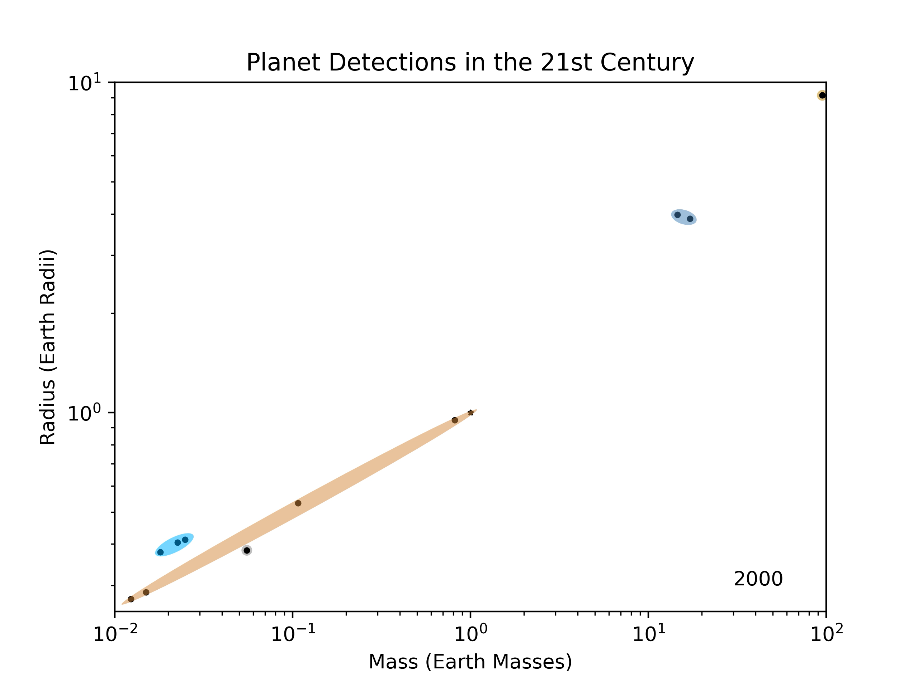

Slide 60
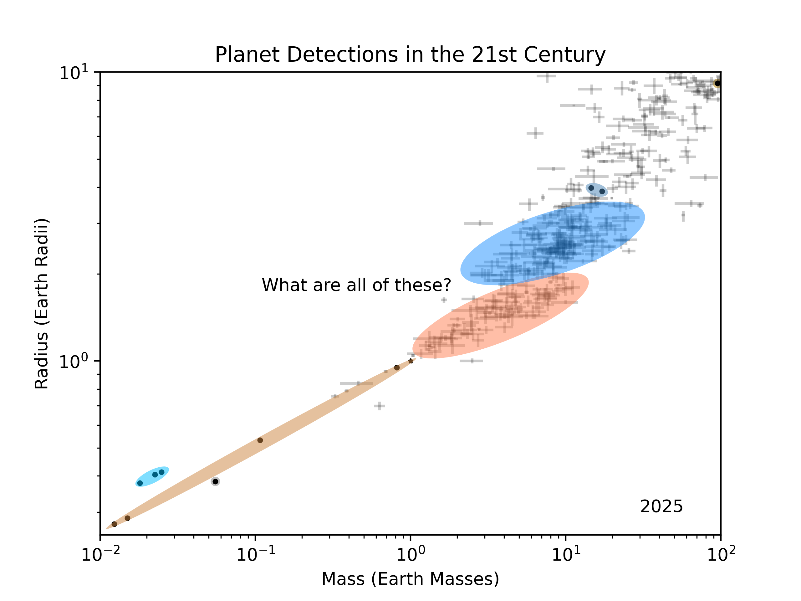

Slide 61
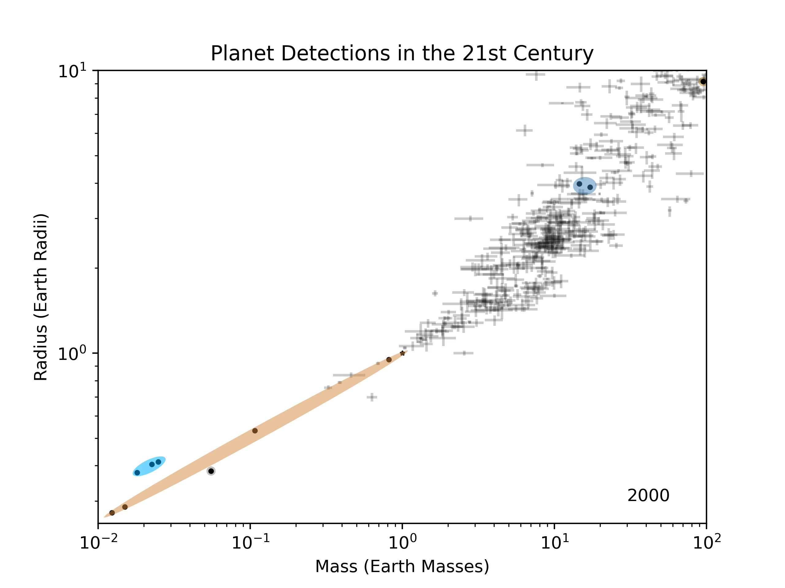

Slide 62
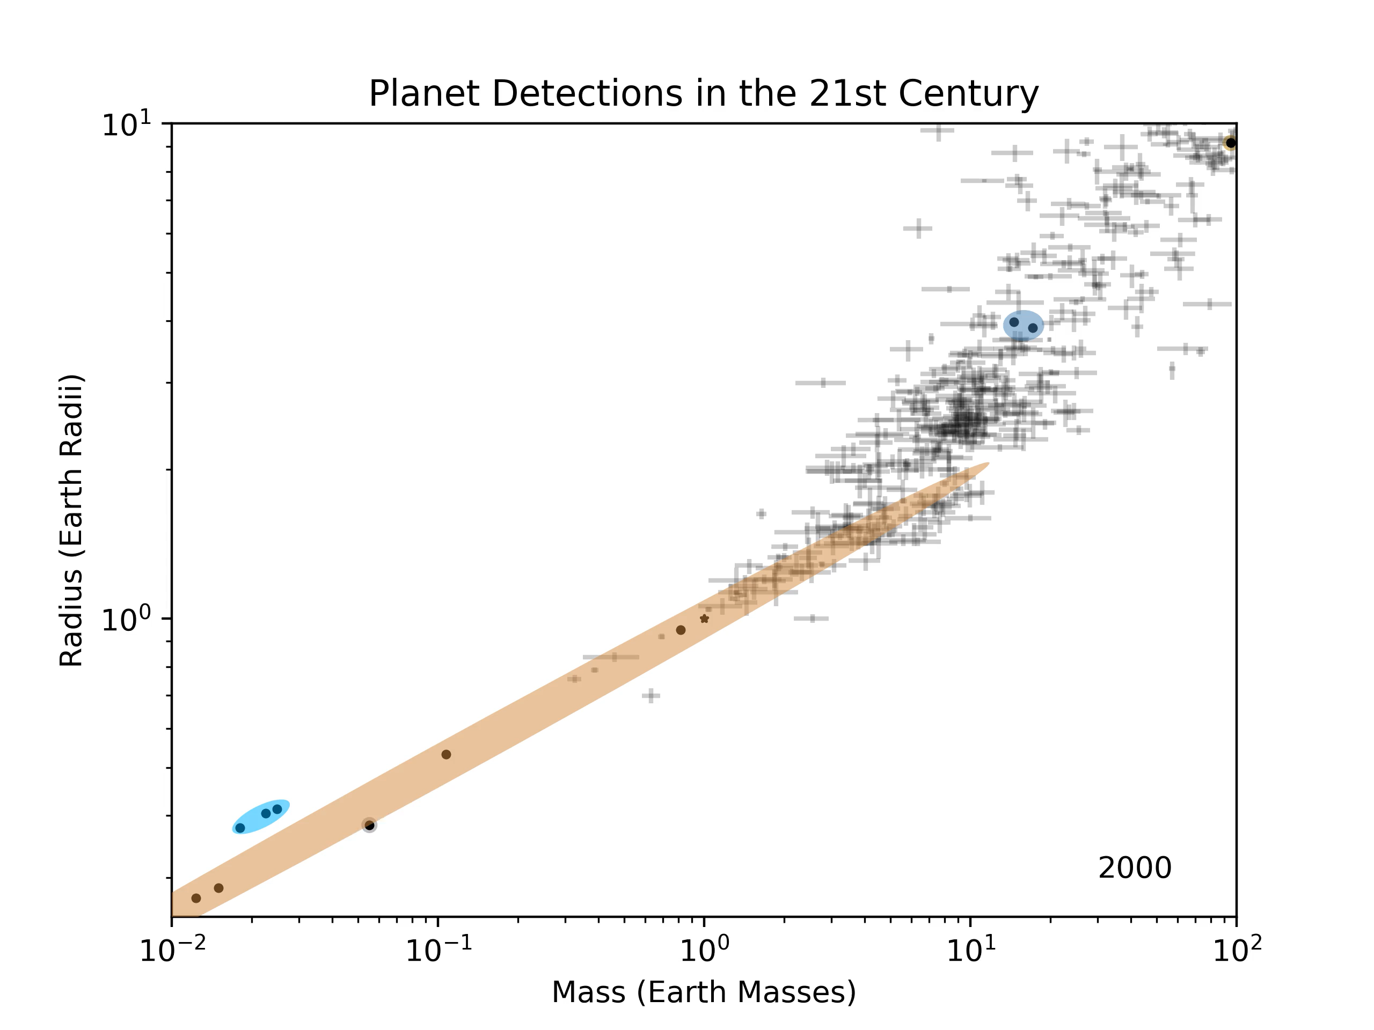

Slide 63
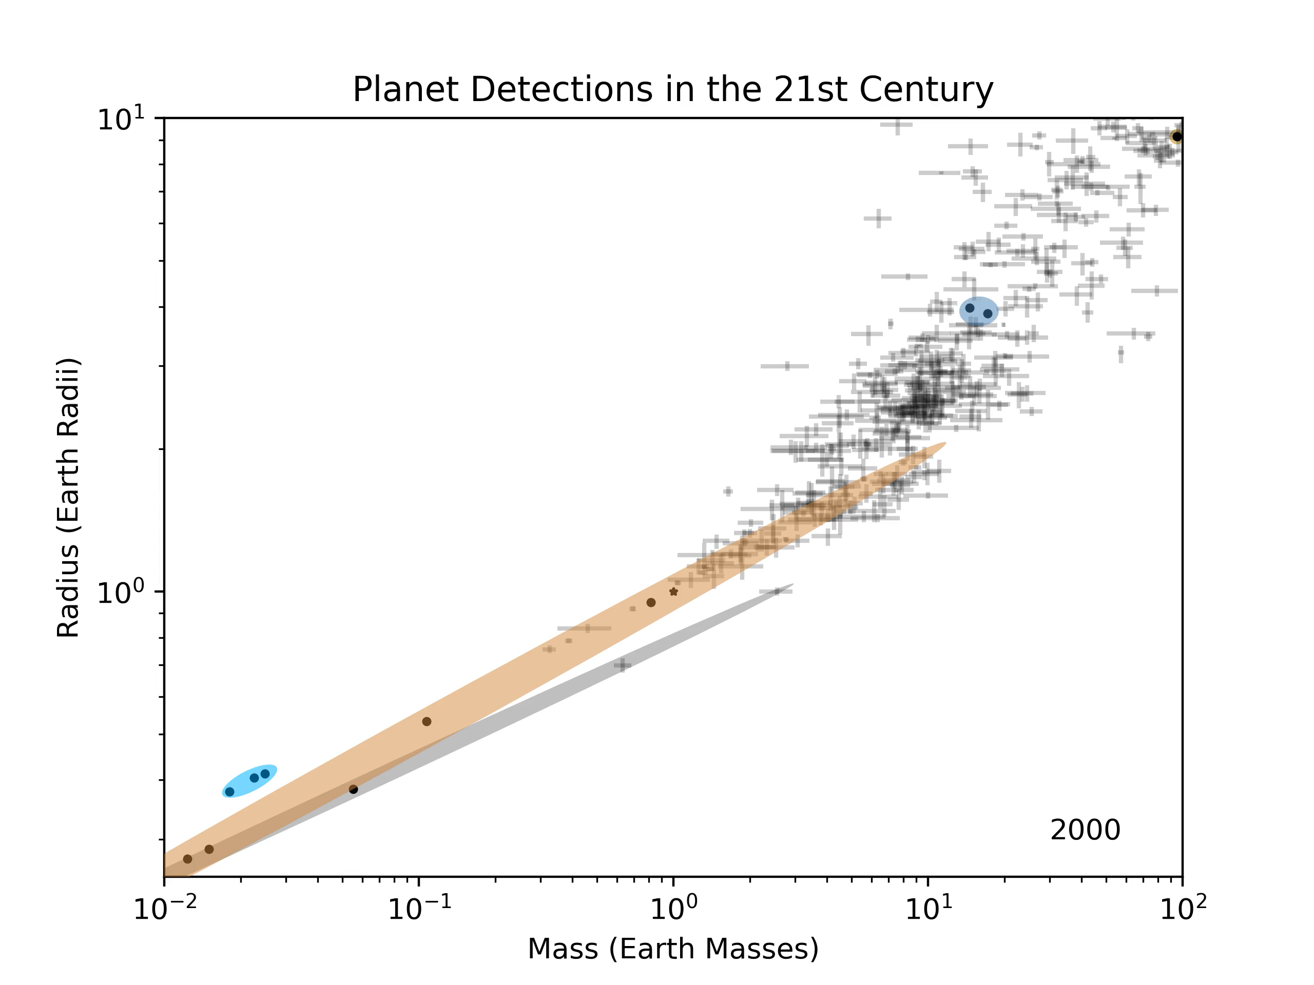

Slide 64
