Slide 1
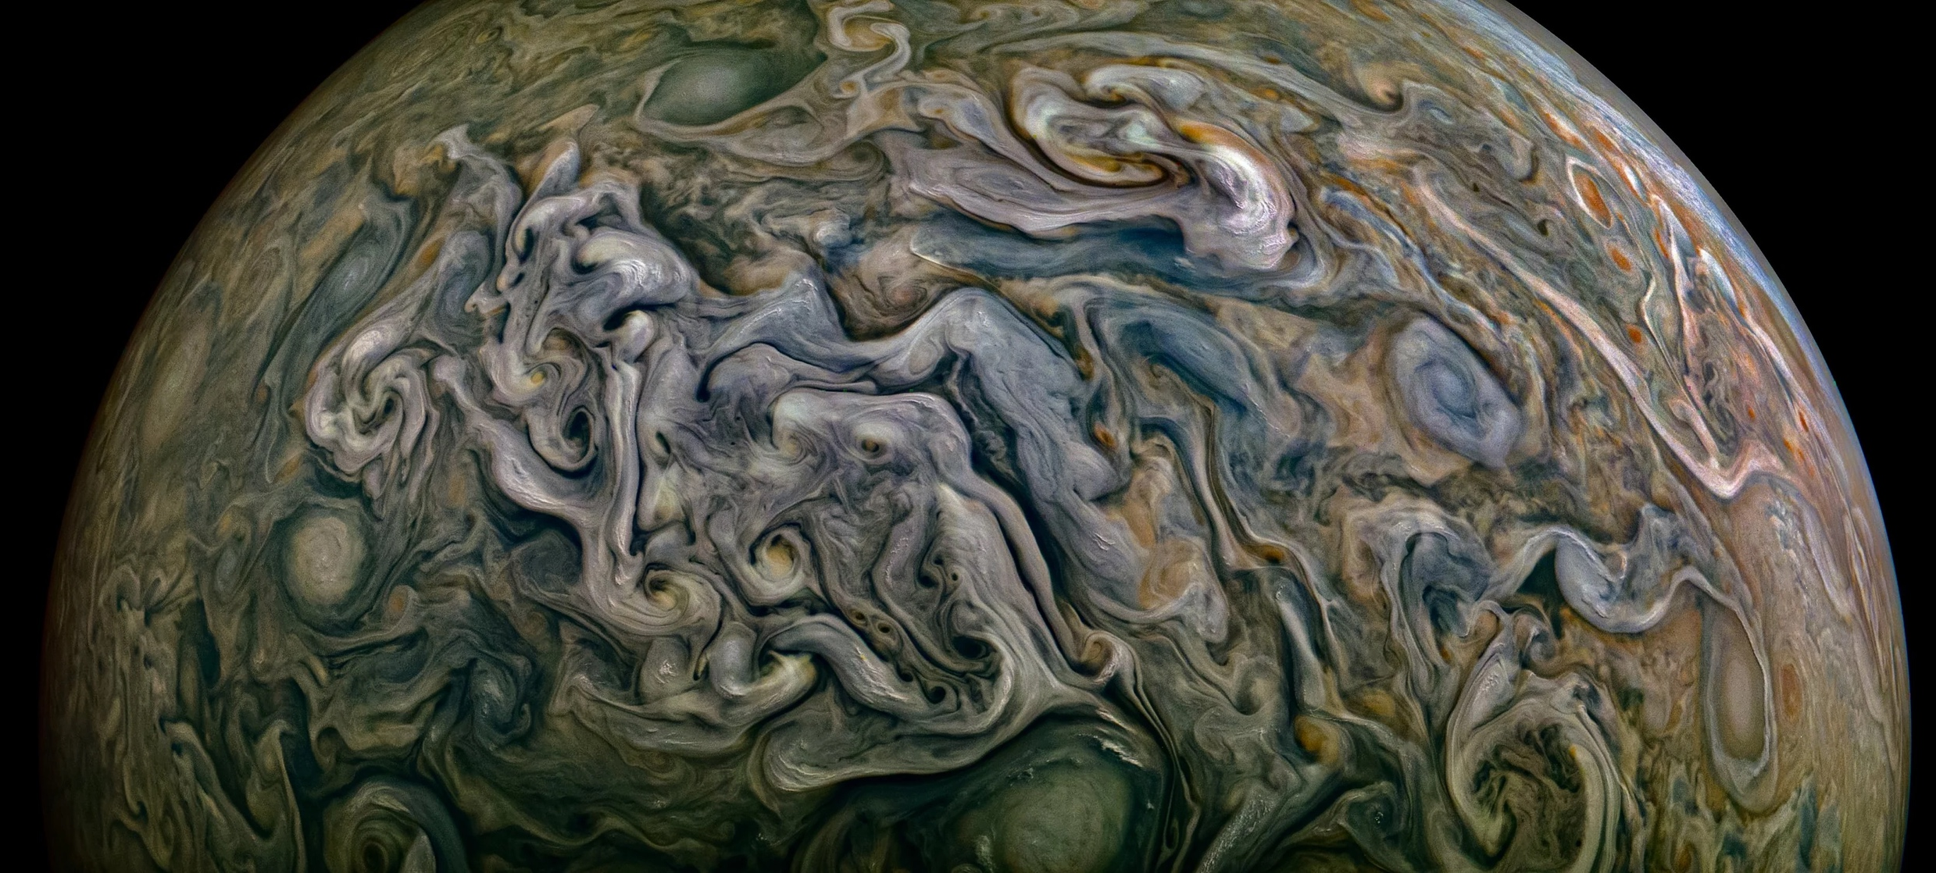



The Importance of Detailed Alkali Line Profiles in High Density H₂ Environments
Louis Siebenaler¹, Nicole Allard², Yamila Miguel^{1,3}
1: Leiden Observatory; 2: Observatoire de Paris; 3: SRON Netherlands institute for Space Research

Slide 2
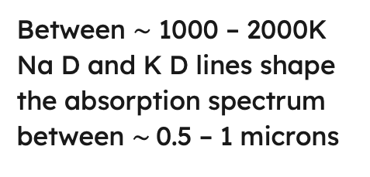
1
Importance of Na D and K D lines
Na D
(0.5891, 0.5897 nm)
K D
(0.7667, 0.7701 nm)
Between $\sim$ 1000 – 2000K Na D and K D lines shape the absorption spectrum between $\sim$0.5 – 1 microns
siebenaler@strw.leidenuniv.nl

Slide 3
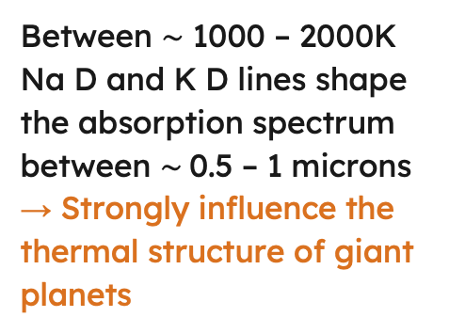
1
Importance of Na D and K D lines
Na D
(0.5891, 0.5897 nm)
K D
(0.7667, 0.7701 nm)
Between $\sim$ 1000 – 2000K Na D and K D lines shape the absorption spectrum between $\sim$0.5 – 1 microns
→ Strongly influence the thermal structure of giant planets
siebenaler@strw.leidenuniv.nl
Casasayas-Barris et al. 2017

Slide 4
2
Importance of Na D and K D lines
Siebenaler et al. 2025 (see also Guillot et al. 2004)
Between $\sim$ 1000 – 2000K Na D and K D lines shape the absorption spectrum between $\sim$0.5 – 1 microns
→ Strongly influence the thermal structure of giant planets
siebenaler@strw.leidenuniv.nl

Slide 5
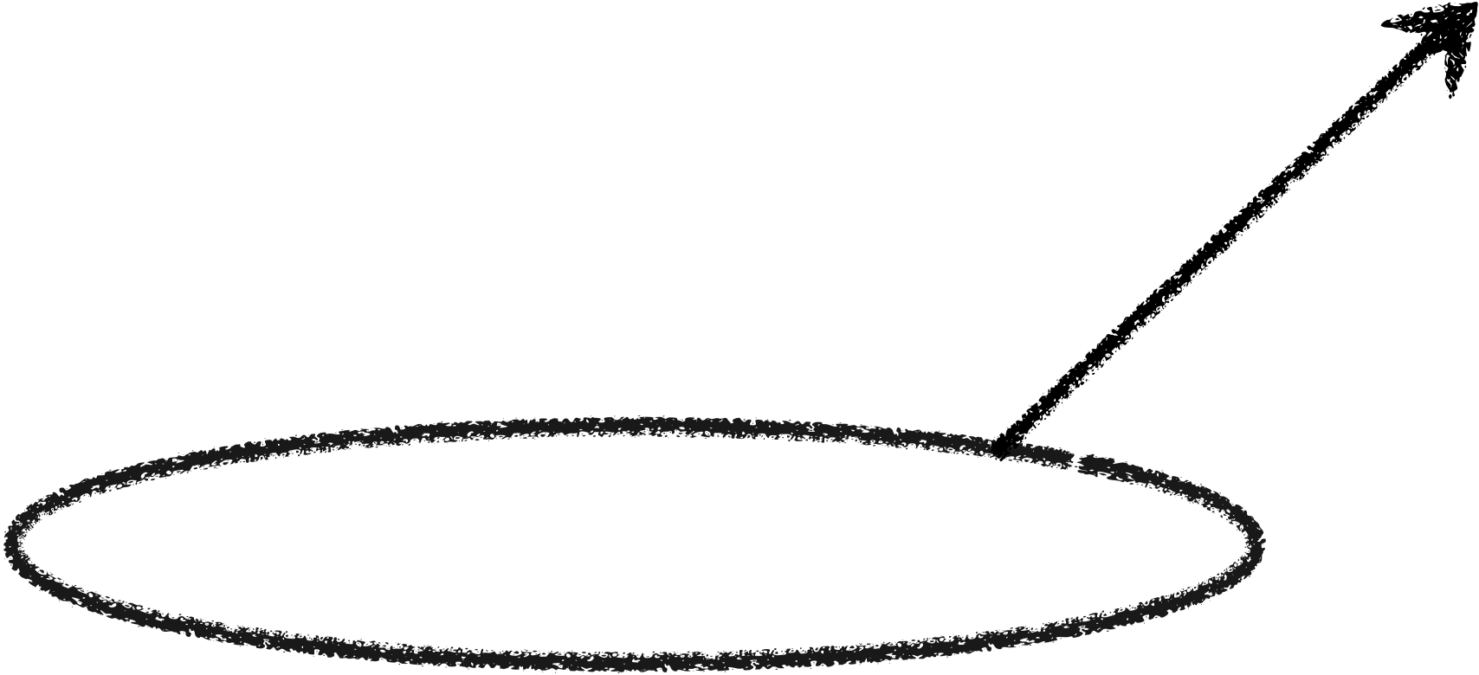
2
Importance of Na D and K D lines
Siebenaler et al. 2025 (see also Guillot et al. 2004)
What do the Na D and K D lines look like at P > 100 bar?
siebenaler@strw.leidenuniv.nl

Slide 6





Impact Theory
3
Temporal Space
FT
Spectrum
$$ω_{0}$$
$$Δω$$
$$∝τ^{−1}$$
$$τ$$
Lorentz Profile
$$∝{\left\langle τ\right\rangle }^{−1}$$
siebenaler@strw.leidenuniv.nl
e.g. Lorentz 1906, Lenz 1924, Weisskopf 1932

Slide 7

Impact Theory
3
Temporal Space
FT
Spectrum
Impact Theory probes small $Δω$
(line cores)
$$ω_{0}$$
$$Δω$$
$$∝τ^{−1}$$
$$τ$$
Lorentz Profile
$$∝{\left\langle τ\right\rangle }^{−1}$$
siebenaler@strw.leidenuniv.nl
e.g. Lorentz 1906, Lenz 1924, Weisskopf 1932

Slide 8




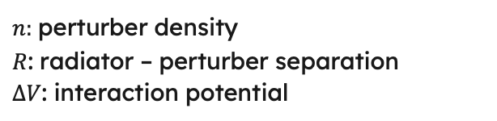
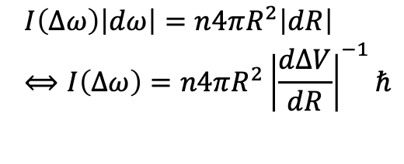
4
Quasistatic Theory
Interaction between perturber and radiator occurs at very small separation R (system is static)
$$I\left(Δω\right)\left|dω\right|=n4πR^{2}\left|dR\right| \\ ⟺I\left(Δω\right)=n4πR^{2}{\left|\frac{dΔV}{dR}\right|}^{−1}ℏ$$
$n:$ perturber density
$R$: radiator – perturber separation
$ΔV$: interaction potential
$$ω_{0}$$
$$ω_{0}+Δω$$
$$ω_{0}$$
$$Δω=ΔV(R)/ℏ$$
siebenaler@strw.leidenuniv.nl
e.g. Kuhn 1934, Margenau and Watson 1936

Slide 9
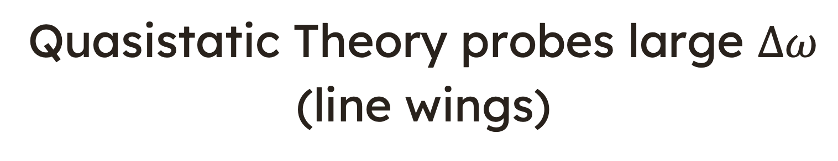
4
Quasistatic Theory
Interaction between perturber and radiator occurs at very small separation R (system is static)
Quasistatic Theory probes large $Δω$
(line wings)
$$I\left(Δω\right)\left|dω\right|=n4πR^{2}\left|dR\right| \\ ⟺I\left(Δω\right)=n4πR^{2}{\left|\frac{dΔV}{dR}\right|}^{−1}ℏ$$
$n:$ perturber density
$R$: radiator – perturber separation
$ΔV$: interaction potential
$$ω_{0}$$
$$ω_{0}+Δω$$
$$ω_{0}$$
$$Δω=ΔV(R)/ℏ$$
siebenaler@strw.leidenuniv.nl
e.g. Kuhn 1934, Margenau and Watson 1936

Slide 10

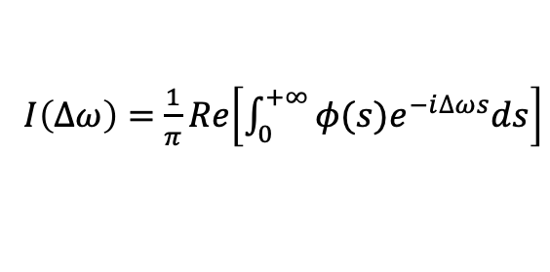
5
Unified Theory
Combines the concepts of the Impact theory and Quasistaic theory to describe line profiles over all $Δω$
$I\left(Δω\right)=$ $\frac{1}{π}Re\left[\int_{0}^{+∞}{φ(s)e^{−i∆ωs}ds}\right]$
Autocorrelation function $φ$ measures the average evolution of the wave train over a time interval $s$ from an initial time $t$
Nicole Allard Magic
siebenaler@strw.leidenuniv.nl
e.g. Anderson 1952, Baranger 1958, Allard et al. 1999

Slide 11
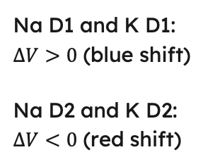
6
Unified Theory vs Impact Theory
Na D
K D
Unified Theory
Impact Theory
Na D1 and K D1: $ΔV>0$ (blue shift)
Na D2 and K D2:
$ΔV<0$ (red shift)
siebenaler@strw.leidenuniv.nl

Slide 12
7
Unified Theory vs Impact Theory
Na D
K D
siebenaler@strw.leidenuniv.nl

Slide 13
8
Unified Theory vs Impact Theory
Na D
K D
siebenaler@strw.leidenuniv.nl

Slide 14
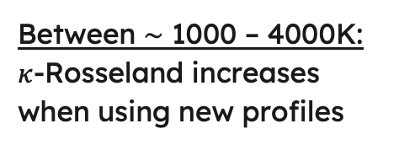
9
Rosseland mean opacity
Between $\sim$ 1000 – 4000K:
$κ$-Rosseland increases when using new profiles
siebenaler@strw.leidenuniv.nl

Slide 15
10
RCB – Warm/Hot Jupiters
Unified Theory
Impact Theory
New opacities lead to warmer interiors → bulk metallicities will increase
siebenaler@strw.leidenuniv.nl

Slide 16
11
Jupiter Stable Layers
siebenaler@strw.leidenuniv.nl

Slide 17
11
Jupiter Stable Layers
siebenaler@strw.leidenuniv.nl

Slide 18
11
Jupiter Stable Layers
siebenaler@strw.leidenuniv.nl

Slide 19
11
Jupiter Stable Layers
Stable layers develop easiest in warm gas giants with low T_{int}
siebenaler@strw.leidenuniv.nl

Slide 20
12
Summary
1
Unified Theory is crucial
At P >500 bar the line profiles show strong deviations from Lorentz profiles
2
Mean Opacities increase
Between 1000 – 4000 K there is a significant increase in the Rosseland-mean opacities
3
New opacities heat up the interior
Warm/Hot Jupiters have warmer interiors when using the new opacities
4
Jupiter stable layer is unlikely
Old warm gas giants are the best candidates for stable layers
siebenaler@strw.leidenuniv.nl

