Slide 1






Atmosphere-interior interactions in the JWST Era
Anjali Piette (she/her)
University of Birmingham
Image credit: ESA/Hubble, M. Kornmesser

Slide 2
What keeps you up at night?
1. Do we know enough about atmospheric processes?
2. Do we know solubilities/miscibility well enough?
3. What’s up with iron cores?
4. All of it.

Slide 3
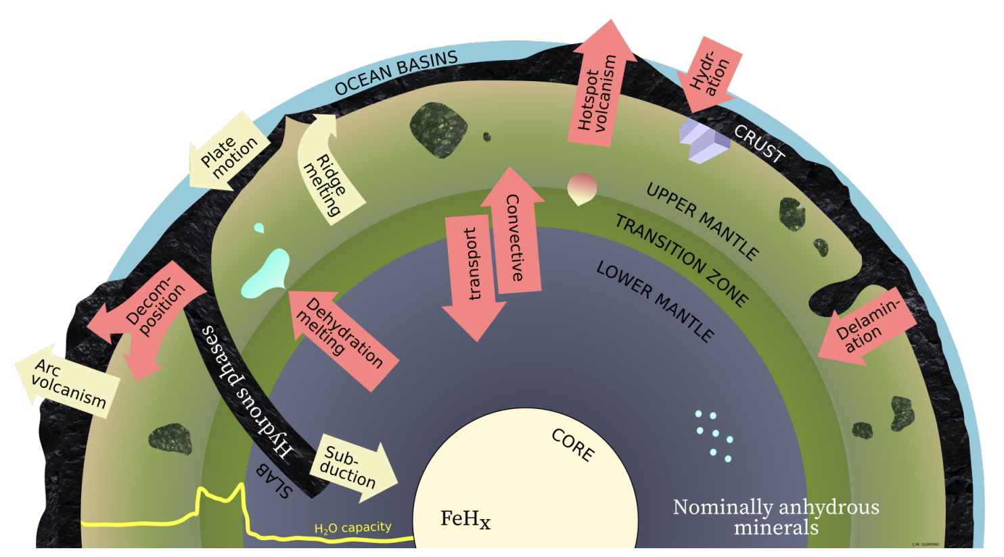
Atmosphere-interior interactions – why bother?
They’re important in the solar system
Guimond+2026

Slide 4
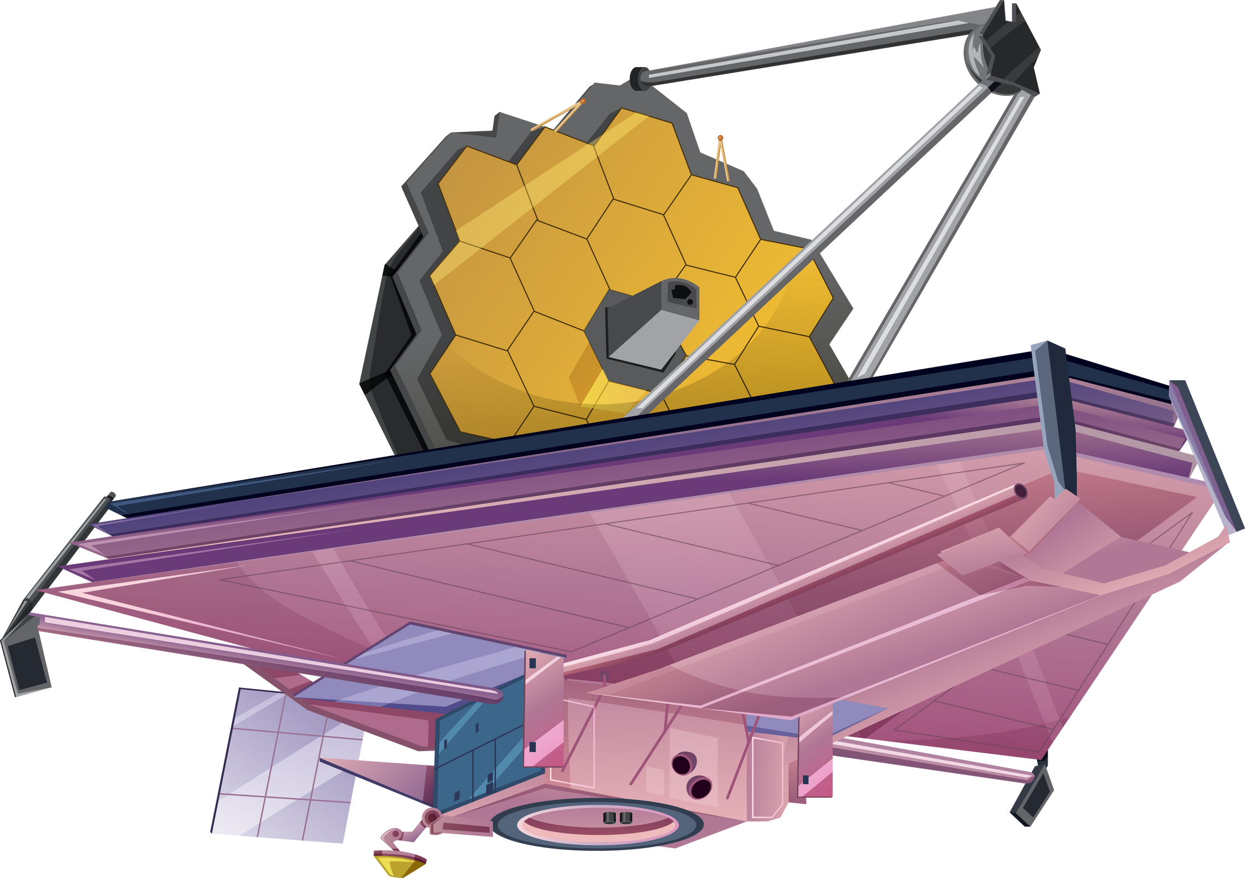
Atmosphere-interior interactions – why bother?
They’re important in the solar system
Deciphering interior compositions
Observable atmosphere
Deep
atmosphere
Mantle
&
Core

Slide 5
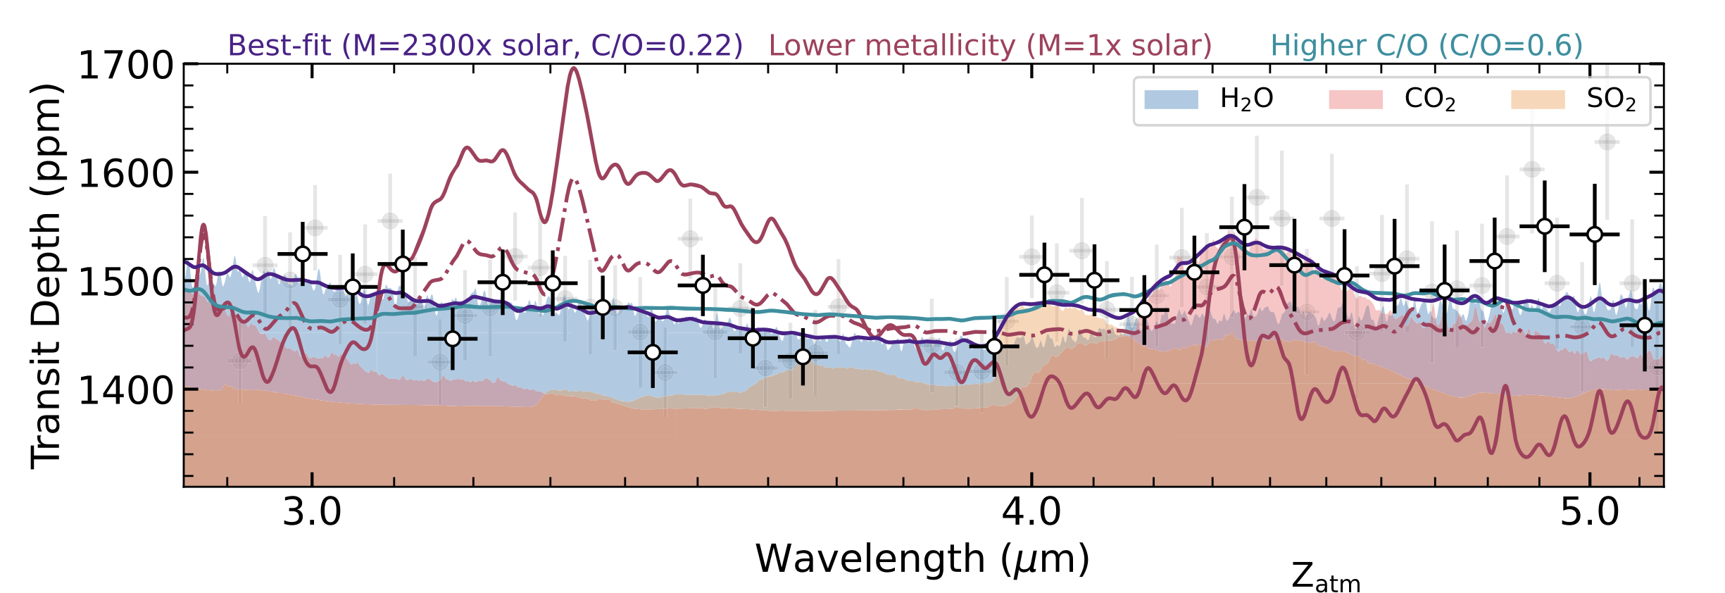
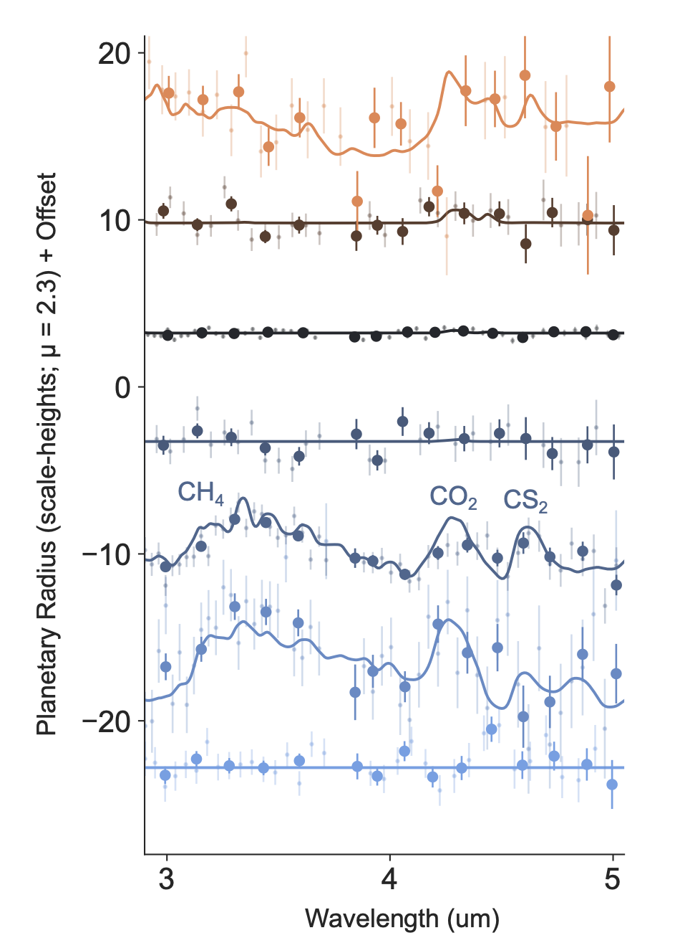
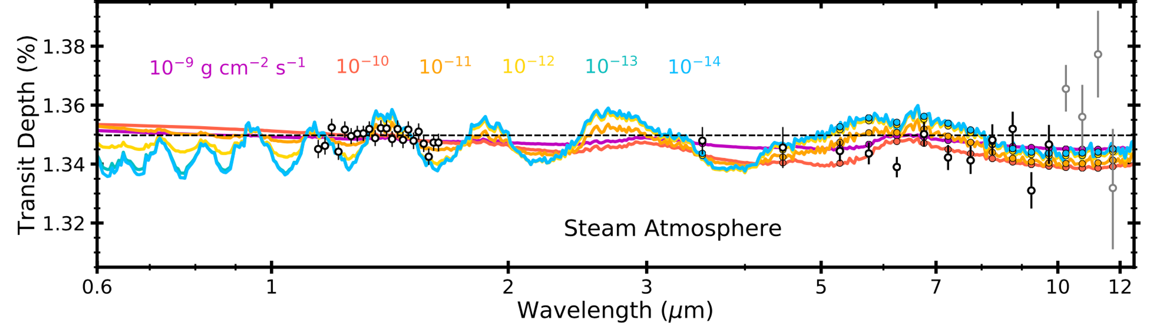
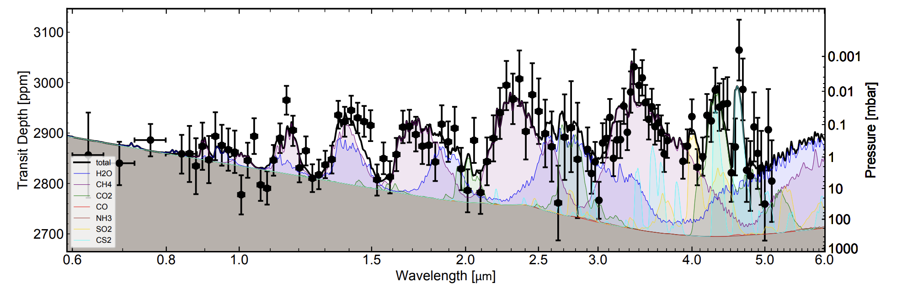
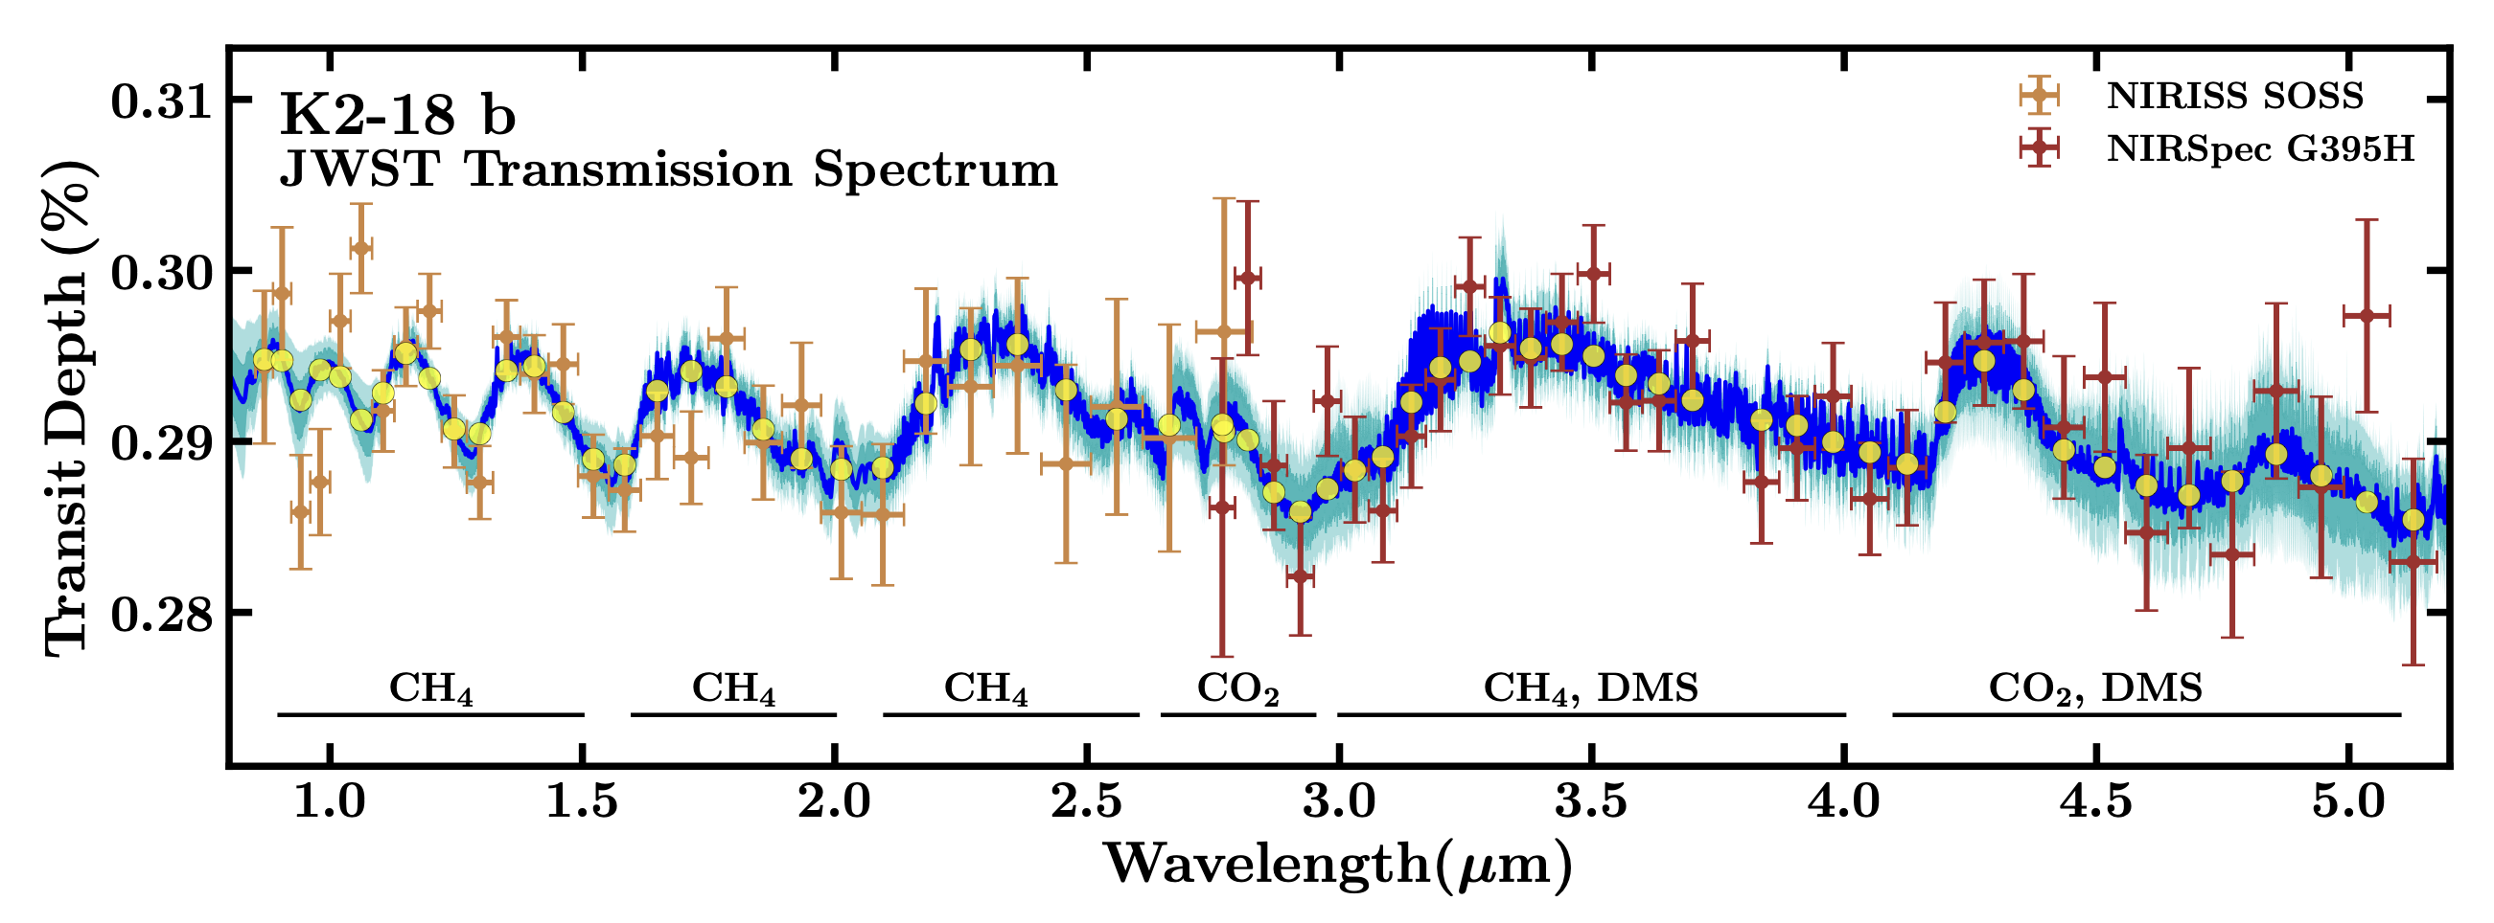
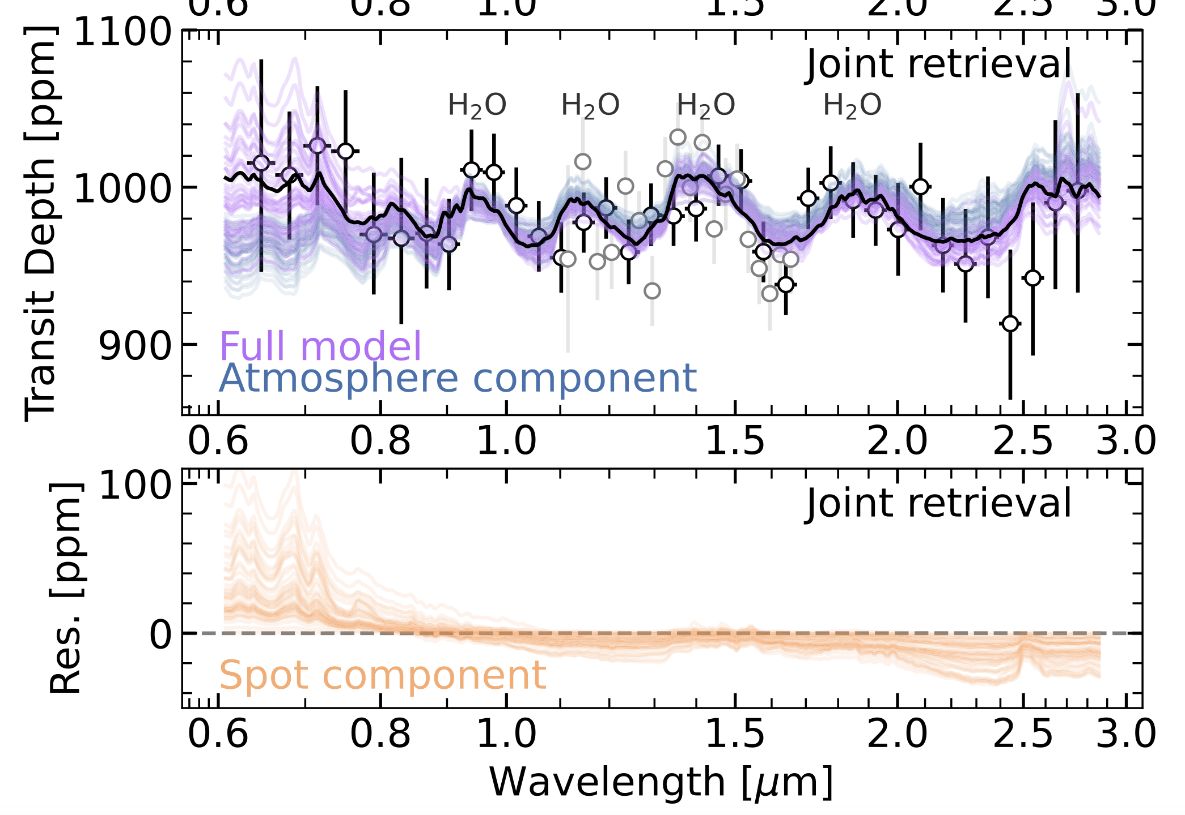
Sub-Neptune observations from JWST
GJ 3090 b, Ahrer+2025
GJ 1214 b, Gao+2023, Kempton+2023, Kreidberg+2014
TOI-270 d, Benneke+2024, Holmberg & Madhusudhan 2024
Espinoza & Perrin 2025
K2-18 b, Madhusudhan+2023
GJ 9827 d, Piaulet-Ghorayeb+2024

Slide 6
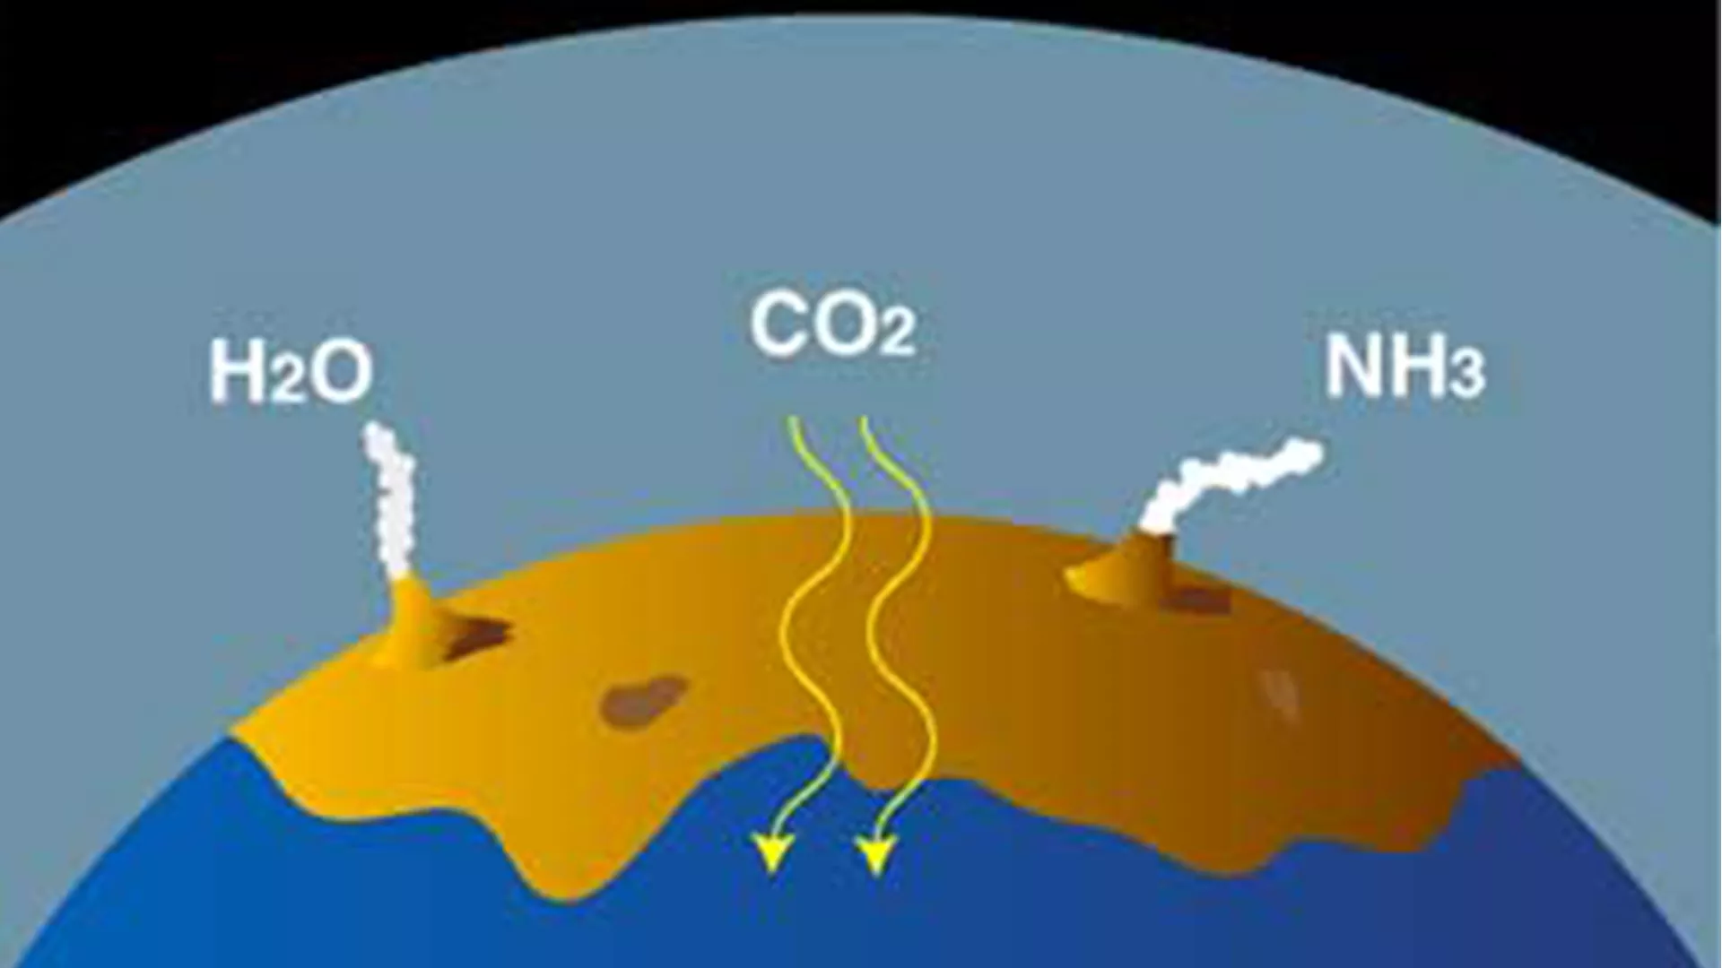
Atmosphere-interior interactions – why bother?
They’re important in the solar system
Deciphering interior compositions
Secondary atmosphere generation
See talk:
Rahul Arora
NOAA/JPL-Caltech

Slide 7
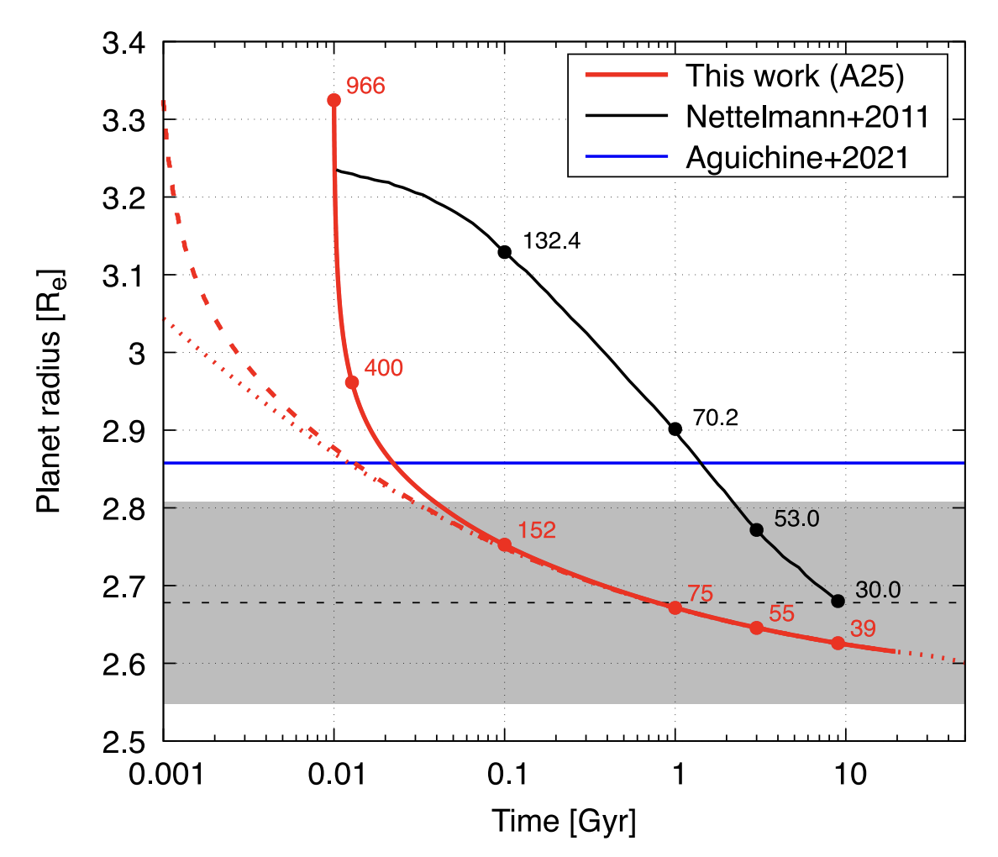
Atmosphere-interior interactions – why bother?
They’re important in the solar system
Deciphering interior compositions
Secondary atmosphere generation
Understanding evolution
Aguichine+2025

Slide 8
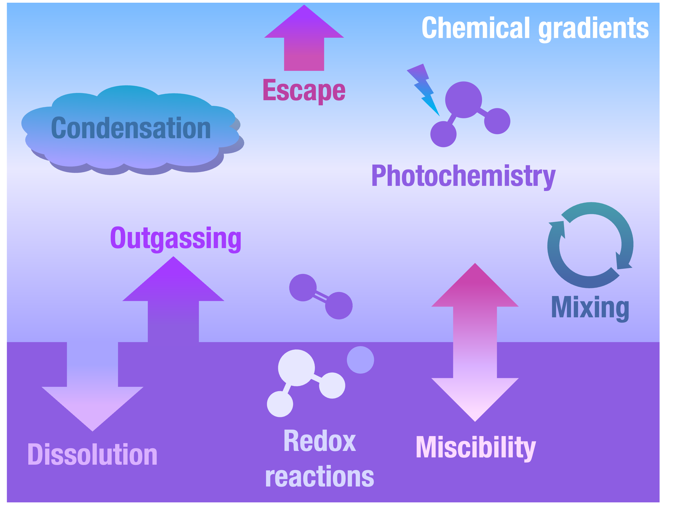
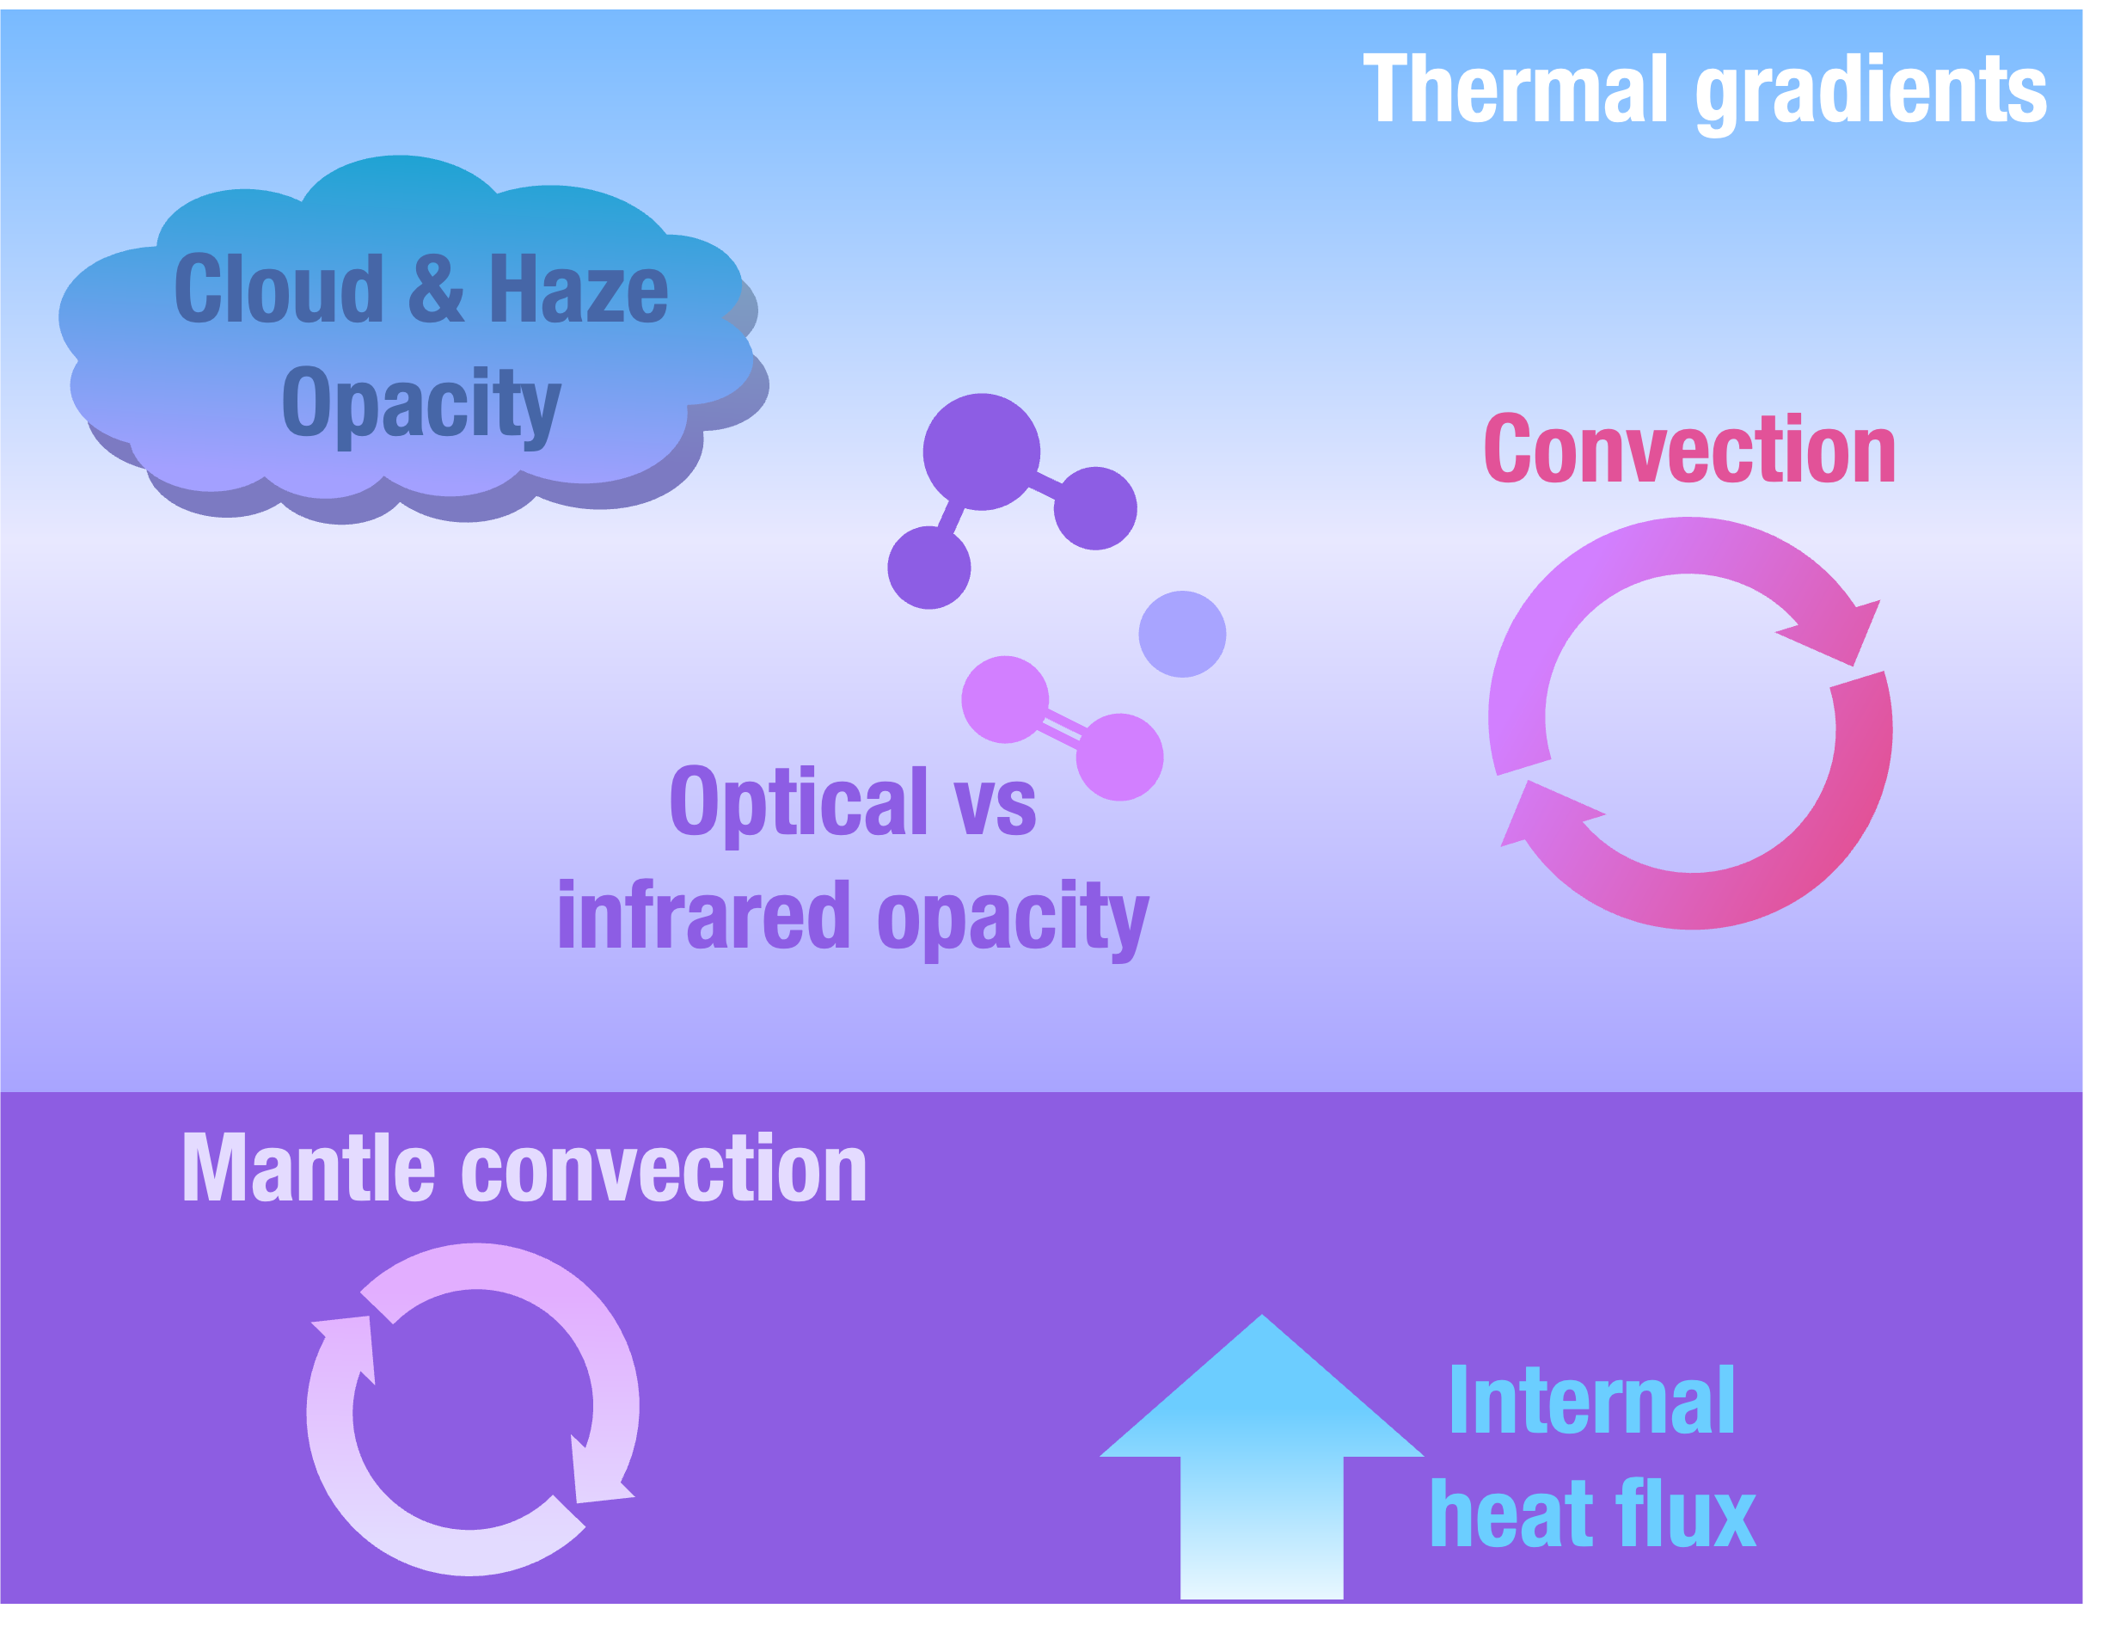
Atmosphere-interior interactions

Slide 9
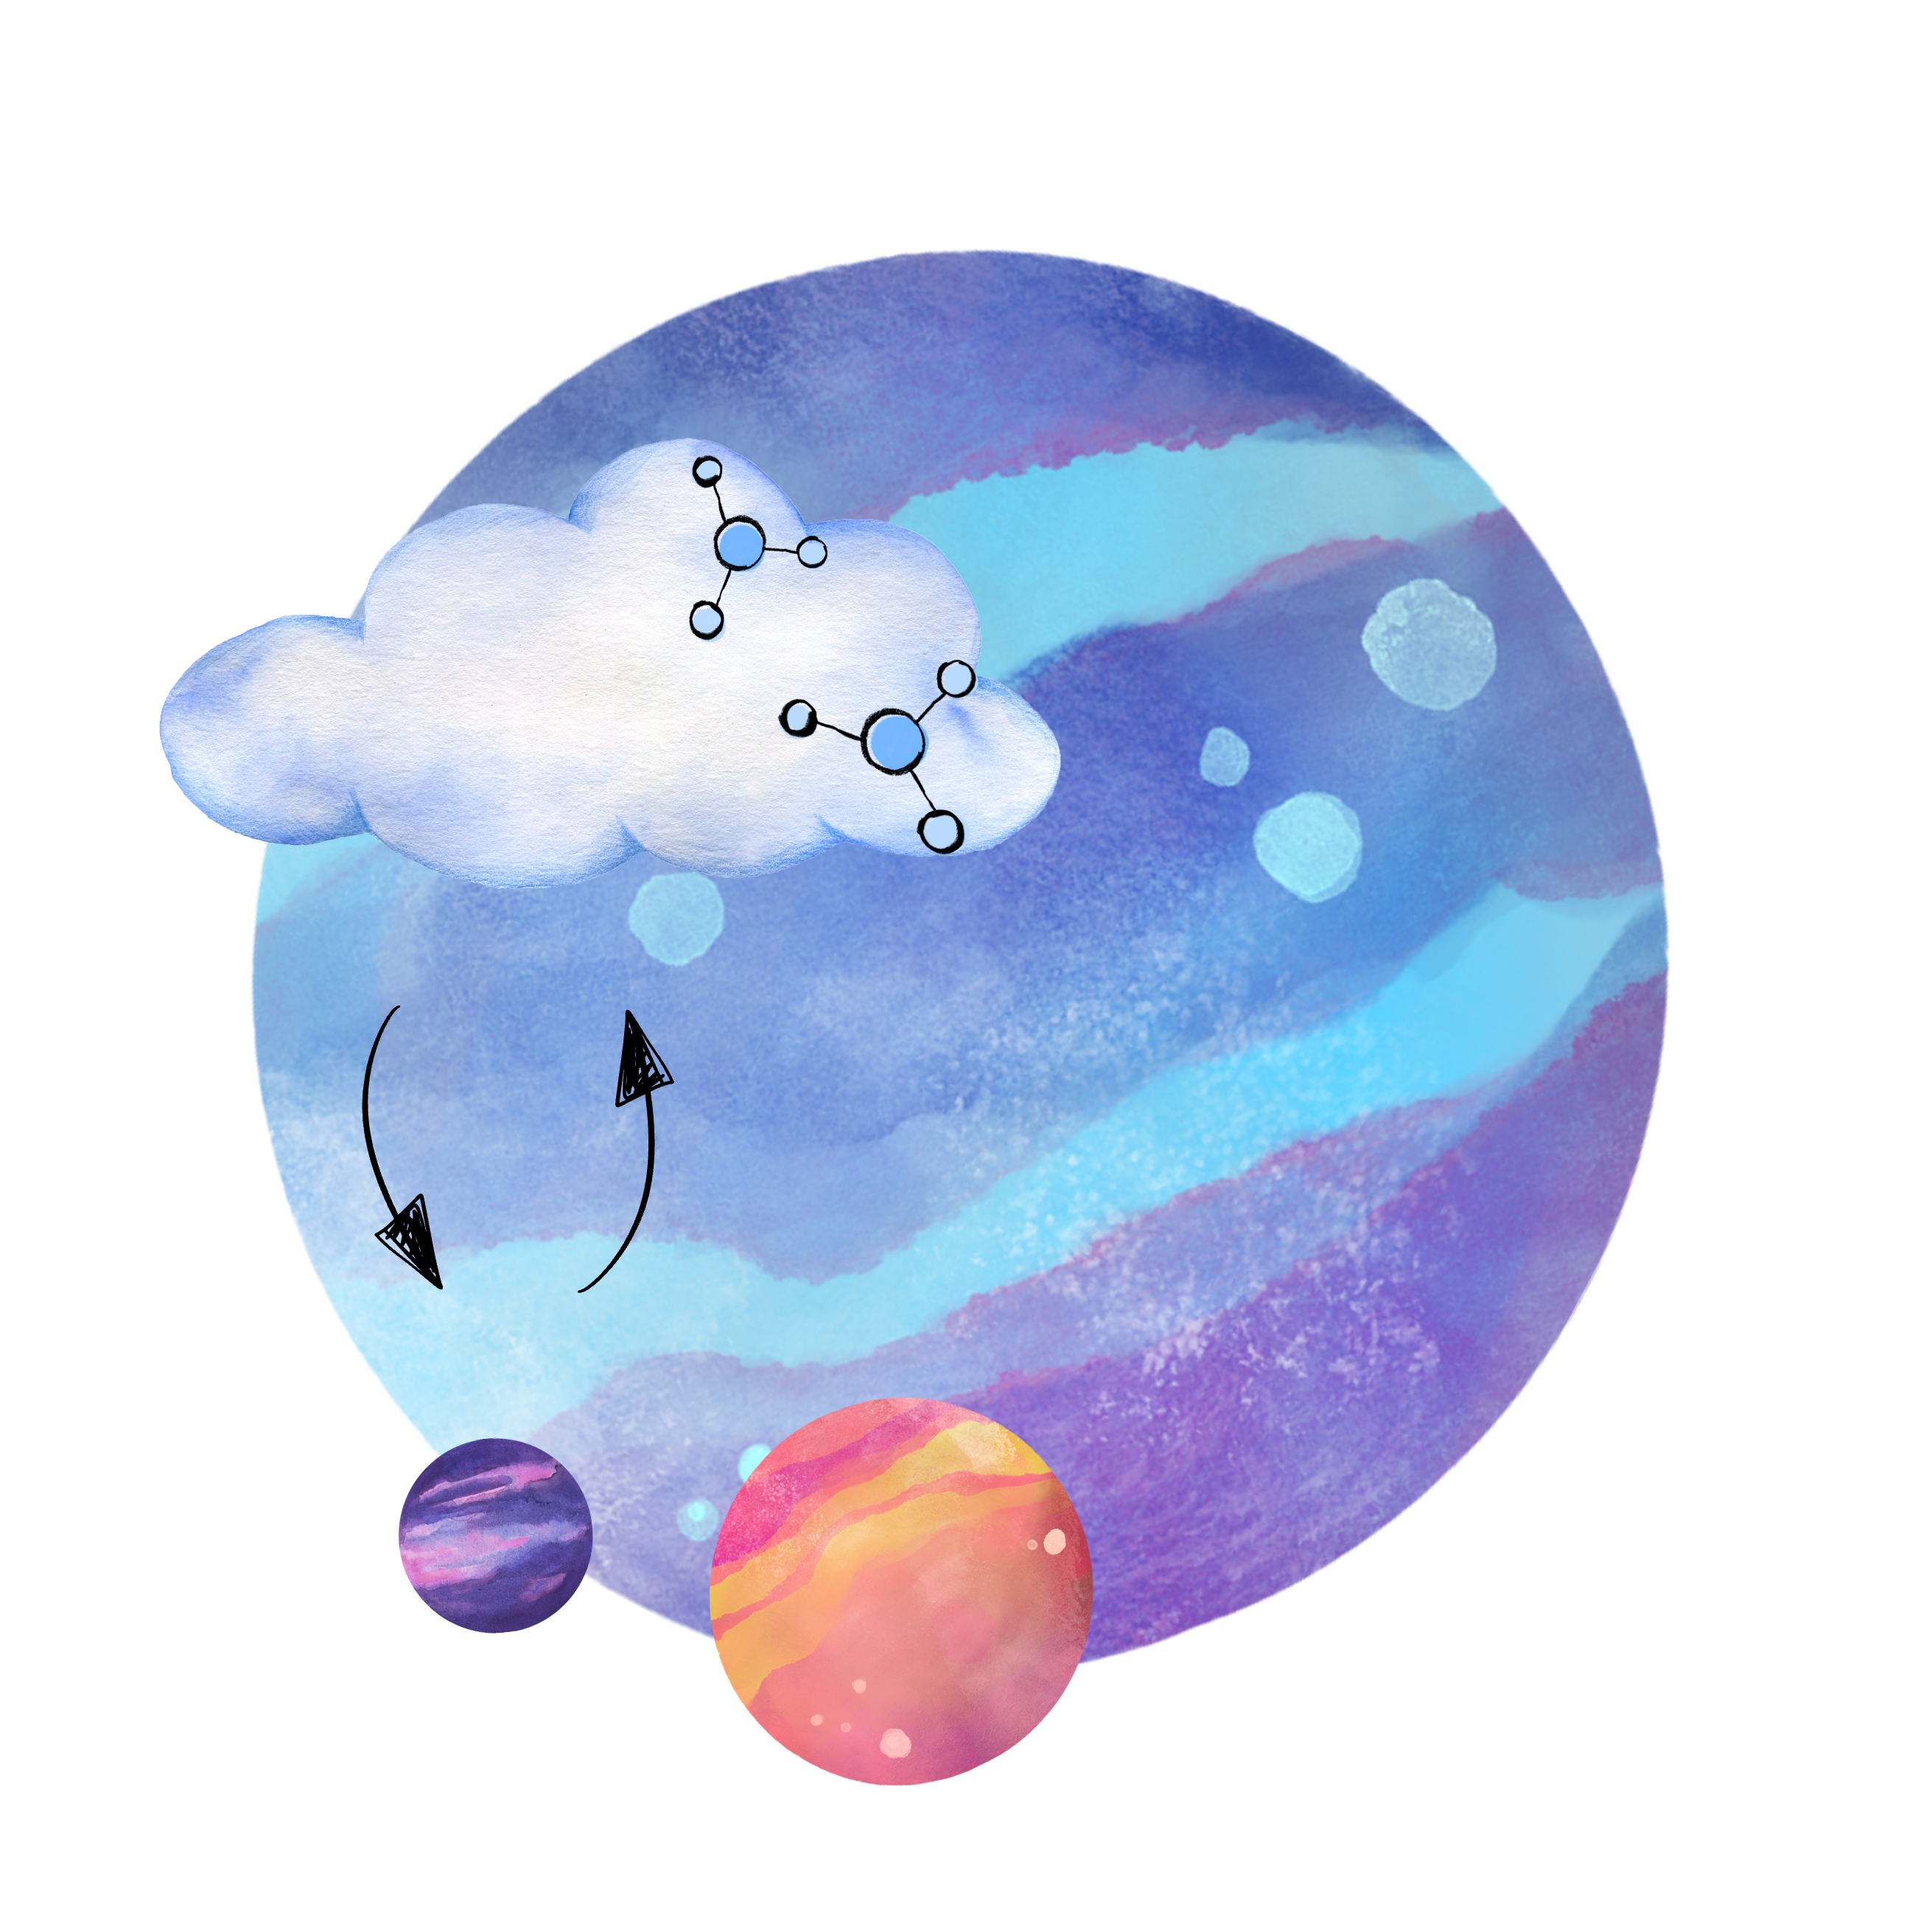
Atmosphere-interior interactions:
1. Atmosphere = boundary condition
2. Interior - Miscible? Molten?
3. Impact on observables?

Slide 10
Atmosphere-interior interactions:
1. Atmosphere = boundary condition
2. Interior - Miscible? Molten?
3. Impact on observables?

Slide 11
Atmosphere-interior interactions

Slide 12


Metallicity impacts interior constraints
High metallicity
Low metallicity
Don’t need as much envelope to get same bulk density →
can have larger mantle + core

Slide 13

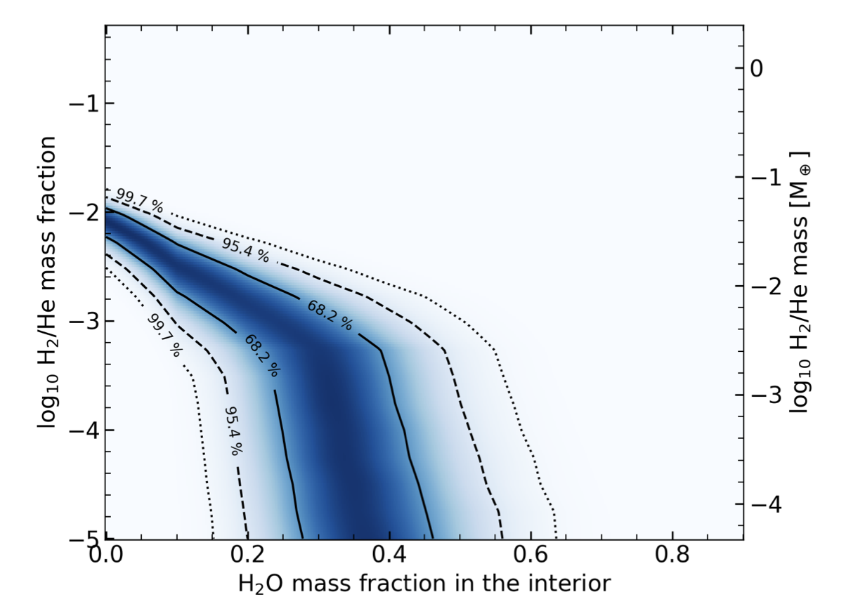
Metallicity impacts interior constraints
High metallicity rules out lowest-density atmosphere scenarios
TOI-270 d, Benneke+2024

Slide 14
Metallicity impacts interior constraints
5% H₂O by mass
Nixon+2024, GJ 1214 b
Minimum MMW considered

Slide 15
Metallicity impacts interior constraints
See talk:
Esther van Dijk
30% H₂O by mass
5% H₂O by mass
Nixon+2024, GJ 1214 b
Minimum MMW considered
MMW preferred by observations

Slide 16
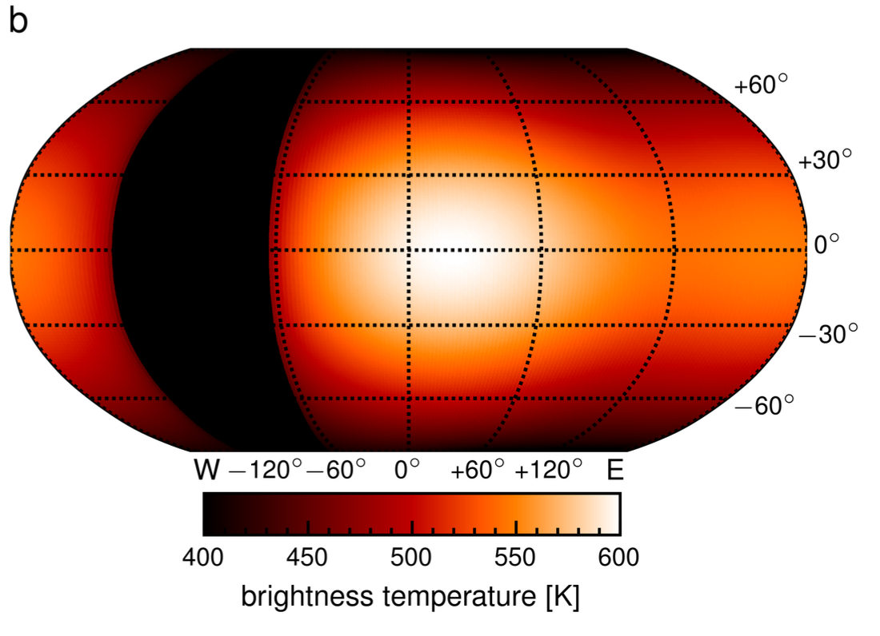
Metallicity – multiple ways of inferring
Detect multiple molecules & their abundances
Flat transmission spectrum in the mid-IR
TOI-270 d, Benneke+2024, Holmberg & Madhusudhan 2024
GJ 1214 b, Gao+2023, Kempton+2023, Kreidberg+2014
Day-night temperature contrast from phase curves
GJ 1214 b, Kempton+2023

Slide 17
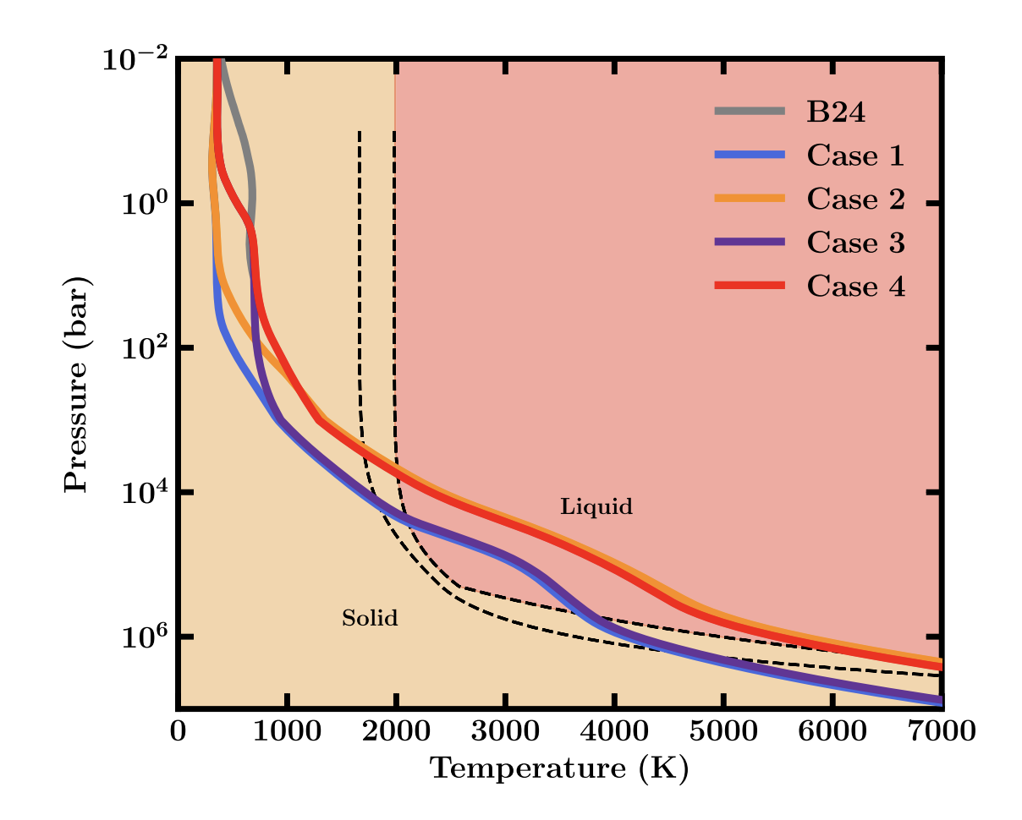
Atmospheric thickness affects surface conditions
See talk:
Frances Rigby
1000 bar atmosphere would have solid surface
10⁵ bar atmosphere would have molten surface
Rigby+2026

Slide 18
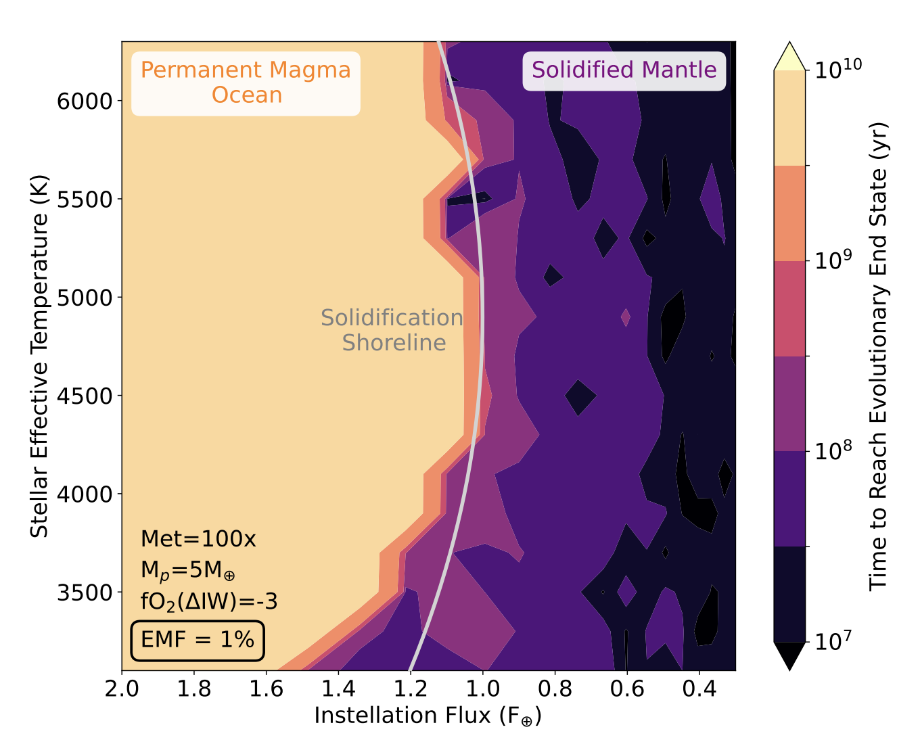
Atmospheric thickness affects surface conditions
Sub-Neptunes with envelope mass fractions of 1%...
…mostly have molten surfaces if rocky
Calder+2025

Slide 19
How hot/cold is the interior?
Atmospheric temperature profile
=
boundary condition for interior
Pressure
See talk:
John Allen
Temperature

Slide 20


Aerosols impact interior constraints
More haze vs
less haze leads to colder, denser interior
See talk:
Jacob Ayre
Nixon+2024

Slide 21
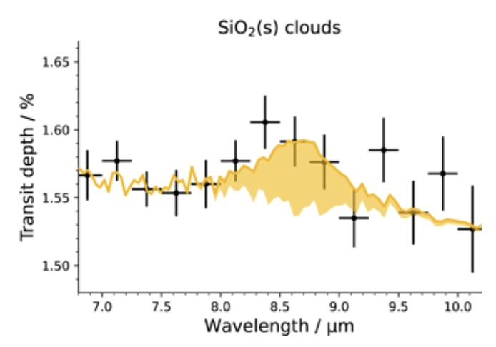
Aerosols – multiple ways of inferring
Very precisely flat near-IR transmission spectrum
GJ 1214 b, Kempton+2023
GJ 1214 b, Gao+2023, Kempton+2023, Kreidberg+2014
Measure the energy budget from infrared phase curve
Observe spectral features from clouds
WASP-17 b, Grant+2023

Slide 22
Convection affects the atmosphere-interior temperature gradient
Dry convection?
See talk:
Wei Qiang
Observe a temperature up here…
P
T
But how hot is it down here?
Convective inhibition?
Moist convection?
P
P
T
T

Slide 23
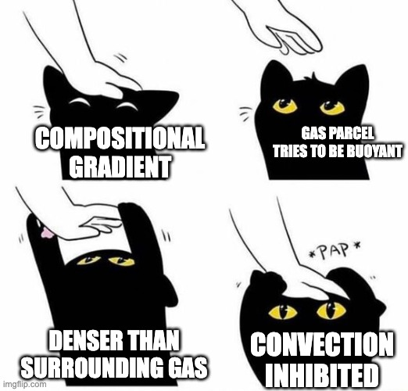
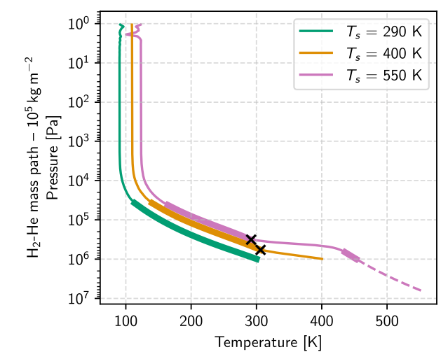
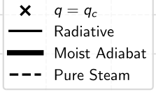
Mind the gap! Convective inhibition
Steep temperature jump due to radiative layer
Innes et al. 2023, see also Leconte et al. 2024, Barrier & Madhusudhan 2024

Slide 24
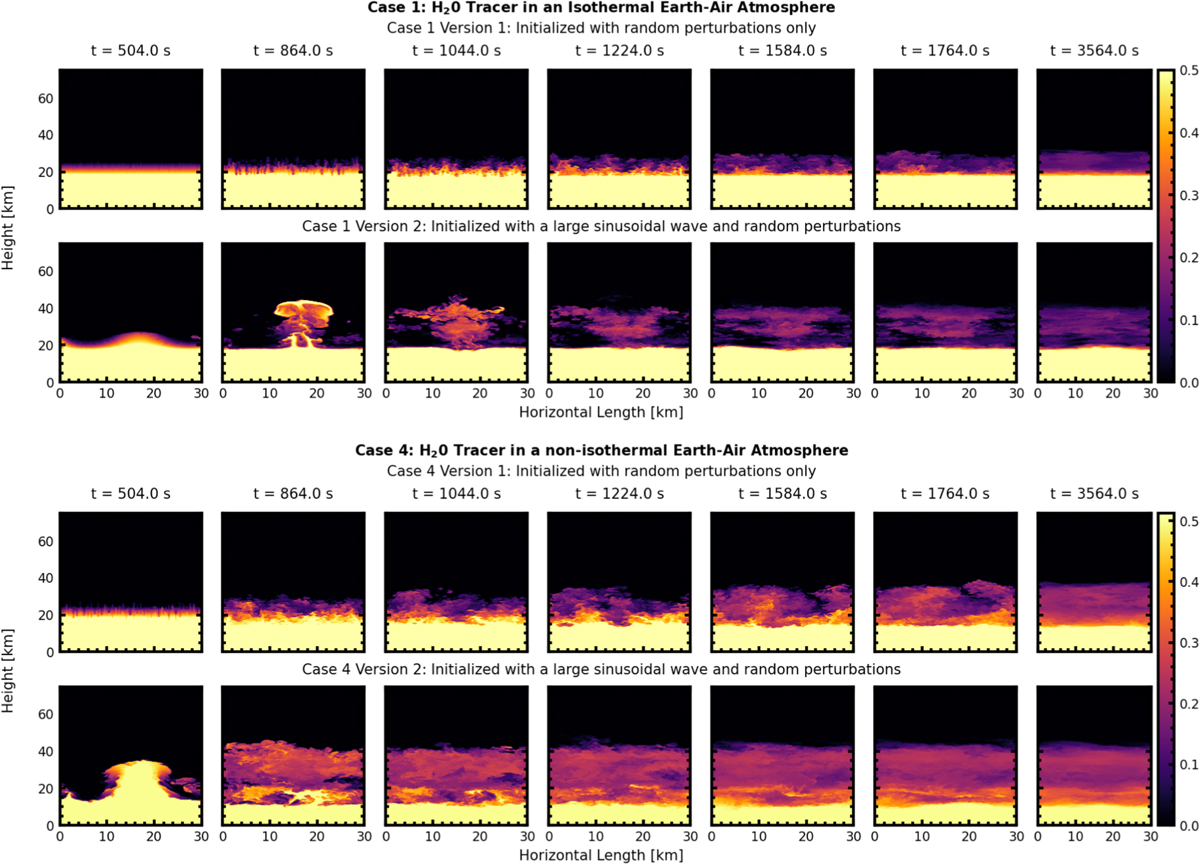
Compositional convection – different final states possible!
Isothermal
Mas mixing ratio of tracer
Non-isothermal
Habib & Pierehumbert 2024
Time

Slide 25
Atmosphere-interior interactions:
1. Atmosphere = boundary condition
2. Interior - Miscible? Molten?
3. Impact on observables?

Slide 26
2. Atmosphere-interior interactions

Slide 27

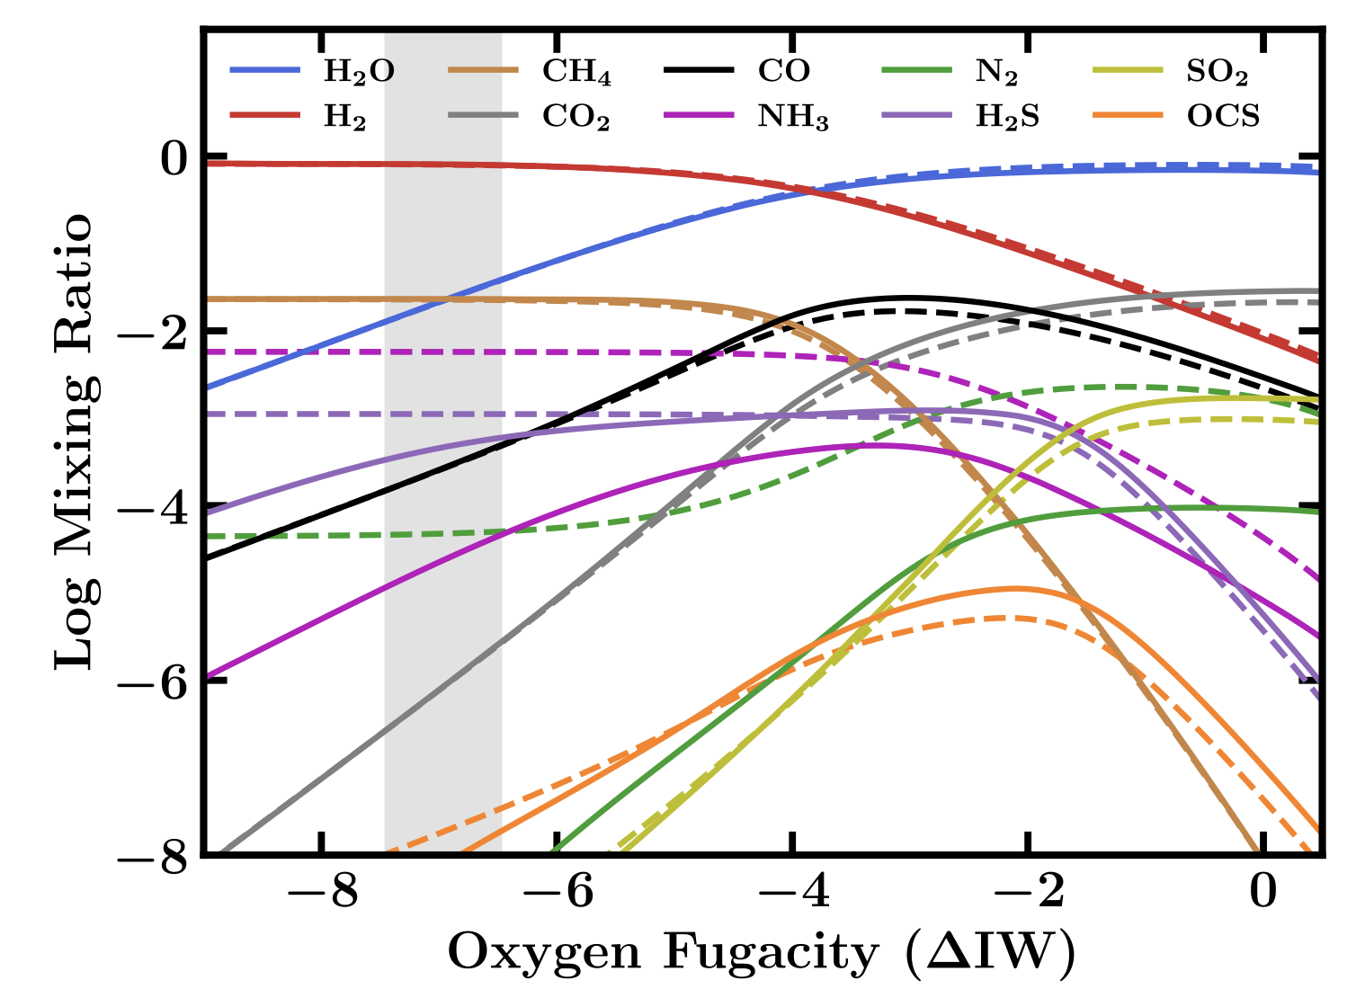

Solubility depends on many factors
Composition
Pressure
Temperature
Rigby et al. 2024
More oxidising

Slide 28
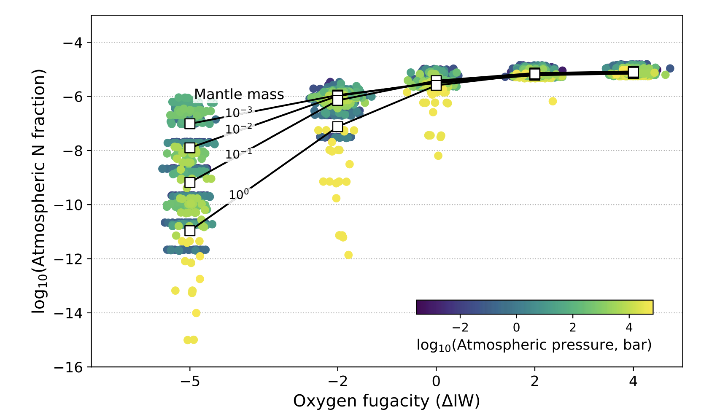
Atmospheric composition → What dissolved? → Surface composition?
Hydrogen-rich = more reducing
Rigby et al. 2024
Shorttle et al. 2024
More oxidising
More oxidising

Slide 29


Hydrogen solubility depends on magma composition
Silica melts first
Young, molten planets have “primitive” rock composition
Processes such as melting separate rock components

Slide 30

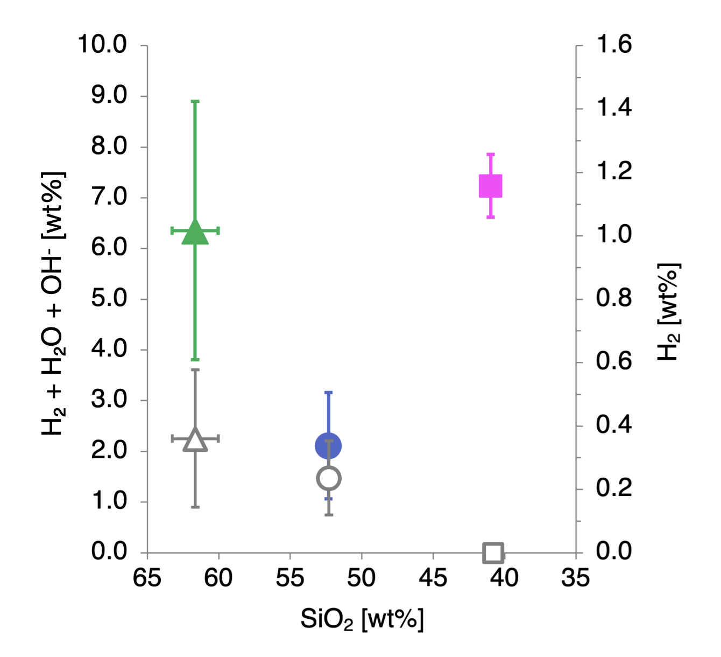
Hydrogen solubility depends on magma composition
Kara Brugman
Univ. New Mexico
Past work seems to show a trend in solubility vs magma ocean “primitiveness”
(Hirschmann et al. 2012)
Higher H solubility
Brugman et al.
More primitive magma composition
(as expected for sub-Neptunes)

Slide 31
Hydrogen solubility depends on magma composition
Kara Brugman
Univ. New Mexico
Past work seems to show a trend in solubility vs magma ocean “primitiveness”
(Hirschmann et al. 2012)
Higher H solubility
… but recent measurements show more complexity
(Brugman et al., in revision)
Brugman et al.
More primitive magma composition
(as expected for sub-Neptunes)

Slide 32
2. Atmosphere-interior interactions

Slide 33
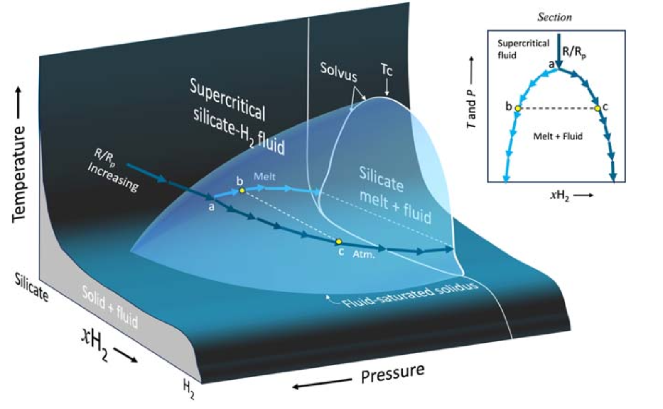
Where does miscibility happen?
Young+2024

Slide 34
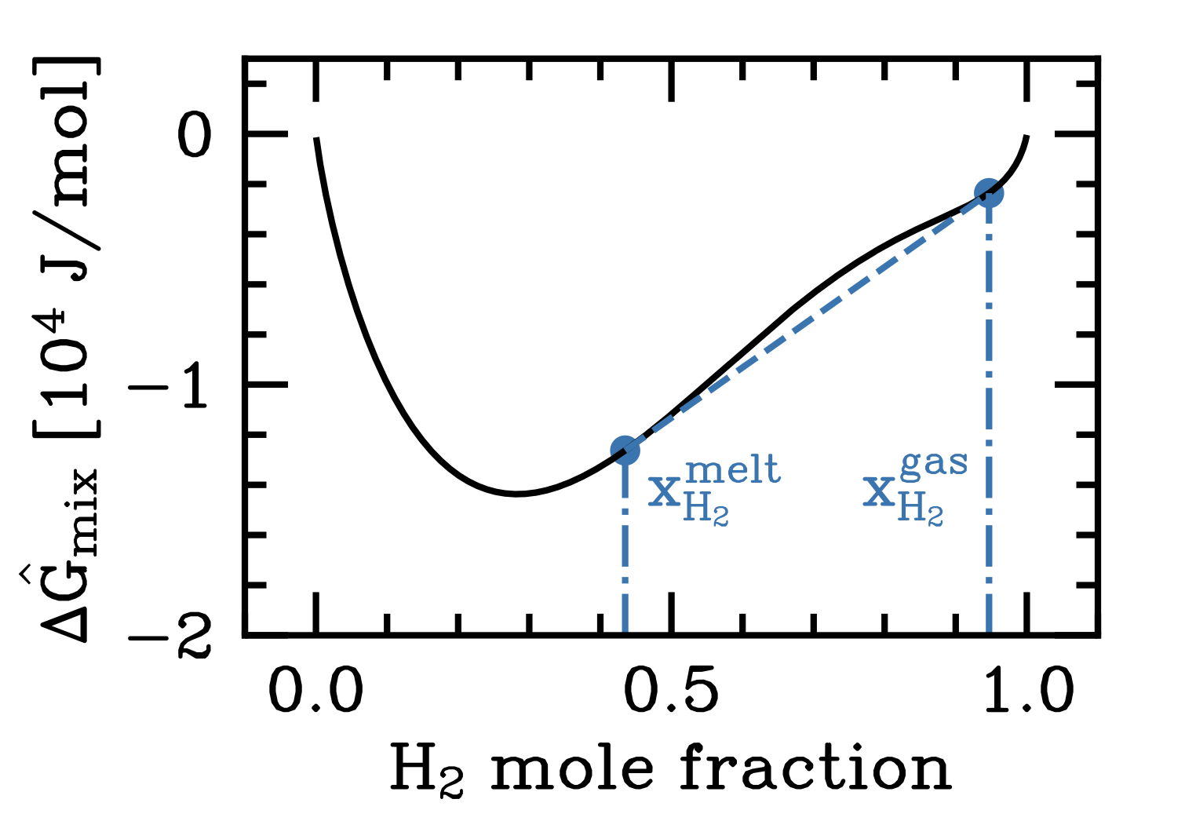
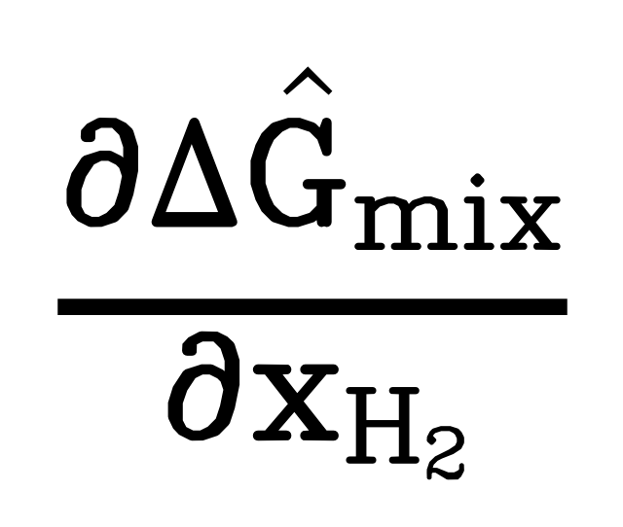
Example: Miscibility of a H₂ – MgSiO₃ fluid
3975 K
=
chemical potential
(must be same for all components)
Rogers+2025

Slide 35
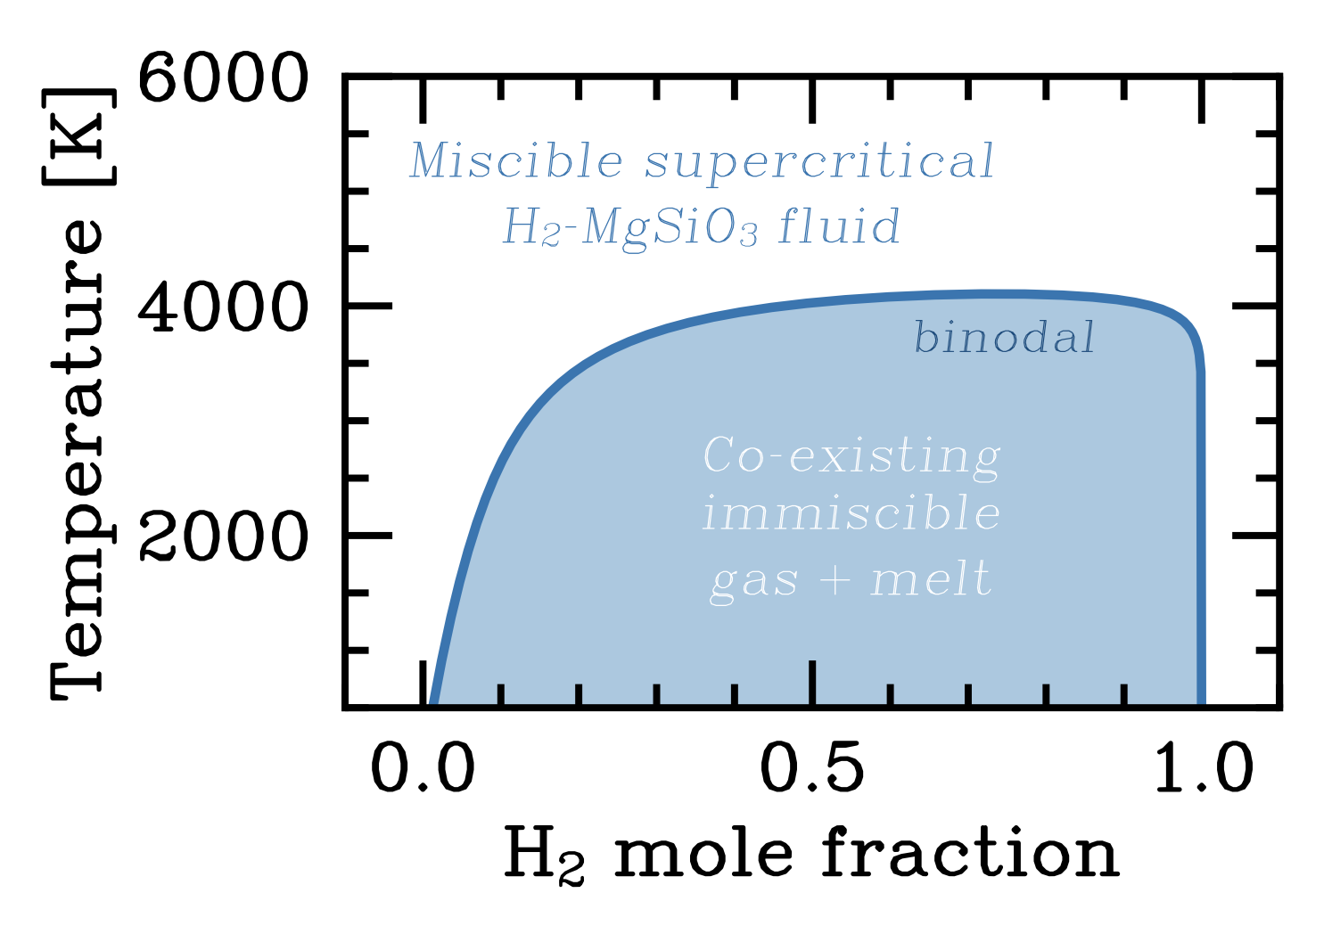
Example: Miscibility of a H₂ – MgSiO₃ fluid
3975 K
Rogers+2025

Slide 36
Example: H₂ – MgSiO₃ fluid
3975 K
Temperature
Rogers+2025

Slide 37
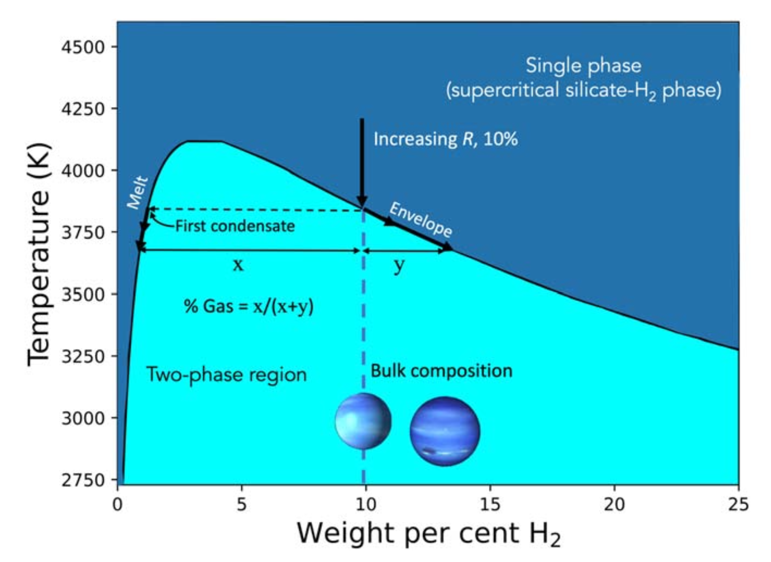
Example: Miscibility of a H₂ – MgSiO₃ fluid
Young+2024

Slide 38
Where does miscibility happen?
Pressure
Young+2024

Slide 39
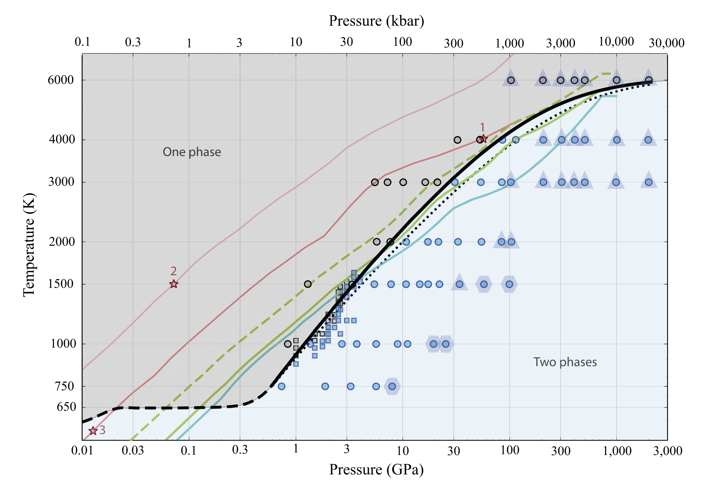


H₂ and H₂O can be miscible at high temperatures
Mixed
De-mixed
Gupta+2025 (molecular dynamics simulations)

Slide 40
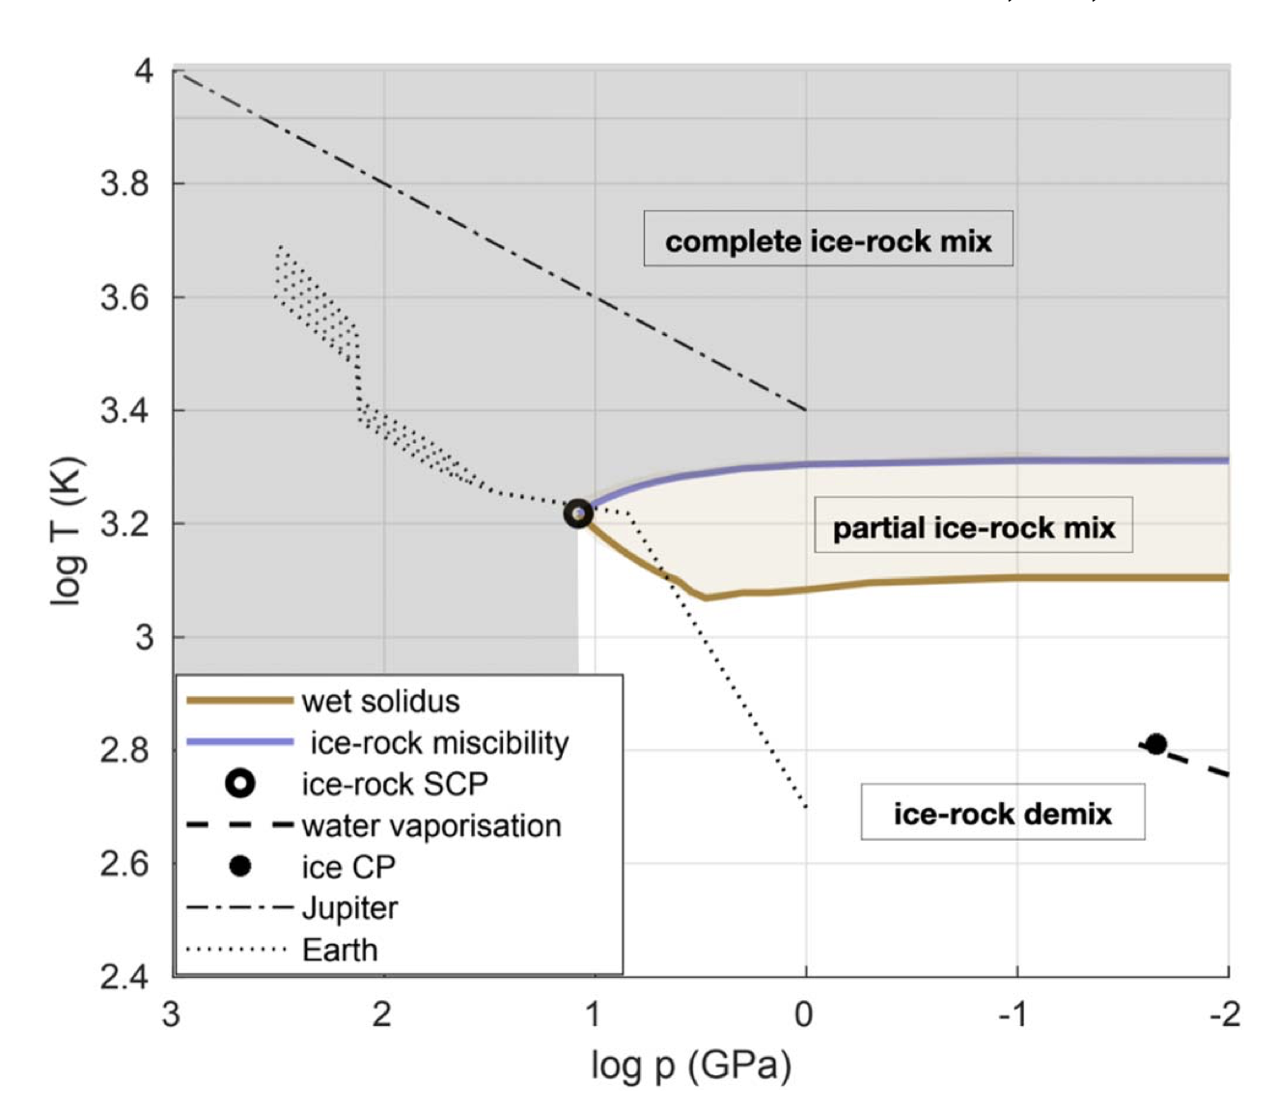


H₂O and rock can be miscible at high temperatures
Mixed
De-mixed
Vazan+2022
10⁴ bar

Slide 41
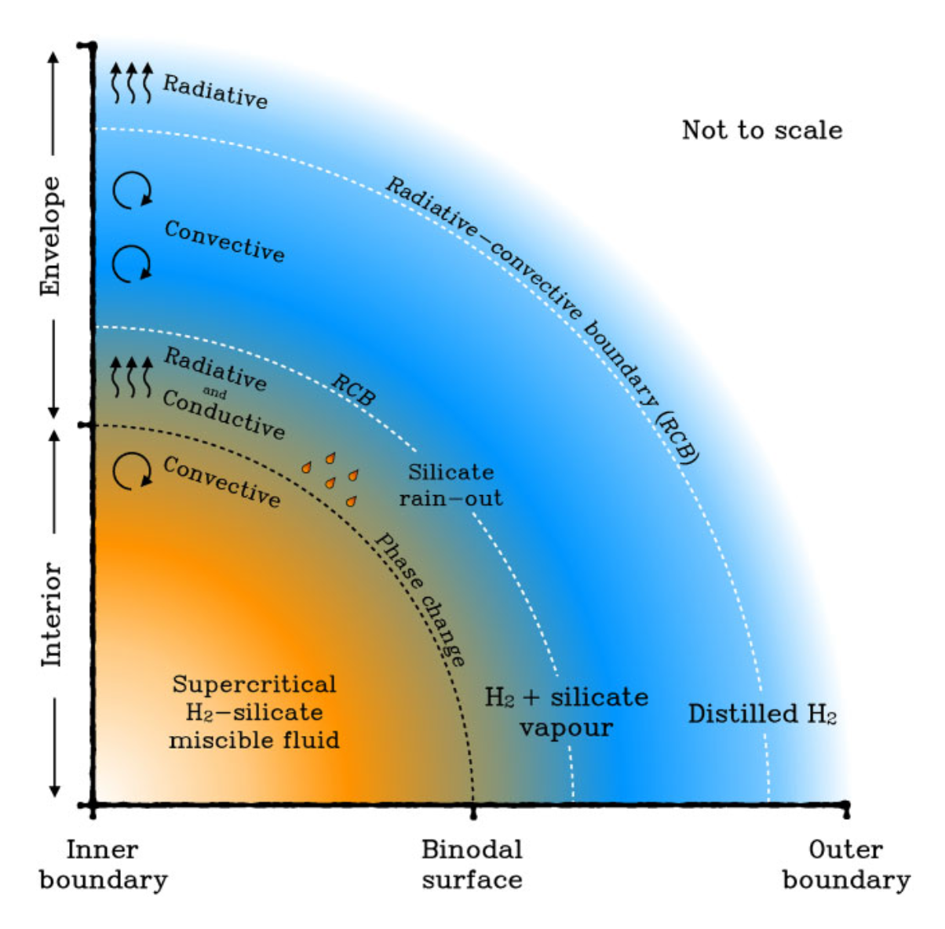
Miscibility can change the structure of sub-Neptunes
Rogers+2025

Slide 42
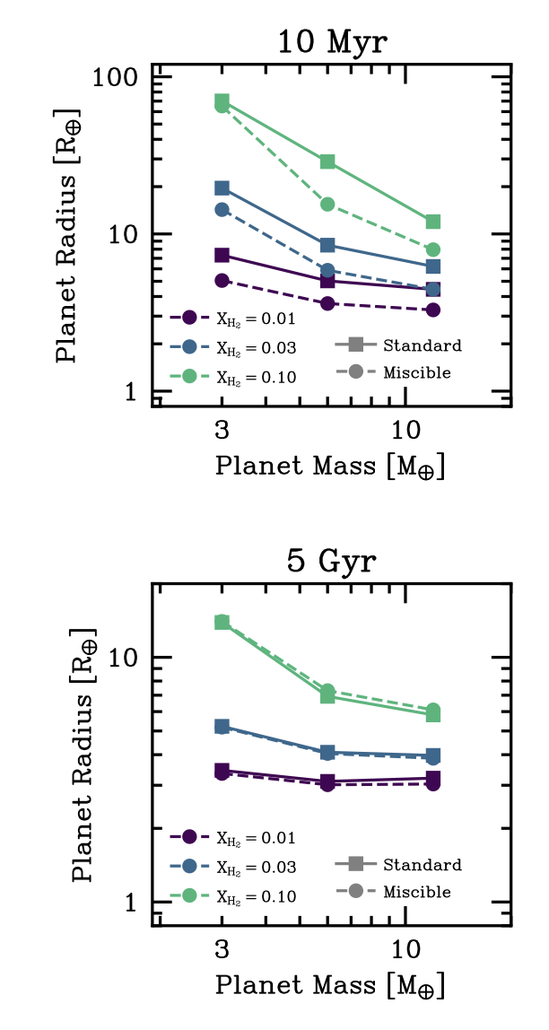
Miscibility can change the structure of sub-Neptunes
Rogers+2025
… and their evolution
Rogers+2025

Slide 43
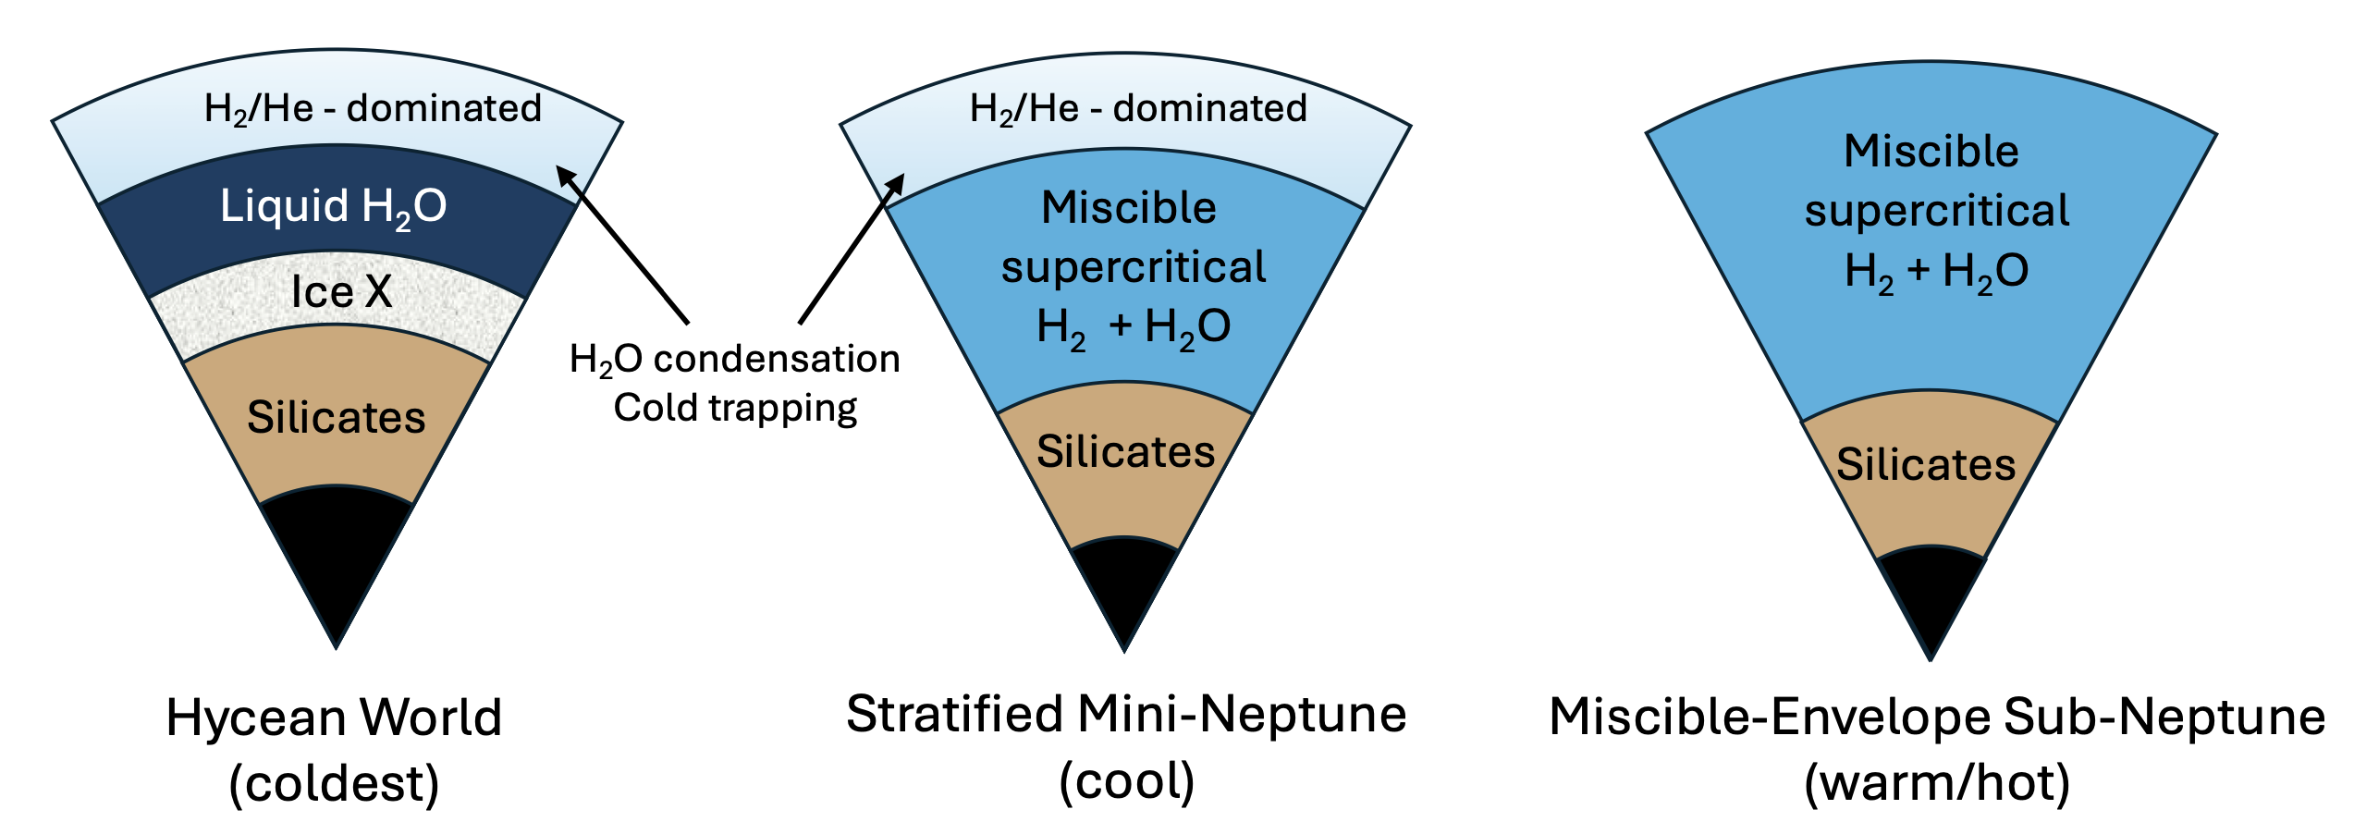
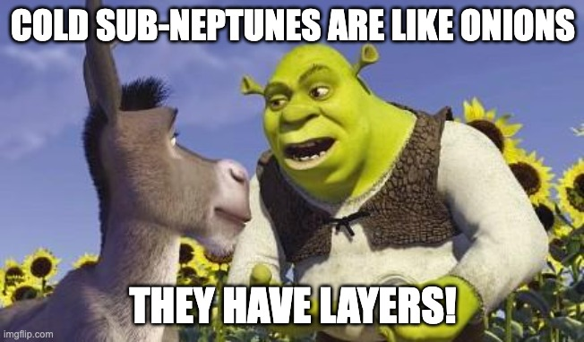
Miscibility can change the structure of sub-Neptunes
Benneke+2024
Hotter
More ogre-like

Slide 44
2. Atmosphere-interior interactions

Slide 45
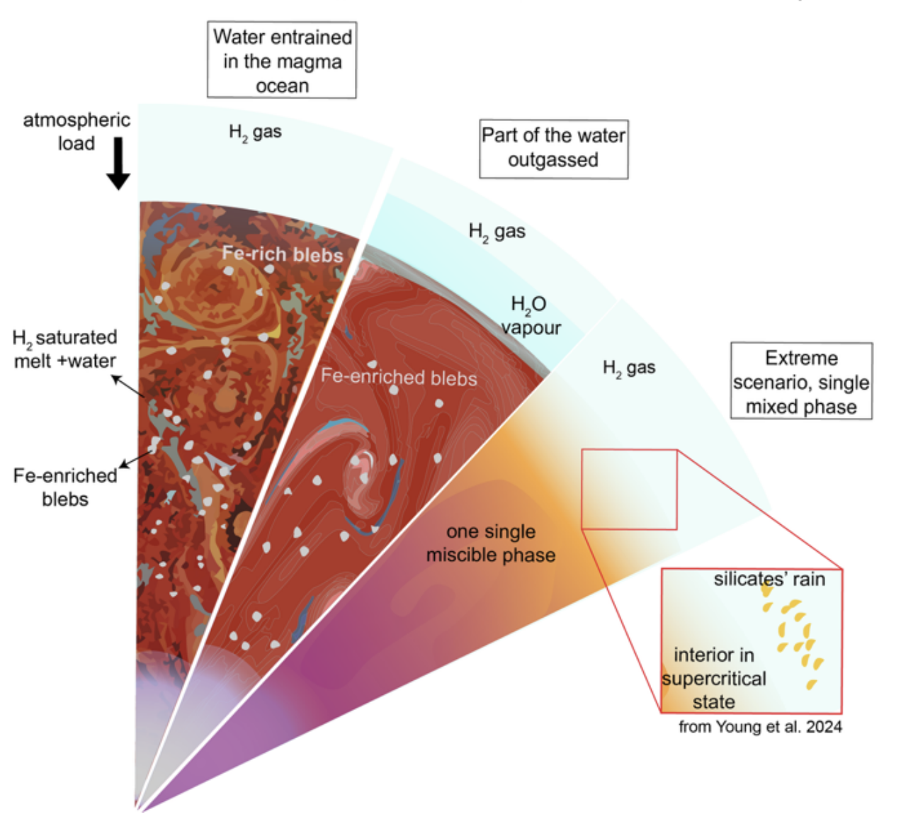
H₂ atmosphere + O-rich mantle = H₂O production
Miozzi+2025, see also Horn+2025

Slide 46
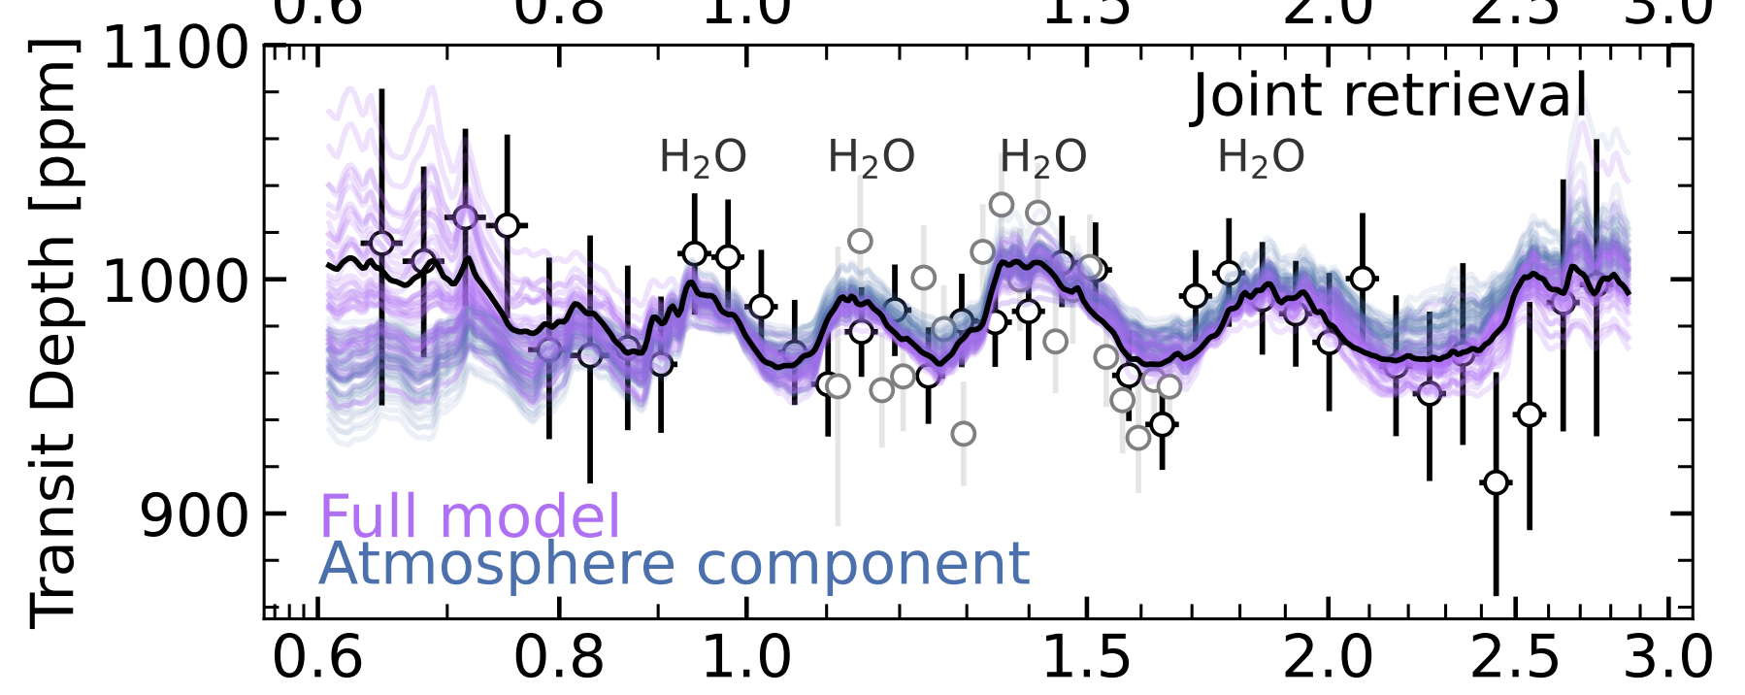
H₂ atmosphere + O-rich mantle = H₂O production
Piaulet-Ghorayeb+2024, GJ 9827 d
Miozzi+2025, see also Horn+2025

Slide 47
2. Atmosphere-interior interactions
Core
V
O
L
A
T
I
L
E
S

Slide 48
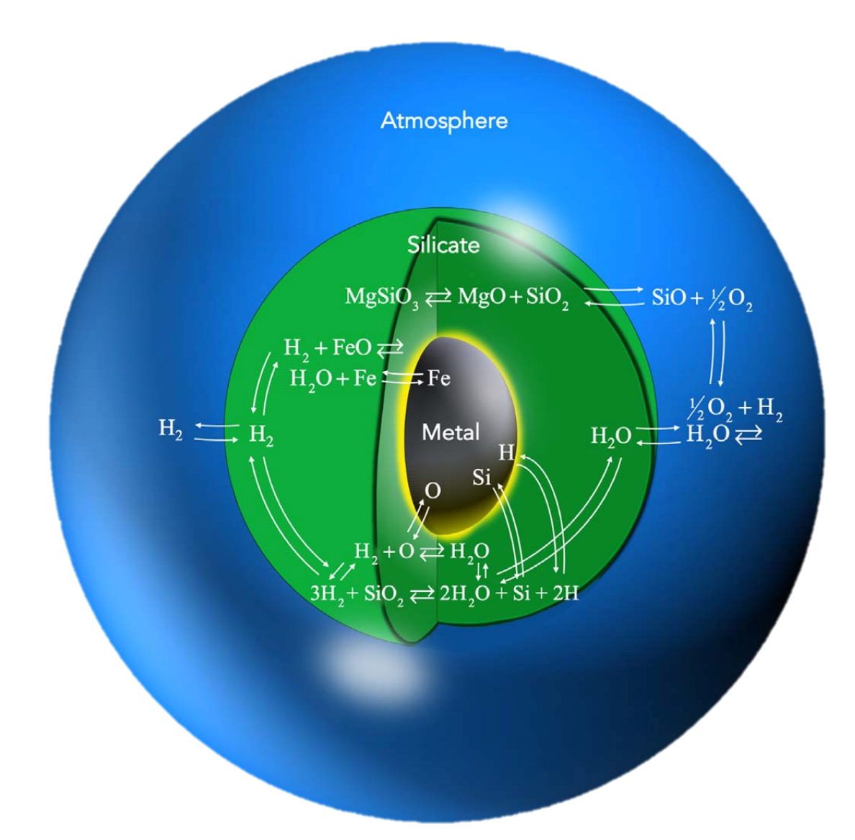

Volatiles can go in the core too
O, H go into metal core
Schlichting & Young 2022

Slide 49
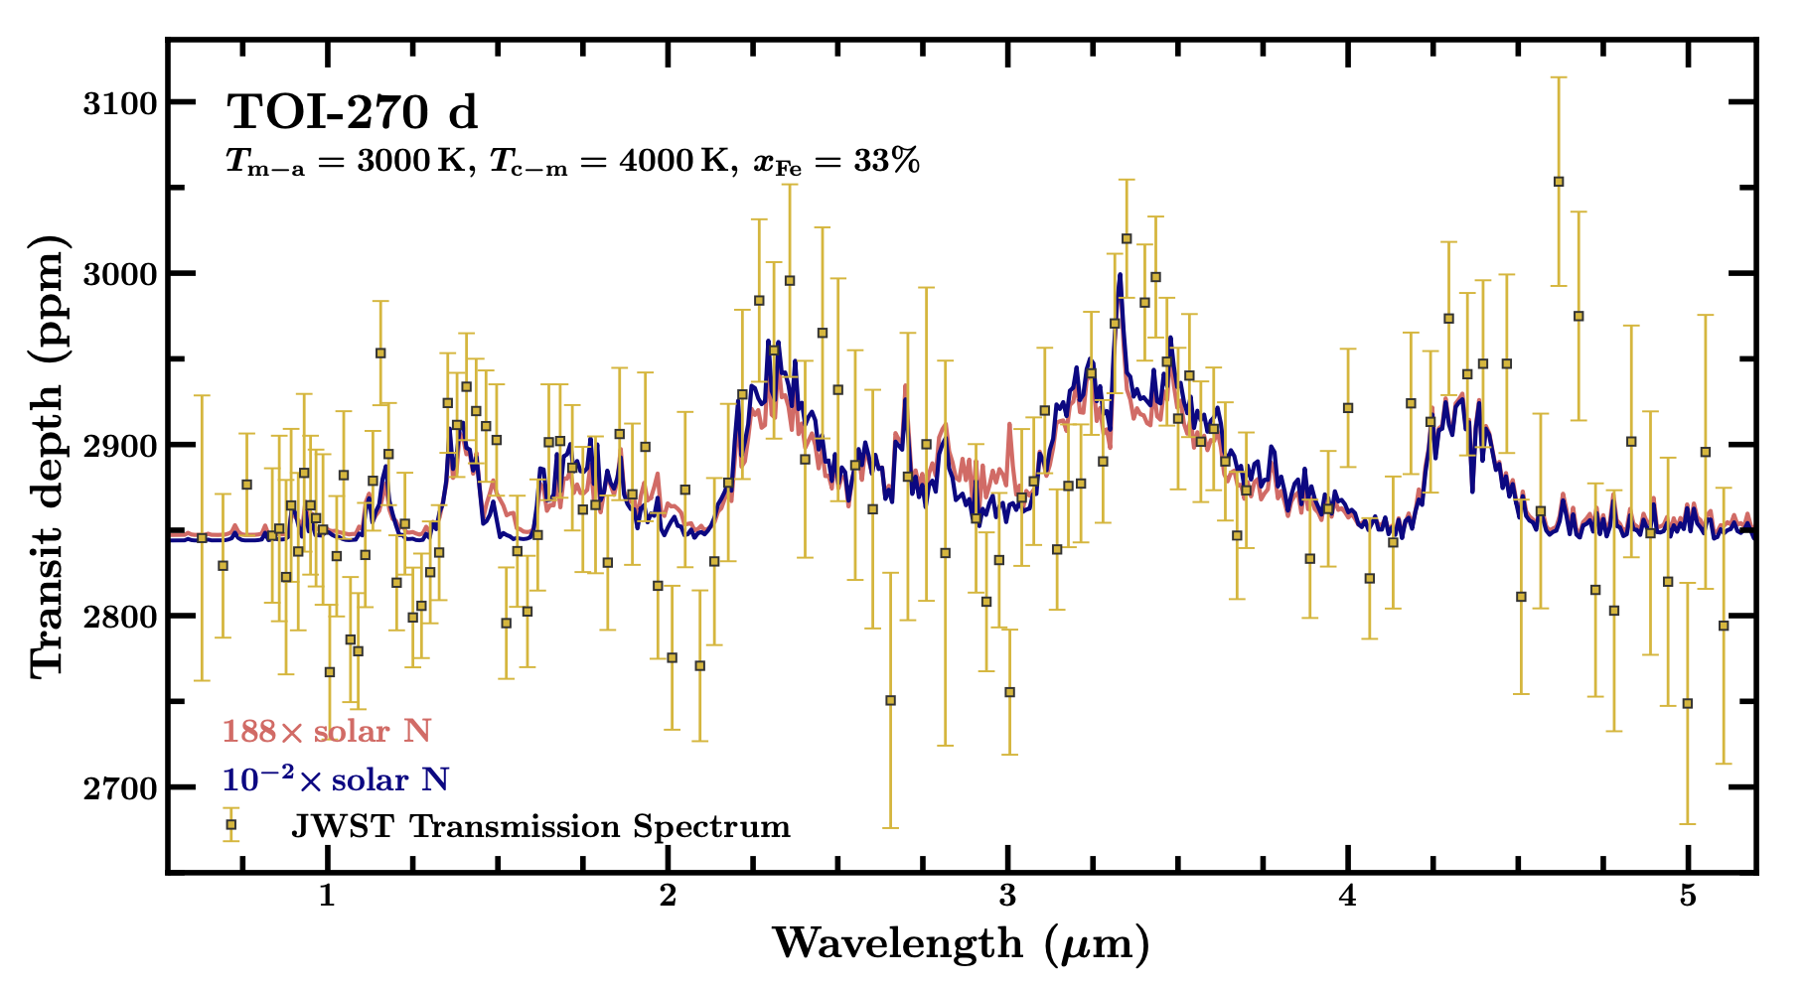
Volatiles can go in the core too
See talk:
Anand Bhongade
Can explain some sub-Neptune observations
O, H go into metal core
Nixon+2025, see also Benneke+2024
Schlichting & Young 2022

Slide 50
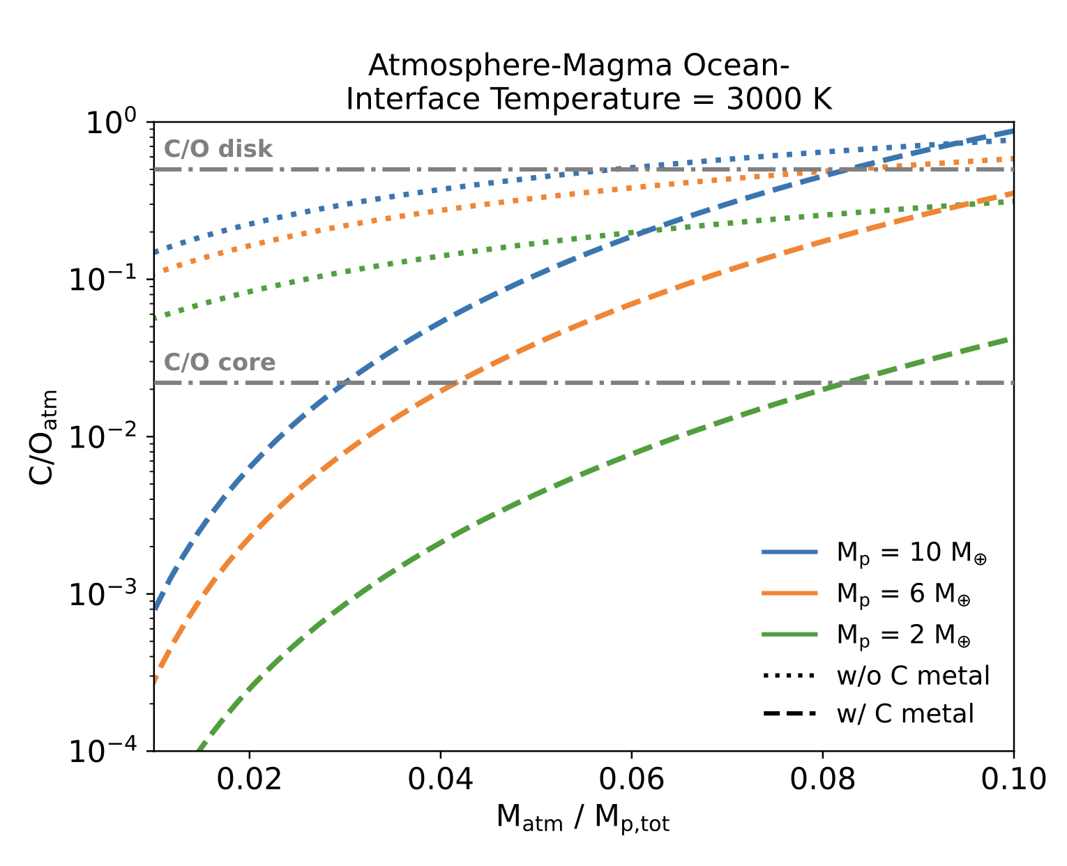
What if O and C go into the core?
O goes in core but C doesn’t
→
Higher C/O in atmosphere
O and C go in core
→
Lower C/O in atmosphere
Werlen+2025

Slide 51

Observations
Models
Experiments

Slide 52
Atmosphere-interior interactions:
1. Atmosphere = boundary condition
2. Interior - Miscible? Molten?
3. Impact on observables?

Slide 53
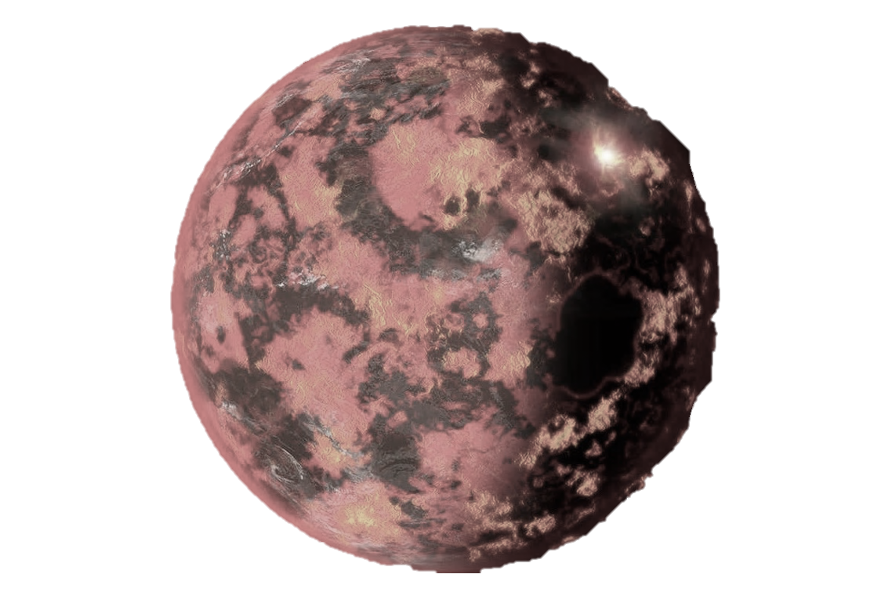
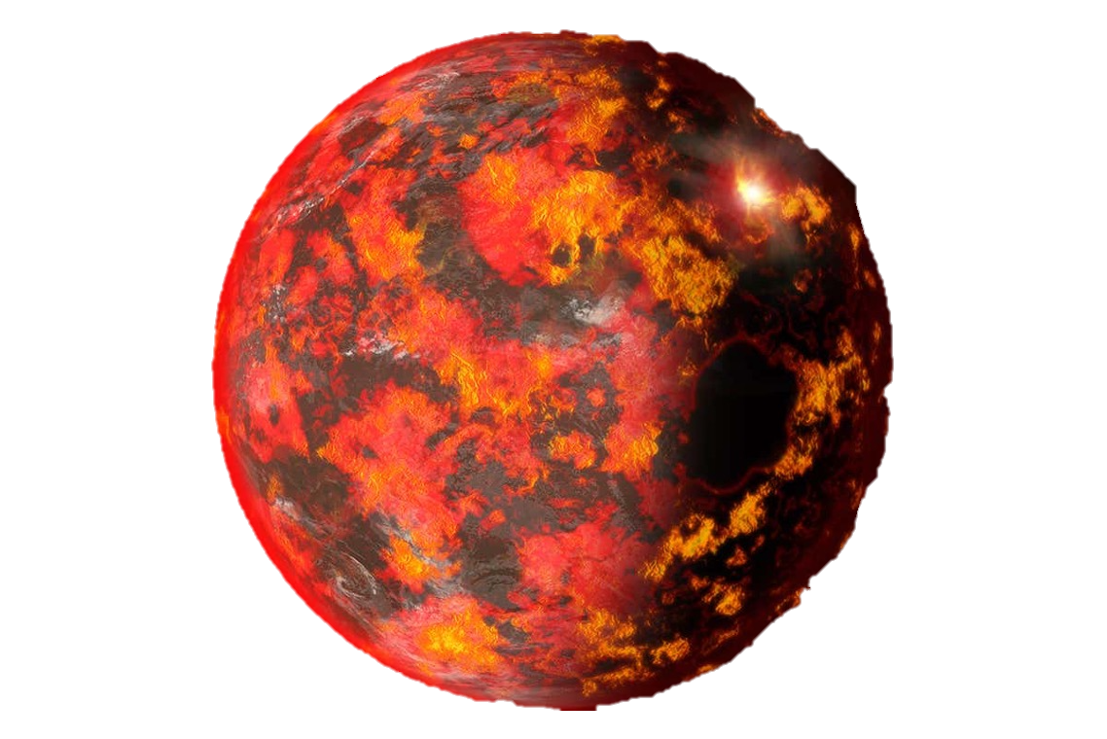
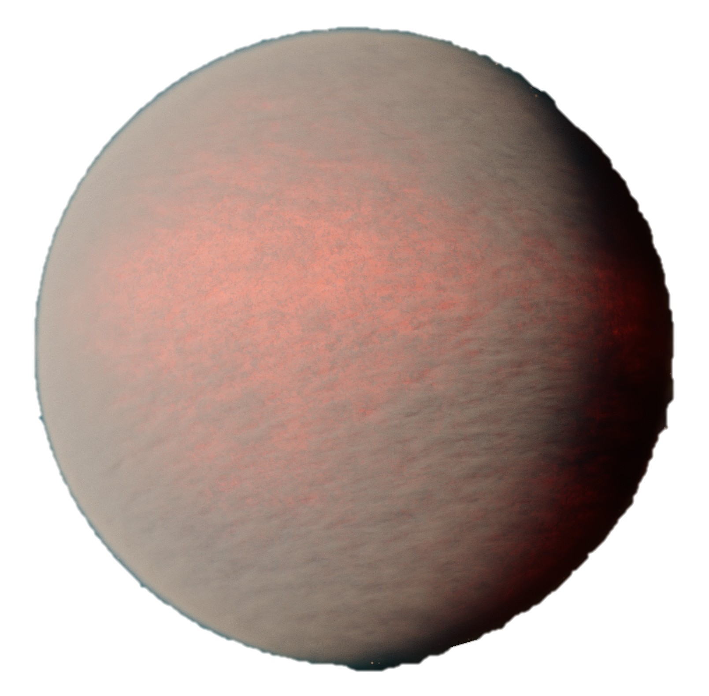
Many variables → Need many observables!
See talk:
Remo Burn
Atmospheric composition
Extreme planets & populations
Density profiles (Love numbers)

Slide 54
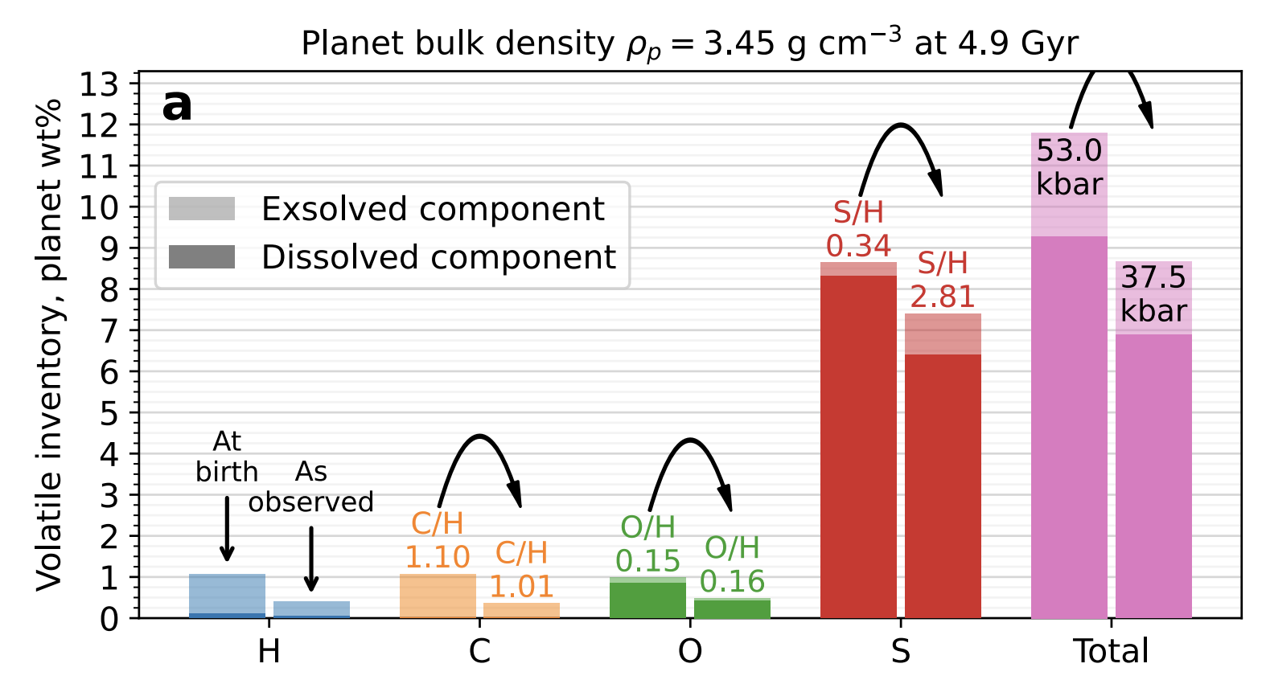
Clues from looking at more than one element
Atmospheric evolution of
L 98-59 d
Nicholls+2026

Slide 55
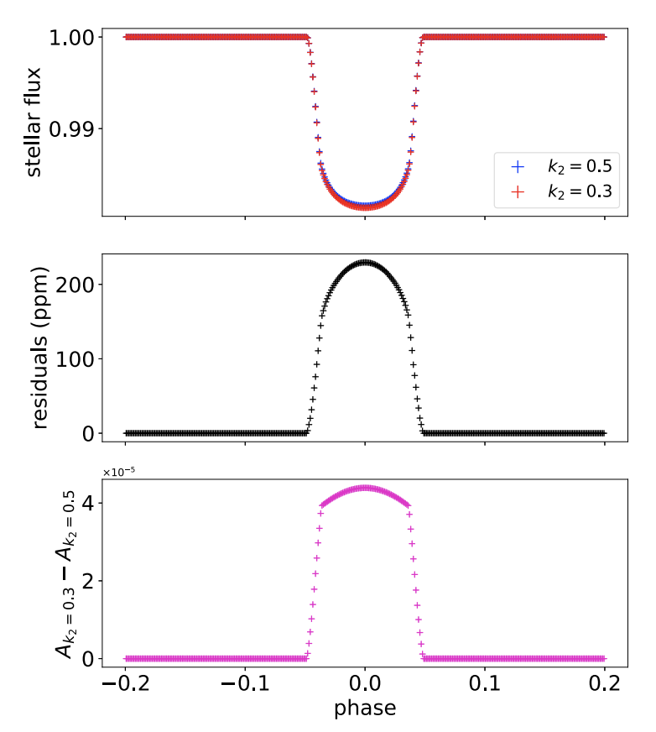
Density profiles / Love numbers
See also JWST GO-7188, PI: Lorena Acuña
Low k₂ Love number
High k₂ Love number
Hellard+2019, see also Akinsanmi+2019

Slide 56
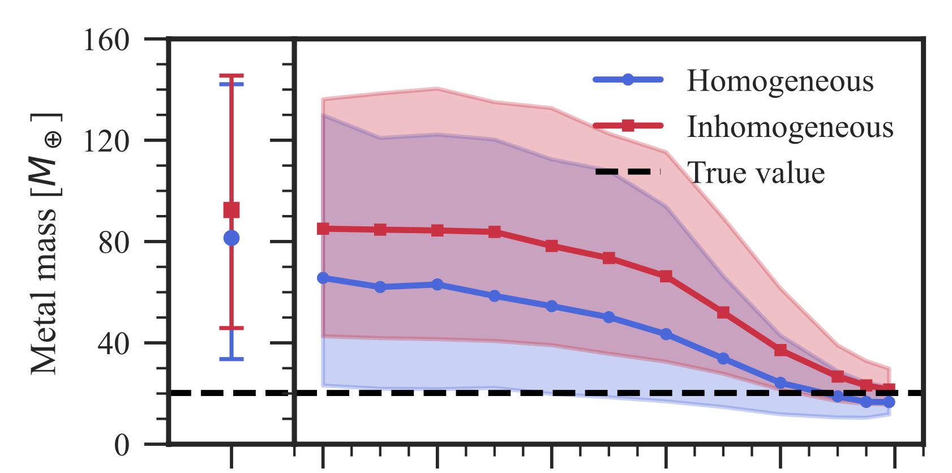
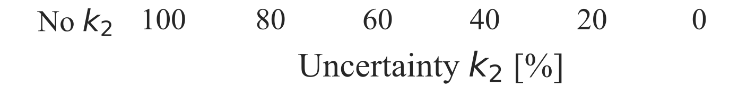
Density profiles / Love numbers
See also JWST GO-7188, PI: Lorena Acuña
Knowledge of the k₂ Love number can significantly improve constraints on interior properties
Van Dijk & Miguel 2025

Slide 57
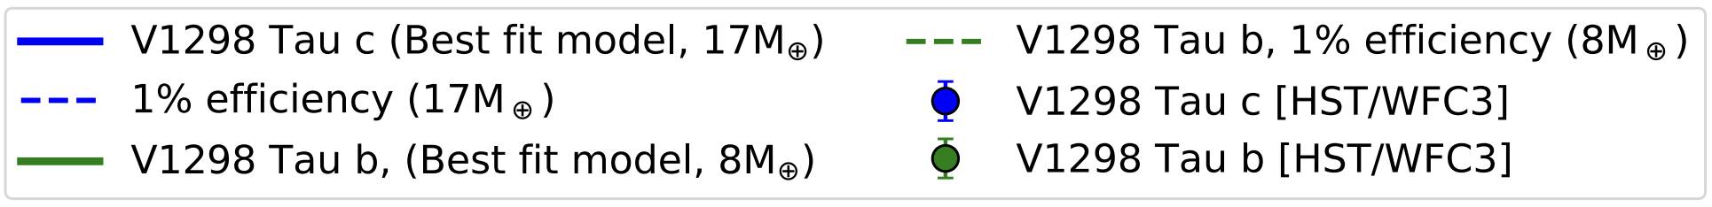
Probing extremes: young planets
Neptune/sub-Neptune progenitors
Sub-solar to solar metallicities found with HST
Glimpse at planets before significant atmospheric loss?
V 1298 Tau b,c, Barat+2024
see also KRONOS JWST program (PIs: Feinstein & Welbanks)

Slide 58
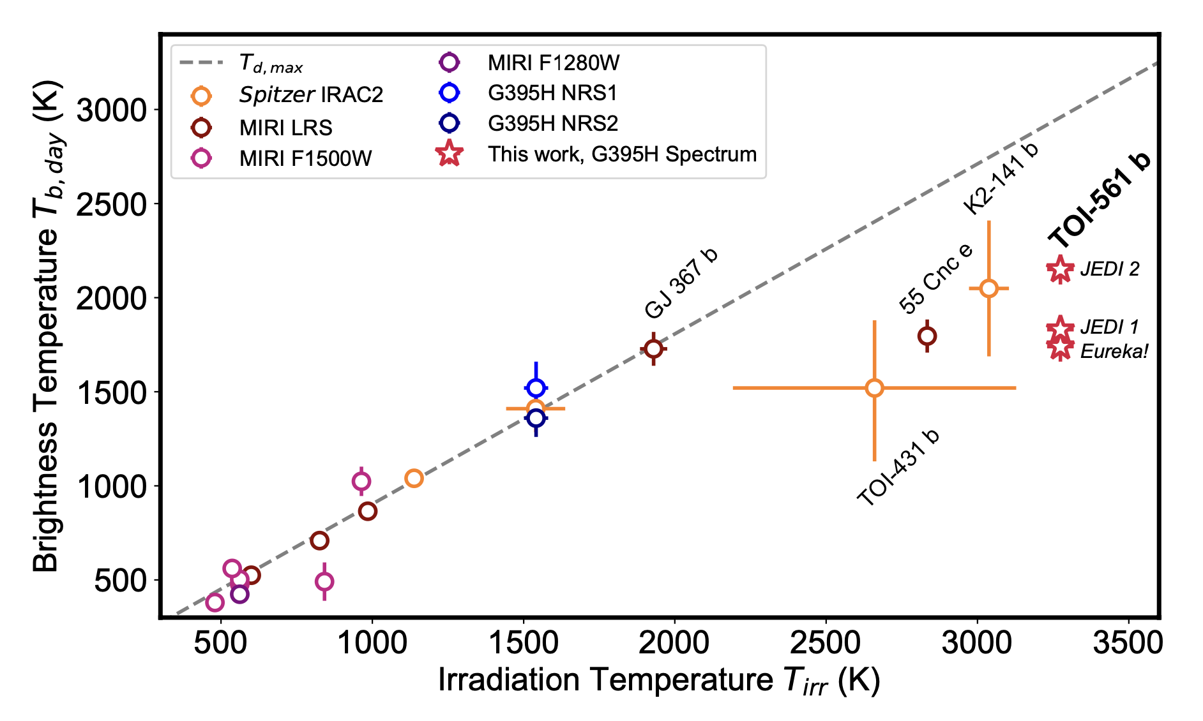
Probing extremes: lava worlds
What’s cooling down the hottest lava worlds?
Outgassing thick secondary atmospheres?
Reflective clouds?
Teske+2025

Slide 59
Atmosphere-interior interactions are a group effort!
Atmosphere = boundary condition
Atmospheric composition, aerosols, mixing all matter
High pressure properties are key!
Mantle & core can store a lot of volatiles, which impacts atmospheric observables
Many variables → need many observables
E.g. abundances of different elements, Love numbers, populations of exoplanets
Observations
Models
Experiments

