Slide 1
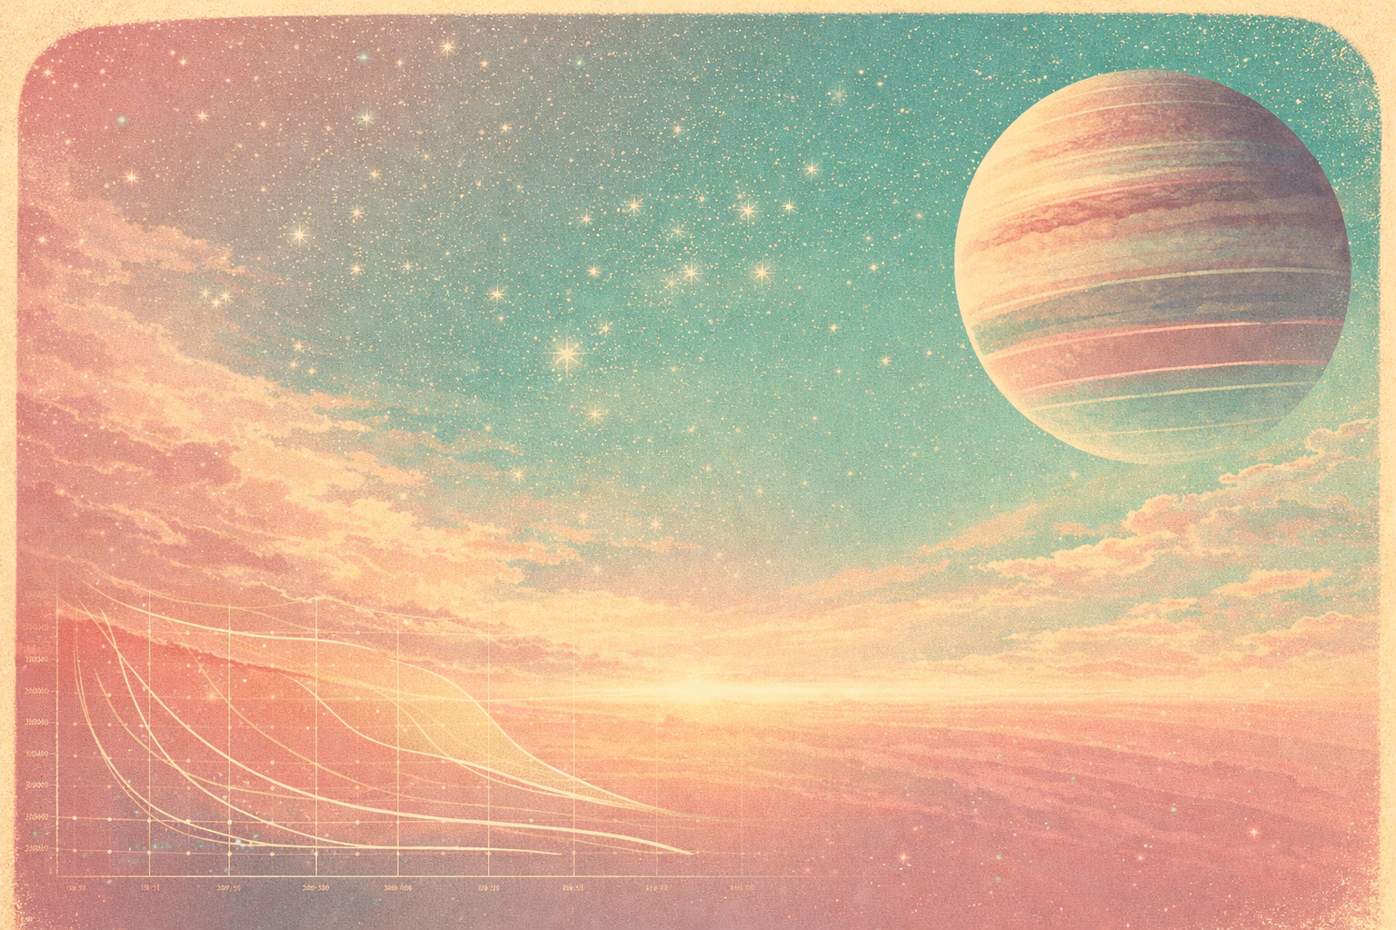
Opacities
and their impact on the interior, atmosphere-interior connections and evolution of giant planets
Yamila Miguel & Louis Siebenaler
Leiden Observatory
SRON
Layers of Understanding, Heidelberg 2026

Slide 2

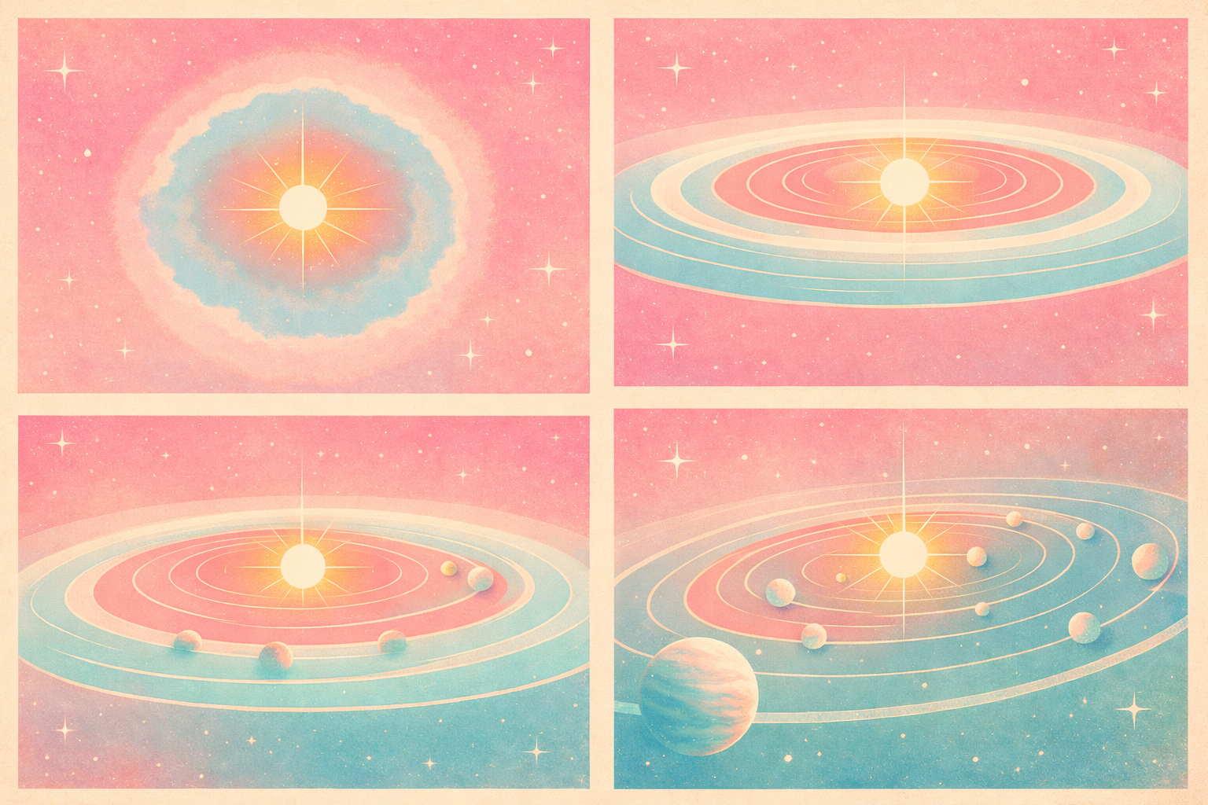


AIM: Characterise Planets to learn about planetary physics, their evolution and origins
Yamila Miguel – Leiden Observatory | SRON

Slide 3
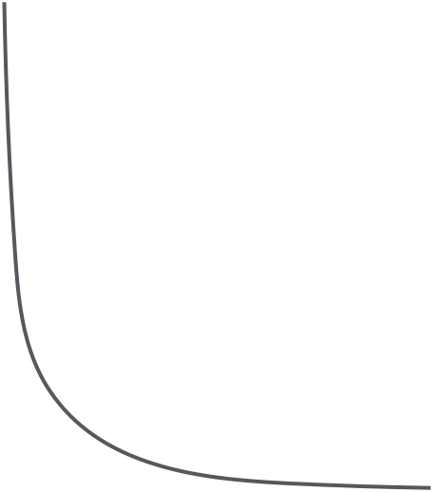
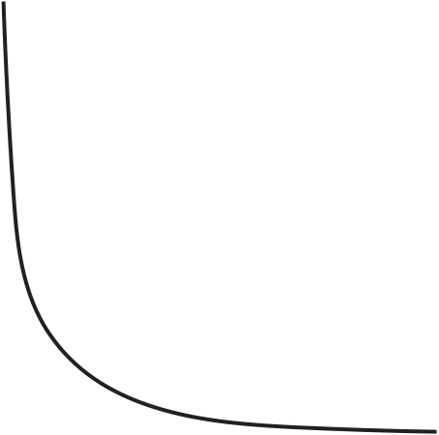




Opacities,
Why do we care?
01
They Control the temperature structure
Set how efficiently radiation is transported
02
Pressure
They determine the radiative vs. convective regions
Determine the radiative-convective boundary
Determine the presence of radiative regions (Louis talk!)
Influences mixing
03
Regulate the planetary cooling and evolution
Affect the inferred age, entropy and internal structure
04
They determine what observations probe
Spectra are filtered by opacity at different wavelengths
Determine the radius of gaseous planets
$$κ$$
05
They Impact atmospheric dynamics
Radiative timescale depends on opacity
Affects day–night heat redistribution
temperature
Yamila Miguel – Leiden Observatory | SRON

Slide 4

However, opacities depend on wavelength and RT calculations are computationally expensive.
Use pre-tabulated opacity tables!
Yamila Miguel – Leiden Observatory | SRON

Slide 5
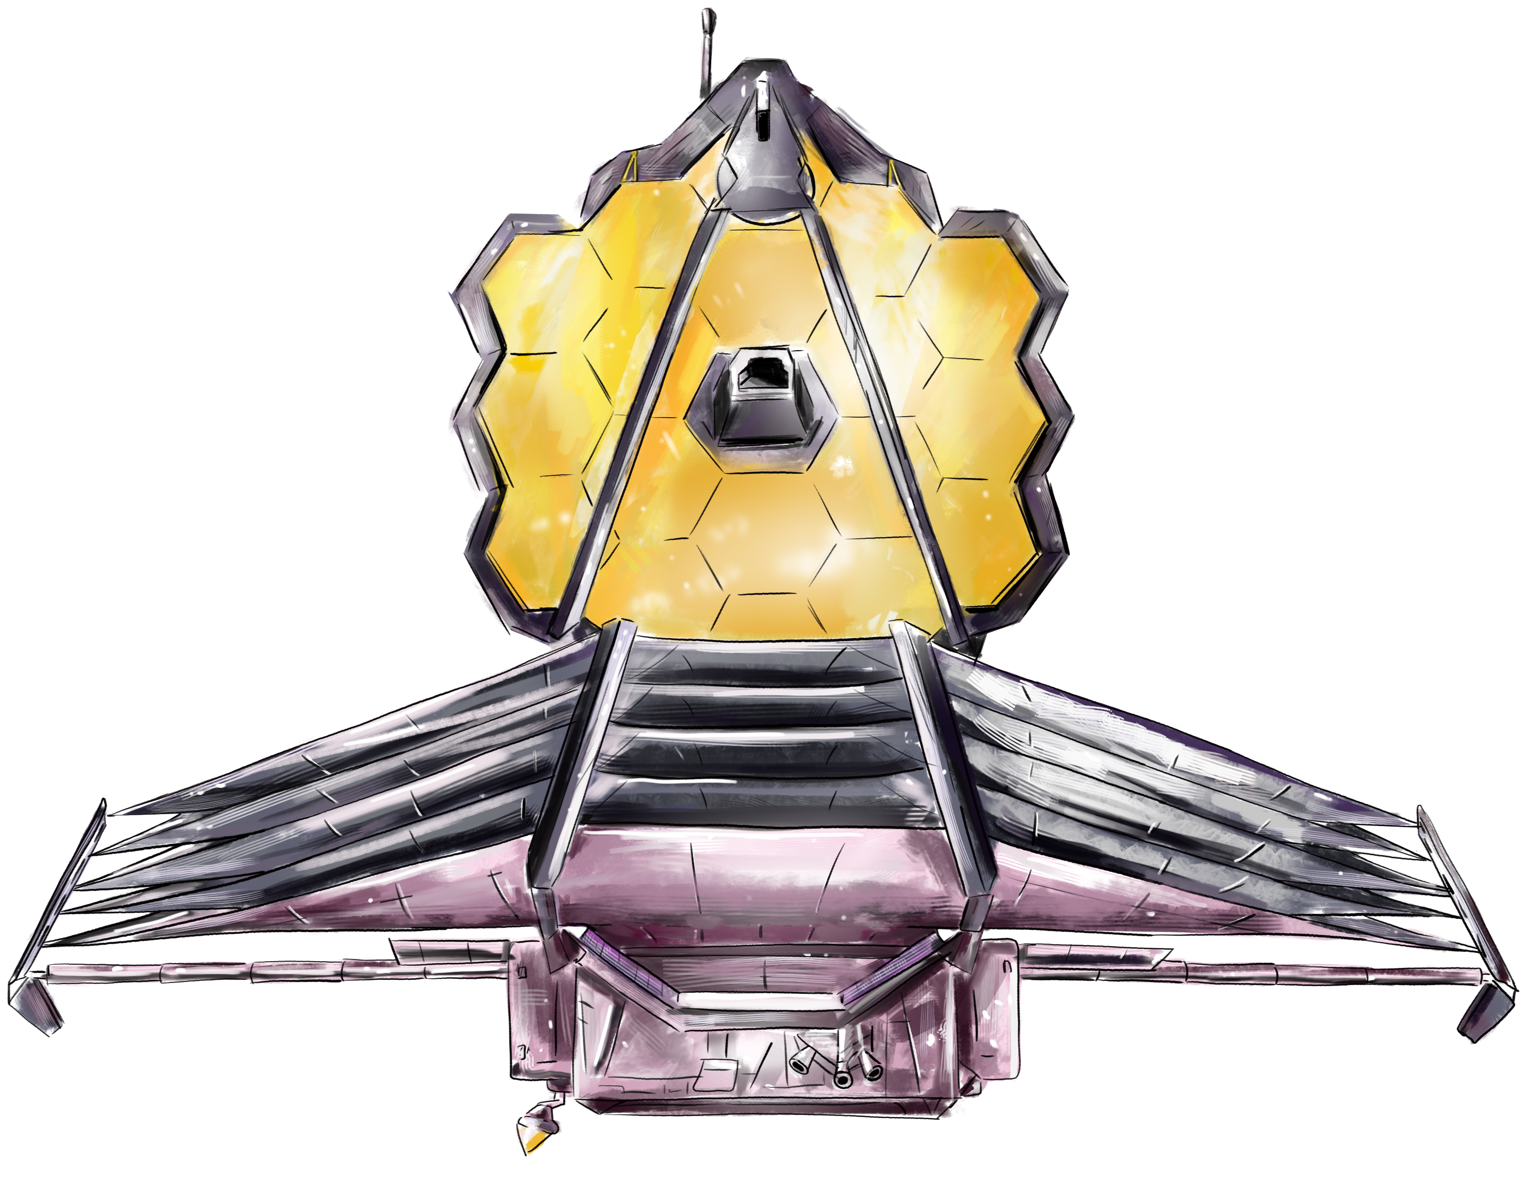
Previous work
The most common ones are:
Freedman, Marley & Lodders (2008)
Freedman et al. (2014)
The main difference with ours is:
New and updated opacities from EXOMOL (Tennyson et al. 2024) and HITRAN (Gordon et al. 2022)
Improvements in the sodium and potassium lines (Allard et al. 2016, 2018, 2023, 2024, 2025)
Extended the parameter space (P from 300 to 10000 bars, T from 4000 to 6000 K)
Inclusion of condensate opacities
OTHER TABLES
Malygin et al. (2014)
Marigo et al (2024)
Yamila Miguel – Leiden Observatory | SRON

Slide 6
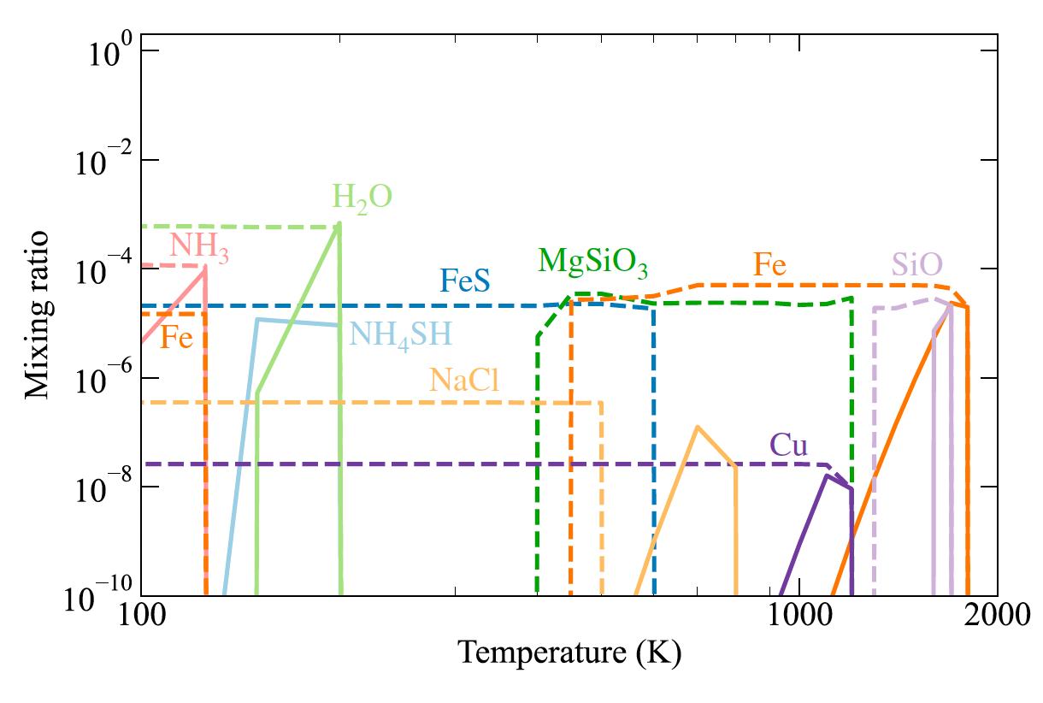
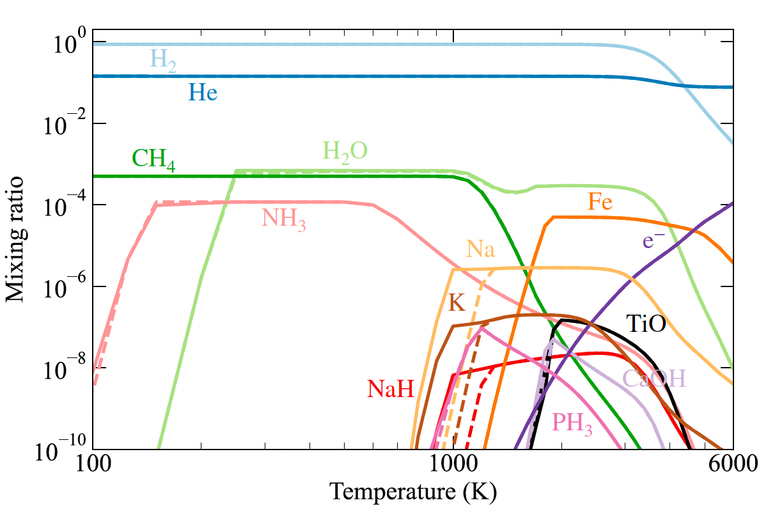

Methods: Chemistry calculations
SIEBENALER & MIGUEL (2026)
step 01
step 02
  DEFINE THE GRID
  100 < T < 6000K
  1e-6 < P < 1e5 bars
  0.1 < $λ$< 500 $μ$m
  [M/H] = −0.5 , −0.3 , 0 , +0.3, +0.5, +0.7, +1.0, +1.5, +1.7
  Particle sizes: 0.01, 0.05, 0.1, 0.5, 1, 2, 5, 10, and 50μm
CHEMISTRY CALCULATIONS
Chemical equilibrium
Condensates with rainout approximation
Yamila Miguel – Leiden Observatory | SRON

Slide 7
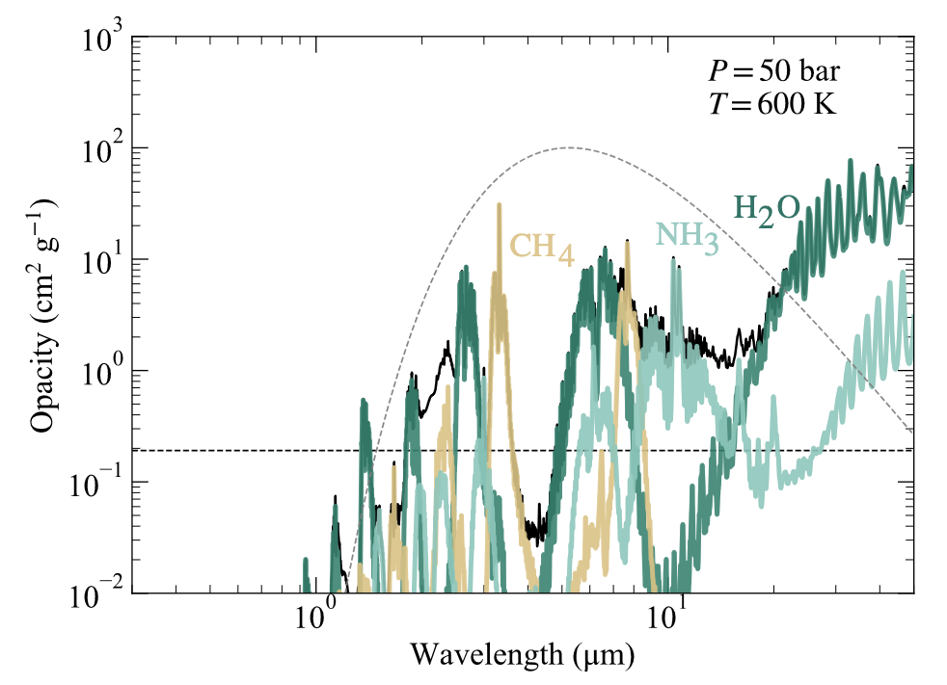
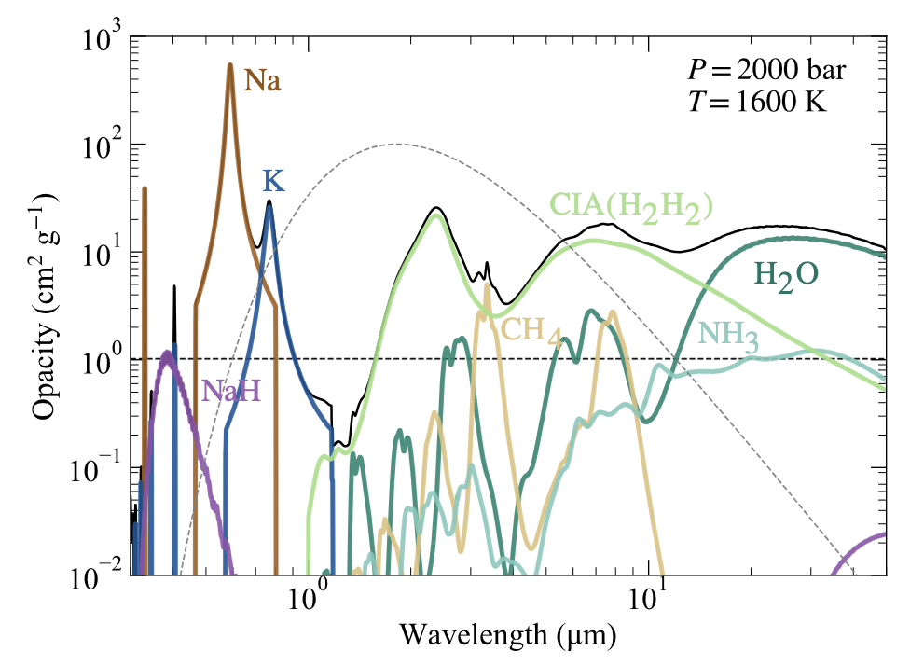
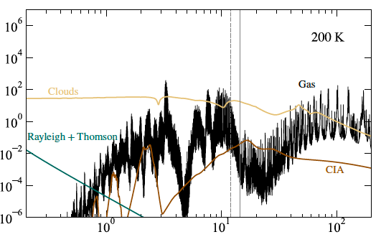
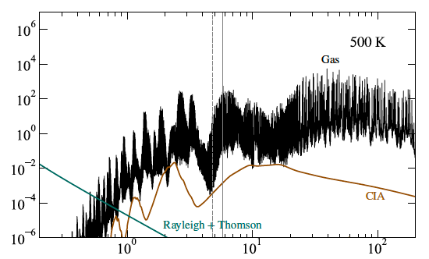

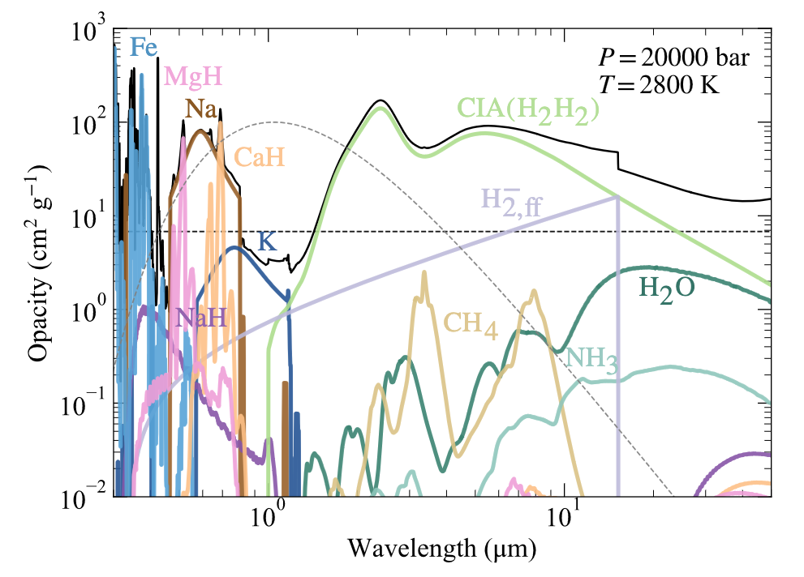
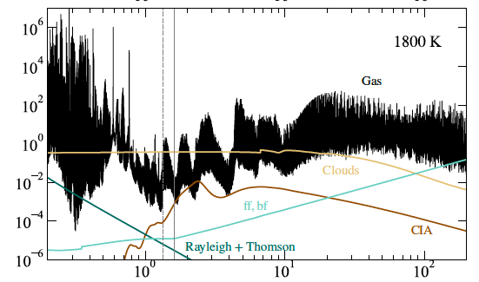
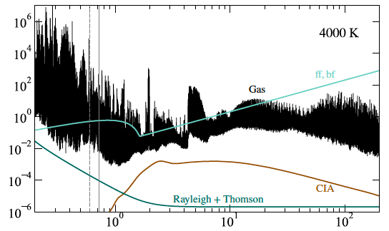



Methods: opacities
SIEBENALER ET AL. (2025)
SIEBENALER AND MIGUEL (2026)
B$λ$(600K)
B$λ$(1600K)
step 03
SUMMARY RELEVANT SOURCES
OF OPACITY (SOLAR) AT
Low T and P: Clouds, H₂O, CH₄, NH₃
Medium T and P: Na, K, CIA(H2-H2)
High T and P: Clouds or ff, bf, Fe, MgH, CaH, Na, K
B$λ$(2800K)
OPACITY CALCULATIONS
Absorption cross section of atoms (11), molecules (34), condensates (26) and CIA (8), ff and bf interactions (11)
Scattering cross sections
Yamila Miguel – Leiden Observatory | SRON

Slide 8

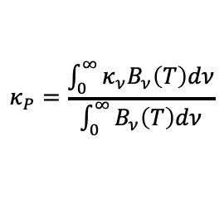
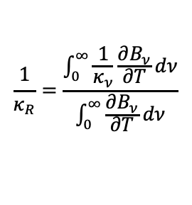
Methods: Mean opacities
step 04
Planck
ROSSELAND
$$κ_{P}=\frac{\int_{0}^{∞}{κ_{ν}B_{ν}\left(T\right)dν}}{\int_{0}^{∞}{B_{ν}\left(T\right)dν}}$$
$$\frac{1}{κ_{R}}=\frac{\int_{0}^{∞}{\frac{1}{κ_{ν}}\frac{∂B_{ν}}{∂T}dν}}{\int_{0}^{∞}{\frac{∂B_{ν}}{∂T}dν}}$$
MEAN OPACITIES
Optically thin regimes
Useful for describing thermal emission and cooling
Optically thick regimes
Useful for describing radiative energy transport
Yamila Miguel – Leiden Observatory | SRON

Slide 9
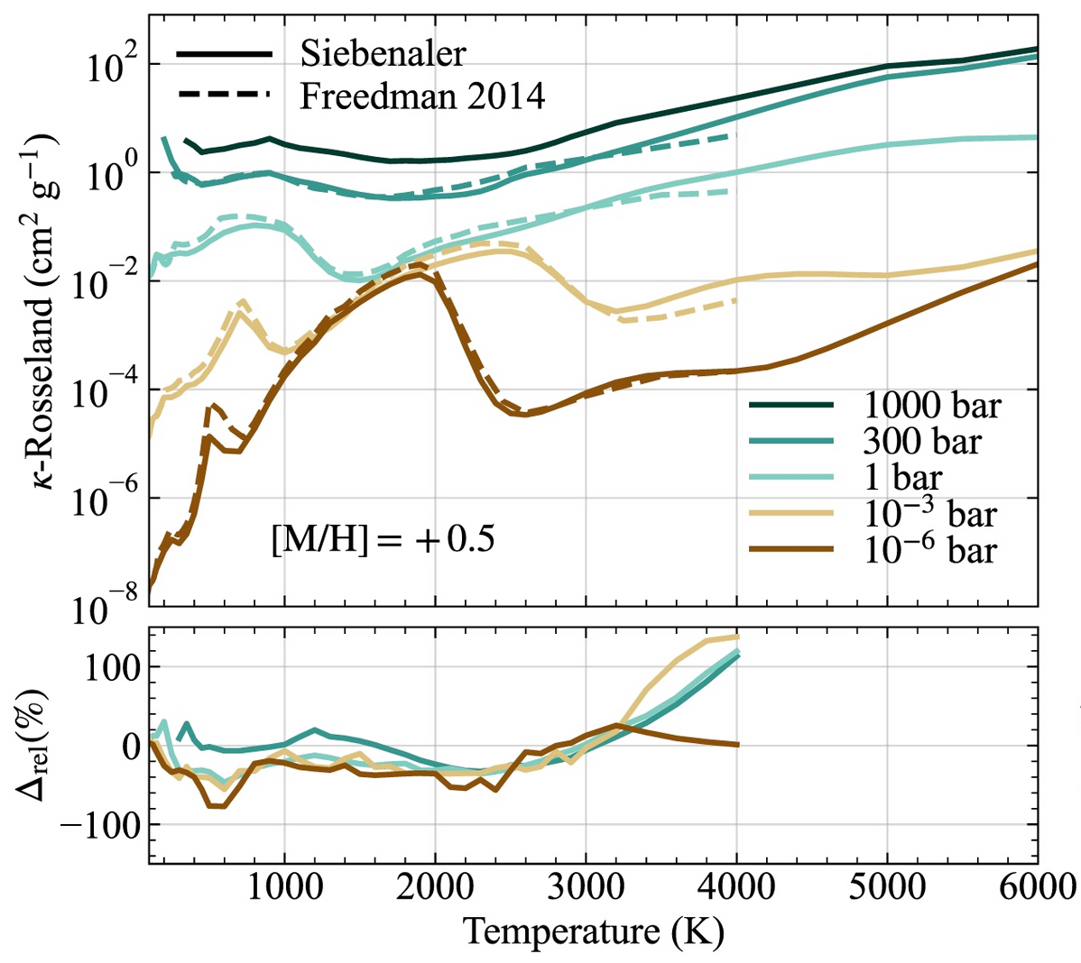
Results
Cloud-free rosseland
SIEBENALER & MIGUEL (2026)
Yamila Miguel – Leiden Observatory | SRON

Slide 10
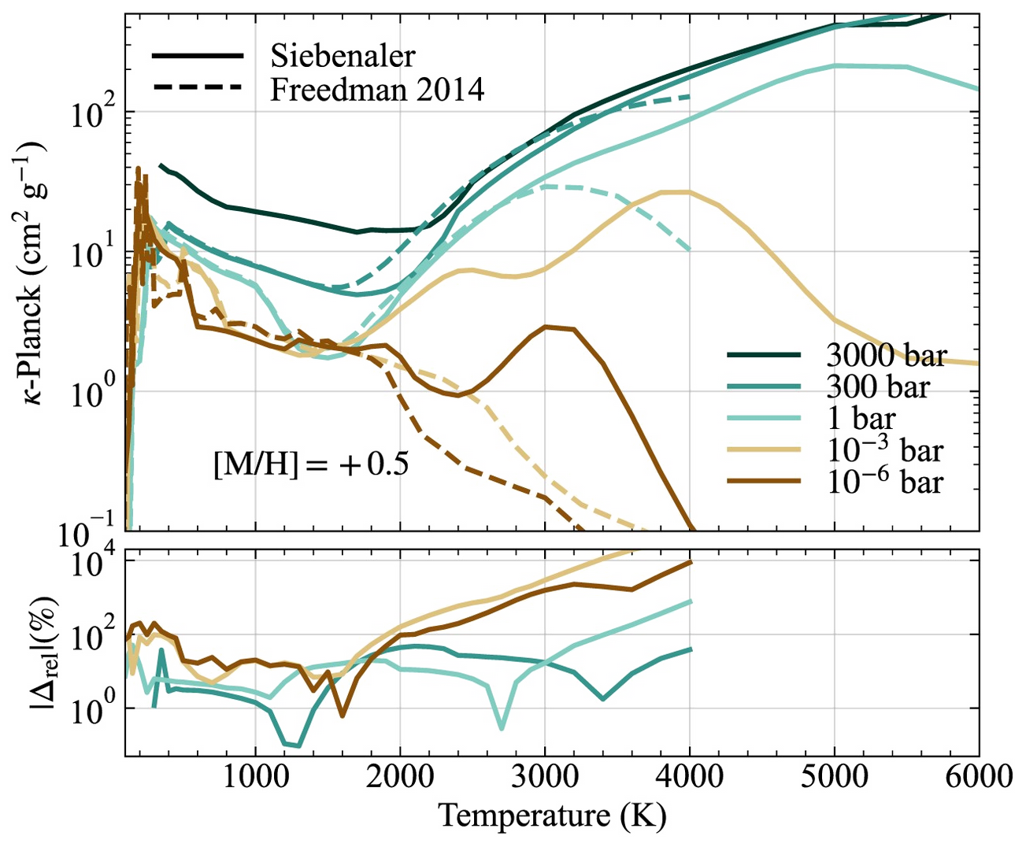
Results
Cloud-free PLANCK
SIEBENALER & MIGUEL (2026)
Yamila Miguel – Leiden Observatory | SRON

Slide 11
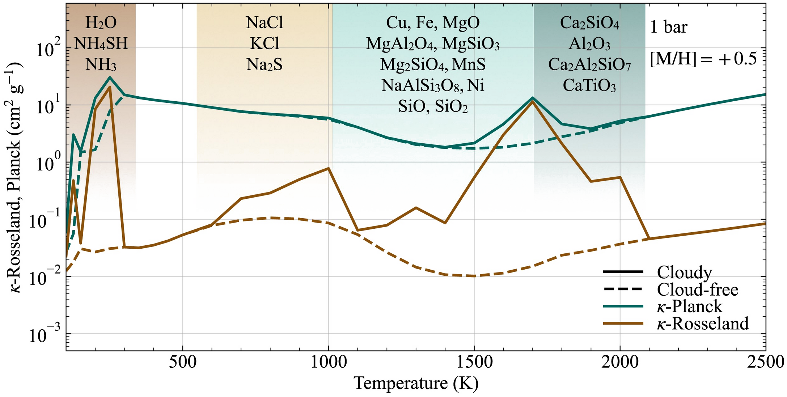
Results
Cloudy opacities
SIEBENALER & MIGUEL (2026)
Yamila Miguel – Leiden Observatory | SRON

Slide 12
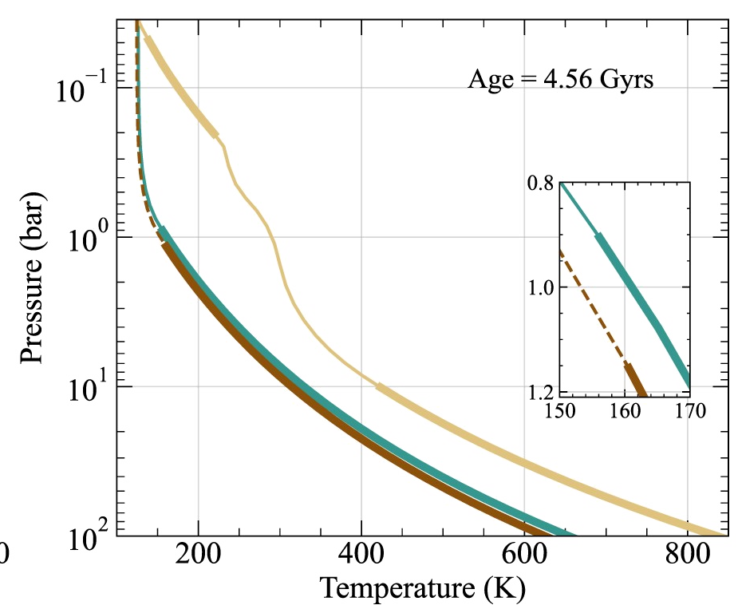
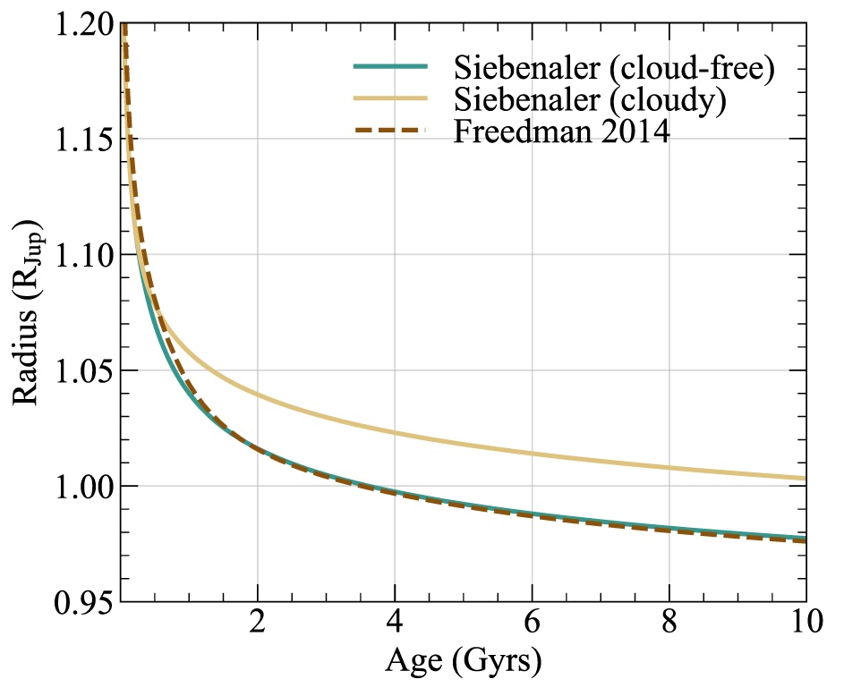
Applications
SIEBENALER & MIGUEL (2026)
Yamila Miguel – Leiden Observatory | SRON

Slide 13




Take home messages
01
Opacities control planetary structure, evolution, and interpretation
Yamila Miguel
Louis Siebenaler
Nicole Allard
Tristan Guillot
SaM de Regt
02
We extend the parameter space significantly
03
Included updated line lists and additional absorbers changes the opacities dramatically
We find differences of up to 100% in Rosseland and of orders of magnitude for Plack means compared with previous tables (Freedman et al. 2014)
04
05
We provide the first publicly available cloudy mean opacity tables using the rainout approach
06
Clouds significantly increase Rosseland, but have a weaker effect on Planck opacities

Slide 14
Discussion

Slide 15
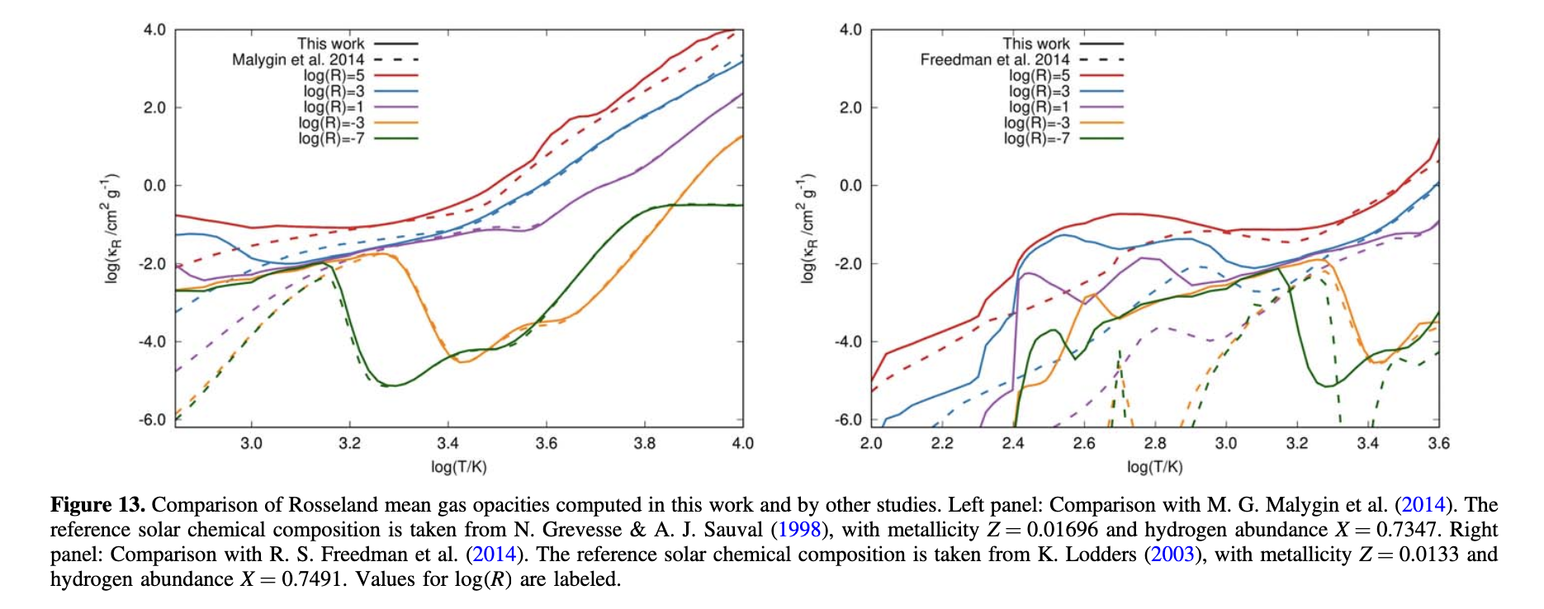

Other tables (in P, $ρ$)
Marigo et al. 2024

