Slide 1
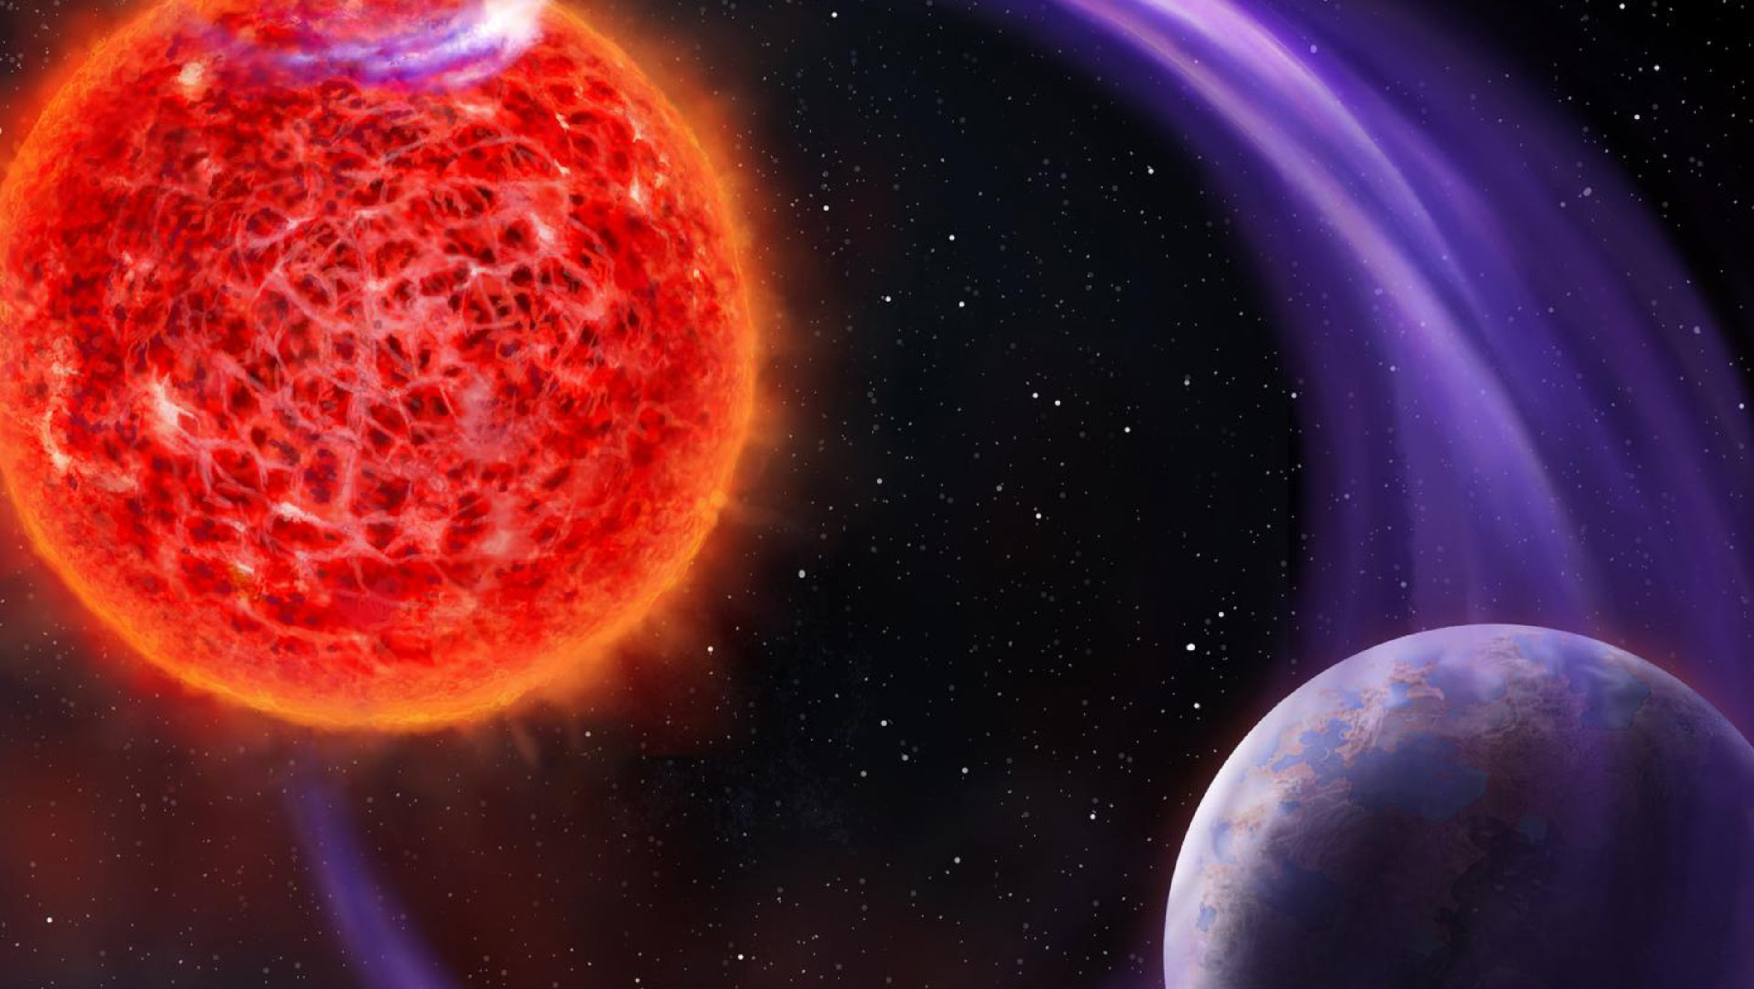
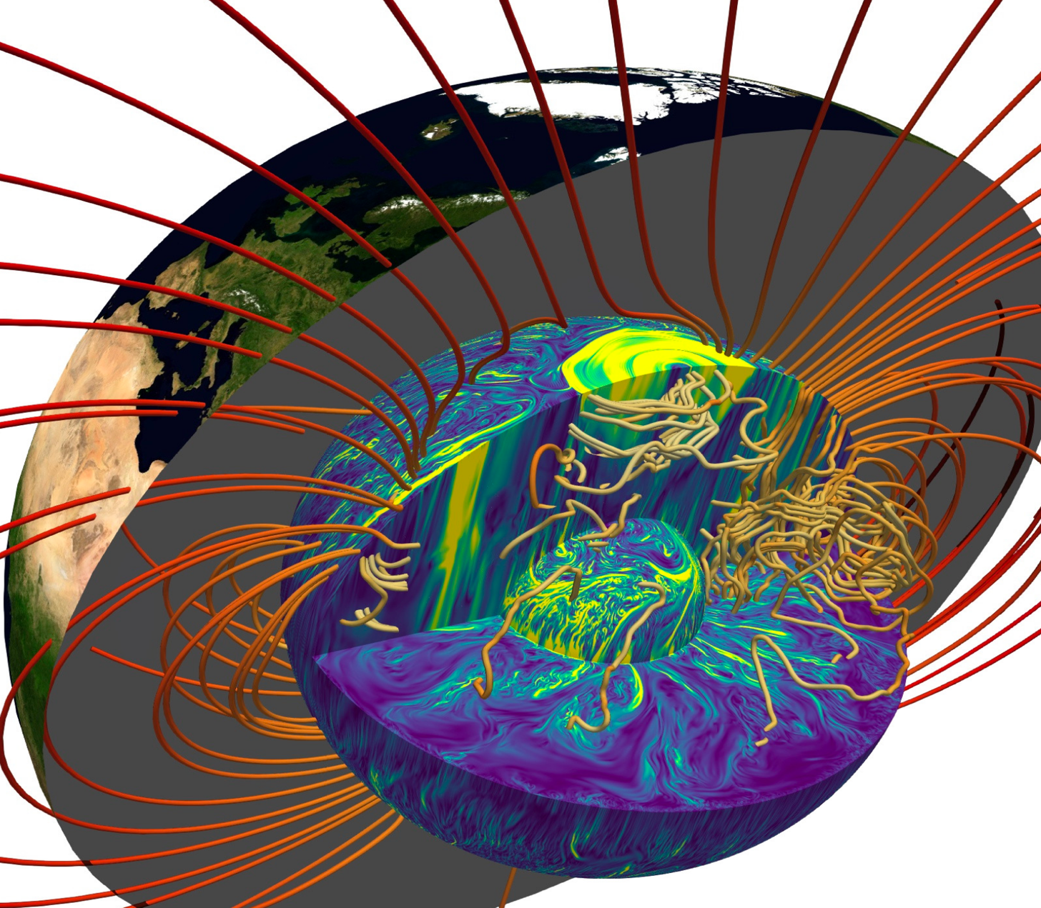



A semi-analytic rocky planetary structure model
(and dynamo action)
Credit: Danielle & Futselaar, Landeau + 2022
Simon Cloutier
(CEA Paris-Saclay)
Antoine Strugarek, Allan Sacha Brun
Layers of Understanding
Heidelberg
March 14th 2026

Slide 2
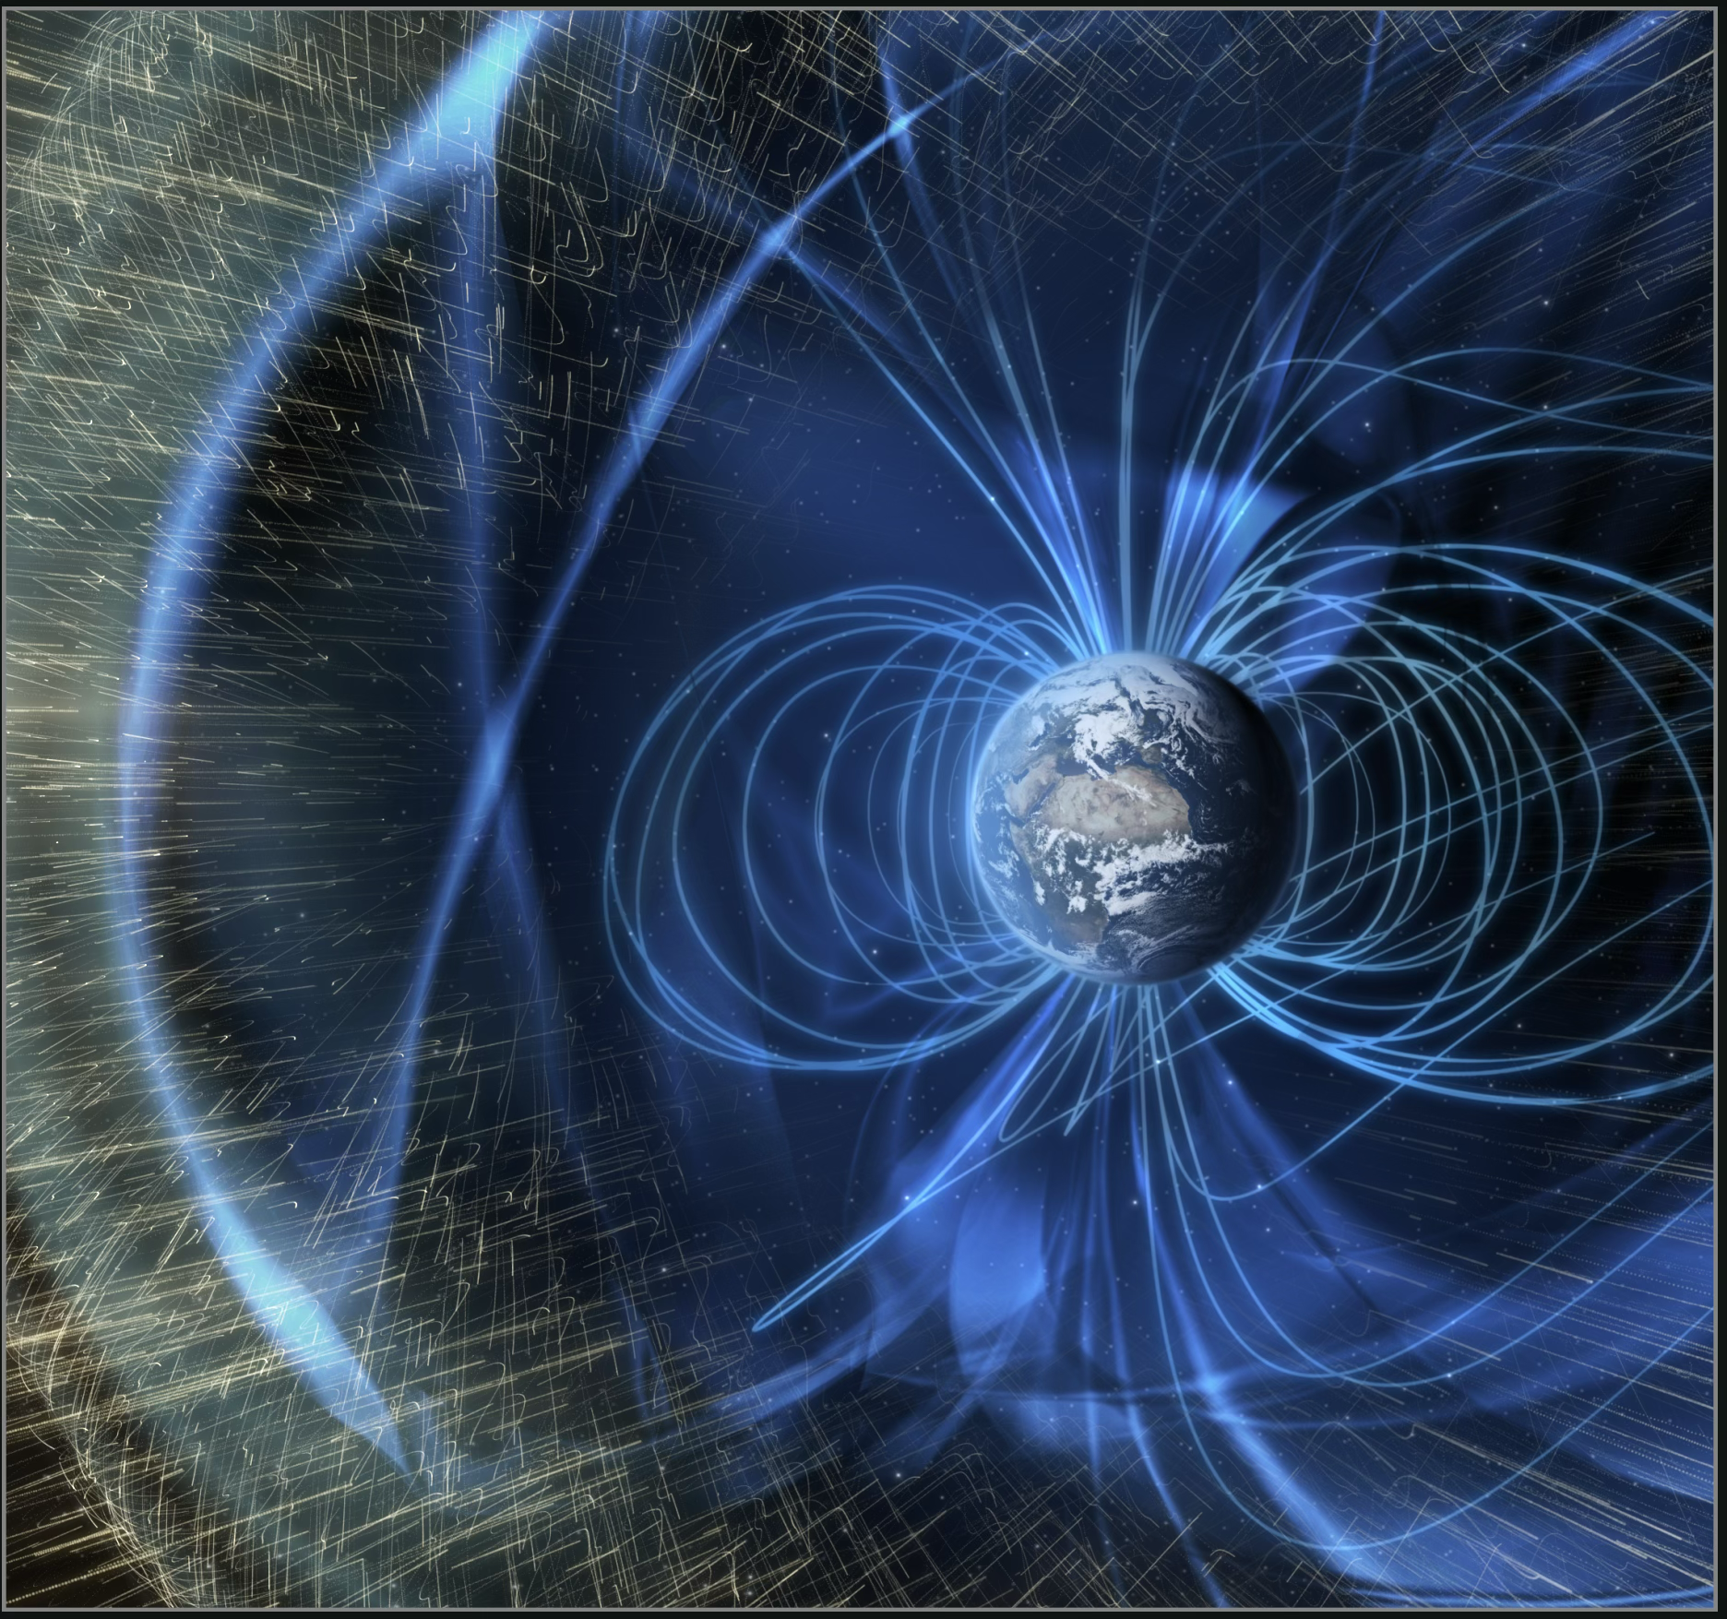
Importance of magnetic fields for rocky planets
Presence of magnetic fields is crucial for atmospheric retention
Mars lost its atmosphere and its water when its dynamo ceased to function?
Magnetic fields are revealing of the planetary structure
Crédit: NASA/GSFC

Slide 3
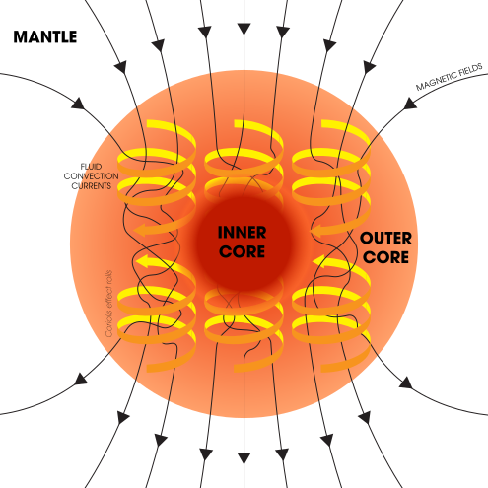
Magnetic field generation in rocky planets
Magnetic induction through turbulent flows in the metallic core (so at least partially liquid)
Two sources of convection:
Thermal convection (superadiabatic temperature profile)
Compositional convection (existence of a solid inner core expulsing light elements: density jump at ICB).
Main candidates for the light elements in the Earth’s core (5-10% wt – Birch 1952): Si, O, S (Hirose+ 2013)
Important:
All of Si, O and S contribute to decrease the core’s density
But only O significantly contributes to the ICB density jump (Alfè+ 2002)
Credit: Andrew Z. Colvin

Slide 4
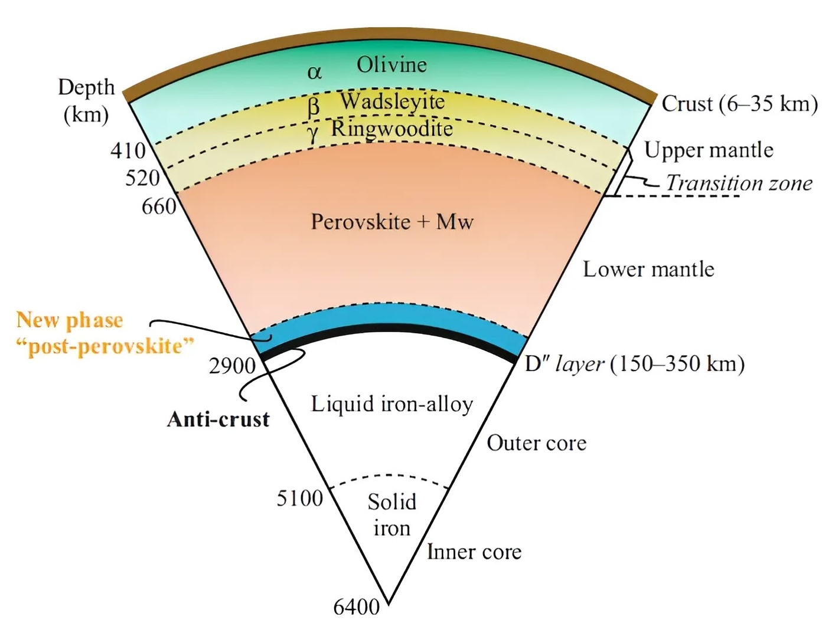

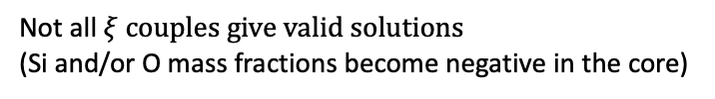
Rocky planet structure model
Input
Mass $M_{p}$
Radius $R_{p}$
Composition $ξ=\frac{Fe}{Mg},\frac{Mg}{Si}$
Sotin+ 2007
Brugger+ 2017
Not all $ξ couples give valid solutions$
(Si and/or O mass fractions become negative in the core)
Output
Inner core size and density jump
Ohmic dissipation
Magnetic field
Credit: Merriam-Webster 2015
Hypotheses
Chemical inventory:
Mantle: Mg, Si, O, Fe
Core: Fe, Ni, Si, O
Structure:
Core + 4 mantle layers
Core completely liquid
Thermal state:
CMB temperature = silicate melting
Fixes thermal age
Plotnykov & Valencia 2020
Inner core determined after by intersection of
adiabatic and melting (Lindemann) temperature curves
Stixrude 2014

Slide 5
Analytic formulation
Poisson equation + Adams-Williamson
(hydrostatic equilibrium + adiabaticity):
Seismic parameter
(pure compression sound speed^2)
Compression length
(∝ Jeans’ length = free-fall timescale ⨉ sound speed)
(generalization of Labrosse+ 2001)
Rocky planets are weakly compressible
→ series expansion solution and keep only first terms
First term core:
Cold logarithmic equation of state:
Mass
Gravity
Pressure
(exactly Eq. 9 of Labrosse + 2001)
Similar procedure for mantle layers
Result: solution family for $ρ_{c}$etc. and composition

Slide 6
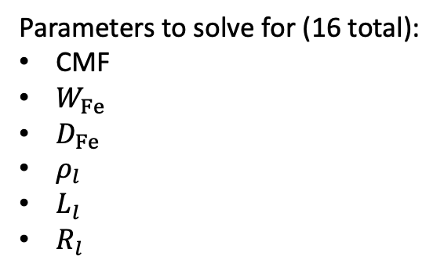
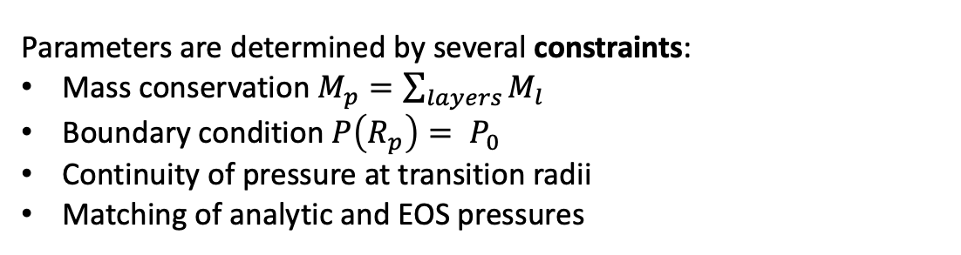
Numerical solution
Parameters to solve for (16 total):
CMF
$W_{Fe}$
$D_{Fe}$
$ρ_{l}$
$L_{l}$
$R_{l}$
Core mass fraction
Bulk iron weight fraction
Iron partition coefficient (core/mantle iron content)
Density at base layer
Compression length of layer
Mantle transition radii
Parameters are determined by several constraints:
Mass conservation $M_{p}=\sum_{layers}{M_{l}}$
Boundary condition $P\left(R_{p}\right)= P_{0}$
Continuity of pressure at transition radii
Matching of analytic and EOS pressures
System of differential equations → system of nonlinear algebraic equations
Solved through least-squares algorithm

Slide 7
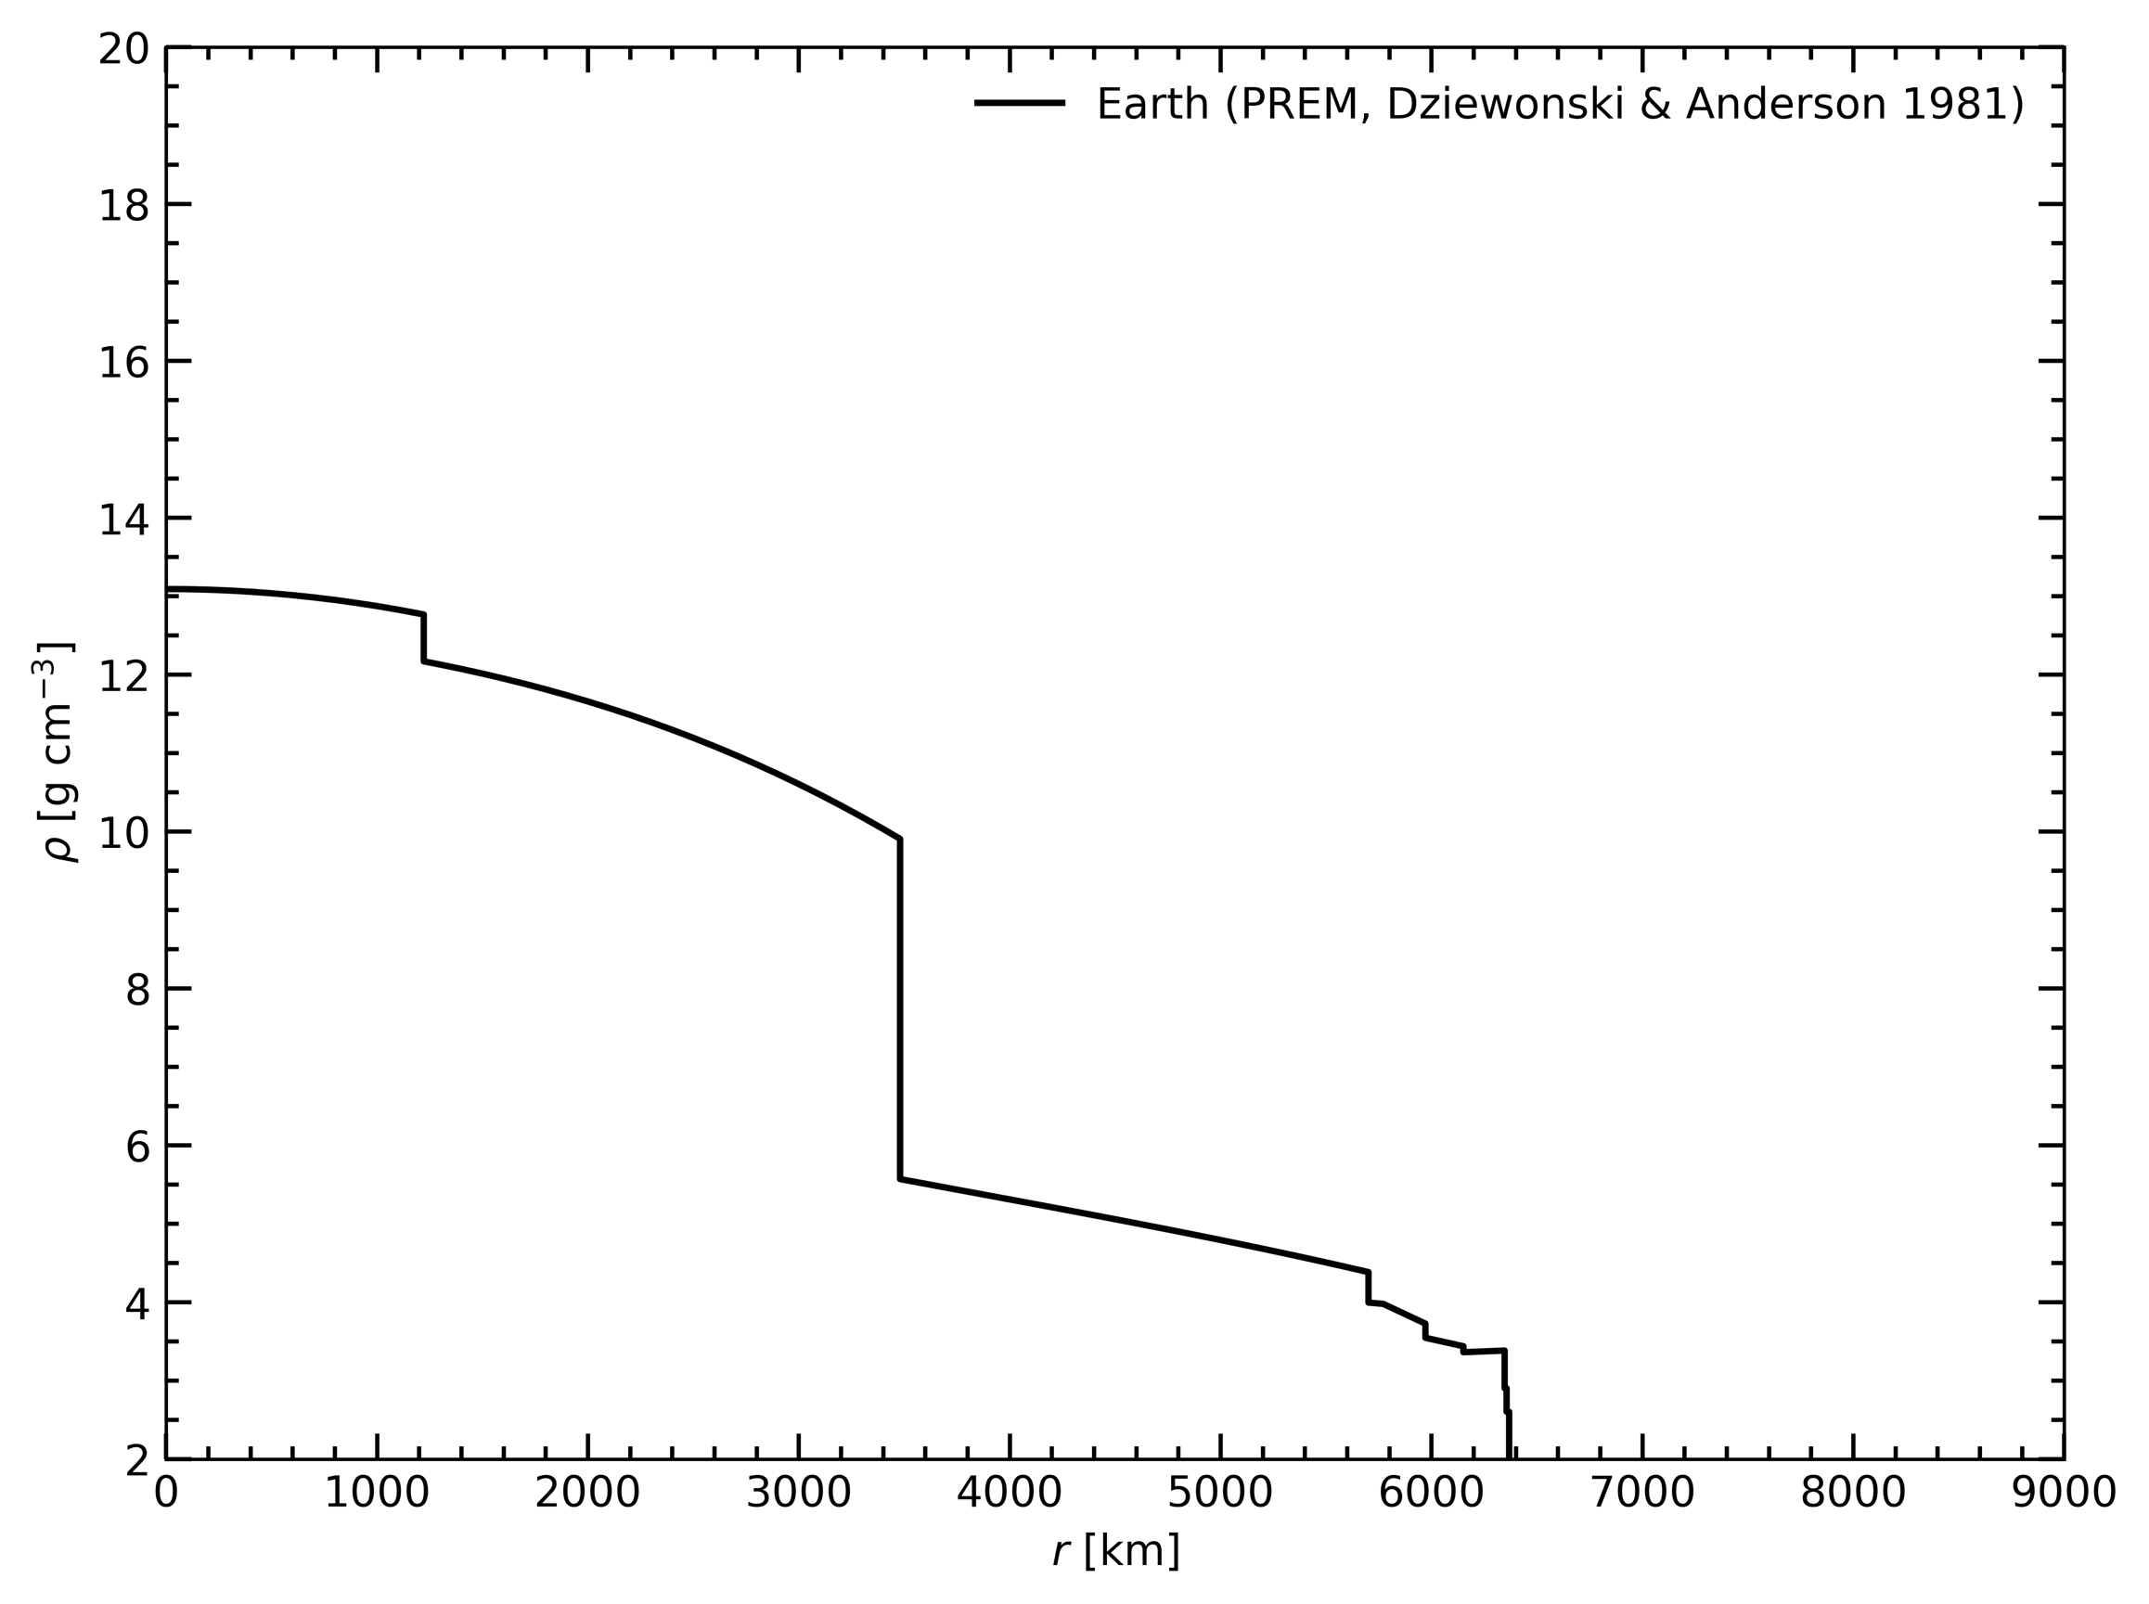
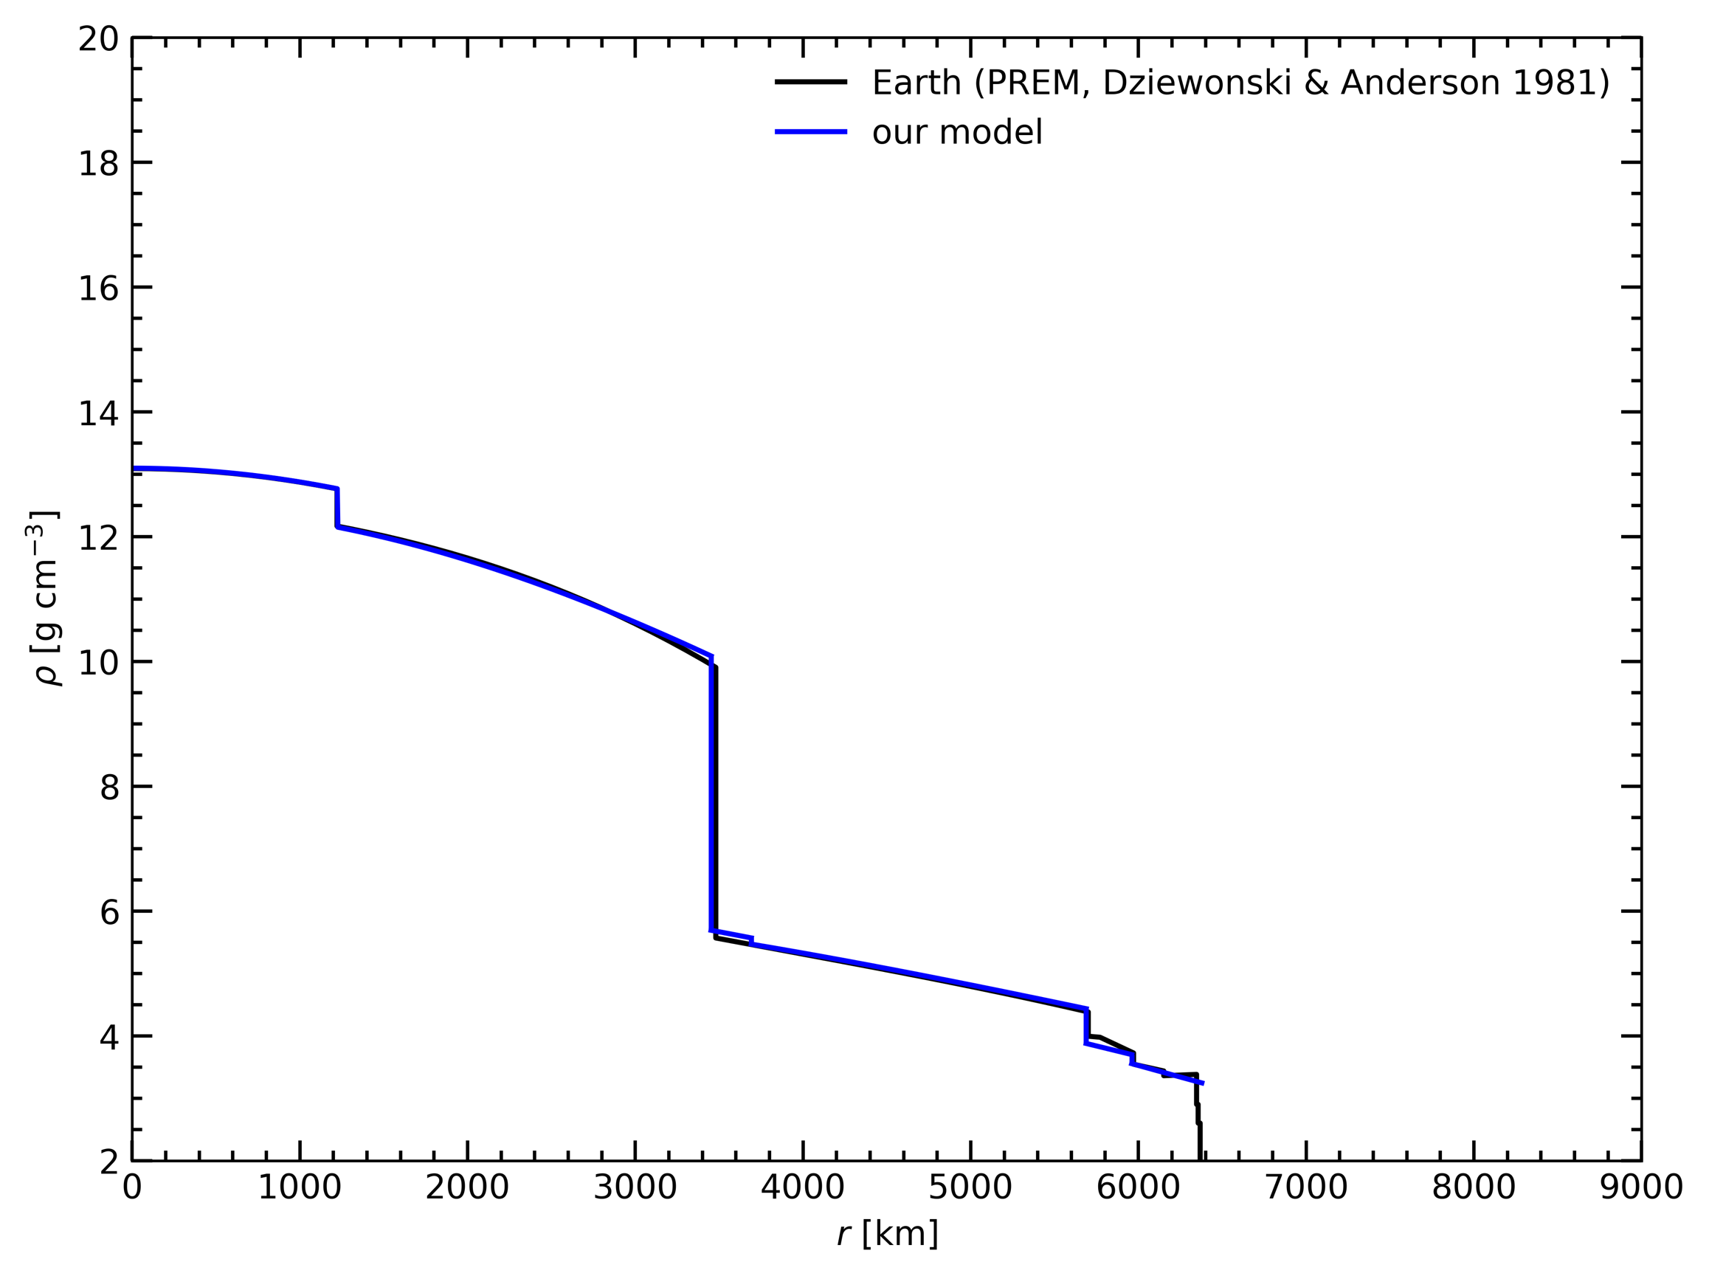
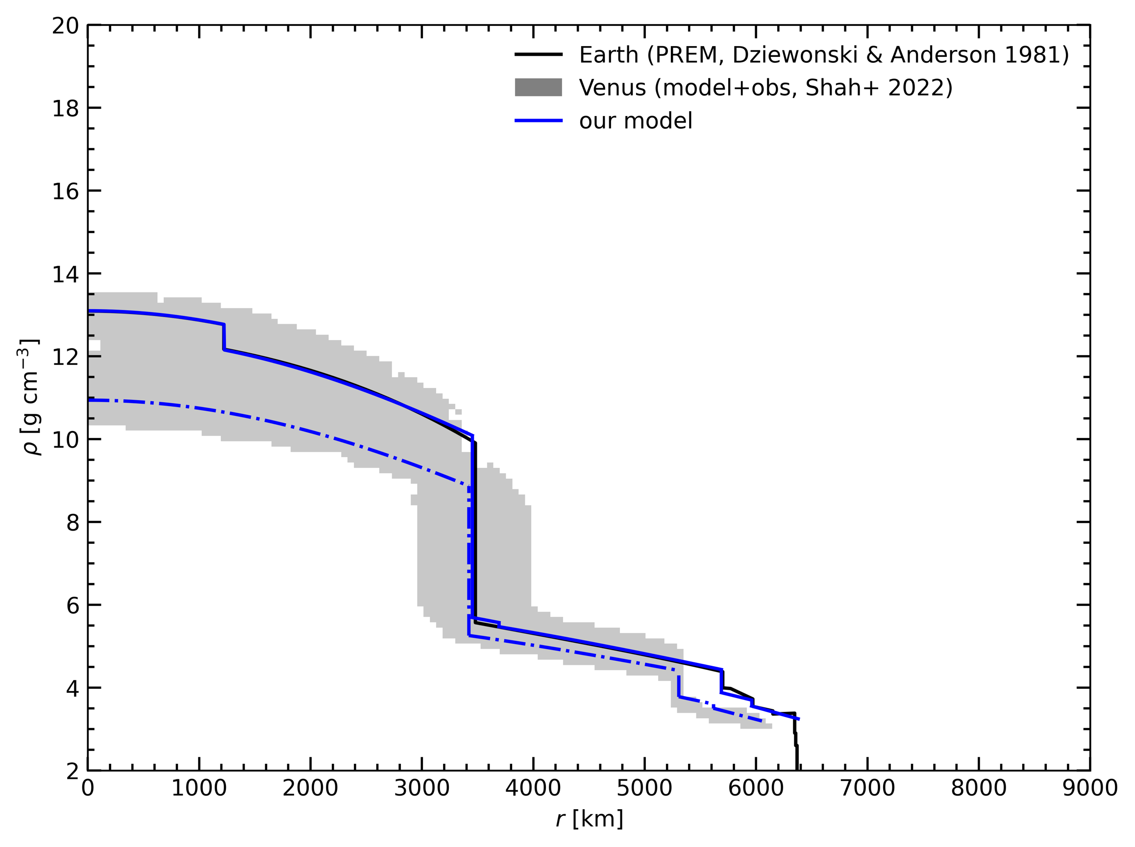
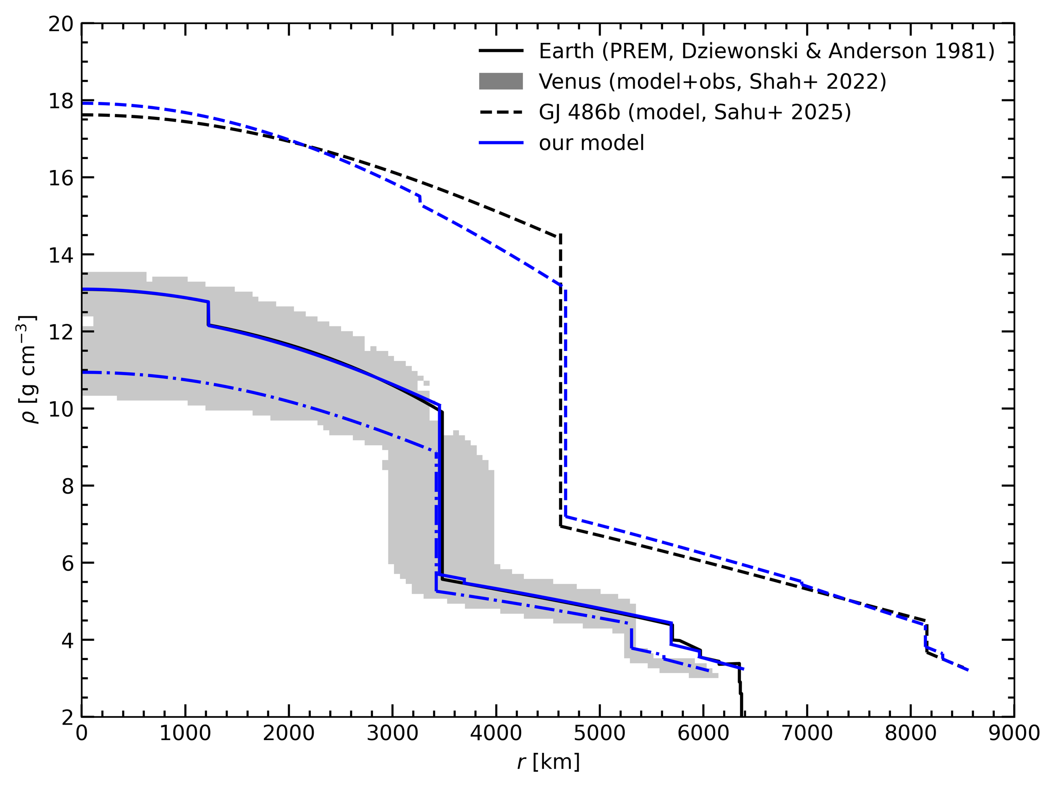
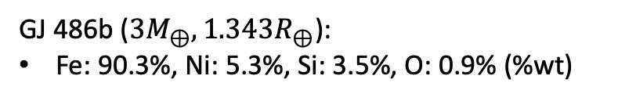
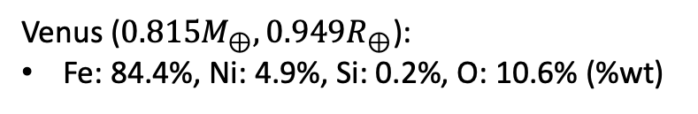
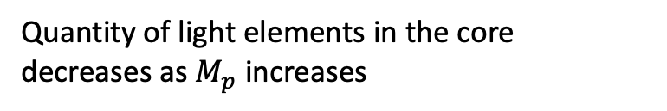
Model validation: Earth, Venus, GJ 486b
Venus (${0.815M}_{⊕}, 0.949R_{⊕}$):
Fe: 84.4%, Ni: 4.9%, Si: 0.2%, O: 10.6% (%wt)
Earth:
Fe: 87.2%, Ni: 5.4%, Si: 3.2%, O: 4.1% (%wt)
GJ 486b (${3M}_{⊕}, 1.343R_{⊕}$):
Fe: 90.3%, Ni: 5.3%, Si: 3.5%, O: 0.9% (%wt)
Quantity of light elements in the core decreases as $M_{p}$ increases

Slide 8
Effect of composition on the size of the inner core
Inner/outer core radius fraction
100% solid
100% liquid
For a given ($M_{p}$, $R_{p}$) the core can be from completely liquid to completely solid depending on the composition

Slide 9
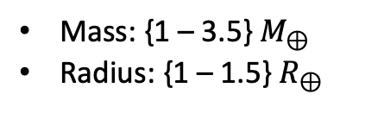
Application of the model to a 4D grid
Mass: {1 – 3.5} $M_{⊕}$
Radius: {1 – 1.5} $R_{⊕}$
Fe/Mg: {1.3 – 2.5}
Mg/Si: {0.9 – 1.6}
Input parameter ranges:
Core mass fraction
Inner/outer core radius fraction
100% solid
Partially solid core
100% liquid
Denser planets have a larger CMF and a larger fraction of their core is solid
Planets with partially solid cores (compositional convection) sit in the middle of the distribution

Slide 10
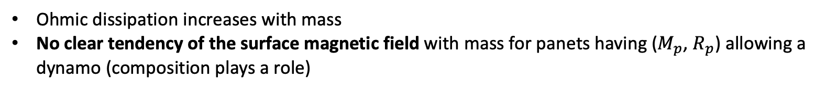
Ohmic dissipation, surface magnetic field
Buffett+ 1996
Christensen & Aubert 2006
Ohmic dissipation increases with mass
No clear tendency of the surface magnetic field with mass for panets having ($M_{p}$, $R_{p}$) allowing a dynamo (composition plays a role)

Slide 11
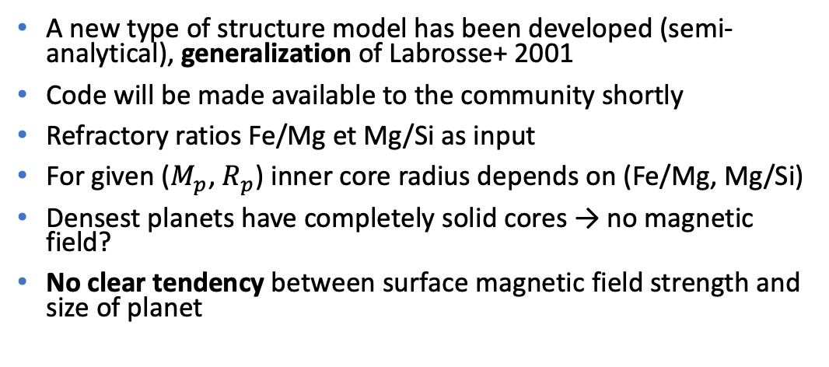
Conclusions and perspectives
A new type of structure model has been developed (semi-analytical), generalization of Labrosse+ 2001
Code will be made available to the community shortly
Refractory ratios Fe/Mg et Mg/Si as input
For given ($M_{p}$, $R_{p}$) inner core radius depends on (Fe/Mg, Mg/Si)
Densest planets have completely solid cores → no magnetic field?
No clear tendency between surface magnetic field strength and size of planet
Extension of the grid to less and more massive planets
Thermal evolution
Exploration of the possible dynamo regimes
Looking for a new postdoc!

Slide 12
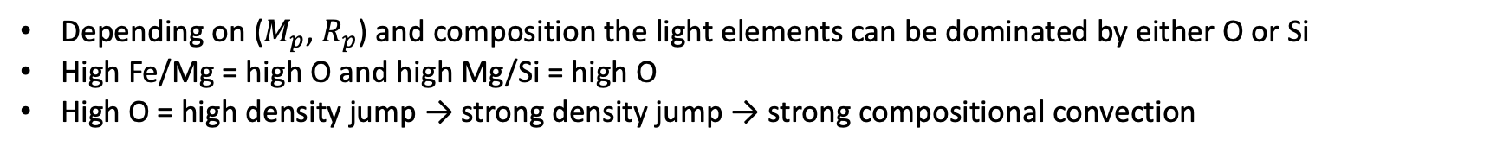
Effect of composition on the fraction of oxygen in the core
100% O
100% Si
Depending on ($M_{p}$, $R_{p}$) and composition the light elements can be dominated by either O or Si
High Fe/Mg = high O and high Mg/Si = high O
High O = high density jump → strong density jump → strong compositional convection

Slide 13
Effect of composition on Ohmic dissipation
Formalism of Buffett+ 1996
Completely liquid cores do not necessarily have much smaller Ohmic dissipations
For the Earth a factor of 2 between low and high oxygen content

Slide 14


Melting depression
Usual melting depression law (e.g. Stevenson+ 1983, Anderson & Duba 1997, Stixrude 2014):
$x:$ molar fraction of solvent
Entropy of melting (Anderson 1995, Stishov 1975):
${ΔV}_{m}:$ volume change upon melting
Clausius-Clapeyron + Lindemann:
Problem: depression law assumes small depression and size of inner core is very sensitive on exact law
Solution: use expression of ${ΔS}_{m}$ to integrate over melting depression
Equation for melting depression

Slide 15
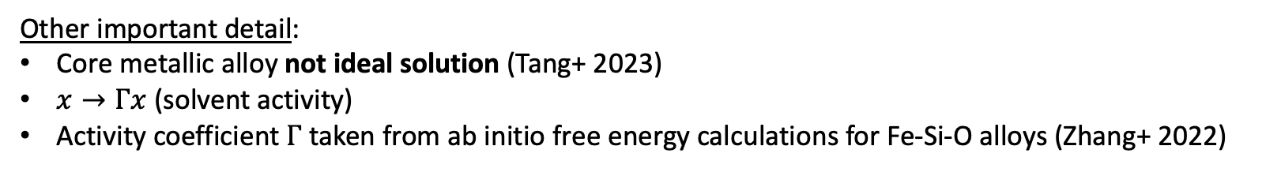
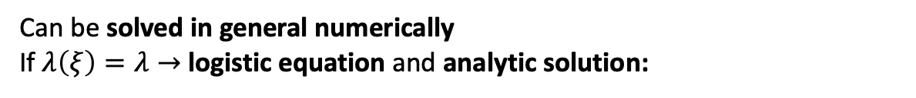
Melting depression
Equation for melting depression
Can be solved in general numerically
If $λ\left(ξ\right)=λ→$logistic equation and analytic solution:
Other important detail:
Core metallic alloy not ideal solution (Tang+ 2023)
$x→Γx$ (solvent activity)
Activity coefficient $Γ$ taken from ab initio free energy calculations for Fe-Si-O alloys (Zhang+ 2022)

Slide 16
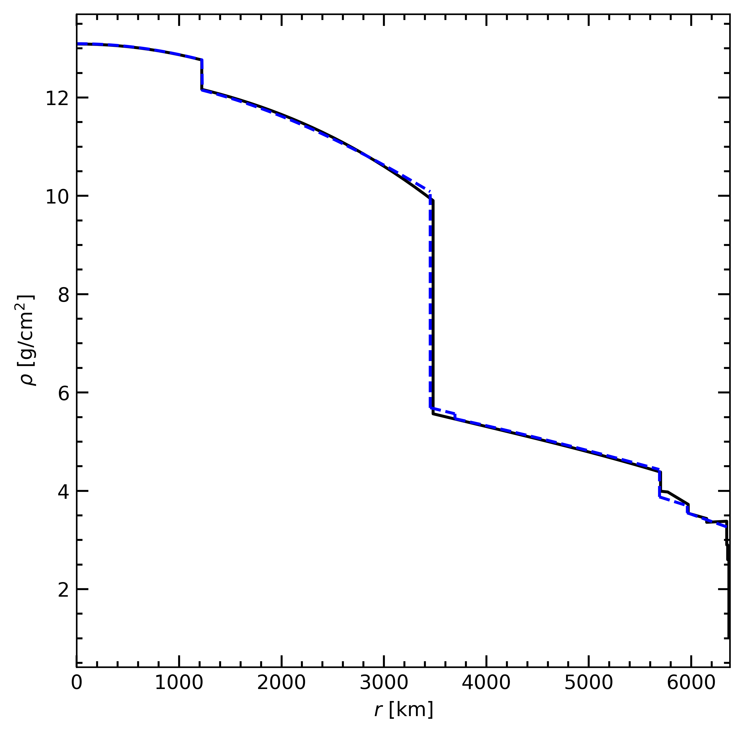
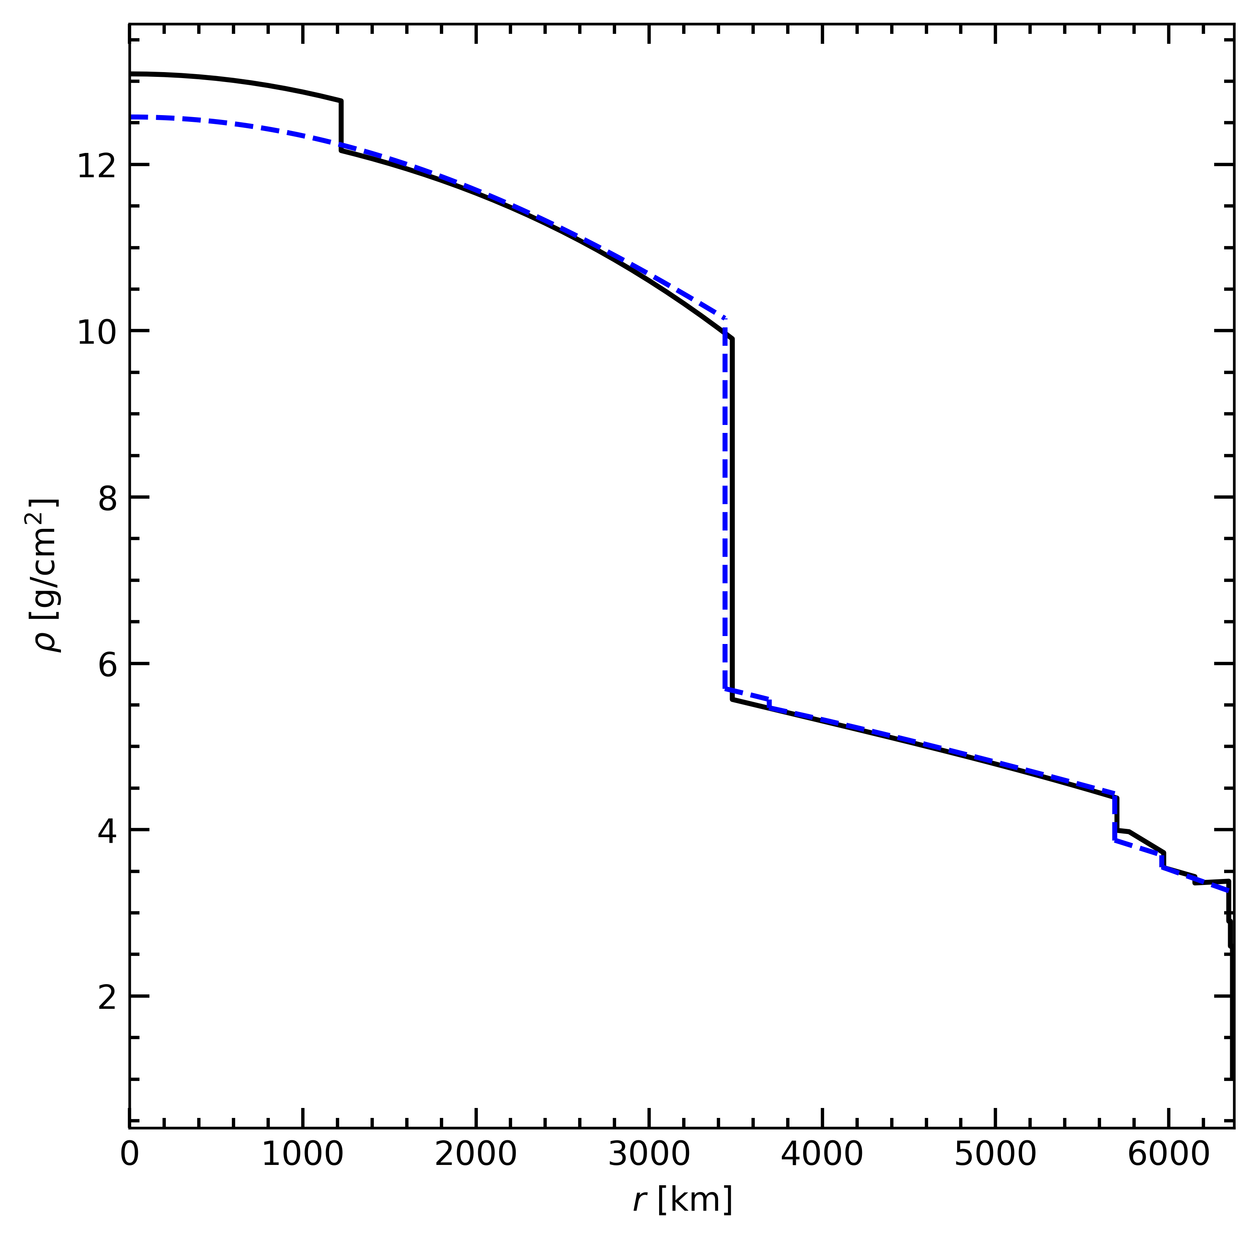

Sensitivity to melting depression law
Core non-ideal + updated depression law
Core non-ideal + old depression law
Core ideal + old depression law
For a given composition can be the difference between sizable inner core and no inner core
Here the setting the CMB temperature to silicate melting compounds the effect

Slide 17
Déduction du champs magnétique
Dissipation Ohmique (Buffet + 1996):
Champs magnétique: loi d’echelle de Christensen & Aubert 2006
Flux d’anomalie de masse

