Slide 1
Mixtures and Solubility
Armin Bergermann

Slide 2
Overview
Motivation: Matter Under Extreme Conditions
Theory: Density Functional Theory and Molecular Dynamics
Results:
  Hydrogen – Helium/Neon Mixtures
  Hydrogen – Carbon Mixtures
  Hydrogen – Water Mixtures
Summary & Outlook

Slide 3
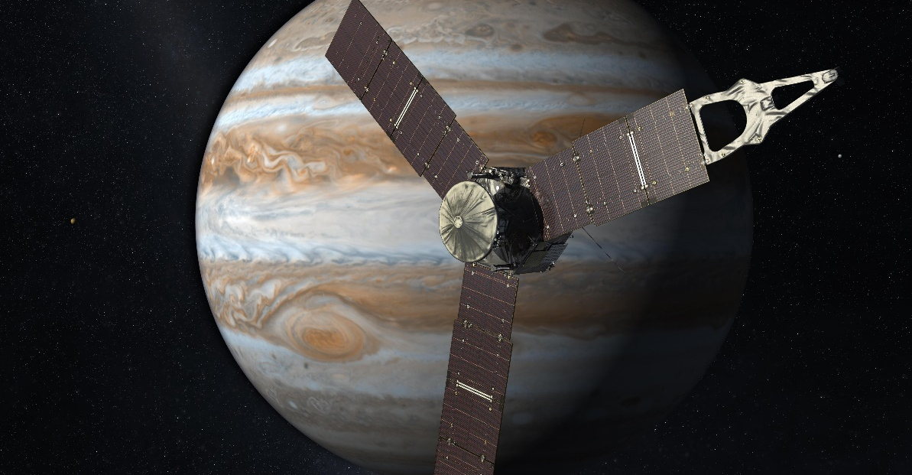
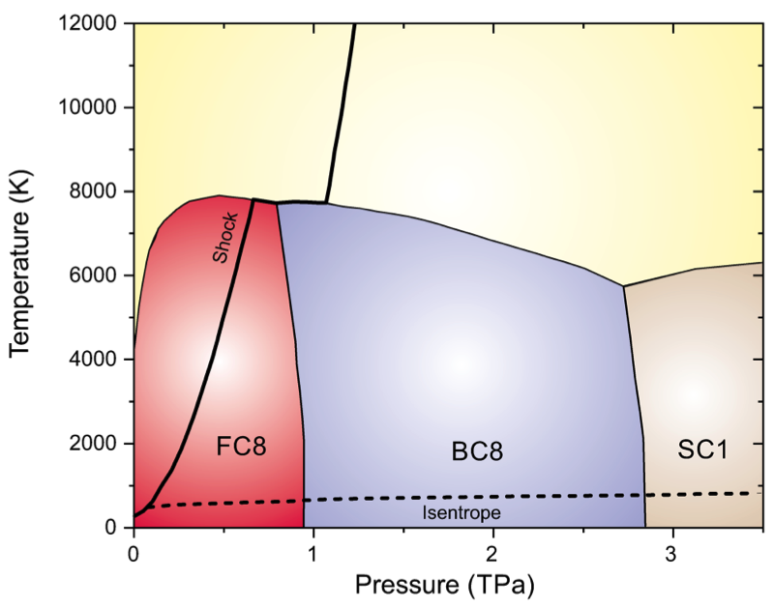
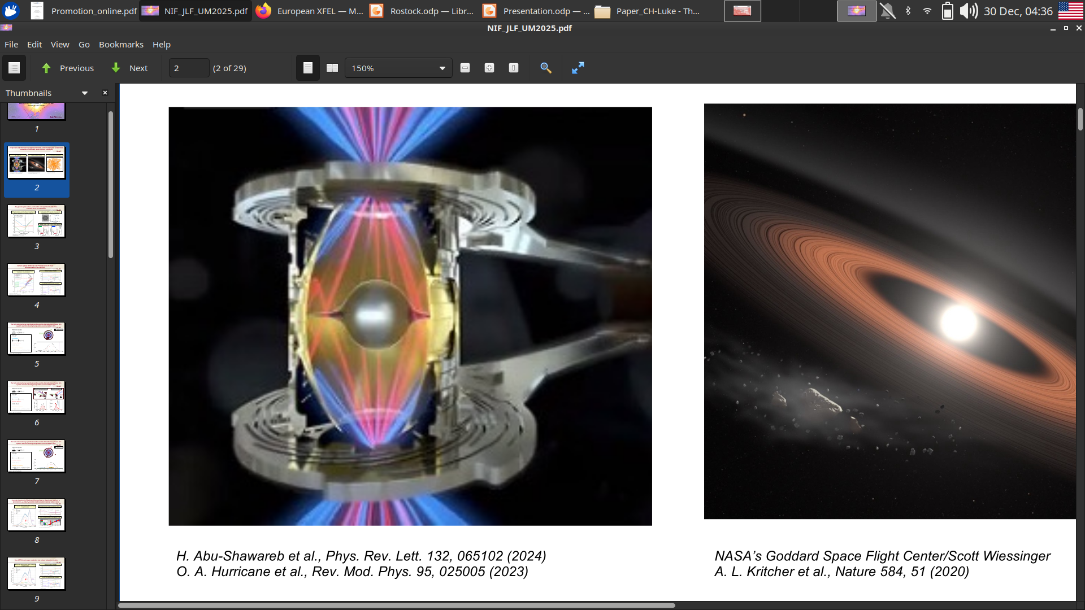
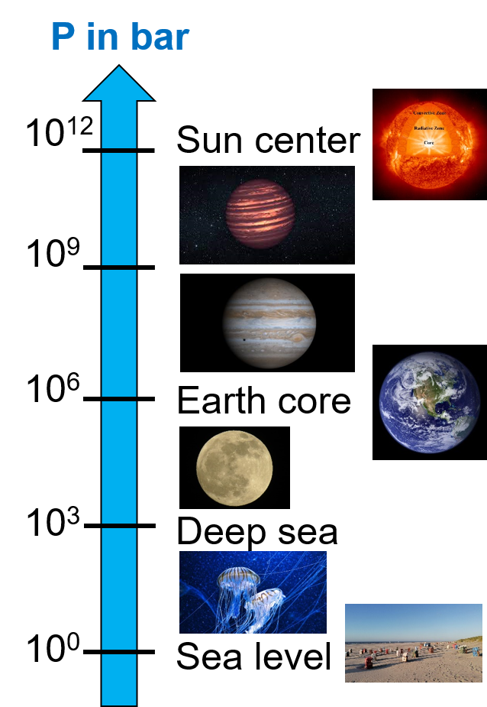
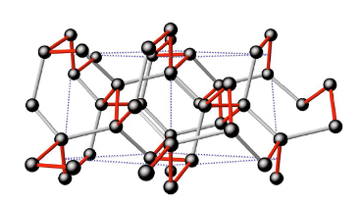
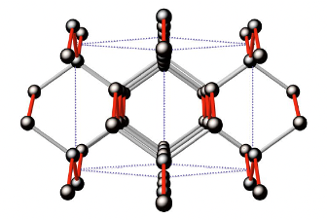
Matter under Extreme Conditions
BC8: super-diamond
Jupiter & Juno
T. Guillot; Protostars and Protoplanets VII Astronomical Society, (2023)
Extreme Pressures
Intertial
confinment
fusion (ICF)
D. Kraus, A. Bergermann et al.;in preparation
H. Abu-Shawareb et al., Phys. Rev. Lett. 132, 065102 (2024)
O. A. Hurricane et al., Rev. Mod. Phys. 95, 025005 (2023)

Slide 4
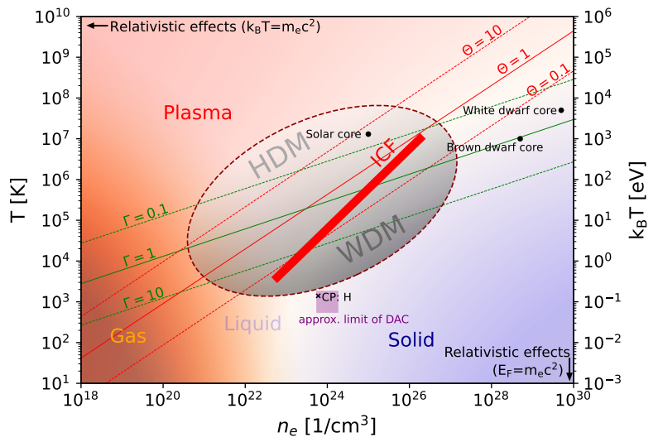
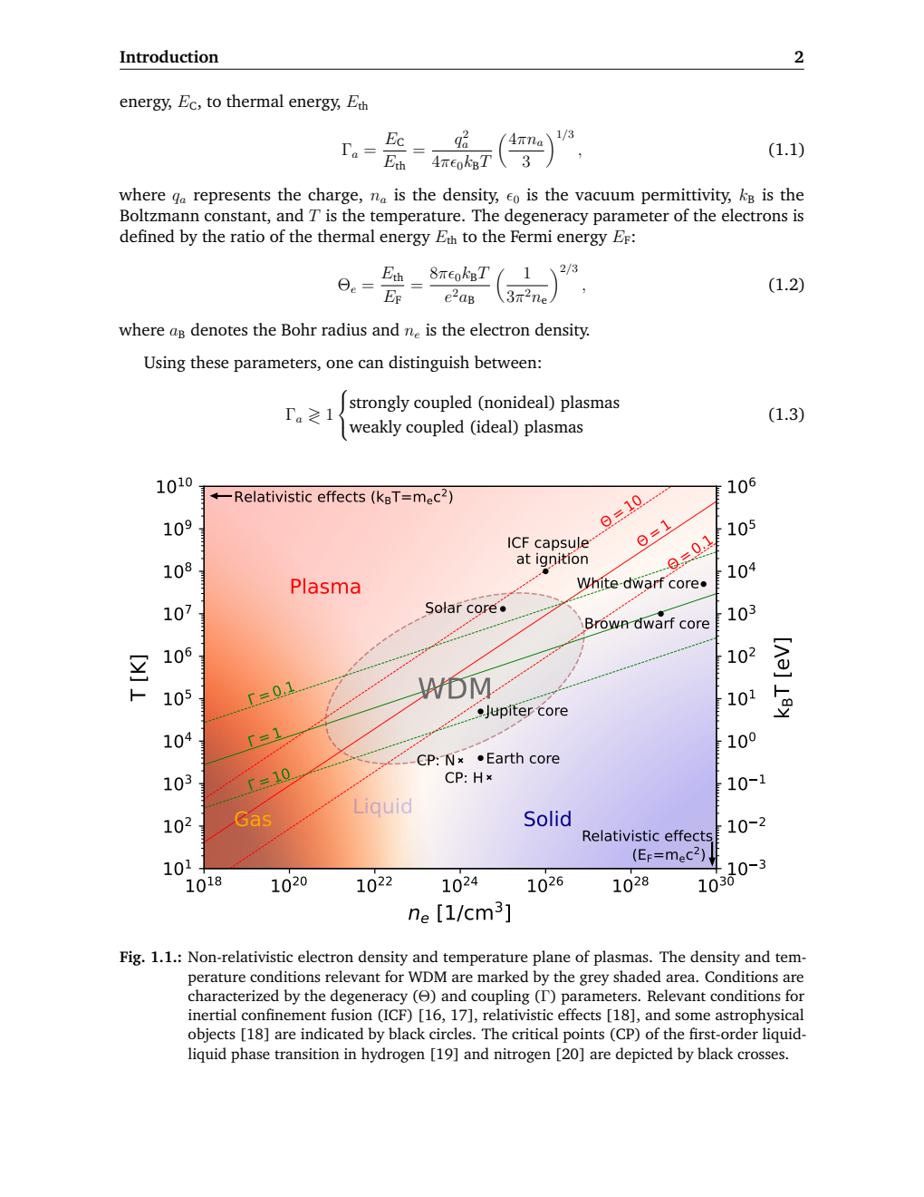
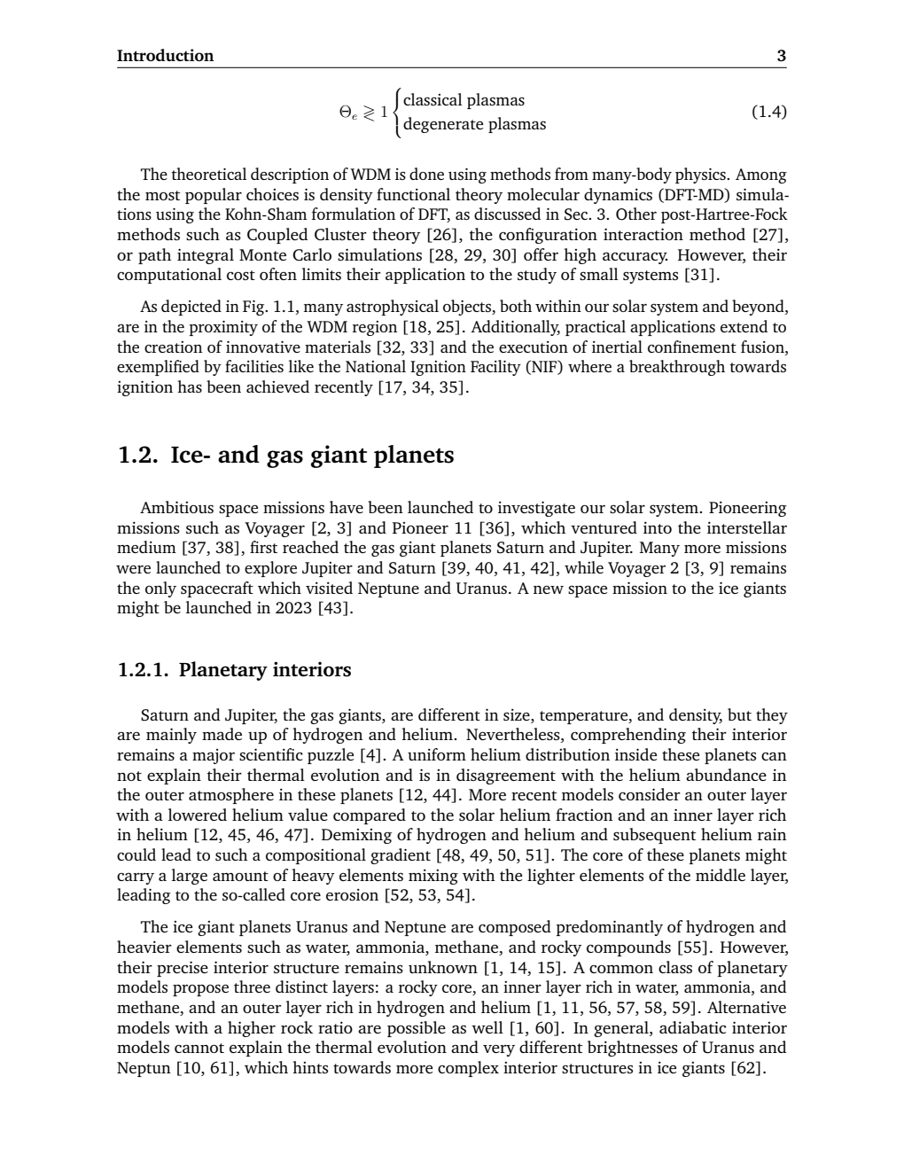
Matter under Extreme Conditions
Plasma Phase Diagram
Coupling Parameter
Degeneracy Parameter
A. Bergermann and U. Kleinschmidt; submitted to Phys. Plasmas
R. Redmer; Phys. Rep. 282 (2-3), 35-157

Slide 5
Density Functional Theory

Slide 6
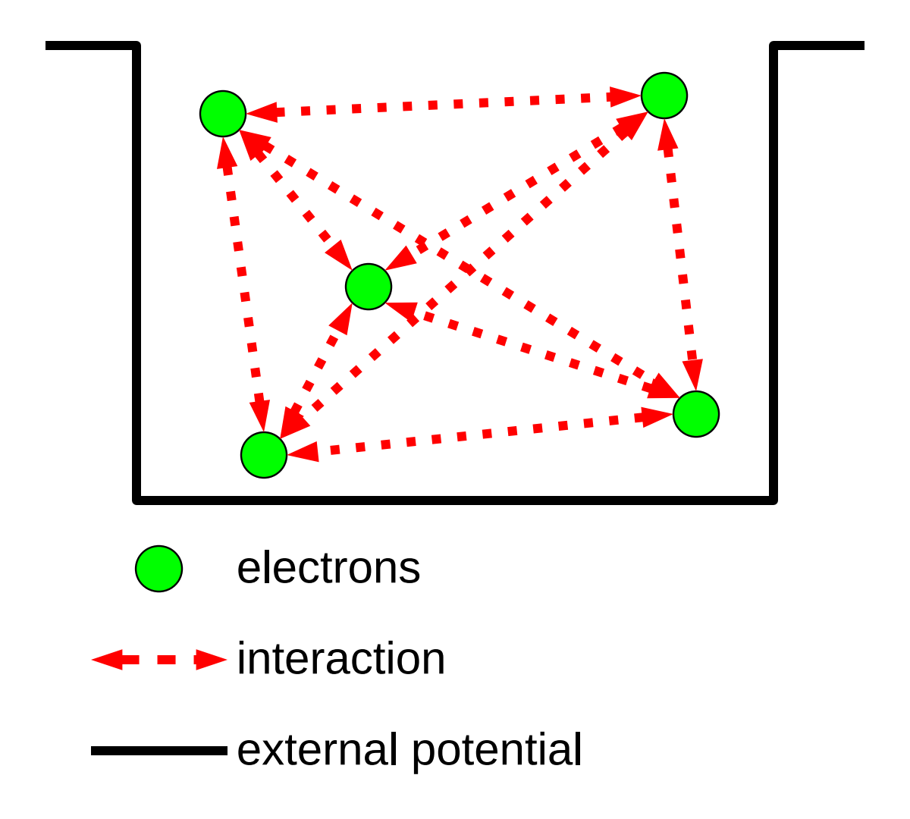
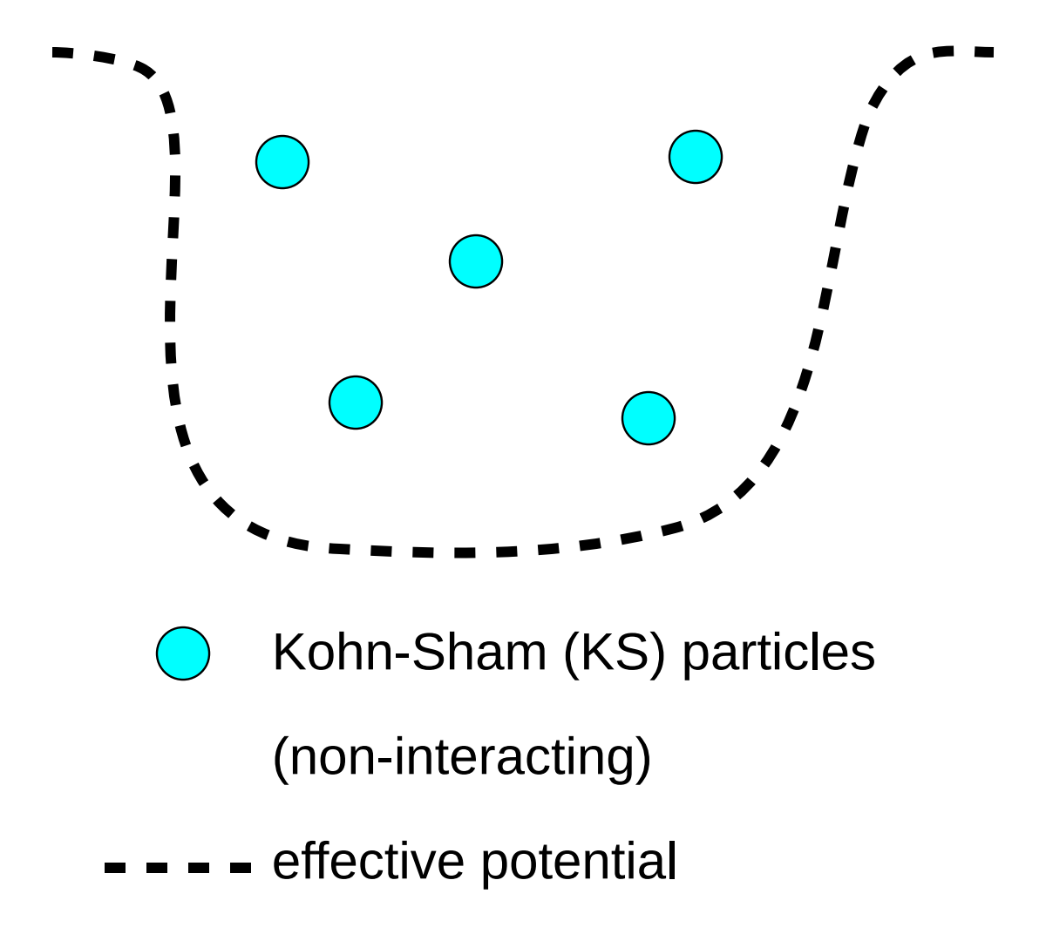
Density Functional Theory
Interacting particles
Non-interacting particles
Not feasible for more than a few
interacting particles.
Fundamental quantity:
ground-state wave-function Ψ(r)
Replaces n-particle problem with n 1-particle problems
Fundamental quantity: ground-state electron density ρ(r)
Adapted from Lorenzen and Preising

Slide 7
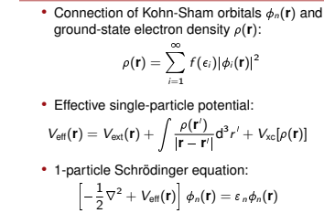
Density Functional Theory
Non-interacting particles
Hohenberg and Kohn; Phys. Rev. 136, B864 (1964)
Kohn; Phys. Rev. Lett. 51, 1596 (1983)
Kohn and Sham; Phys. Rev. 140, A1133 (1965)

Slide 8
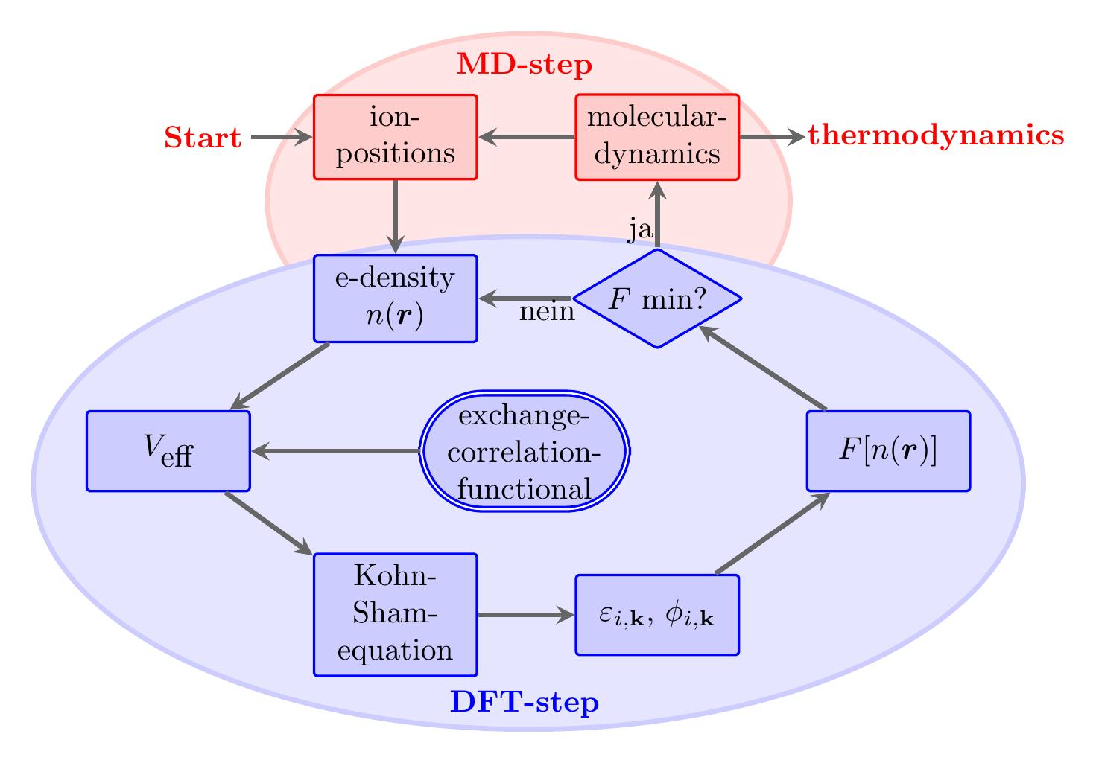
Density Functional Theory
Workflow
Hohenberg and Kohn; Phys. Rev. 136, B864 (1964)
Kohn; Phys. Rev. Lett. 51, 1596 (1983)
Kohn and Sham; Phys. Rev. 140, A1133 (1965)

Slide 9
Density Functional Theory
Can easily lead to deviations of
20 – 50 %
VASP workflow
Hohenberg and Kohn; Phys. Rev. 136, B864 (1964)
Kohn; Phys. Rev. Lett. 51, 1596 (1983)
Kohn and Sham; Phys. Rev. 140, A1133 (1965)

Slide 10
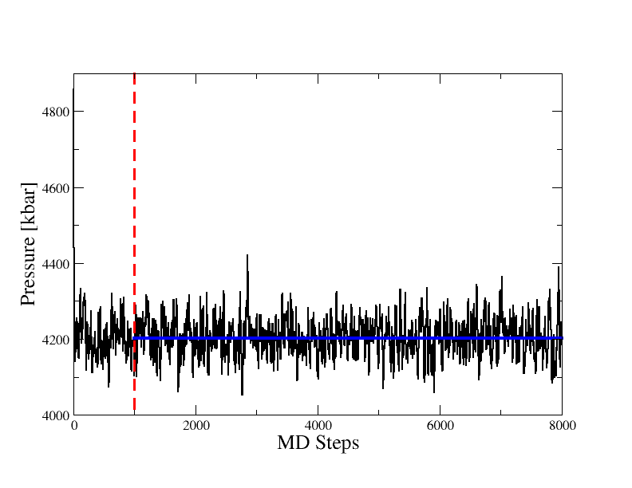
Simulation parameters and limits
Example output: Pressure
Parameters
Typically we simulate between 60 and 1000 atoms
The total simulation time up to a few ps
Limitations
Uncertainty due to the exchange-correlation functional
Thermodynamic processes on longer timescales can not be simulated

Slide 11
Hydrogen – Helium Mixtures

Slide 12
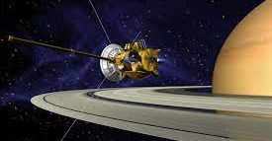
Hydrogen – Helium Mixtures
Jupiter & Juno
Saturn & Cassini
Gas giant planets Saturn & Jupiter: H and He
He rain in Saturn & Jupiter
Atmospheric He depletion compared to the protosolar value
Sinking droplets release gravitational energy
Slows down the cooling significant
T. Guillot; Protostars and Protoplanets VII Astronomical Society, (2023)

Slide 13
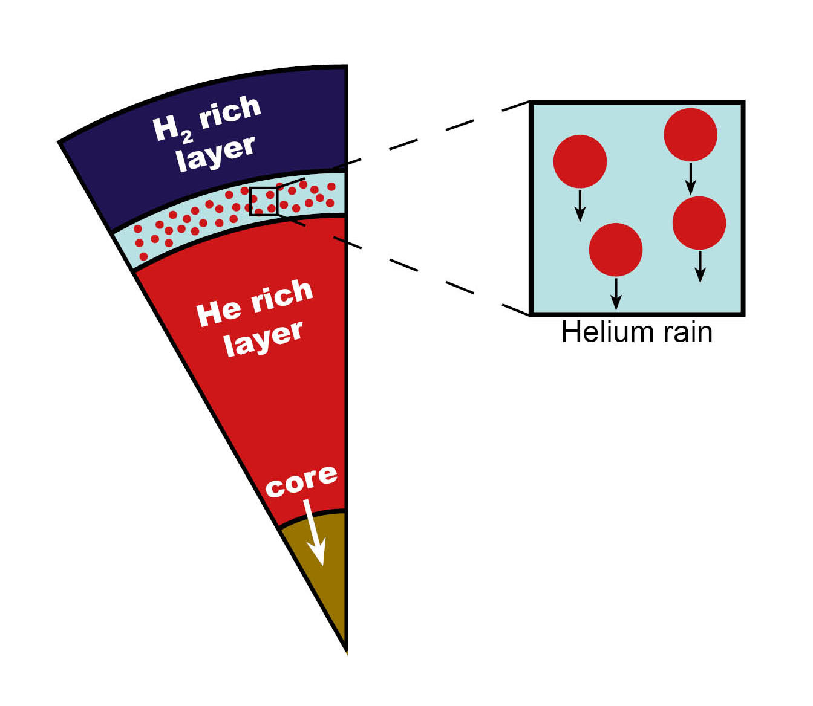
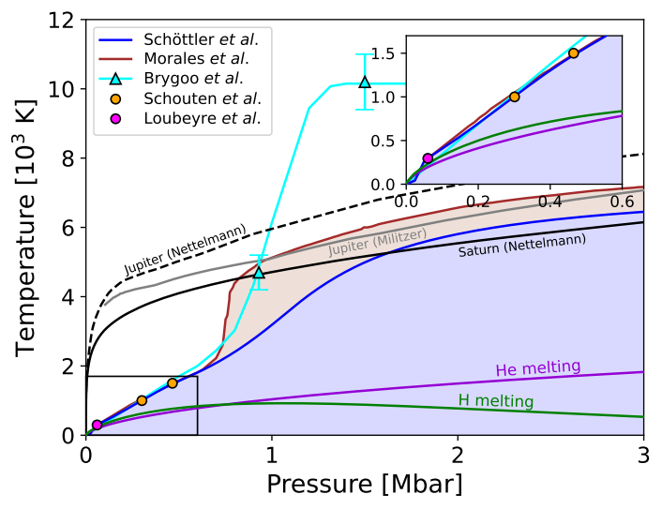
Hydrogen – Neon Mixtures
Helium rain
H-He phase diagram
Gas giant planets Saturn & Jupiter: H and He
He rain in Saturn & Jupiter
Atmospheric He depletion compared to the proto solar value
Sinking droplets release gravitational energy
Slows down the cooling significant
Experimental campaigns remain illusive
A. Bergermann; Phys. Rev. E 103, 013307 (2021)
M. Schoettler and R. Redmer; Phys. Rev. Lett. 120, 115703 (2018)
M. A. Morales, et al.; Proc. Natl. Acad. Sci. USA 106, 1324 (2009)
S. Brygoo, et al.; Nature (2020)

Slide 14
Hydrogen – Neon Mixtures
Helium rain
H-He phase diagram
Experimental campaign based on reflectivity
Gas giant planets Saturn & Jupiter: H and He
He rain in Saturn & Jupiter
Atmospheric He depletion compared to the proto solar value
Sinking droplets release gravitational energy
Slows down the cooling significant
Further experimental campaigns remain illusive
A. Bergermann et al.; Phys. Rev. E 103, 013307 (2021)
M. Schoettler et al.; Phys. Rev. Lett. 120, 115703 (2018)
M. A. Morales, et al.; Proc. Natl. Acad. Sci. 106, 1324 (2009)
S. Brygoo, et al.; Nature (2020)

Slide 15
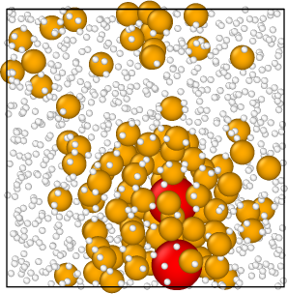
Hydrogen – Helium – Neon Mixtures
Hydrogen – Helium and Neon
Galileo probe revealed that Jupiter’s atmosphere is significantly depleted in Ne
Trace amounts of Ne dissolves in the He-rich droplets and rains down
Further experimental campaigns remain illusive: How to proceed?
A. Bergermann; Phys. Rev. E 103, 013307 (2021)
M. Schoettler and R. Redmer; Phys. Rev. Lett. 120, 115703 (2018)
M. A. Morales, et al.; Proc. Natl. Acad. Sci. USA 106, 1324 (2009)
S. Brygoo, et al.; Nature (2020)

Slide 16
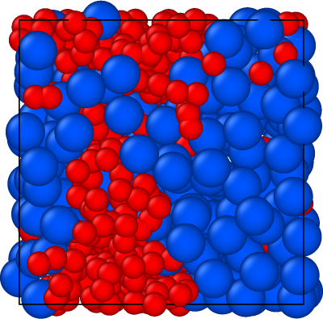
Hydrogen – Neon Mixtures
H-Ne: DFT-MD simulation cell
Hydrogen – Neon phase separation
DFT-MD simulations of H-Ne
  512 H and Ne atoms
  simulation times of up to 100 ps
  PBE exchange correlation functional
Evaluate phase separation from structural properties:
  Blue: Neon
  Red: Hydrogen

Slide 17
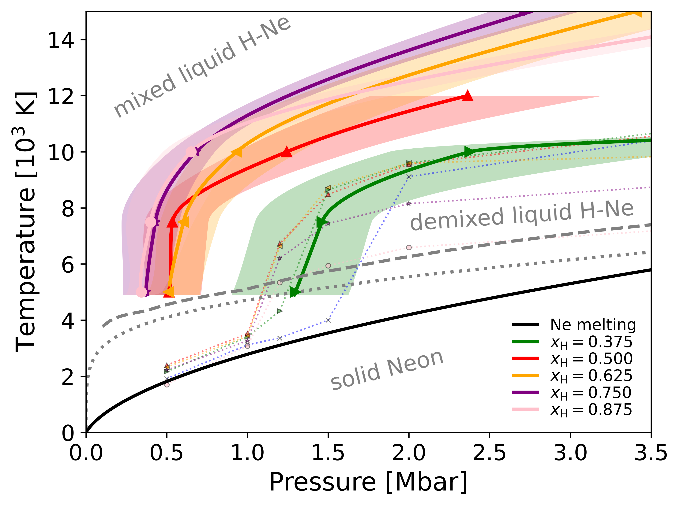
Hydrogen – Neon Mixtures
H-Ne phase diagram
Hydrogen – Neon phase separation for different H-Ne concentrations
Pronounced phase separation at pressures below 0.5 Mbar
Experimentally accessible: strong X-ray scattering of Ne
Several proposals at the European XFEL and the Z-Machine in Albuquerque
Reinvestigate H-He demixing only after we understood H-Ne

Slide 18
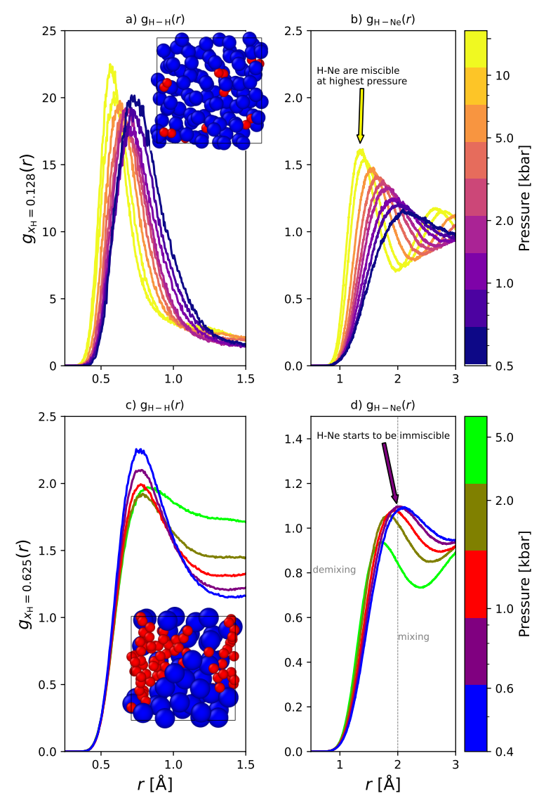
Hydrogen – Neon Mixtures
Pair Distribution Functions at 10000 K
Hydrogen – Neon phase separation: Electrical conductivity and H2 molecules
Ne triggers the formation of H2 molecules
(pure H2 dissociates at 1000 K)
Only H and Ne phase separate but not H2 and Ne

Slide 19
C-H-N-O Mixtures

Slide 20
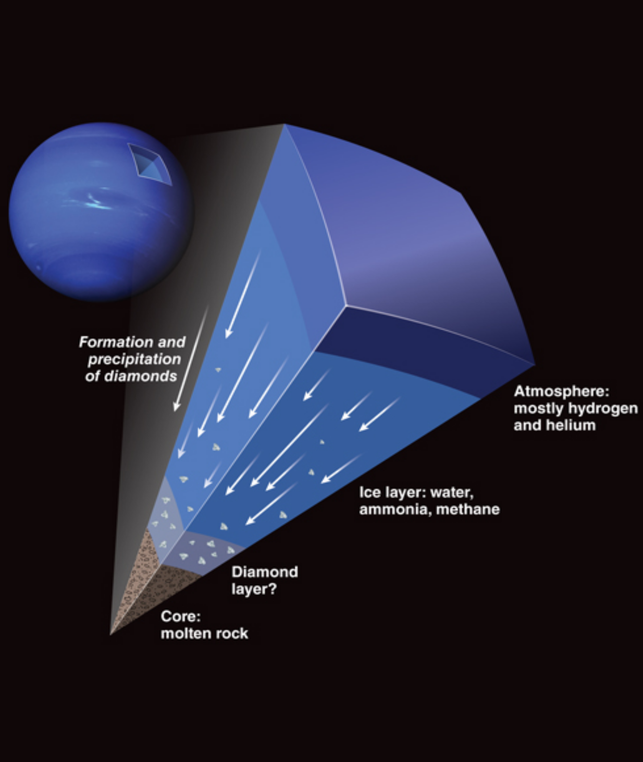
Hydrogen – Carbon Mixtures
Diamond rain
Inertial confinement fusion
BC8: super-diamond
Diamond formation in shock-compressed
C-H-N-O mixtures
Diamond rain in Neptune and Uranus
Inertial confinement fusion
(ICF capsules)
Novel materials (superconductors, BC8, ...)
H. Abu-Shawareb et al., Phys. Rev. Lett. 132, 065102 (2024)
O. A. Hurricane et al., Rev. Mod. Phys. 95, 025005 (2023)
D. Kraus, A. Bergermann et al.;in preparation
D. Kraus et al.; Nat. Astron. 1, pages 606–611 (2017)
Bethkenhagen et al., Astrohpys. J., 848, 67 (2017)

Slide 21
Hydrogen – Carbon Mixtures
Diamond rain
Inertial confinement fusion
BC8: super-diamond
Diamond formation in shock-compressed
C-H-N-O mixtures
Diamond rain in Neptune and Uranus
Inertial confinement fusion
(ICF capsules)
Novel materials (superconductors, BC8, ...)
H. Abu-Shawareb et al., Phys. Rev. Lett. 132, 065102 (2024)
O. A. Hurricane et al., Rev. Mod. Phys. 95, 025005 (2023)
D. Kraus, A. Bergermann et al.;in preparation
D. Kraus et al.; Nat. Astron. 1, pages 606–611 (2017)
Bethkenhagen et al., Astrohpys. J., 848, 67 (2017)

Slide 22
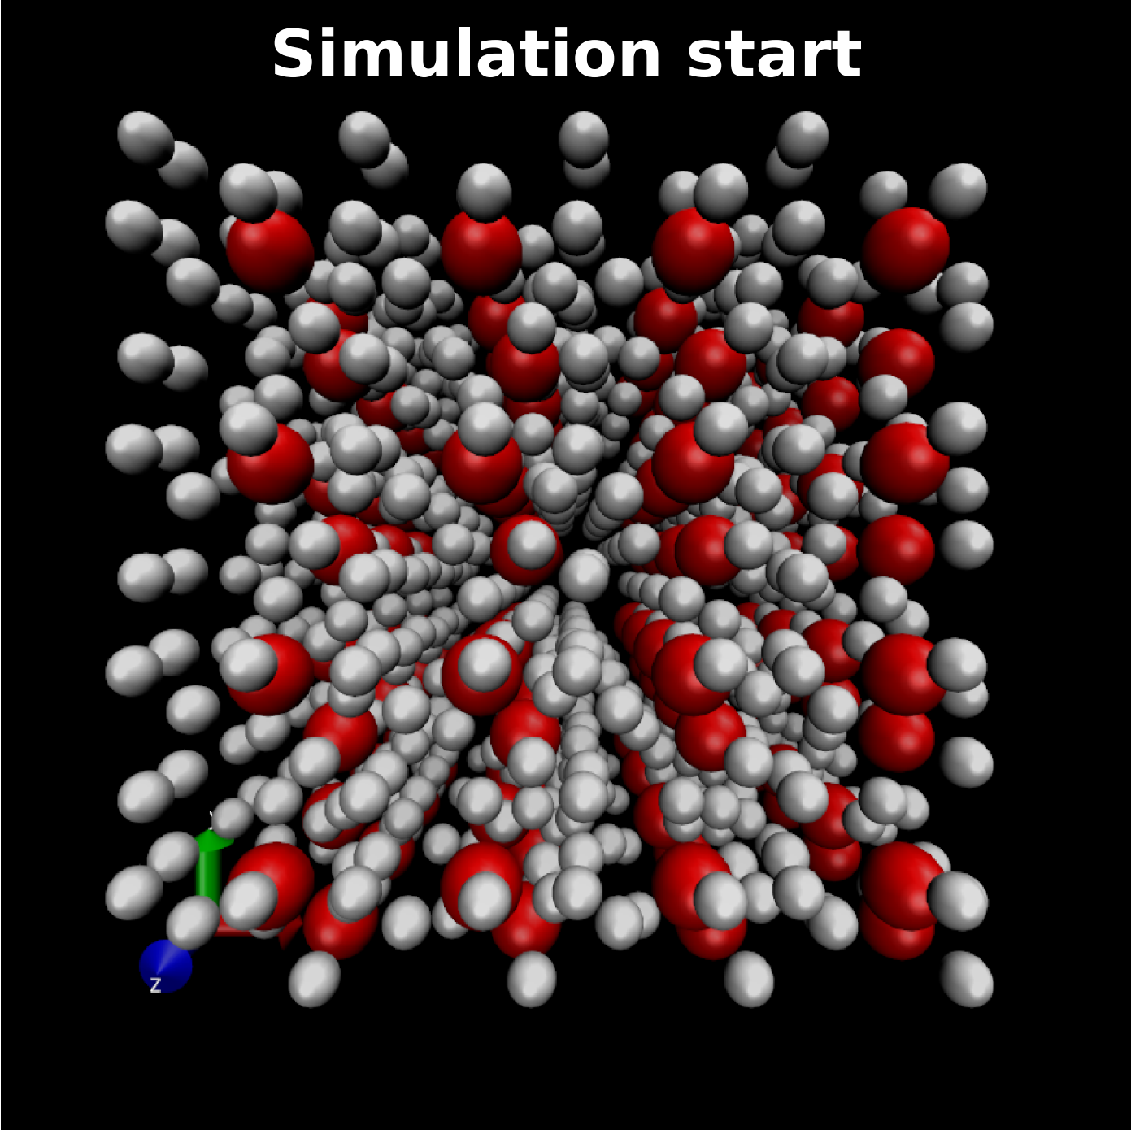
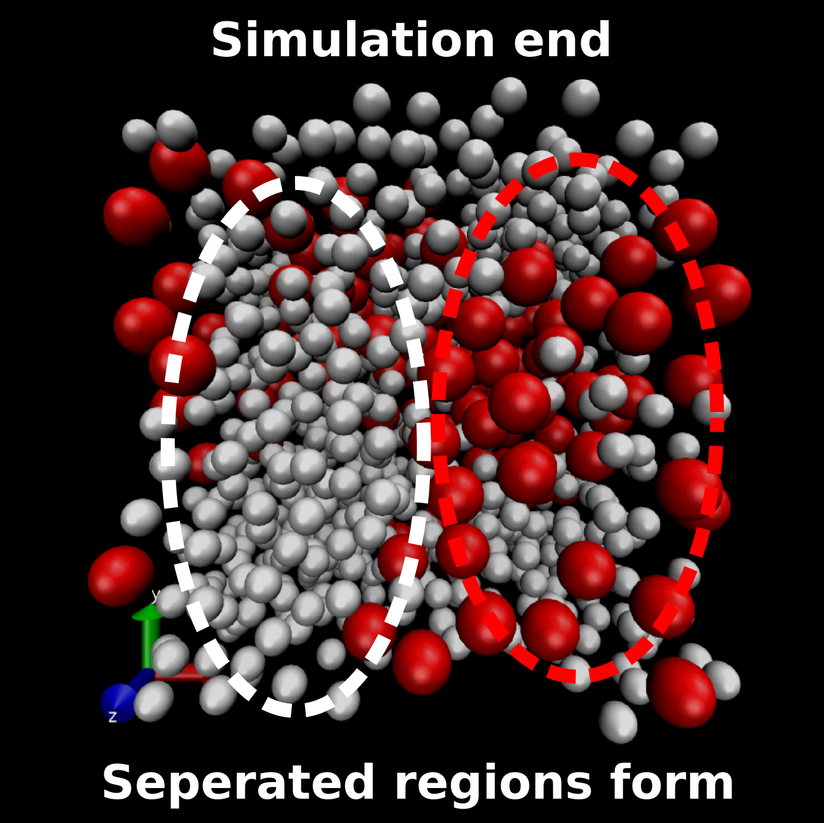
C-H Mixtures
Diamond formation can not be seen with DFT-MD simulation
CH demixing might be seen with DFT-MD simulation
D. Kraus, A. Bergermann et al.;in preparation

Slide 23
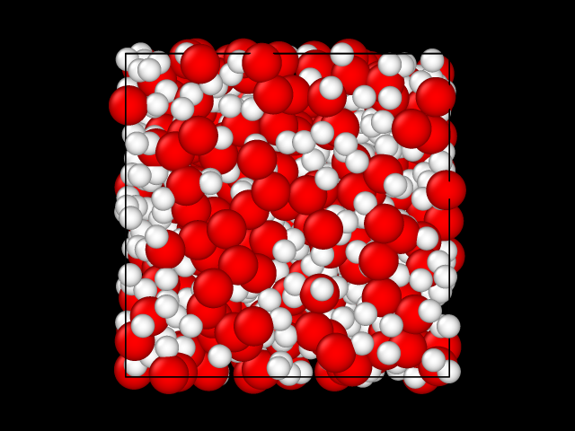
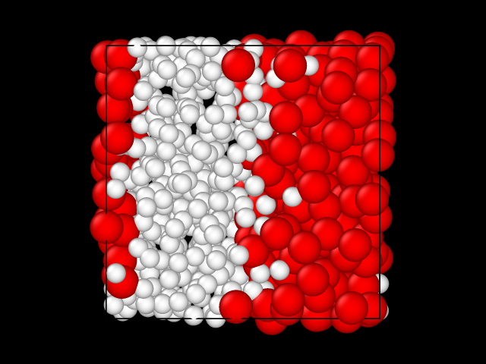
C-H Mixtures
Diamond formation can not be seen with DFT-MD simulation
CH demixing might be seen with DFT-MD simulation
Simulation 1 (start with a mixed system)
Simulation 2 (start with a demixed system)
≠
No demixing
No mixing

Slide 24
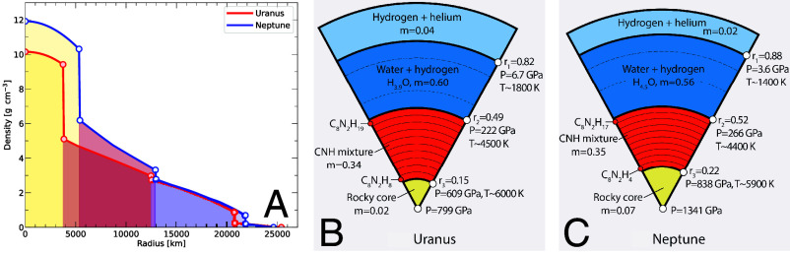
C-H-N-O Mixtures
Militzer et al. studied a mixture of H2O, CH4, and NH3 using machine learning
They predict a H2O dominated fluid in the upper mantel and a CH4-NH3 mixture below
The C-H-N fluid might form a stable stratified layer: Magnetic field is primarily generated in the out H2O rich layer
Interior of Neptune and Uranus

Slide 25
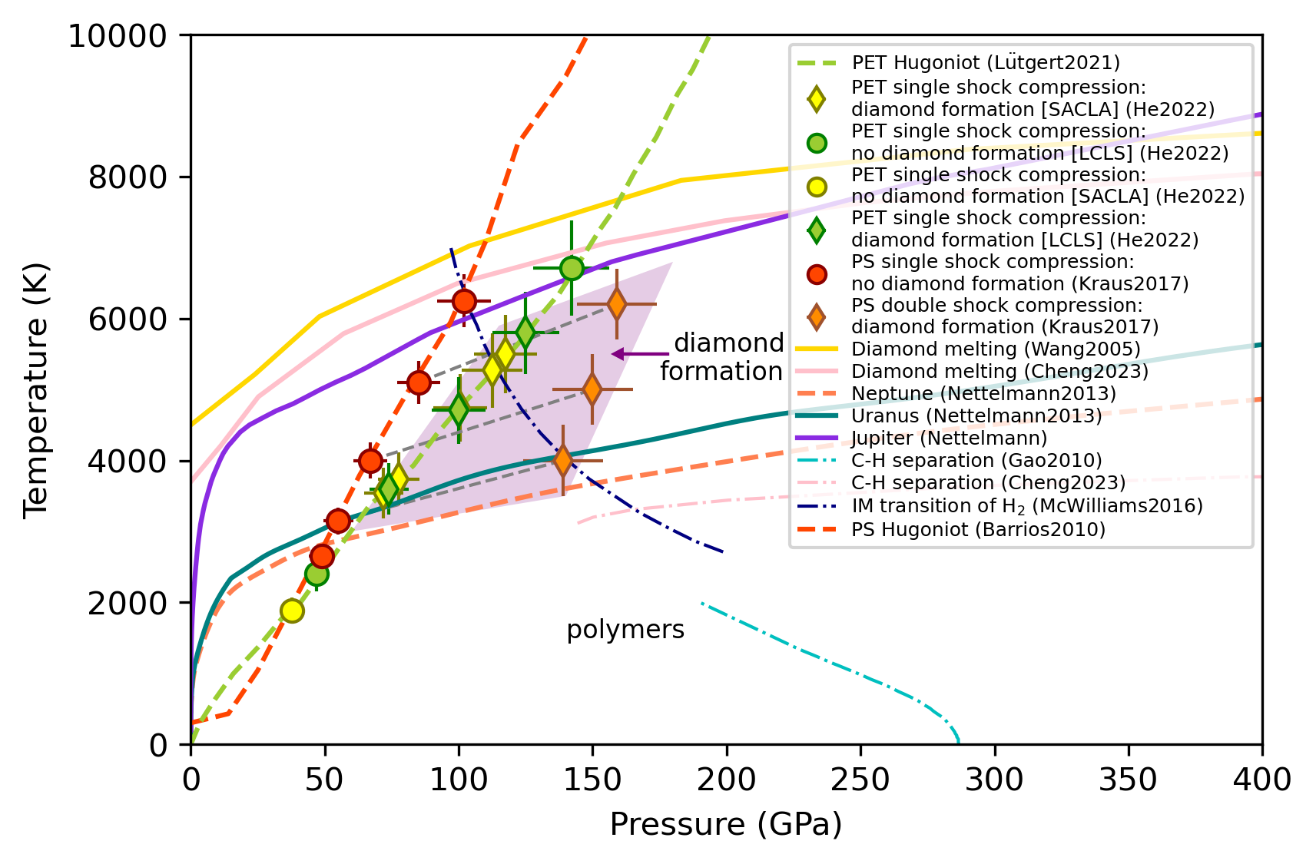
C-H Mixtures
Experimental evidence of diamond formation in C-H mixtures
Diamond where found in laser-shocked C-H-N-O mixtures.
  X-ray diffraction
  small-angle X-ray scattering
Static compression campaigns using diamond anvil cells found diamonds at even lower p-T conditions.
D. Kraus et al.; Nat. Astron. 1, pages 606–611 (2017)
Z. He et al.; Sci. Adv. 8 (35), eabo0617 (2022)
M. Forst et al.; Nat. Astron. 8, 174-181 (2024)

Slide 26
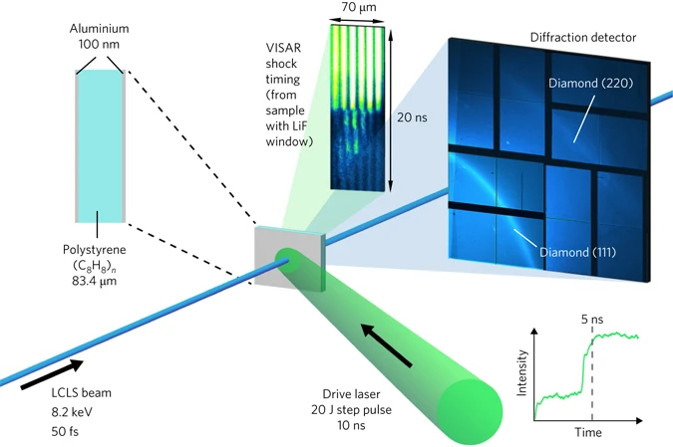
C-H Mixtures: Laser Compression
Compression: two shocks in polystyrene (two delayed laser beams with step pulses)
Resulting P-T conditions: 150 Gpa and 5000 K
Probe: 8.2 keV, 50 fs X-ray pulse
Findings: diamond forms during second compression
Experimental setup
D. Kraus et al.; Nat. Astron. 1, pages 606–611 (2017)

Slide 27
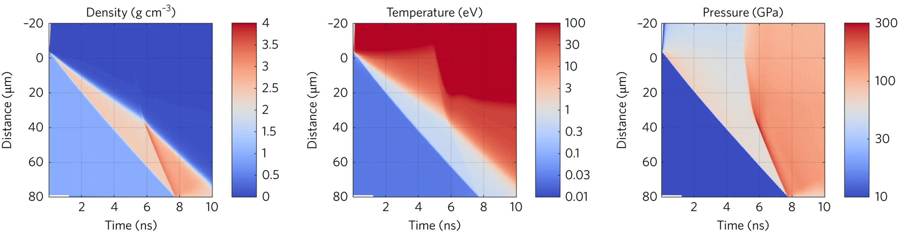
Hydrodynamic Simulations
HELIOS simulations show ρ, T, and P during two-stage compression (The laser drives two delayed shocks from the top into the sample)
Second shock enters the pre-compressed material after about 6 ns
Both shocks merge at the rear side at about 7.6 ns
ρ ≈ 3.0 g/cm³, T ≈ 5,000 K, P ≈ 150 GPa
Hydrodyanmic Simulation of Density, Temperature, and Pressure

Slide 28
Hydrogen – Water demixing

Slide 29
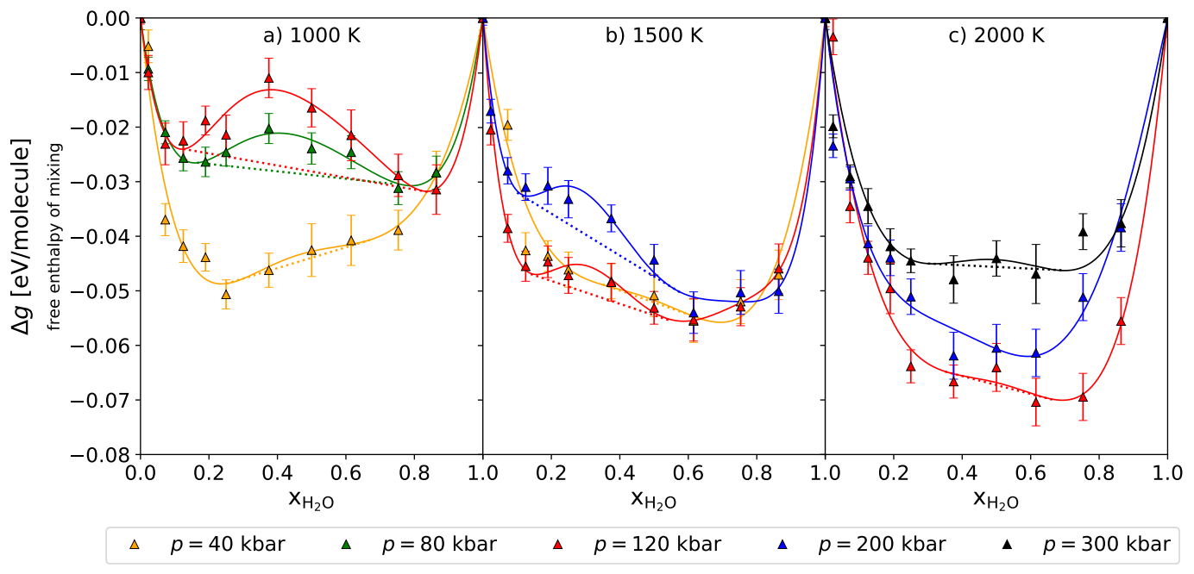
H2-H2O demixing
Hydrogen-Water demixing: Gibbs free energy
Bergermann et al., Phys. Rev. B 109, 174107 (2024)

Slide 30
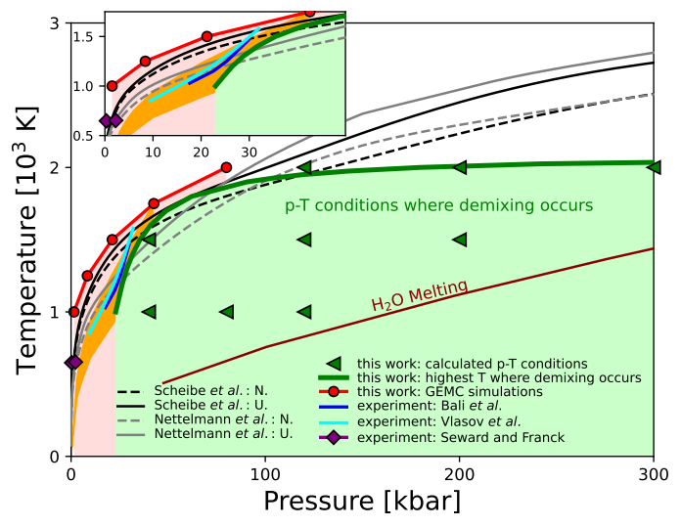
H2-H2O demixing
Hydrogen-Water demixing
H2O-H2 might be immiscible under relevant p-T conditions
Very good agreement between experimental campaigns and theory
Recently applied Uranus, Neptune, K2-18 b and TOI-270d
  The out envelope might be significantly influenced by H2-H2O demixing
Bergermann et al., Phys. Rev. B 109, 174107 (2024)
Howard et al., Astron. Astropys. 703, A145 (2025)

Slide 31
Outlook & Summary

Slide 32
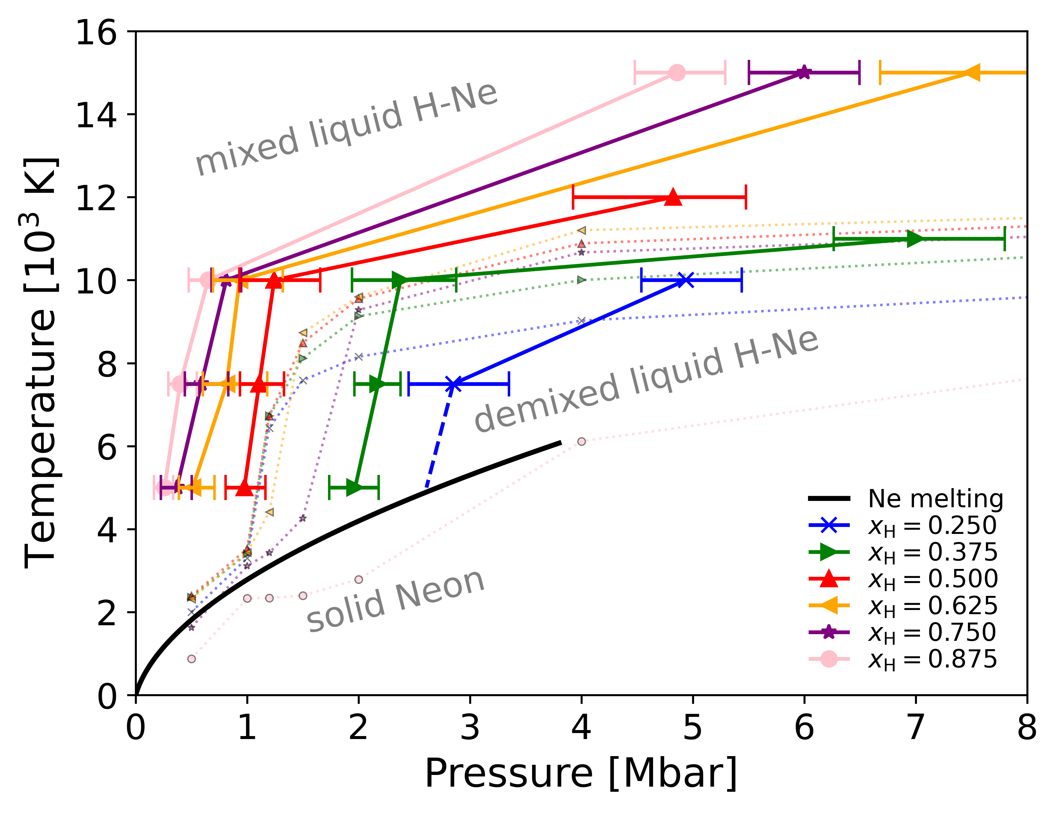
Summary & Outlook
Hydrogen – Neon phase separation
Proxy system for H-He phase separation
Hydrocarbon
Vast diversity of predictions for C-H-N-O demixing and/or diamond formation
Further experimental campaigns/theoretical investigation are needed
Hydrogen – Water demixing
Indications for partial demixing in the outer envelope of water rich planets.

