Slide 1
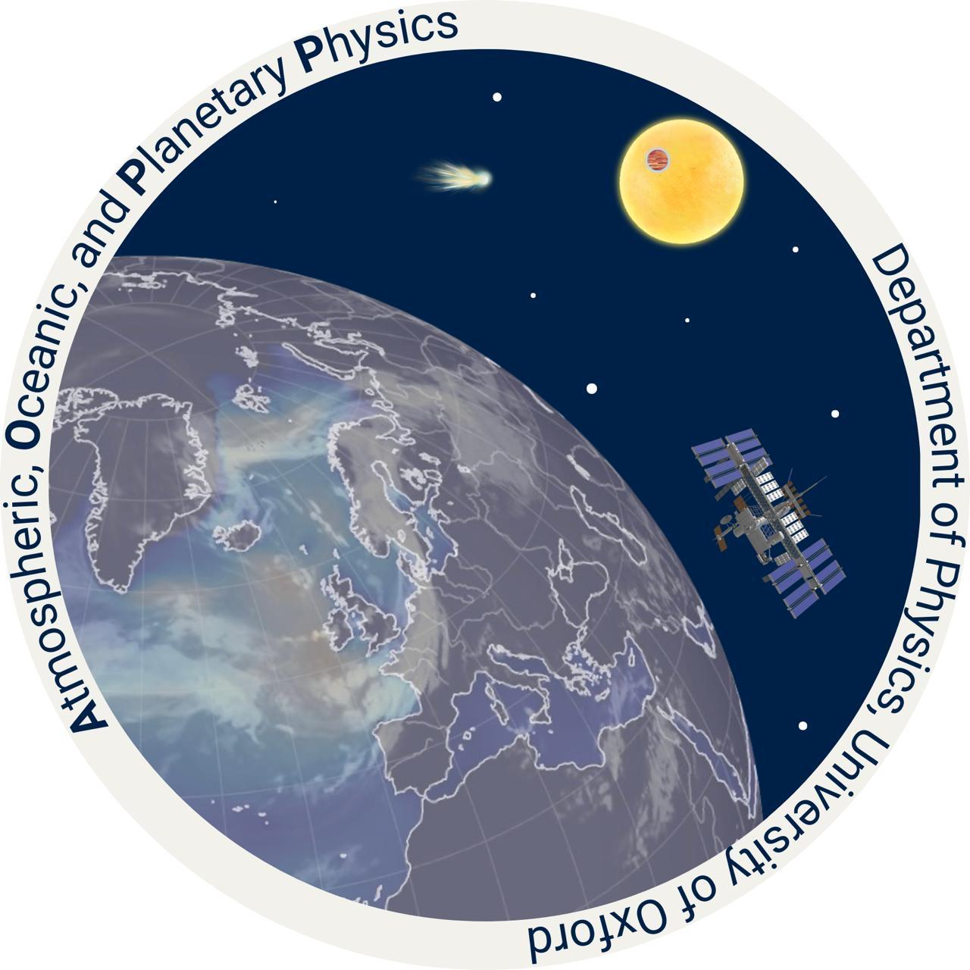

Interior Evolution, Circulation Models, and JWST Observations of WASP-76b
John Allen
Atmospheric, Oceanic, and Planetary Physics, University of Oxford
john.allen@physics.ox.ac.uk
With: T. D. Komacek, J. Wardenier, L. Coulombe, + WASP-76b JWST NIRSpec/G395H phase curve team

Slide 2
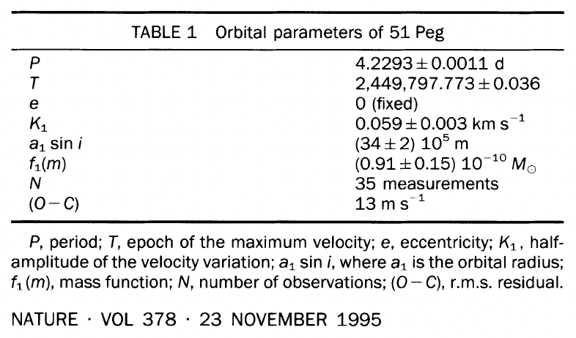
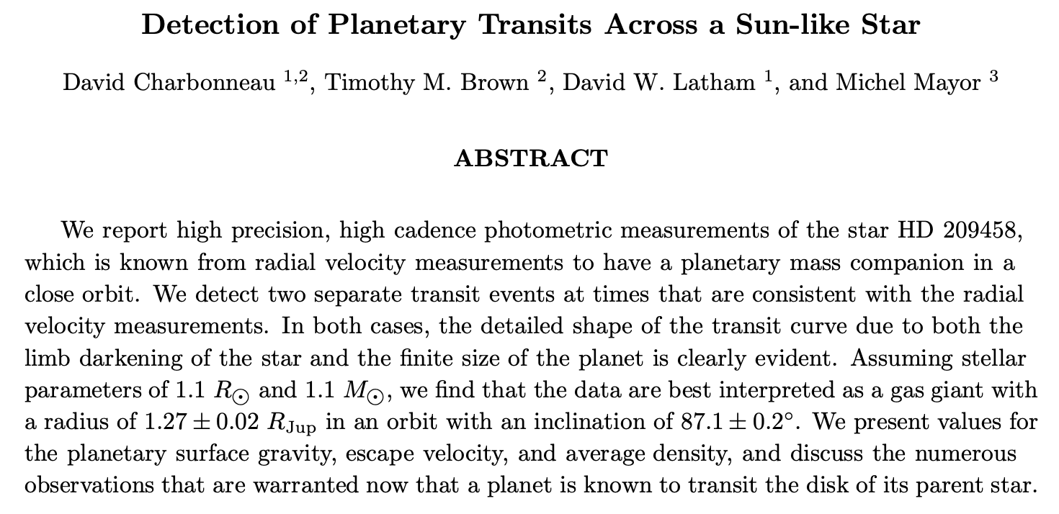
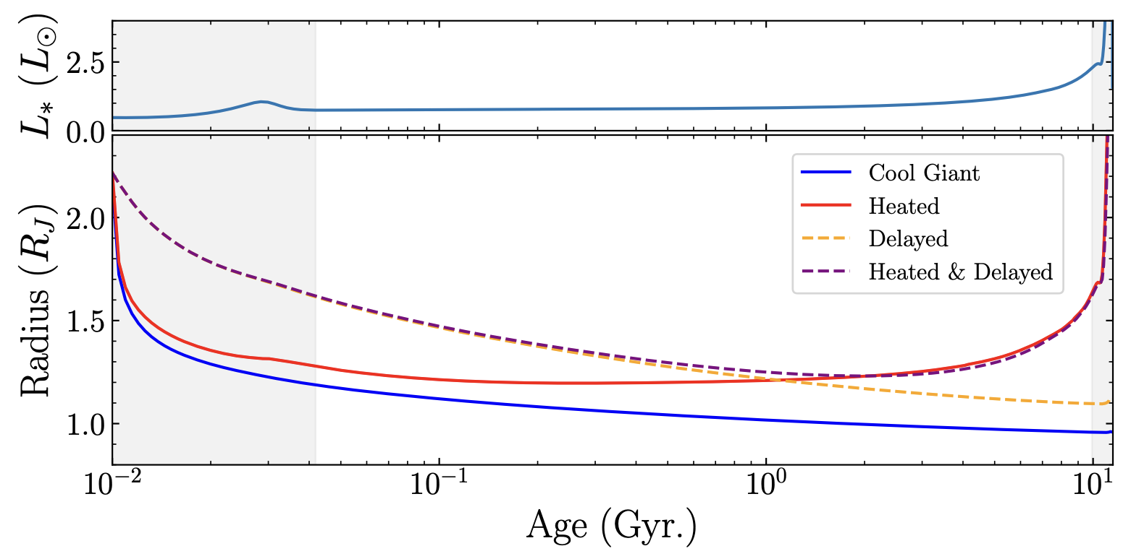
Hot Jupiter radius inflation is the oldest unsolved problem in exoplanet interior science
The first exoplanet discovered around a sun-like star was a hot Jupiter (Mayor + Queloz, 1995)
The first exoplanetary radius measured was inflated (Charbonneau+, 2000; Henry+ 2000)
Many proposed mechanisms for radius inflation, see e.g. Thorngren+ 2025

Slide 3
WASP-76b gives an opportunity to study the effect of radius inflation on observables

Slide 4

WASP-76b gives an opportunity to study the effect of radius inflation on observables

Slide 5
WASP-76b gives an opportunity to study the effect of radius inflation on observables

Slide 6
WASP-76b gives an opportunity to study the effect of radius inflation on observables

Slide 7
Weak, deep, internal heating can inflate WASP-76b’s radius to the observed value

Slide 8
Weak, deep, internal heating can inflate WASP-76b’s radius to the observed value

Slide 9
Weak, deep, internal heating can inflate WASP-76b’s radius to the observed value

Slide 10
Weak, deep, internal heating can inflate WASP-76b’s radius to the observed value

Slide 11
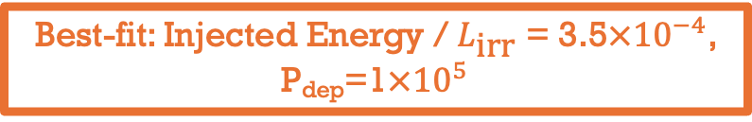
Weak, deep, internal heating can inflate WASP-76b’s radius to the observed value
Best-fit: Injected Energy / $L_{\text{irr}}$ = 3.5$×{10}^{−4}$, P_{dep}=1$×{10}^{5}$

Slide 12
We compare simulations with ‘cool’ interiors to the best-fit heating profiles
Best-fit heating profile and a no internal heat case shown
Convective regions and radiative regions separated into thick and thin lines, respectively
The heated T-P profiles are used to fix the bottom boundary in the ‘hot’ GCM runs
Can we observe this large deep temperature difference using a GCM?

Slide 13
We consider the effect of other parameters on simulated observables output by the GCM
We use the SPARC framework of the ADAM GCM
In addition to the two interior heat scenarios, we model the effect of:
  Atmospheric drag
  Cloud presence + type
  Atmospheric composition
  Cold-trapping/quenching
For full details of the modelling procedure, keep an eye out for Allen+ 2026 (in prep)!

Slide 14

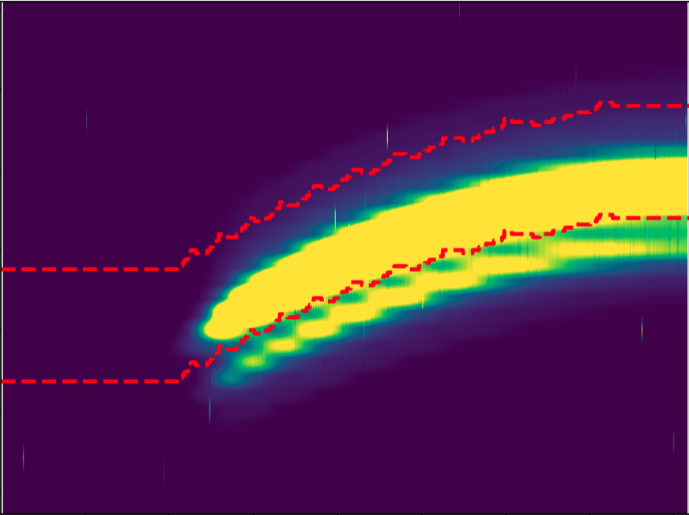
A JWST NIRSPEC phase-curve can help us constrain modelling parameters
Big thanks to Louis-Phillipe Coulombe for coordinating the reductions, and Megan Mansfield and Michael Radica for performing them!

Slide 15
A JWST NIRSPEC phase-curve can help us constrain atmospheric drag

Slide 16
A JWST NIRSPEC phase-curve can help us constrain atmospheric drag

Slide 17
A JWST NIRSPEC phase-curve can help us constrain atmospheric drag

Slide 18
A JWST NIRSPEC phase-curve can help us constrain atmospheric drag

Slide 19
A JWST NIRSPEC phase-curve can help us constrain atmospheric drag

Slide 20
A JWST NIRSPEC phase-curve can help us constrain atmospheric drag

Slide 21
A JWST NIRSPEC phase-curve can help us constrain atmospheric drag
We need relatively strong atmospheric drag to match the observational data

Slide 22
Cloudy GCM’s give a better fit to the NRS1data

Slide 23
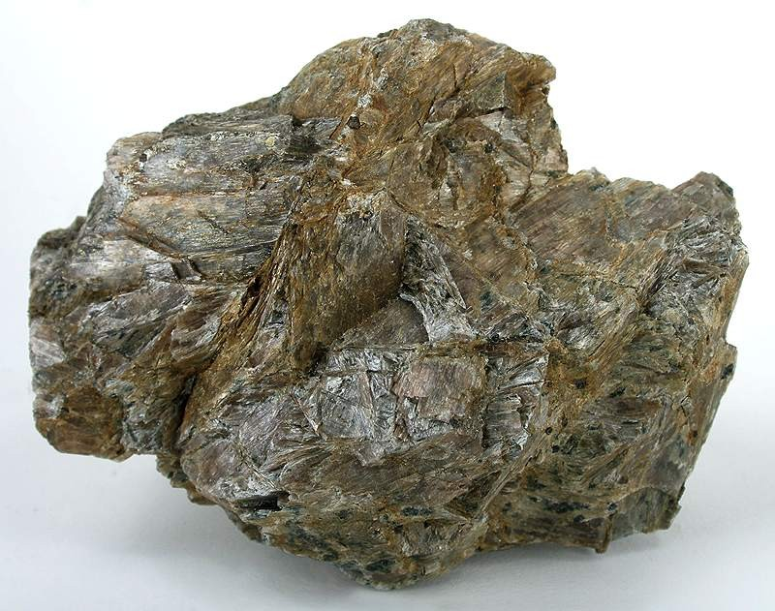
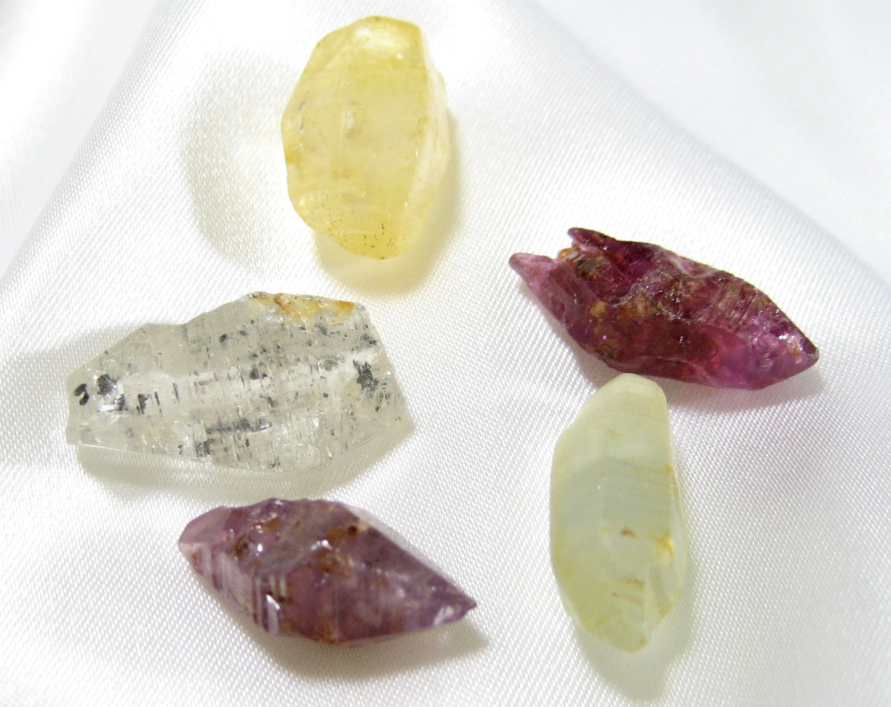
Cloudy GCM’s give a better fit to the NRS1data
Enstatite and Corundum cloud tracers put into the GCM (particle size = 1µm)
𝛕_{d} is the characteristic drag timescale
𝛕_{adv} is the advective timescale

Slide 24
Interior heating has little (to no) effect on simulated observables
𝛕_{d} is the characteristic drag timescale
𝛕_{rad} is the radiative timescale

Slide 25
Interior heating has little (to no) effect on simulated observables

Slide 26
Interior heating has little (to no) effect on simulated observables
Cloud-free, cool interiors only (as before)

Slide 27
Interior heating has little (to no) effect on simulated observables
Cloud-free, hot interior runs overplotted

Slide 28
The modelled T-P profiles are very similar at and above the photosphere
~ photosphere
Hot interior, weakest drag
Cool interior, weakest drag

Slide 29
Further research is required to understand WASP-76b
So far only NRS1 phase-curves shown, NRS2 fits are weaker
Emission spectra are relatively featureless
  We would expect strong T variation with height, alongside significant quantities of condensable vapour
GCM’s have been run exploring the effects of depleted metal oxide species, iron clouds, and different metallicities

Slide 30
Take home messages
Effect of large interior heat is small on the simulated phase-curve compared to other parameters, as modelled by the GCM
A more nuanced interior heating approach is required to investigate the impact of interior heating on atmospheric observables
  E.g. coupling to disequilibrium chemistry and rainout
The nightside of WASP-76b requires modelled clouds to fit the observational data, which affects the interior cooling rate and potentially links to the deep condensable vapour abundance
Thank you for listening!
Questions?

