Slide 1


Volatile content of sub-Neptunes based on interior models
1
1
Dr. Artem (Artyom) Aguichine
Asst. Prof. at Instituto de Astronomía, UNAM in Ensenada, Mexico
Collaborators: Olivier Mousis, Natalie Batalha, Jonathan J. Fortney, James E. Owen,
Nadine Nettelmann, Eliza M.-R. Kempton, Natasha Batalha, Johanna Teske, Francis Nimmo, Lily Larkins*, Emerson Tao*, Hailey Feller*, Madeline Lessard*
April 2026 – Layers of Understanding
*students
Notes:
Hi everyone

Slide 2
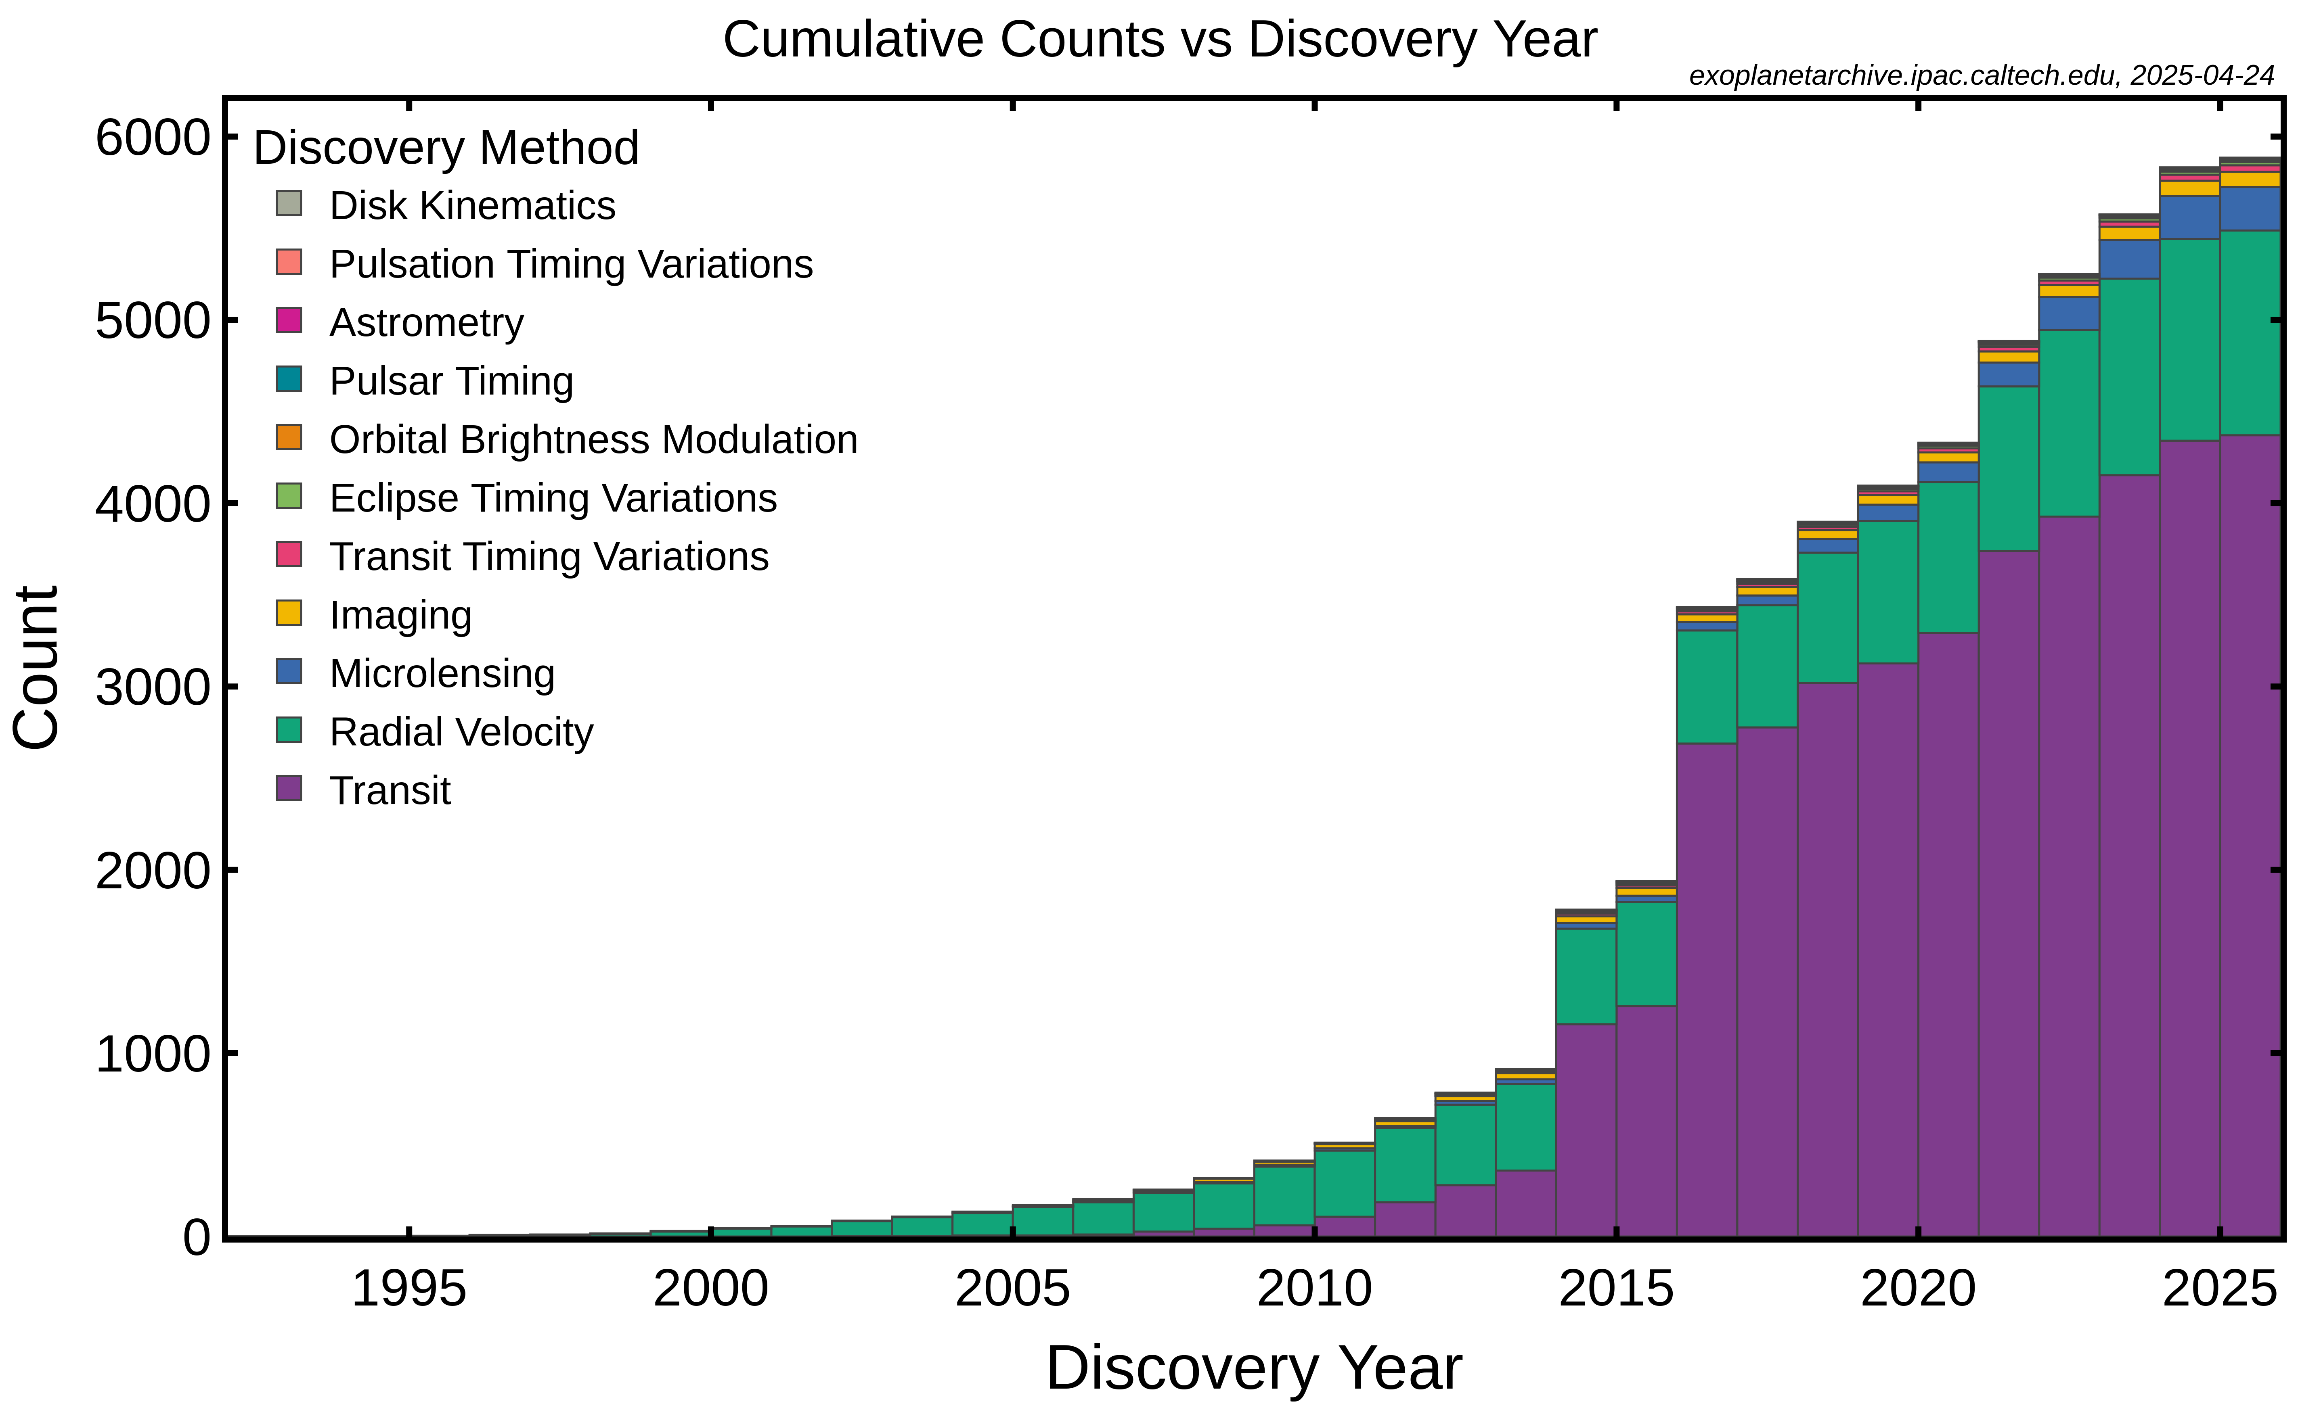
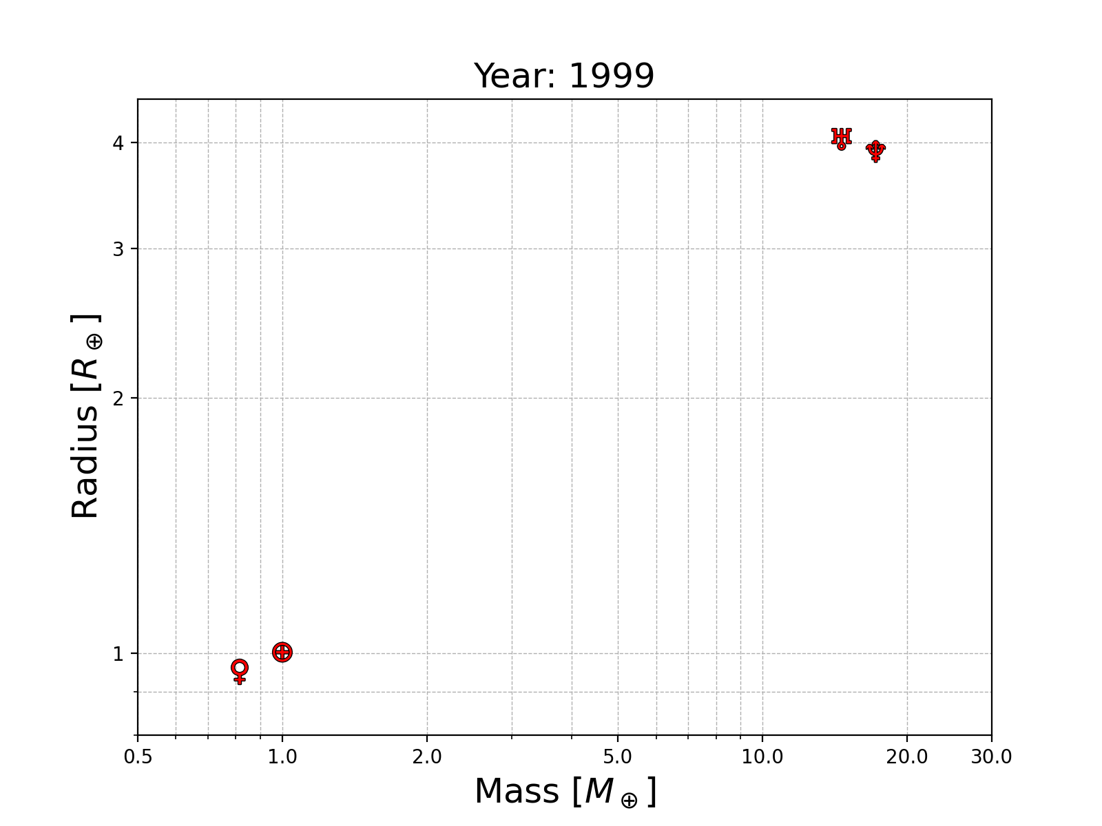
The era of exoplanet demographics
Credit: NASA Exoplanet Archive
Credit: Artem Aguichine
Kepler
Transit: planet radius
Radial Velocity: planet mass
Notes:
The Kepler telescope discovered more than half of currently confirmed exoplanets.
It transformed exoplanet science, allowing to perform exoplanet demographics.

Slide 3
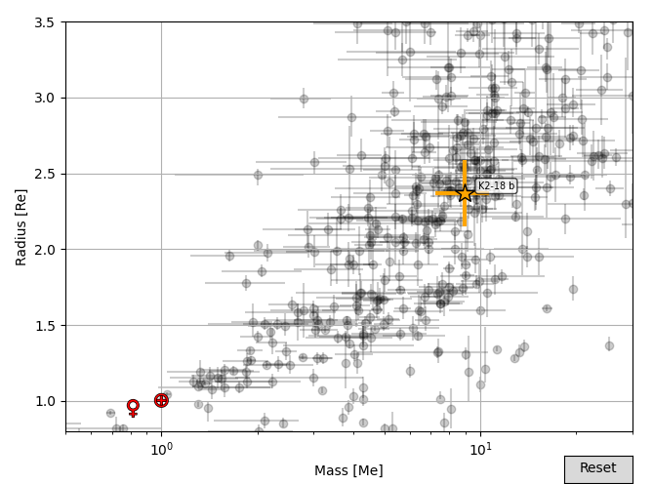
The era of exoplanet demographics
Credit: NASA Exoplanet Archive
Kepler
Transit: planet radius
Radial Velocity: planet mass
Notes:
The Kepler telescope discovered more than half of currently confirmed exoplanets.
It transformed exoplanet science, allowing to perform exoplanet demographics.

Slide 4
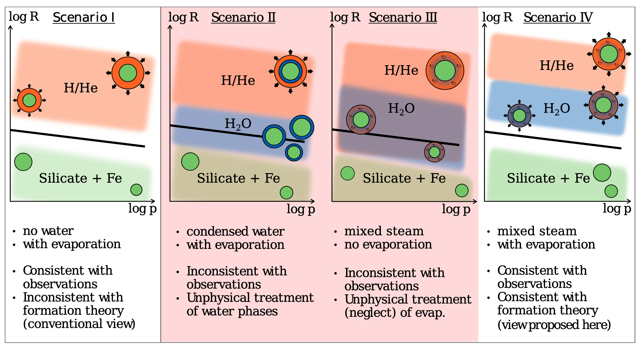
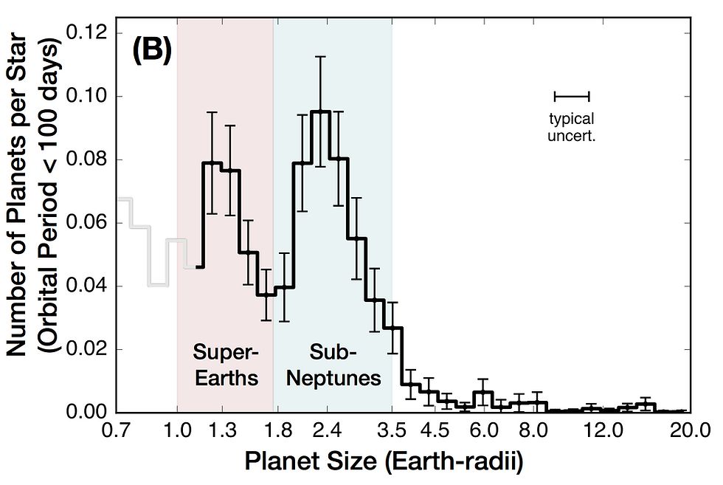
Sub-Neptunes: prime targets for astrobiology
Fulton+2017
Burn+2024

Slide 5
Sub-Neptunes: prime targets for astrobiology
Two leading theories explaining the radius gap and sub-Neptunes size:
  sub-Neptunes are H₂-He rich gas dwarfs, radius gap formed by atmospheric escape (Lopez+2013, Owen+2013)
  sub-Neptunes are H₂O rich steam worlds, radius gap due to composition (Burn+2024, Chakrabarty+2024)
Fulton+2017

Slide 6
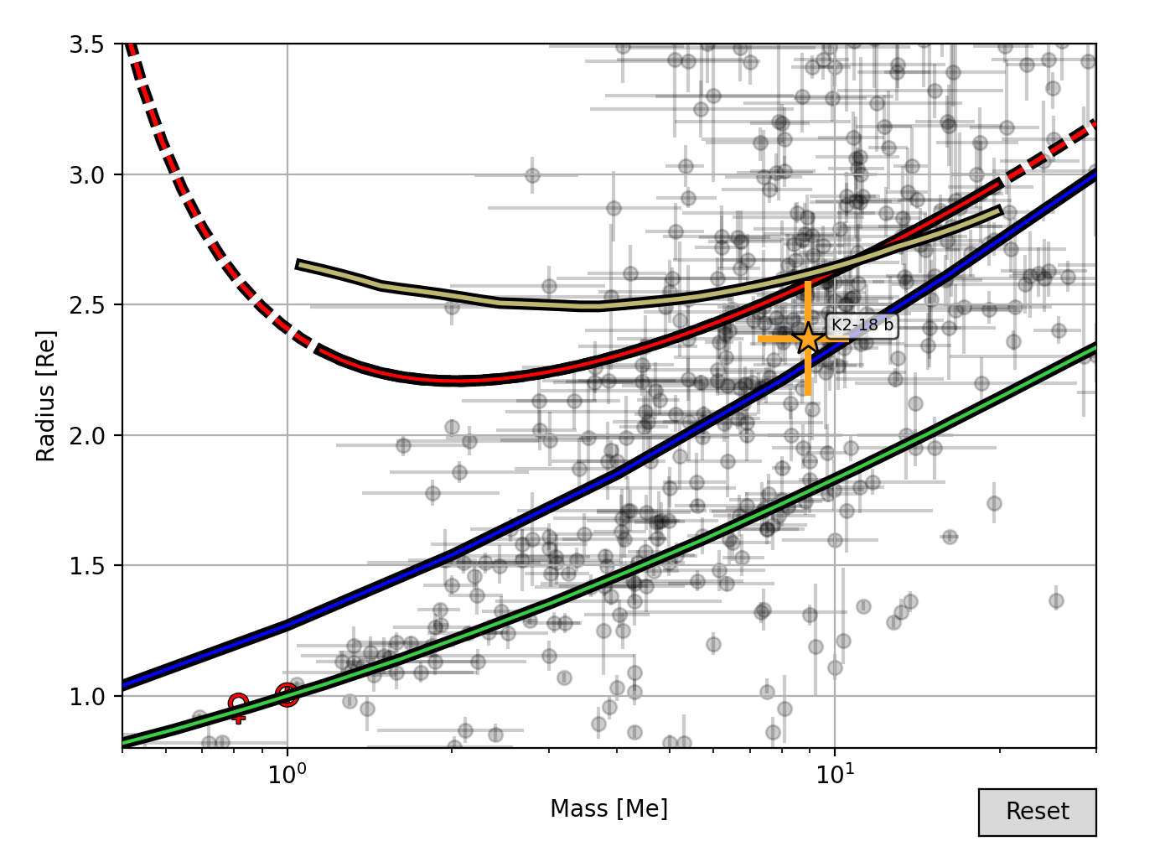
Interior models probe bulk composition
Interior models allow to infer the bulk composition of sub-Neptunes
Compositions are degenerate between gas dwarf and steam world -> additional argument (formation, evolution) are needed
Accurate interior models are essential to constrain bulk compositions and determine the true nature of sub-Neptunes
2% H₂-He
50% steam H₂O
Earth-like line
Aguichine+2024 (mardigras)

Slide 7
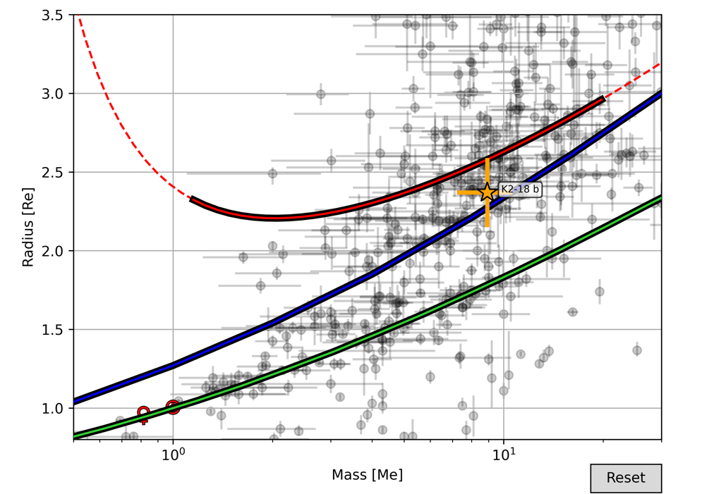
Reinterpretation of sub-Neptune’s interiors
Sub-Neptunes could be steam worlds
or gas dwarf??
2% H₂-He
Steam H₂O:
Aguichine+2021
Liquid H₂O: Zeng+2016
50% steam H₂O
Earth-like line
Notes:
Our model showed that sub-Neptunes, the most common type of exoplanets, could be steam worlds.
Of course, this picture is not complete yet.

Slide 8
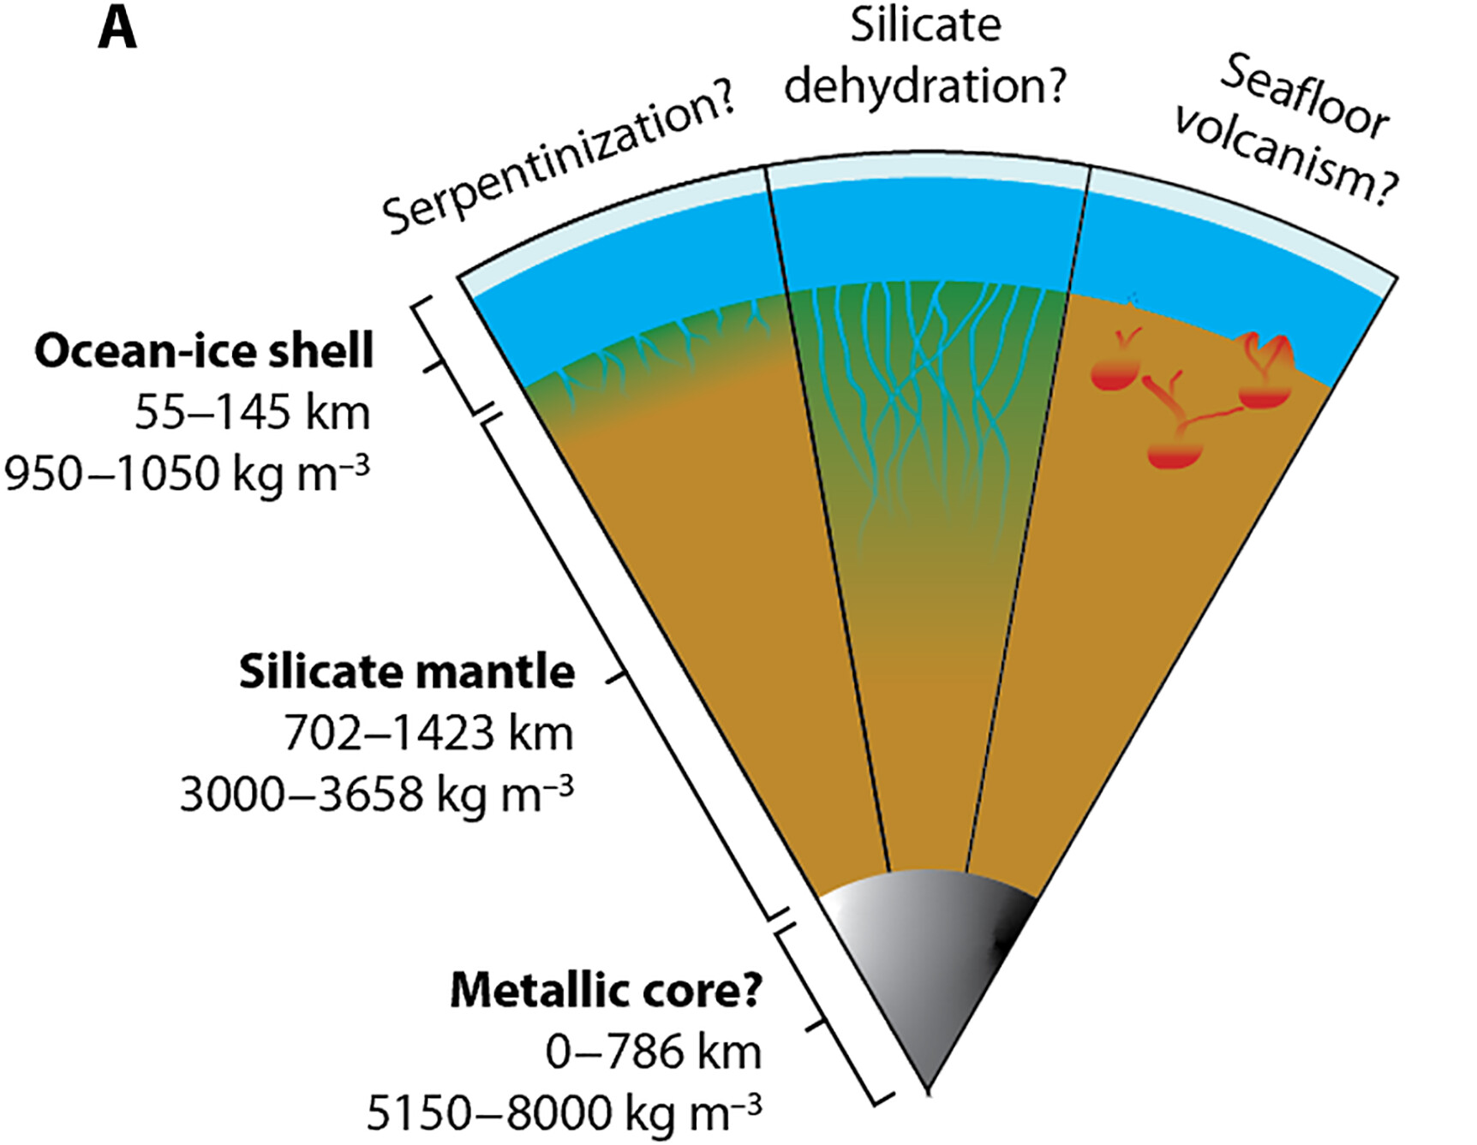
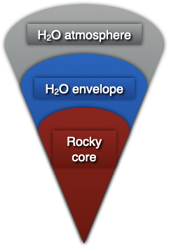
The runaway greenhouse effect
3% of sub-Neptunes:
(Liquid) Water Worlds
97% of sub-Neptunes:
Steam Worlds
Irradiated Ocean Planet (IOP) model (Mousis+2020, Aguichine+2021)
Trinh+2023
Notes:
There is one problem with that approach: it assumes water is condensed at the surface.
In reality, most sub-Neptunes have short periods, and receive so much energy from their host star that they undergo the so-called runaway greenhouse effect.
Water cannot remain in condensed state and forms a steam atmosphere instead, on top of a layer with supercritical water. Such planets are now called steam worlds, and our group in Marseille started modeling them in 2020.

Slide 9
Reinterpretation of sub-Neptune’s interiors
Steam H₂O:
Aguichine+2021
Liquid H₂O: Zeng+2016
50% steam H₂O
50% liquid H₂O
Earth-like line
Notes:
Steam atmospheres are more extended than liquid water oceans, which leads to a re-interpretation of the composition of sub-Neptunes.

Slide 10
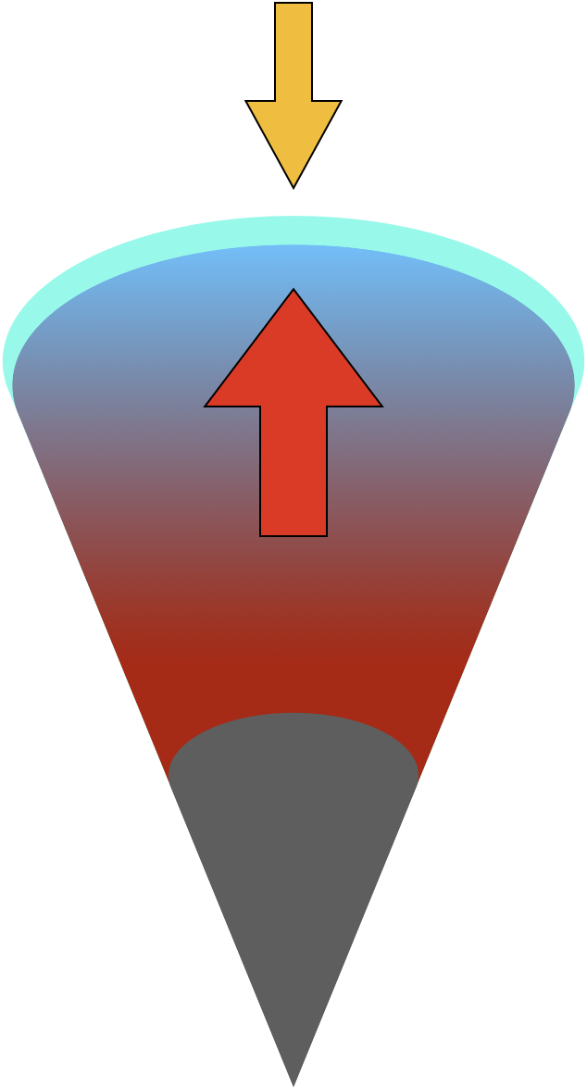


Steam World Evolution (SWE)
Aguichine+2025
L_{in}
Atmosphere
Pure steam atmosphere
Controls heat evacuation rate
Kempton+2023
L_{out}
Envelope
Supercritical H₂O envelope
Thermal and gravitational energy
Aguichine+2021
Core (IOP model)
Earth-like core, but hotter
Thermal, gravitational, and radiogenic energy
Brugger+2016,Aguichine+2021
Jupiter today:
energy out / energy in ~1.8
t = 0
t = 1 Gyr
t = +∞
Notes:
The most recent development of my interior structure model is to model the evolution of steam worlds.
Planets form hot...
This has been modeled for the Solar System, and I’m applying this to steam worlds.

Slide 11
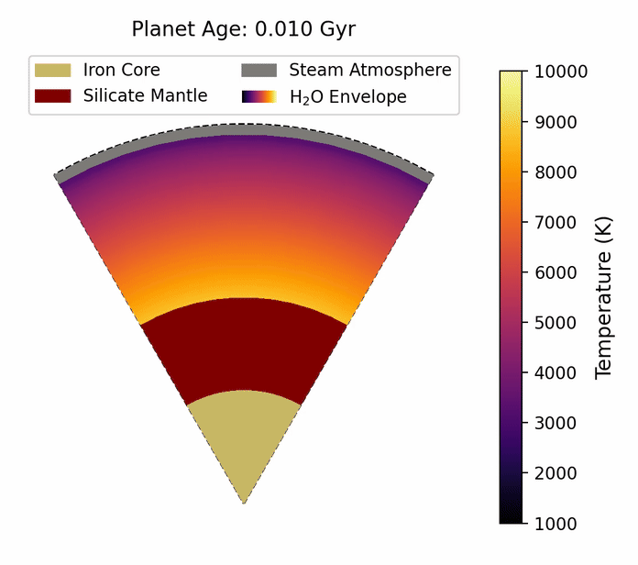


Steam World Evolution (SWE)
Aguichine+2025
Full grids of radius as a function of mass, Teq, age, composition available in Aguichine+2025
Atmosphere
Pure steam atmosphere
Controls heat evacuation rate
Kempton+2023
supercritical H₂O
Envelope
Supercritical H₂O envelope
Thermal and gravitational energy
Aguichine+2021
Evolution tracks on Zenodo
Visualise MR curves in mardigras
silicate mantle
Core (IOP model)
Earth-like core, but hotter
Thermal, gravitational, and radiogenic energy
Brugger+2016,Aguichine+2021
iron core
Notes:
The most recent development of my interior structure model is to model the evolution of steam worlds.
Planets form hot...
This has been modeled for the Solar System, and I’m applying this to steam worlds.

Slide 12
Steam World Evolution (SWE)
Aguichine+2025
Aguichine+2021
Aguichine+2025
Bulk composition of TOI-270d (« vodka planet », Benneke+2024)
No H₂O atmosphere mode (e.g. Zeng+2019): overestimates WMF
« hot interior », Aguichine+2021: underestimates WMF
Evolution model, Aguichine+2025: more accurate WMF
Zeng+2019
Notes:
The most recent development of my interior structure model is to model the evolution of steam worlds.
Planets form hot...
This has been modeled for the Solar System, and I’m applying this to steam worlds.

Slide 13
Reinterpretation of sub-Neptune’s interiors
Sub-Neptunes could be steam worlds.
Steam H₂O:
Aguichine+2021
Liquid H₂O: Zeng+2016
50% steam H₂O
50% liquid H₂O
Earth-like line
Notes:
Our model showed that sub-Neptunes, the most common type of exoplanets, could be steam worlds.
Of course, this picture is not complete yet.

Slide 14
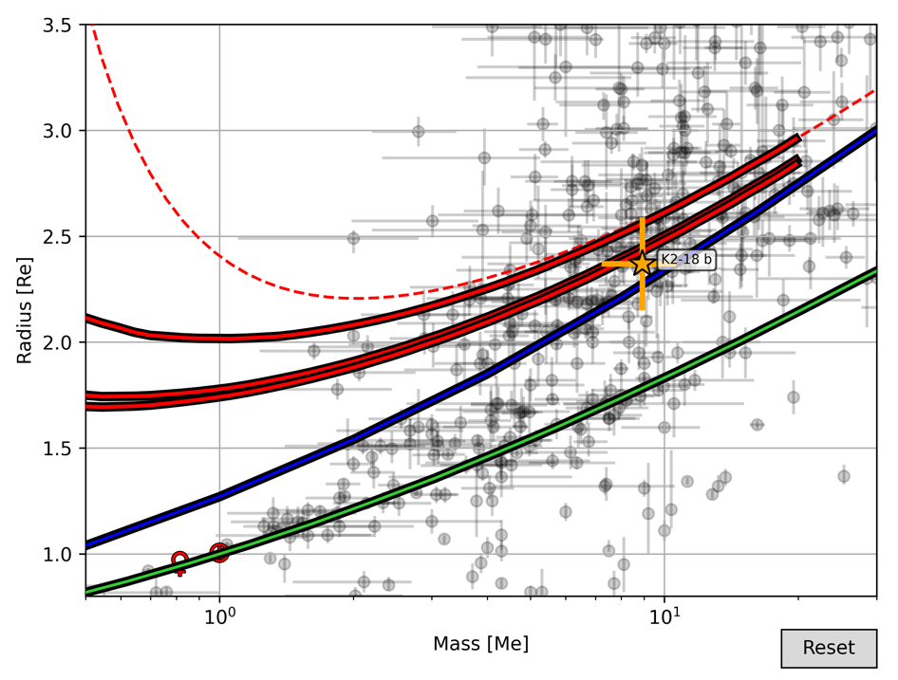

Steam World Evolution (SWE)
Aguichine+2025
50% steam H₂O
10 Myr to 20 Gyr
Steam H₂O:
Aguichine+2025
Liquid H₂O: Zeng+2016
Full grids of radius(mass,Teq,age,composition) available in Aguichine+2025
50% liquid H₂O
Earth-like line
Arxiv paper
Zenodo grids
GitHub mardigras
Notes:
This lead to slightly revised mass-radius relations.

Slide 15
Steam World Evolution (SWE)
Aguichine+2025
Atmosphere
Pure steam atmosphere
Controls heat evacuation rate
Kempton+2023
Envelope
Supercritical H₂O envelope
Thermal and gravitational energy
Aguichine+2021
Core (IOP model)
Earth-like core, but hotter
Thermal, gravitational, and radiogenic energy
Brugger+2016,Aguichine+2021
Zeng+2019: underestimates radius
Aguichine+2021: overestimates radius
Notes:
The most recent development of my interior structure model is to model the evolution of steam worlds.
Planets form hot...
This has been modeled for the Solar System, and I’m applying this to steam worlds.

Slide 16
Reinterpretation of sub-Neptune’s interiors
Sub-Neptunes could be steam worlds
or gas dwarf??
2% H₂-He
Steam H₂O:
Aguichine+2021
Liquid H₂O: Zeng+2016
50% steam H₂O
Earth-like line
Notes:
Our model showed that sub-Neptunes, the most common type of exoplanets, could be steam worlds.
Of course, this picture is not complete yet.

Slide 17
Extension of parameter range
SWE (Aguichine+2025) validity range:
T_{eq} = 500-700 K
Follow-up work: Steam World Evolution Extended in Temperature (SWEET).
Extended validity range:
T_{eq} = 400-1500 K
T_{int} upper lim: 400K -> 800K.
Added to Zenodo and mardigras
Notes:
This lead to slightly revised mass-radius relations.

Slide 18
Same mass, same radius, different composition
H₂O steam/supercritical
H₂/He gas
Rock
Steam World
Gas Dwarf
Pure H₂O envelope: Aguichine+2025
H₂-He (1x solar): Tang+2025
50%
0.43%
(H₂-He)
(H₂O)
50%
99.57%
Image Credit: Aguichine & Batalha
Notes:
Degeneracy in composition.
Breaking this degeneracy was the promise of the JWST.

Slide 19
Volatile content of sub-Neptunes
Methodology:
Interior model grids: planet radius R_{p} as a function of M_{p}, T_{eq}, Age and f_{env}.
Gas dwarf model: Tang+2025 ; Steam world model: Aguichine+2025
Method: use R_{p},M_{p}, T_{eq}, and Age to infer f_{env} with MCMC
Two key points:
1: in gas dwarf, R_{p} very sensitive to f_{env} when f_{env} is small
2: MCMC prior on composition matters (a lot)

Slide 20
Development 2: intermediate grid values
Radius
50% H₂O
Earth-like
5 Me
10 Me
Mass
Notes:
This lead to slightly revised mass-radius relations.

Slide 21
Development 2: intermediate grid values
Radius
50% H₂O (Aguichine+2025)
Earth-like (Zeng+206)
5 Me
10 Me
Mass
Notes:
This lead to slightly revised mass-radius relations.

Slide 22
Development 2: intermediate grid values
Radius
Grid interpolation (and extrapolation)
50% H₂O (Aguichine+2025)
Earth-like (Zeng+206)
5 Me
10 Me
Mass
Notes:
This lead to slightly revised mass-radius relations.

Slide 23
Development 2: intermediate grid values
Radius
Grid interpolation (and extrapolation)
50% H₂O (Aguichine+2025)
Earth-like (Zeng+206)
Linear connection
5 Me
10 Me
Mass
Notes:
This lead to slightly revised mass-radius relations.

Slide 24
Radius at low f_{env}
Radius
Grid interpolation (and extrapolation)
50% H₂O (Aguichine+2025)
Earth-like (Zeng+206)
Linear connection
5 Me
10 Me
Mass
Extrapolation or linear continuation are not physically motivated, and inaccurate.
Notes:
This lead to slightly revised mass-radius relations.

Slide 25
Simple analytical atmosphere model (1)
Any grid will give the radius R₀=R_{core}, R₁, R₂ at envelope fraction f₀=0, f₁, f₂, etc.
Build a simple R_{p}(f_{env}) model
Req 1: R_{p}(f_{env}) reproduces grid data
Req 2: speed is important (MCMC)

Slide 26

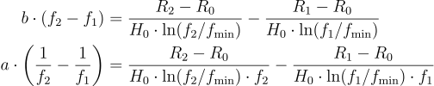
Simple analytical atmosphere model (2)
Question: what is the thickness Z_{atm} of an atmosphere of mass M_{atm}= f_{env} x M_{p}?
Answer: approximated by isothermal atmosphere at average temperature
  where:
    a+c = 1
    f_tau <<< 1
    and
(inspired by Guillot+2010)

Slide 27
Simple analytical atmosphere model
Any grid will give the radius R₀=R_{core}, R₁, R₂ at envelope fraction f₀=0, f₁, f₂, etc.
Build a simple R_{p}(f_{env}) model
Req 1: R_{p}(f_{env}) reproduces grid data
Req 2: speed is important (MCMC)

Slide 28
Simple analytical atmosphere model (1)
Question: what is the thickness Z_{atm} of an atmosphere of mass M_{atm}= f_{env} x M_{p}?
  Hydrostatic equilibrium: always true
  Pressures mostly < 1000 bar: ideal gas law is OK
  Transiting pressure P_{tr} = only depends on composition (same for pure H₂O, or 1xSolar, etc.)
  Top of the atmosphere: isothermal; the rest isn’t

Slide 29
Simple analytical atmosphere model (2)
Challenge: how to build a fast and simple model with complex T profile?
Known: R₀=R_{core}, R₁ and R₂ at f₀=0, f₁, f₂. T_{eq} and M_{core}.
  Step 1: hydrostatic equilibrium: P_{base} = f x g_{surf} / (4 Pi G)
  Step 2: approximate atmosphere thickness: Z_{atm,0} = H₀ x ln(P_{base}/P_{tr}), H₀ scale height at T_{eq}
  Step 3: actual atmosphere thickness is given by an atmosphere of
  average temperature T –> effective scale height H –> Z_{atm} = H x ln(P_{base}/P_{tr})
  Step 4: fit Z_{atm}(f) using known radii (3 data points = up to 3 parameters).
  speed is key –> the fit must be analytical

Slide 30
Simple analytical atmosphere model (3)
Core question: what is the average temperature T(f)?
  Req 1: T(0) = T_{eq}
  Req 2: T(f) must be well-behaved (no inversions, no explosions)
Solution inspired by Guillot 2010 model
  Req 1: a+c = 1
  Req 2: f_tau <<< 1

Slide 31
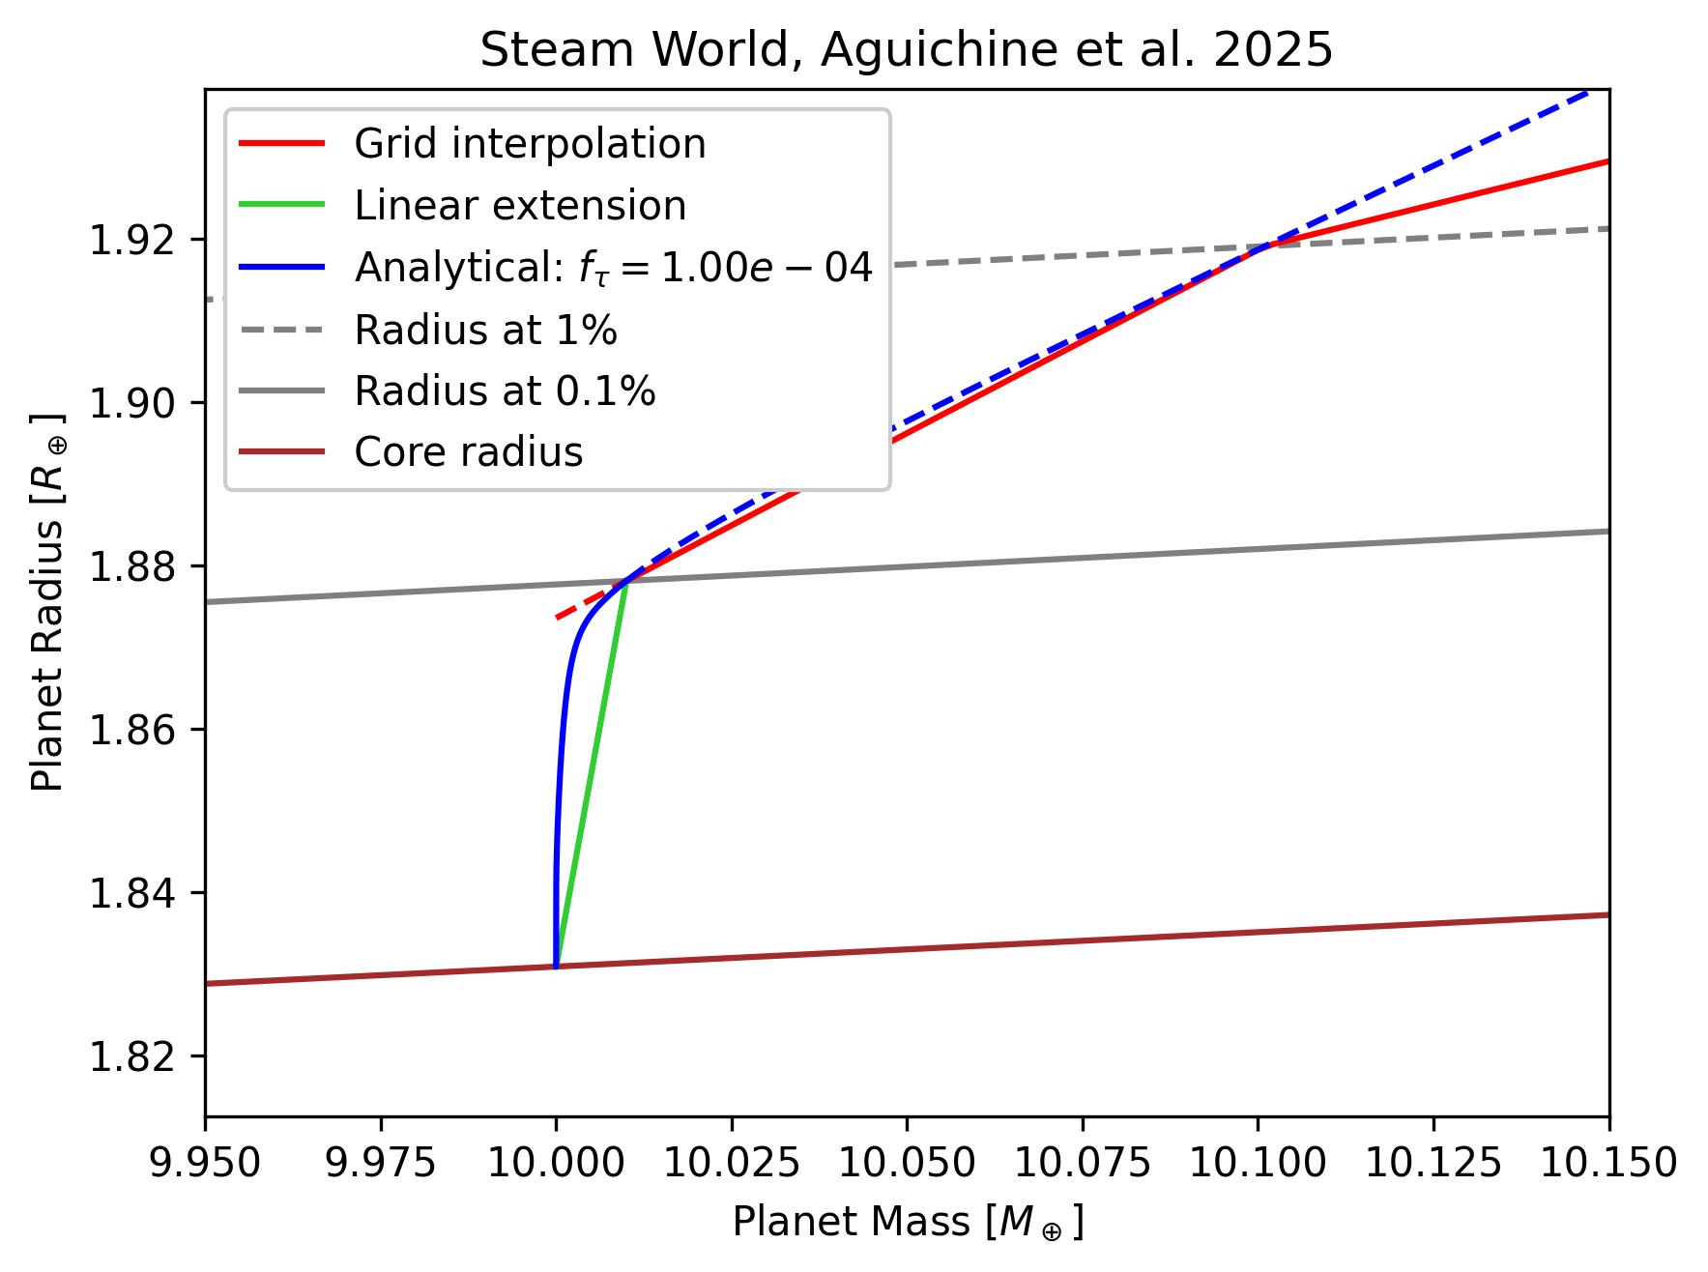
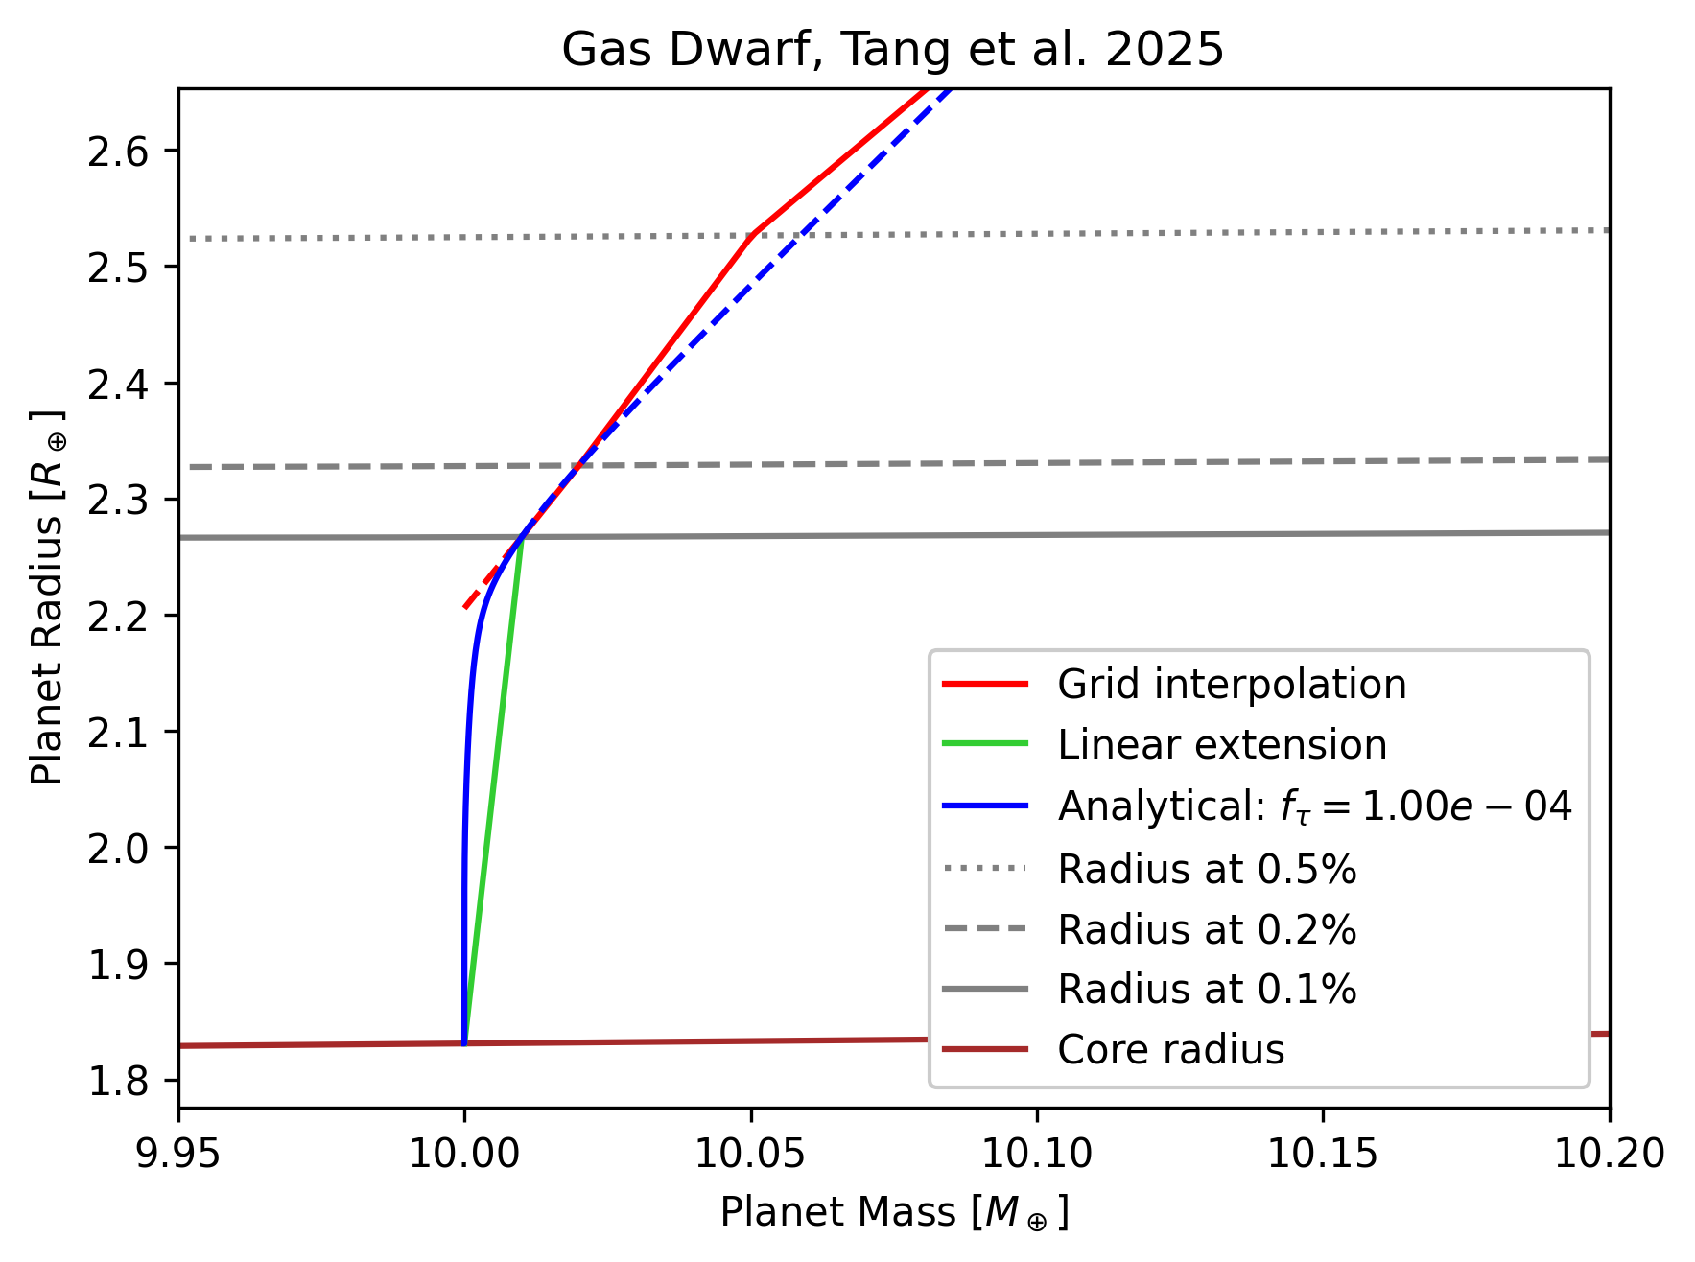
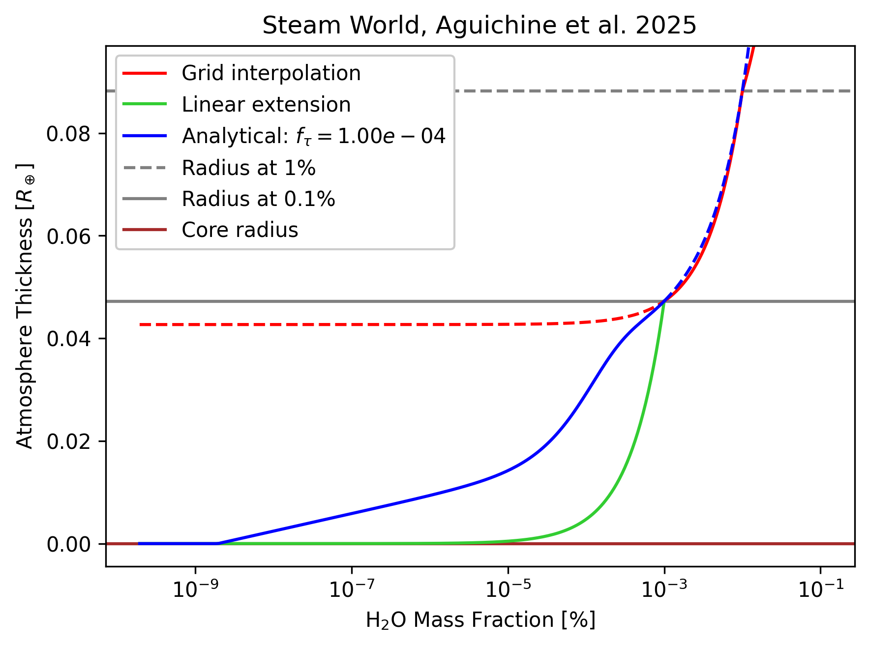
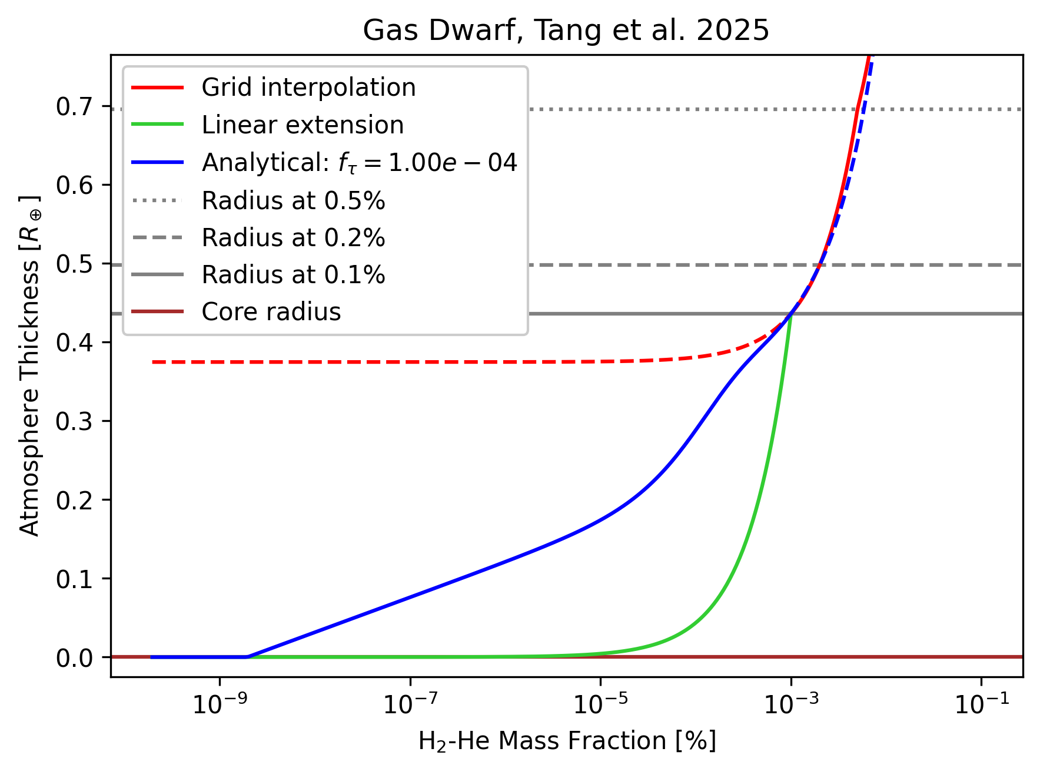
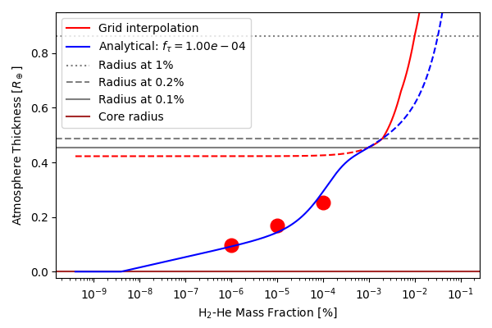
Simple atmosphere model results

Slide 32
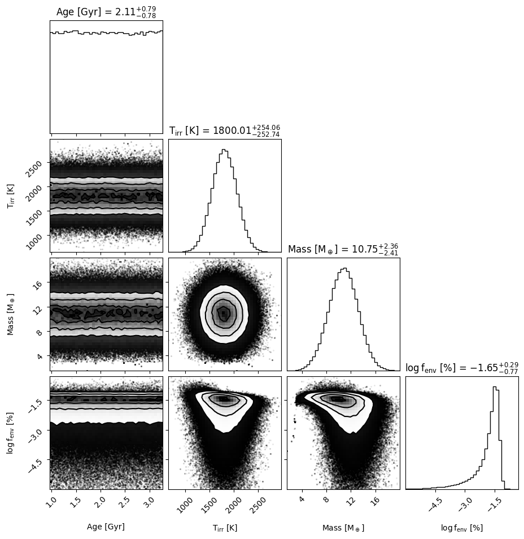
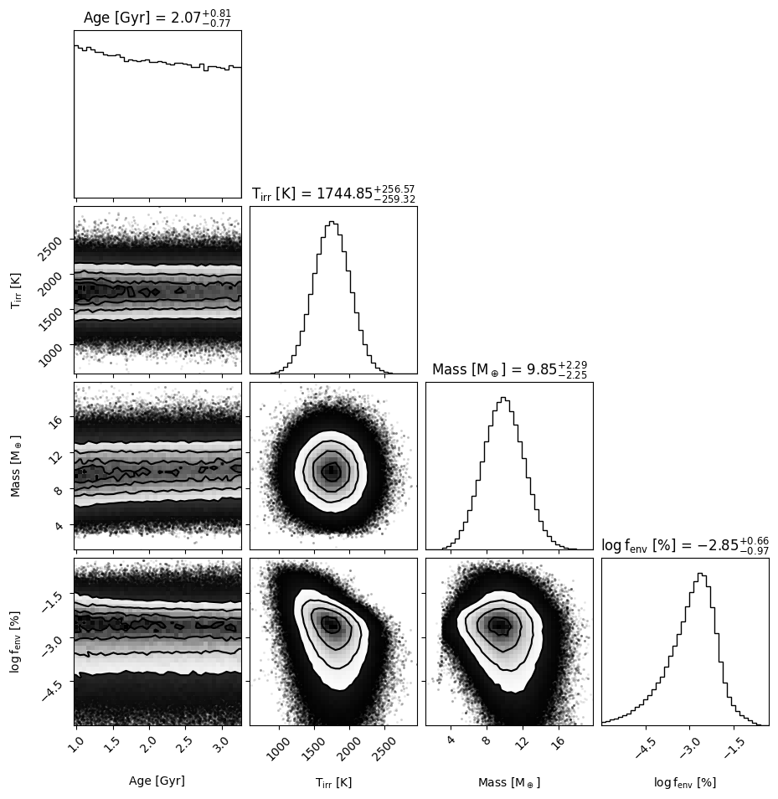
Radius at low f_{env}
Linear model: f_{env} overestimated
This model: f_{env} 10x lower!!!

Slide 33
Radius at low f_{env}
Linear model: f_{env} overestimated
This model: f_{env} 10x lower!!!
planet radius

Slide 34
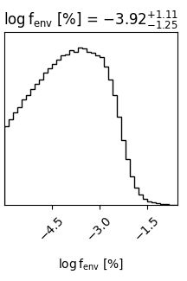
Flat or log-flat sampling
Linear model: fenv overestimated
This model: fenv 10x lower!!!
Log-flat prior: favors small values

Slide 35
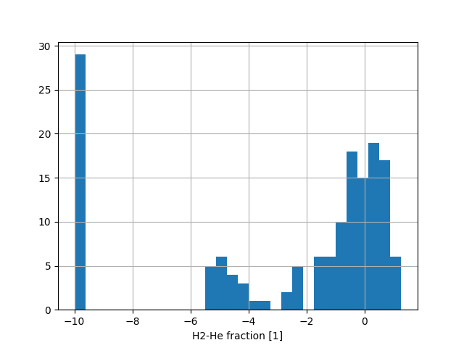
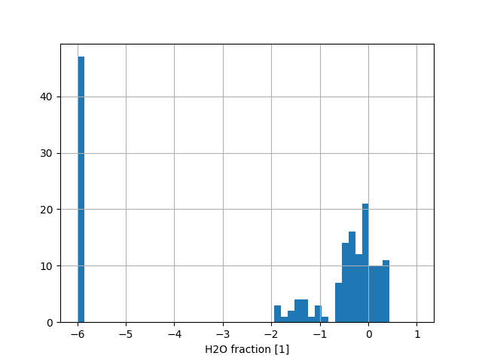
Radius gap in composition space
>100% H2O zone 💀
Grid limit
Radius gap
H2-He transition
Grid limit
>100% H2O zone 💀
Radius gap
Radius gap

Slide 36
Radius gap in composition space
Interior model grid limit
Composition gap
>100% H₂O zone 💀
In both cases (gas dwarf or steam world), there is a composition gap
This composition gap is supported by evolution (atmospheric escape) and formation models
Radius composition gap

Slide 37
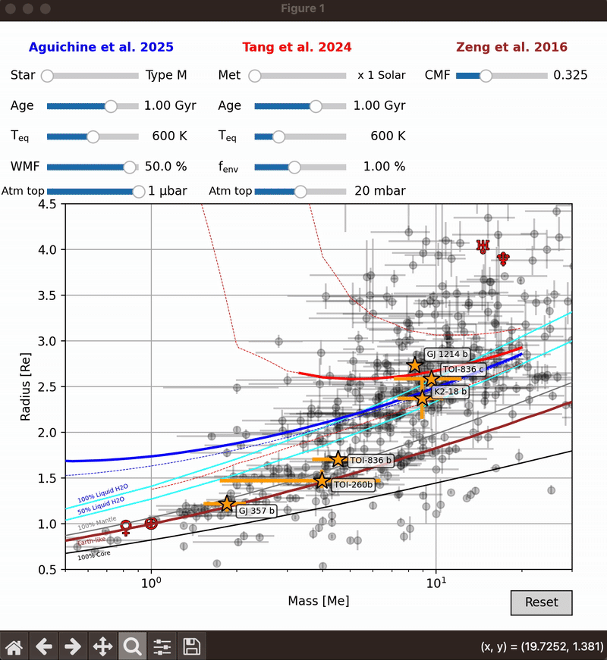
Summary
MARDIGRAS, Aguichine+2024
Radius gap produces a dichotomy in bulk composition, a composition gap:
  This composition is derived using state-of-the-art self-consistent models of gas dwarf (Tang+2025) and steam world (Aguichine+2025) evolution
  This composition accounts for planet radius, mass, Teq, and age
Grids of interior models:
  Available on Zenodo and mardigras
Future work:
  Mixture of H₂O with H₂-He
  Demixing of H₂O from H₂-He (Piaulet-Ghorayeb+2025)

Slide 38

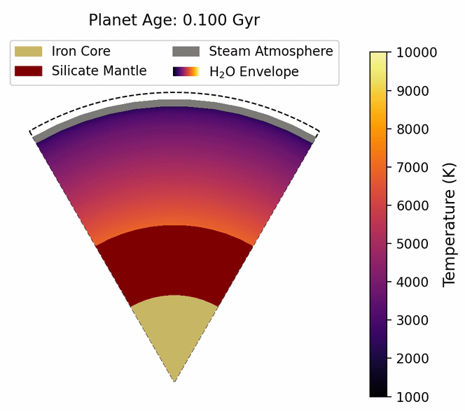
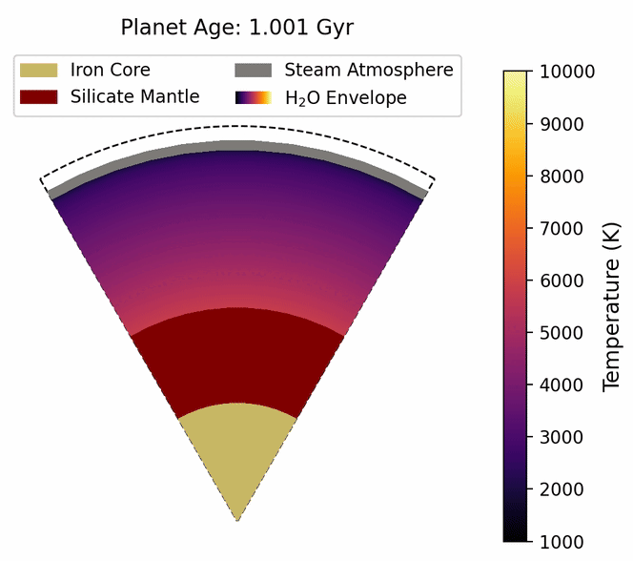
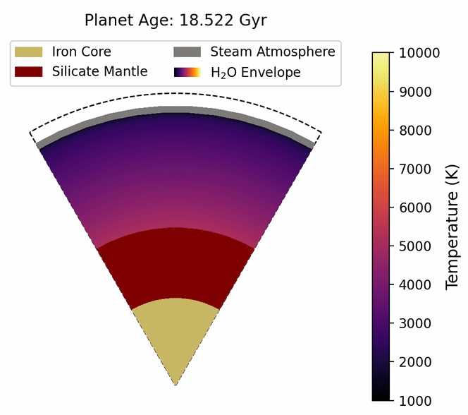
Steam World Evolution (SWE)
Aguichine+2025
supercritical H₂O
silicate mantle
iron core
Notes:
The most recent development of my interior structure model is to model the evolution of steam worlds.
Planets form hot...
This has been modeled for the Solar System, and I’m applying this to steam worlds.

Slide 39
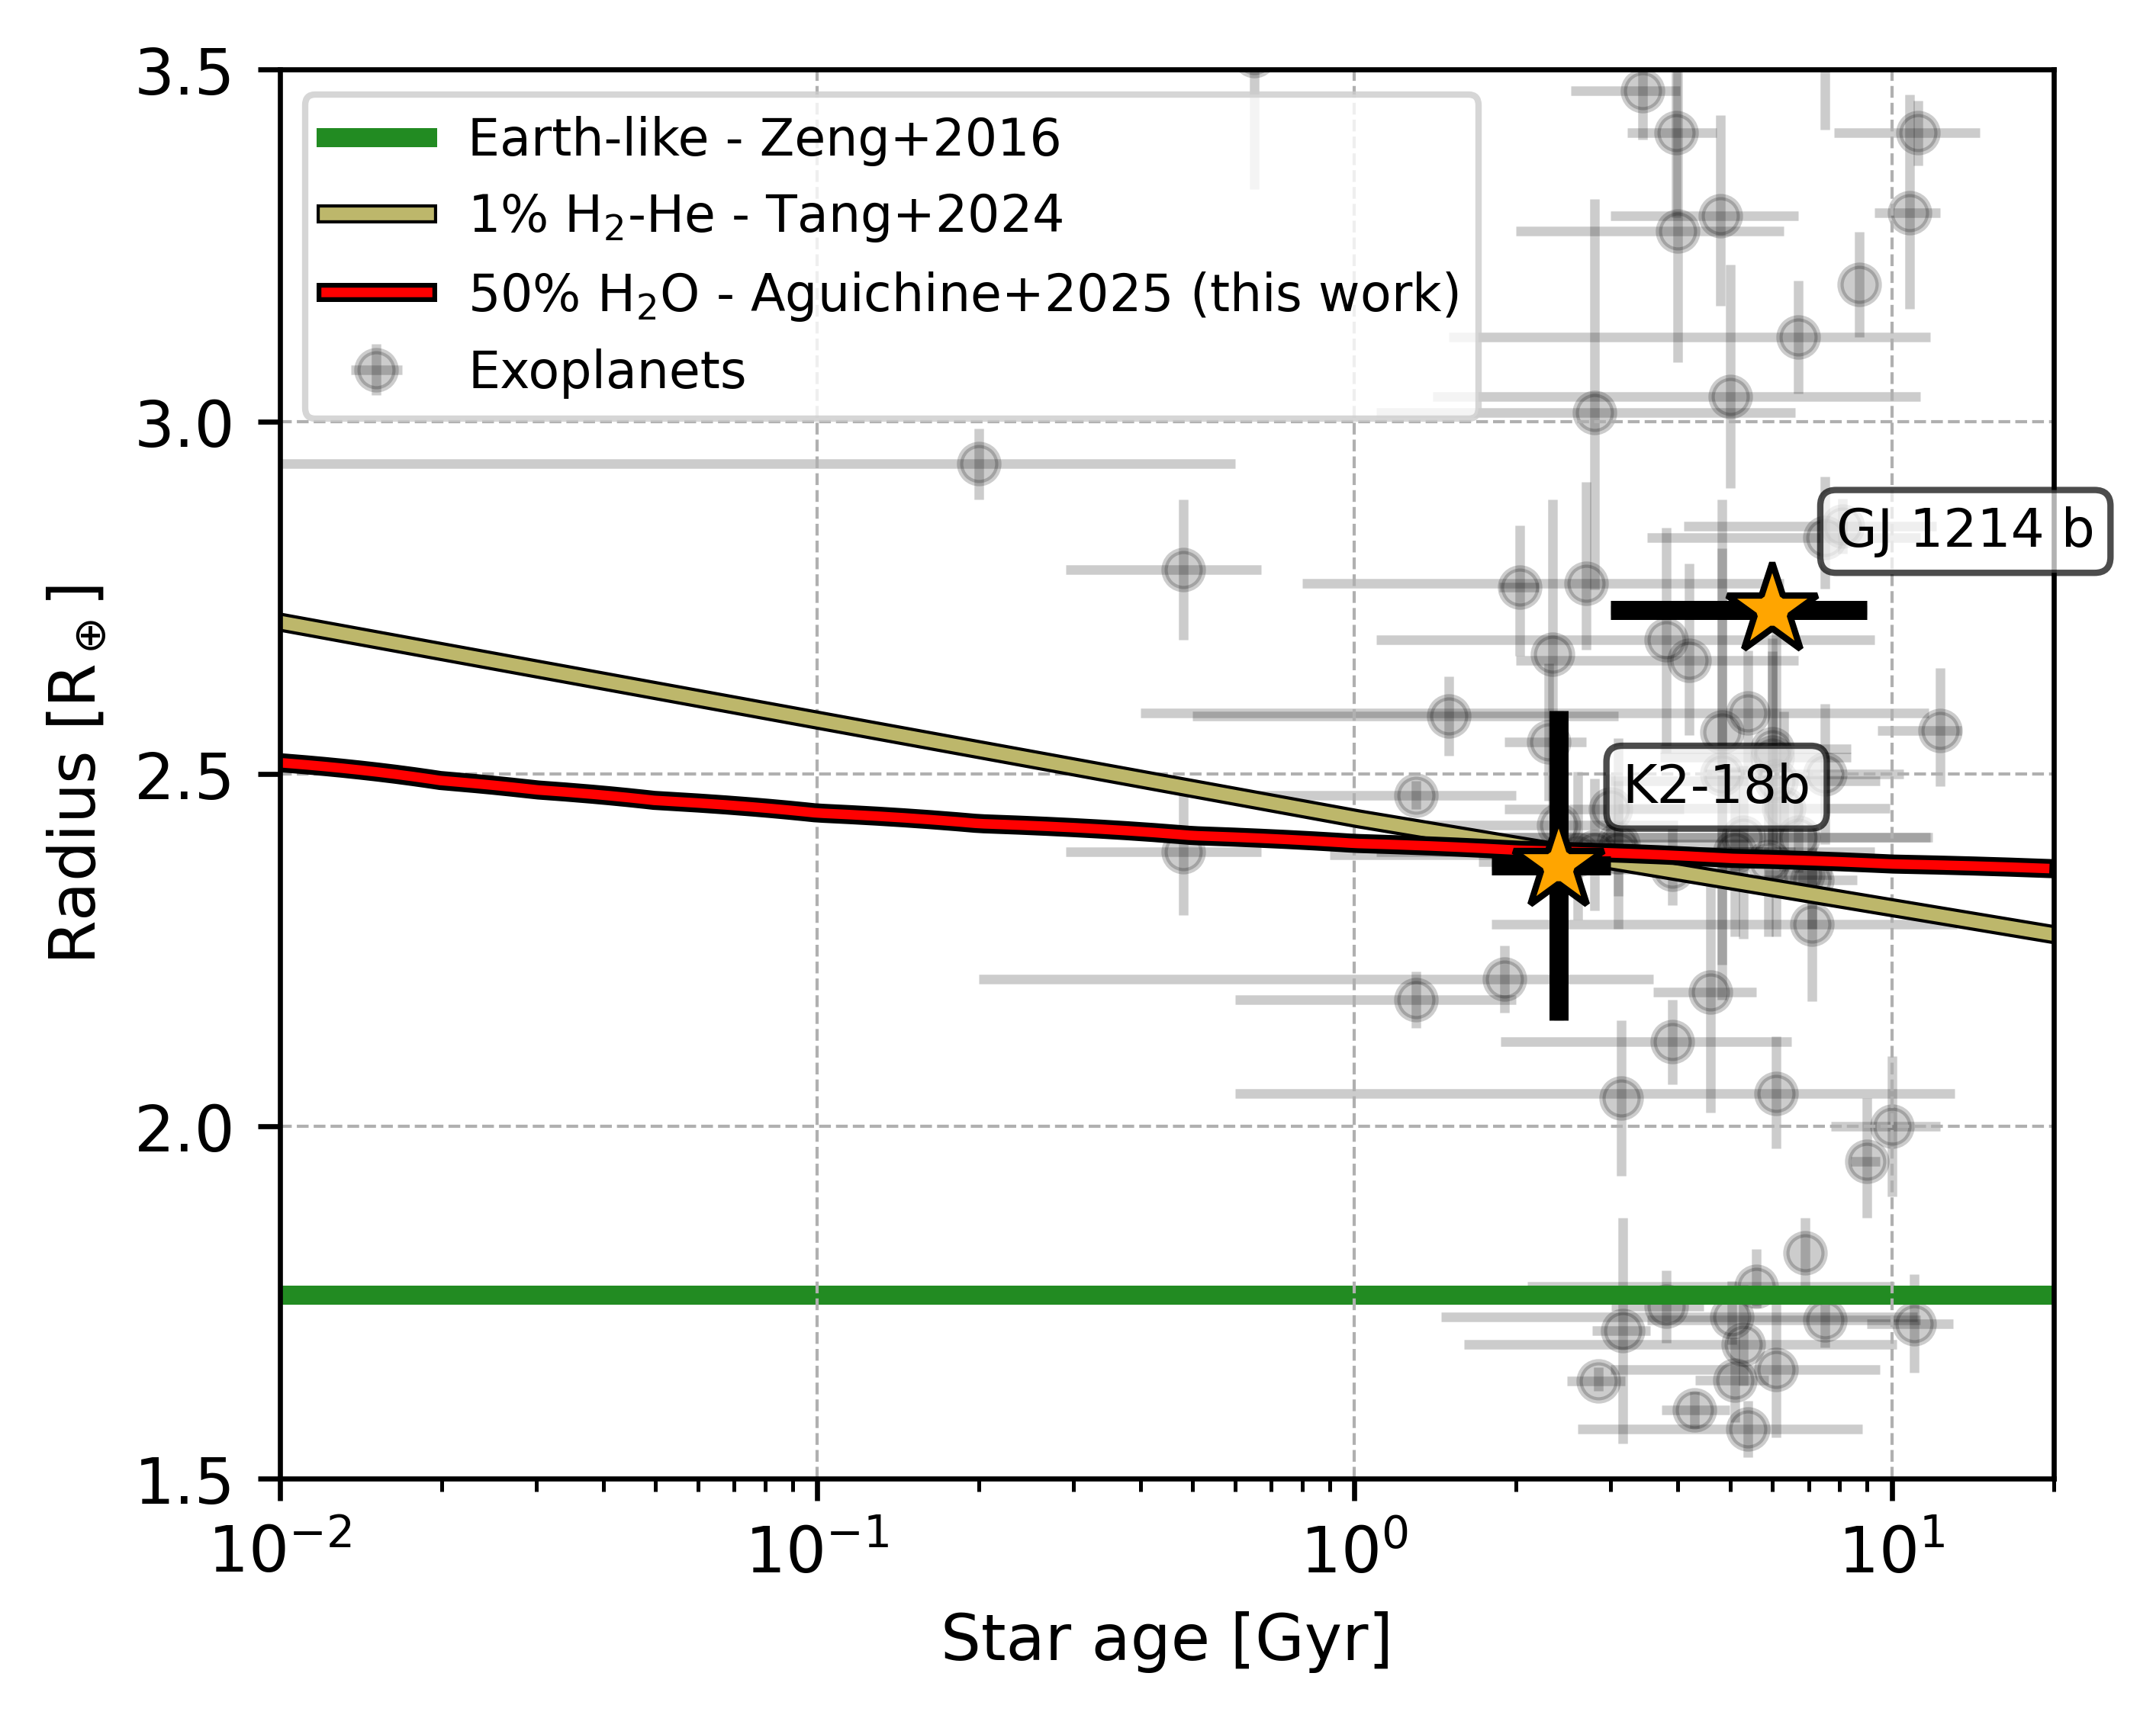
Break the degeneracy with age
?
?
0.6% H₂-He
Better radius and age measurements with PLATO and Gaia:
are sub-Neptunes H₂-He or H₂O?
?
50% H₂O
?
?
?
?
?
?
?
Earth-like
Aguichine & Owen 2025 (in prep)
See also Rogers 2025
Notes:
Most importantly, this new addition has the potential to break the degeneracy in composition using age.
This plot show exoplanets in the radius-age space, and it shows that although interior compositions are degenerate, the rate at which the radius decreases is different.
Currently, we lack precise measurements of stellar ages, but this plot will be filled in the nearby future with missions such as Gaia and PLATO.

Slide 40


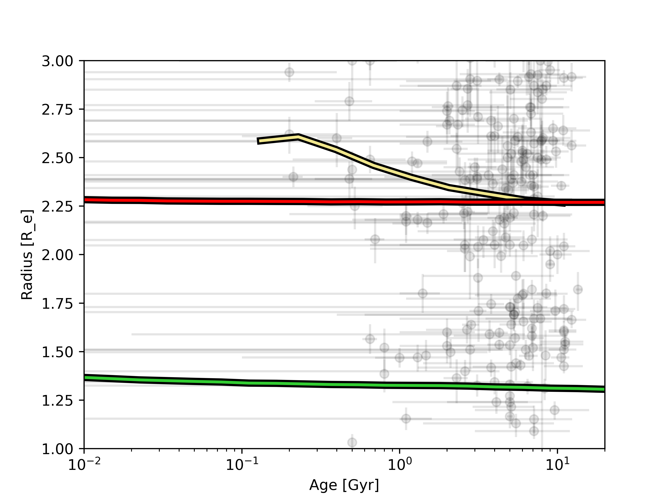
Break the degeneracy with age
H₂-He population
Predicting the population
of sub-Neptune radii
at early age:
if they are Steam Worlds
if they are Gas Dwarves
(population of
100 000 planets)
?
?
?
H₂O population
?
?
?
?
?
?
?
Earth-like population
Aguichine & Owen 2025 (in prep)
See also Rogers 2025
Notes:
In the figure shown here, I model a population of 100.000 planets and report the mode of their radius assuming different compositions.
My steam world evolution model is the most self-consistent and up-to-date. This allows me to accurately predict how the radius of an entire population of exoplanets evolves over time.

Slide 41
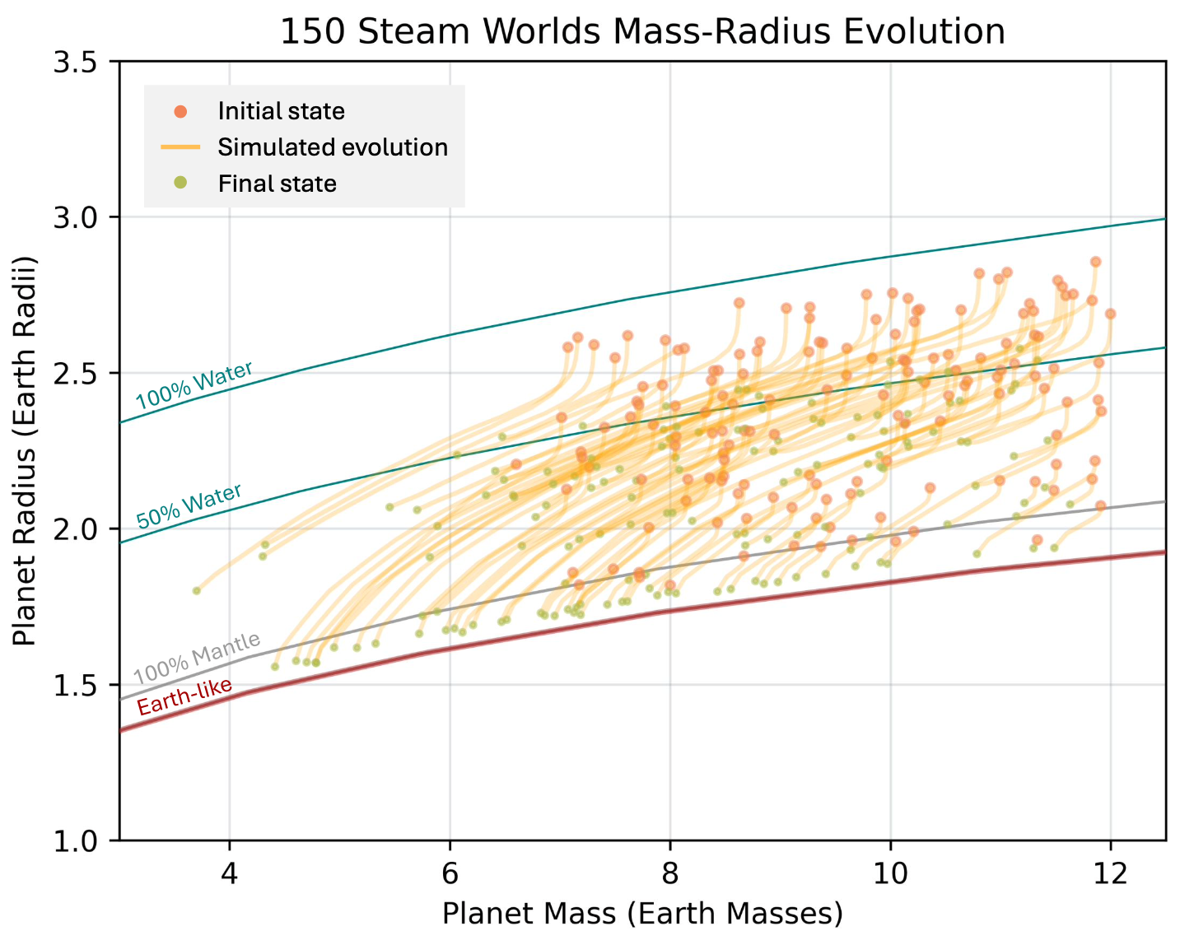

Atmospheric escape of Steam
Envelopes can be stripped by atmospheric escape
Interior composition changes over time
Talk on Friday
Emerson Tao
(undergraduate)
Tao, Aguichine+2025
“Planets on the Edge” conference, May 2025
KITP, UC Santa Barbara
Notes:
One last aspect I want to mention is that composition can change over time, and there is an entire field dedicated to the study of atmospheric escape. I do not model atmospheric escape, but including its effectin my models is critical.
This modeling was done by undergraduate student Emerson Tao, who presented this work at the Planets on the Edge conference that was held last week in Santa Barbara.
His work shows that steam worlds can lose a significant portion of their envelope, and that this is visible in the mass-radius space.

Slide 42

Applications to Machine Learning
M_p
…
T_irr
R_core
…
x_core’
R_mantle
R_b
…
Planet radius
x_h2o
R_h2o
R_a
…
scale height
R_atm
Fitting the radius with Dense Neural Networks for speed and accuracy
…
jeans parameter
(more)
Talk to us ☺
Hailey Feller
(undergraduate)
Notes:
One last aspect I want to mention is that composition can change over time, and there is an entire field dedicated to the study of atmospheric escape. I do not model atmospheric escape, but including its effectin my models is critical.
This modeling was done by undergraduate student Emerson Tao, who presented this work at the Planets on the Edge conference that was held last week in Santa Barbara.
His work shows that steam worlds can lose a significant portion of their envelope, and that this is visible in the mass-radius space.

Slide 43




Rocky planets’ age matters too
Rocky planets could be
molten inside: change in radius
State of the art equations of state (EOS) for iron (Hakim+2018) and mantle (Caracas+2024)
Molten (young)
Present-day Earth
Fully solid
(aged)
Liquid mantle
Solid mantle
Solid mantle
Lily Larkins
(post-bac)
Liquid core
Liquid core
Talk in 3 minutes
Solid core
Solid core
Aguichine+2025 (in prep), Larkins+2026 (in prep)
Notes:
In fact, this also applies to rocky planets to a smaller extent. When the conditions are right, rocky planets can have the rocky part entirely or partially molten, and this phase transition alters the final radius.
This is a project I am working on with undergraduate student Lily Larkins.
She is currently investigating thermal effects on the equation of state of molten minerals.

Slide 44
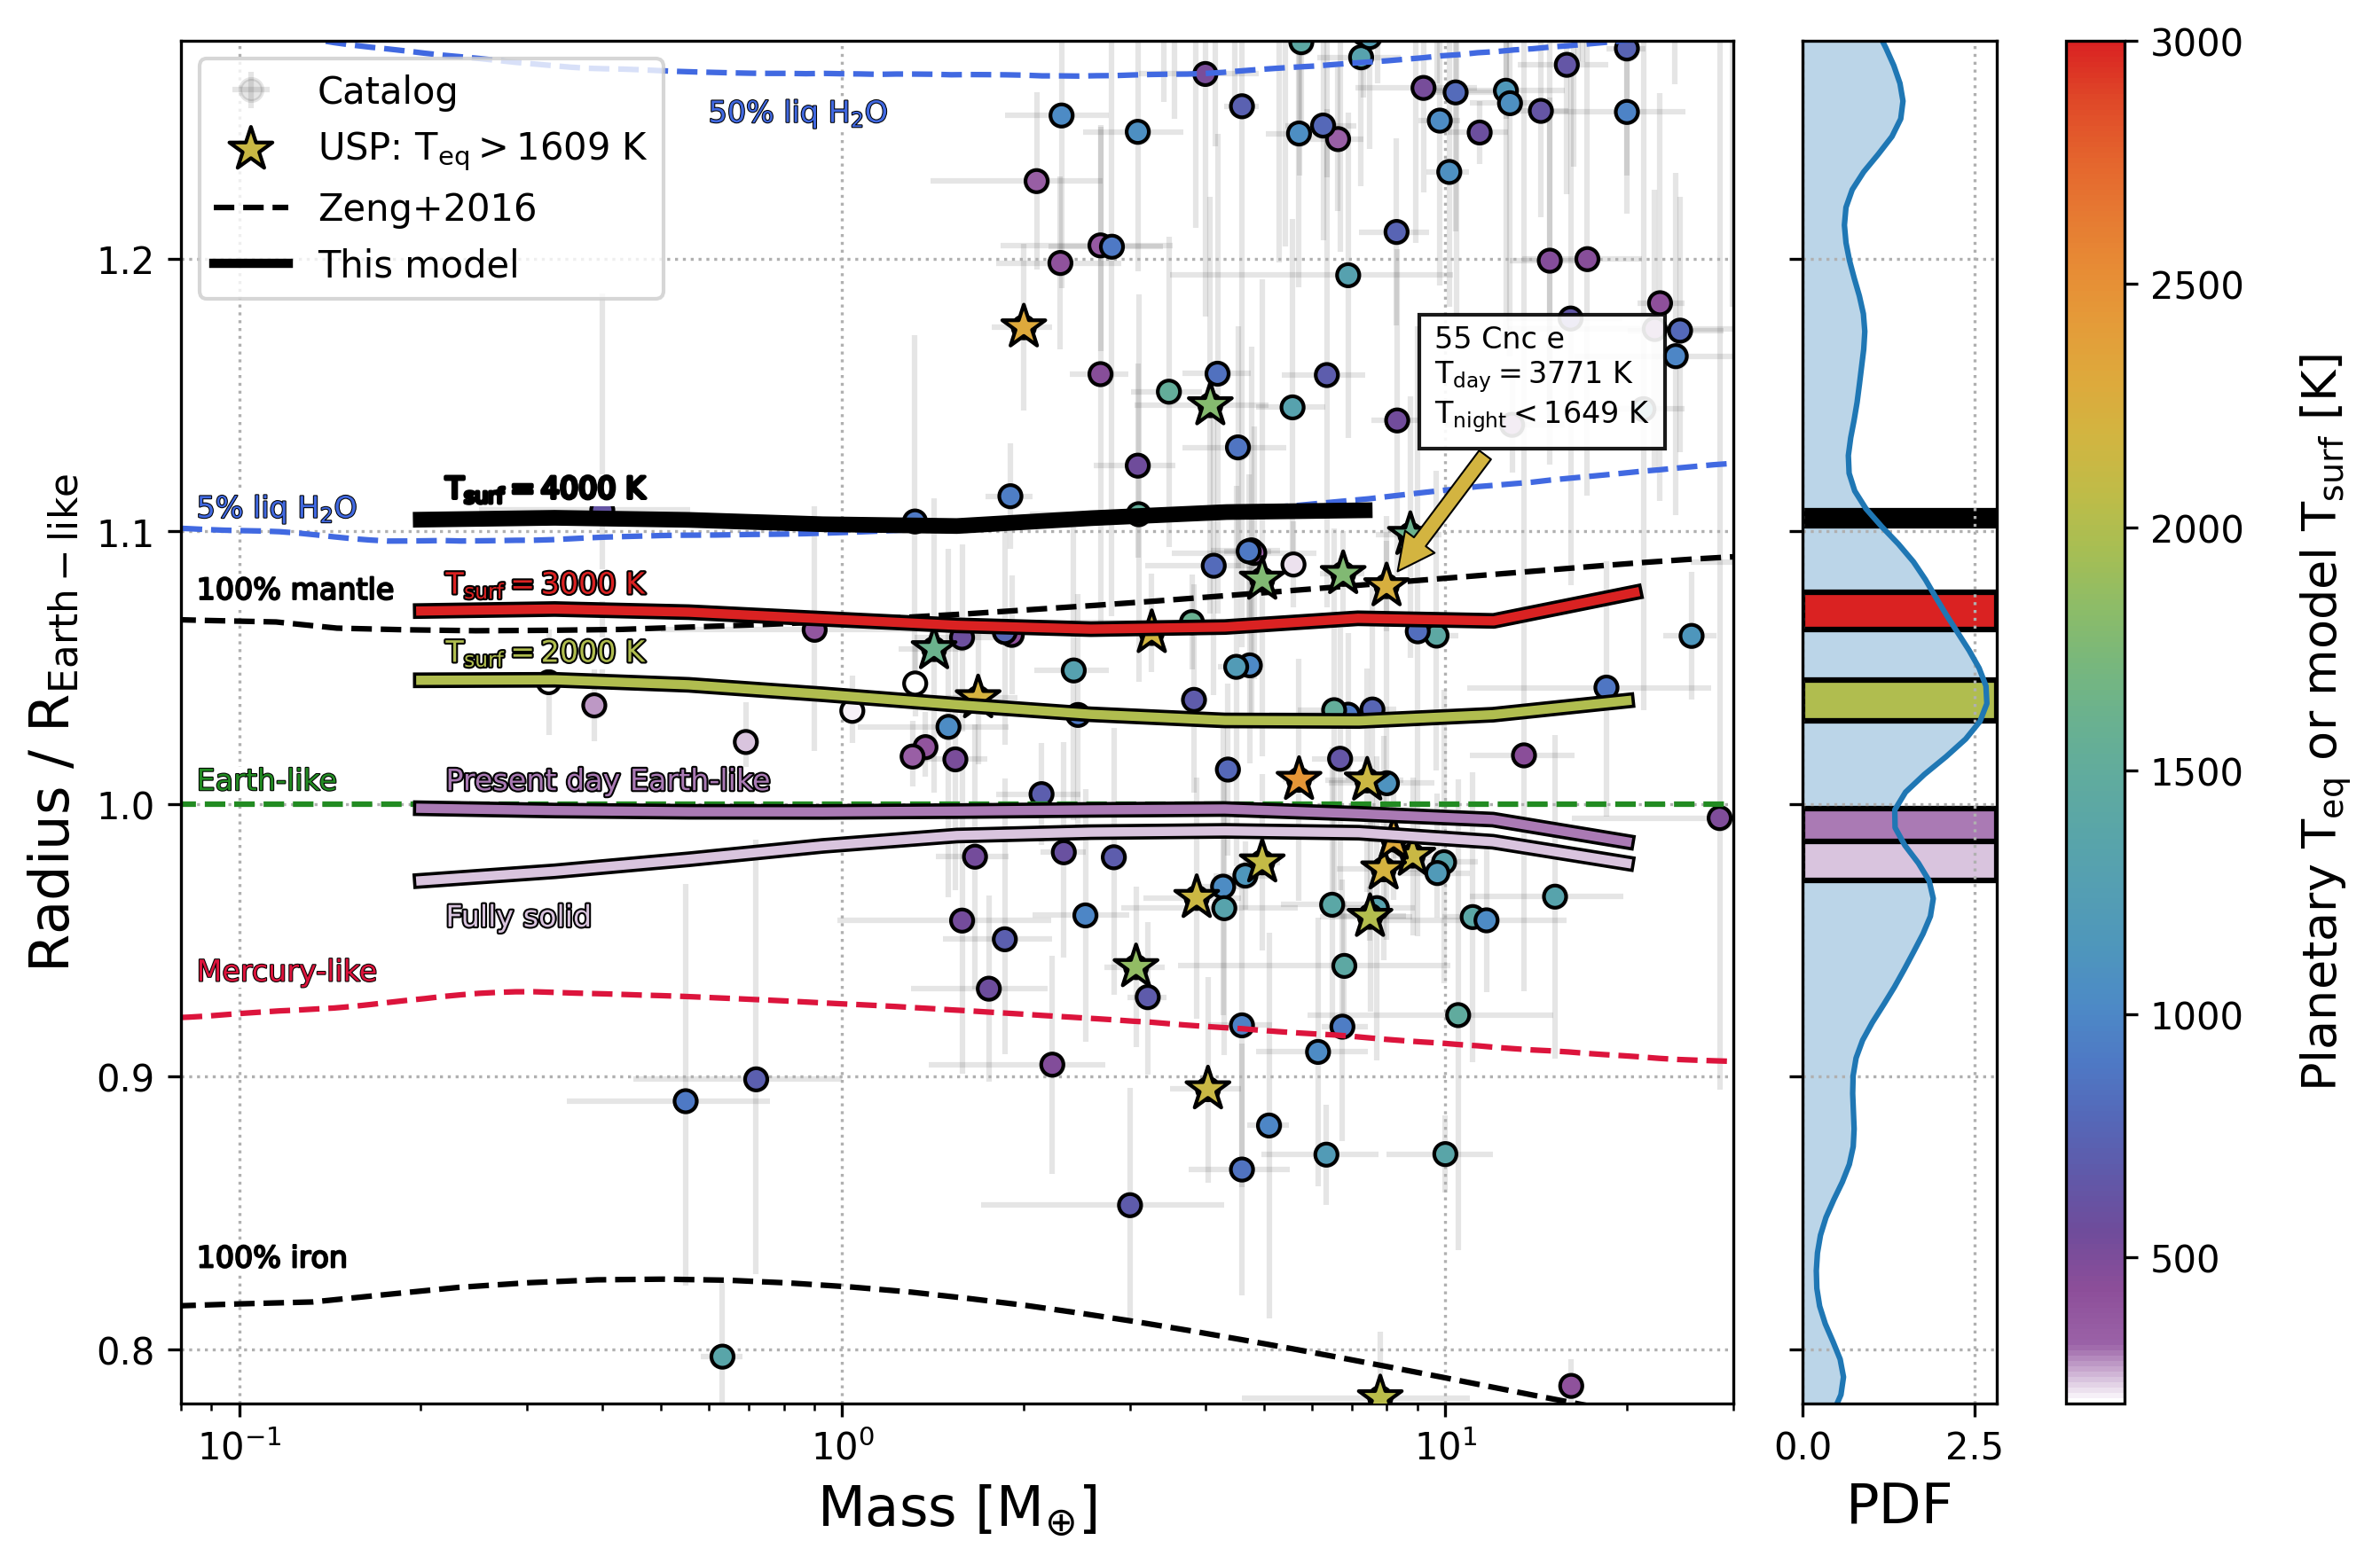
Rocky planets’ age matters too
Molten (young)
Present-day Earth
Fully solid
(aged)
Liquid mantle
Solid mantle
Solid mantle
Liquid core
Liquid core
Solid core
Solid core
See our poster ☺
Aguichine+2025 (in prep), Larkins+2026 (in prep)
Notes:
In fact, this also applies to rocky planets to a smaller extent. When the conditions are right, rocky planets can have the rocky part entirely or partially molten, and this phase transition alters the final radius.
This is a project I am working on with undergraduate student Lily Larkins.
She is currently investigating thermal effects on the equation of state of molten minerals.

Slide 45
Summary
Evolution (stellar age) can distinguish between steam worlds and gas dwarfs
  Time is key!
Modeling is exciting (but hard):
  Need more experiments (opacity, EOS)
  Other phenomenons (mixing, chemistry, etc.) (Kite+2020, Dorn+2021,Vazan+2022)
  Next step: H₂O + H₂-He, CH₄, NH₃
MARDIGRAS (visualisation tool):
  For observers: interpret exoplanet composition, use grids with MCMC
  For experts: compare models
  For educators: teaching tool
MARDIGRAS, Aguichine+2024

Slide 46
Summary
Simple analytical atmosphere model for accurate atmosphere thickness
  Planet radius beyond grid range
  Does not slow down MCMC
MCMC retrieval:
  More accurate inferred volatile content
  Priors are important
Composition of sub-Neptunes:
  « radius gap » preserved in
  composition space for both
  steam world and gas dwarf scenario
MARDIGRAS, Aguichine+2024

Slide 47
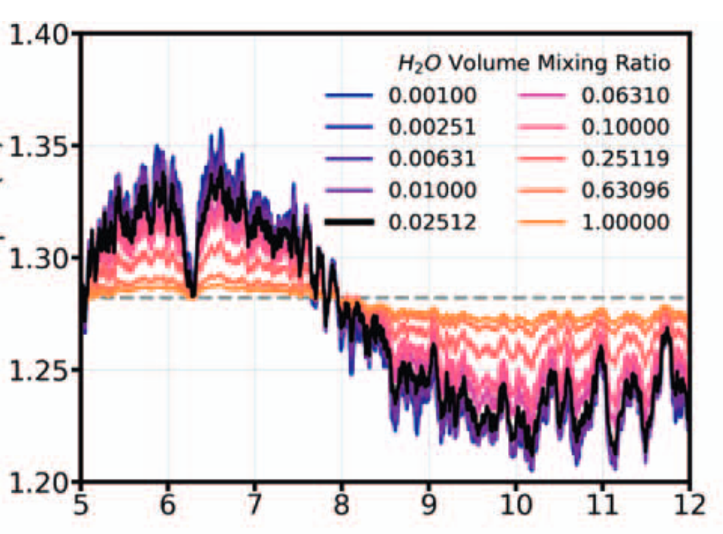
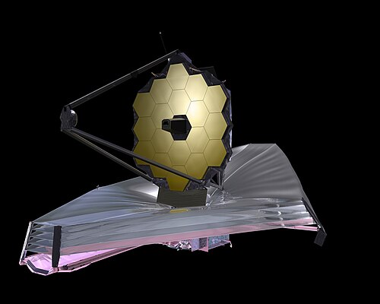
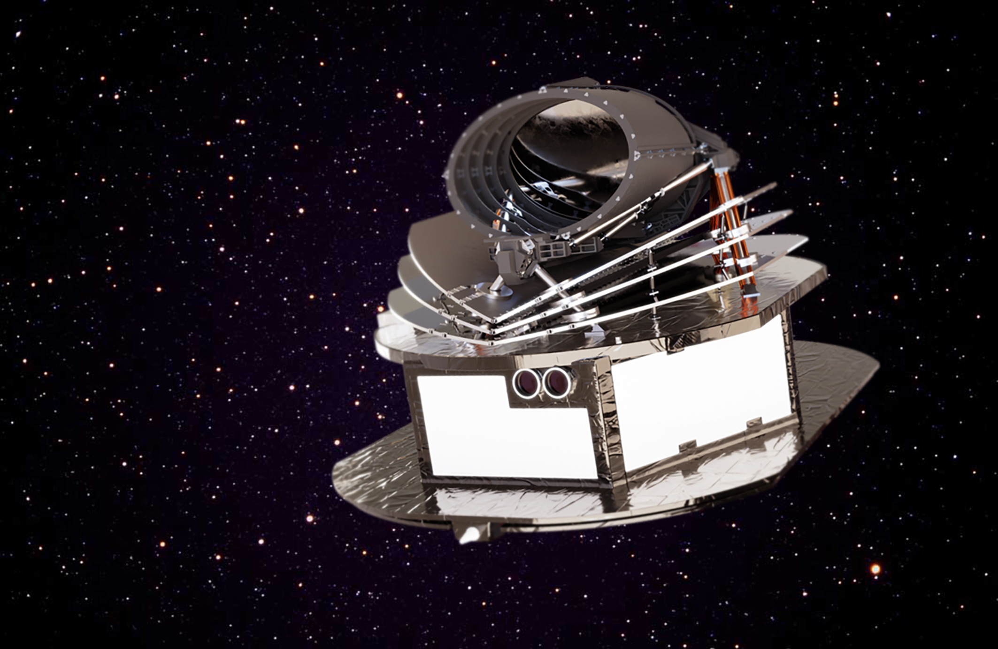
Break the degeneracy: transit spectroscopy
Kempton+2023
Use transit spectroscopy with JWST and ARIEL:
are sub-Neptunes
H₂-He or H₂O?
Transit depth [%]
Wavelength [µm]
Notes:
With a technique called "transit spectroscopy", JWST can take a spectra of an exoplanet's atmosphere. JWST detectors work in the near-IR, which allows to detect most simple volatiles such as H2O, CO, CO2, or CH4.
This technique relies on how extended the atmosphere is, which leads to a counter-intuitive trend: water-rich atmosphere is heavy so the features are small, but a water-poor atmosphere is light and extended so the features are big.

Slide 48
Same mass, same radius, different composition
H₂O steam/supercritical
H₂/He gas
Rock
Steam World
Gas Dwarf
50%
0.43%
Pure H₂O envelope: Aguichine+2025
Featureless spectra
H₂-He (1x solar): Tang+2024
Strong features
(H₂O)
(H₂-He)
50%
99.57%
50.02%
98.87%
Gas dominated
Steam dominated
49.97% H₂O
0.74%
(H₂-He)
H₂-He (50x solar): Tang+2024
Moderate features
Hycean? (Madhusudhan+2020)
Aguichine+2026, in prep.
Small features
0.01% H₂-He
0.49%
(H₂O)
Image Credit: Aguichine & Batalha
JWST sensitivity limit
Notes:
Degeneracy in composition.
Breaking this degeneracy was the promise of the JWST.

Slide 49
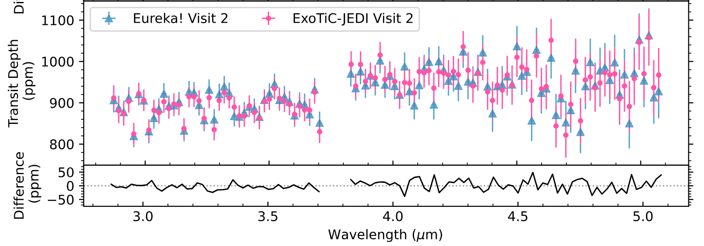
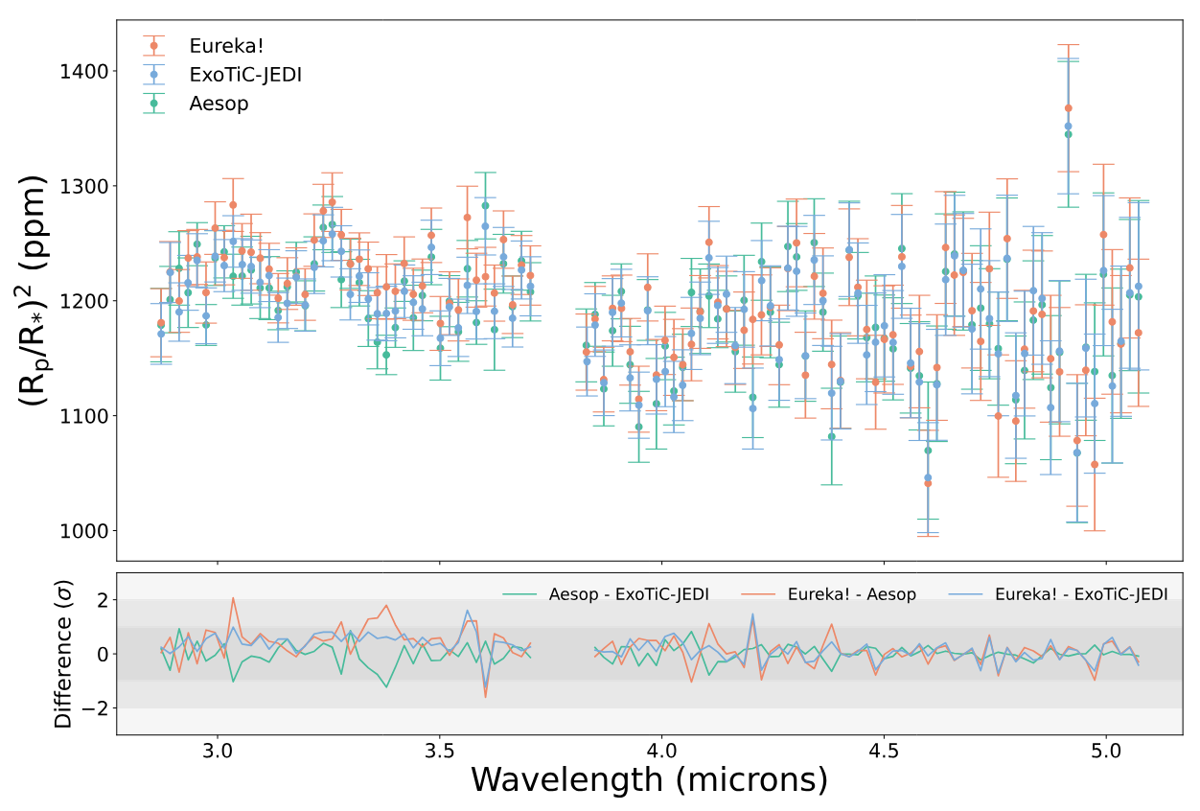
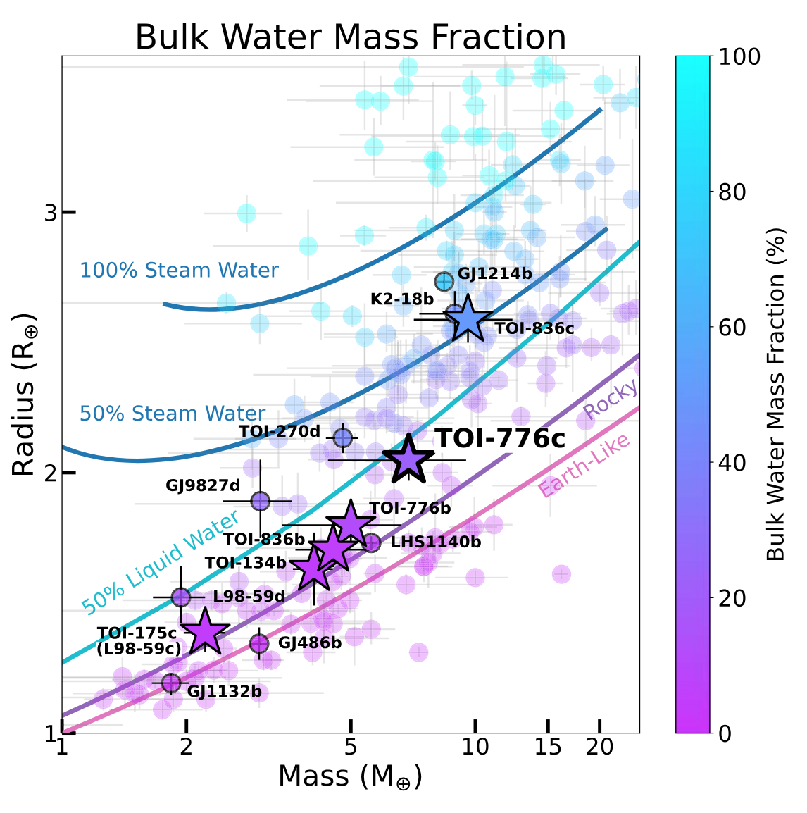
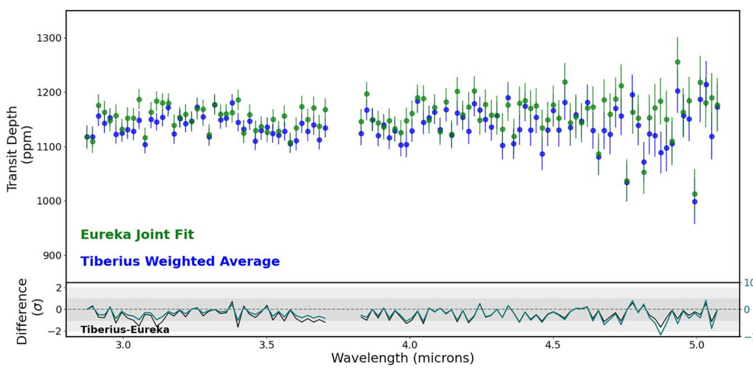
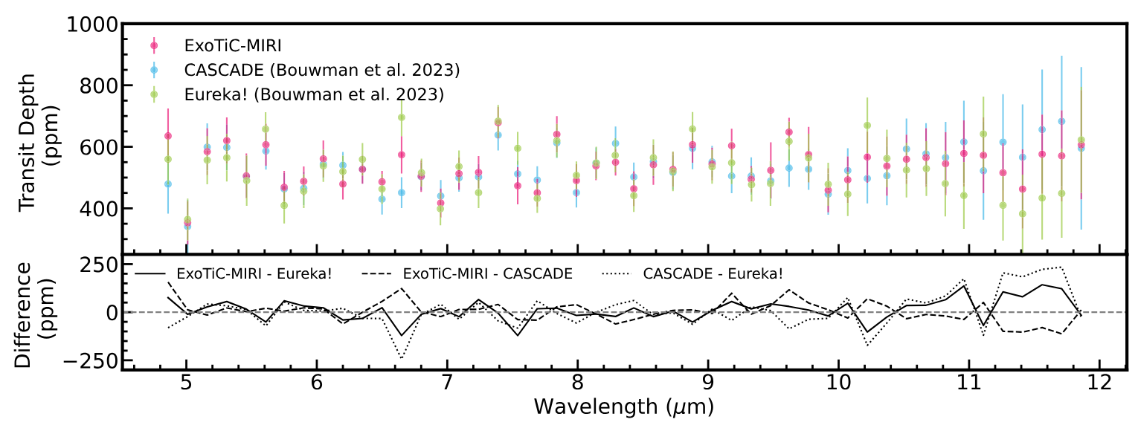
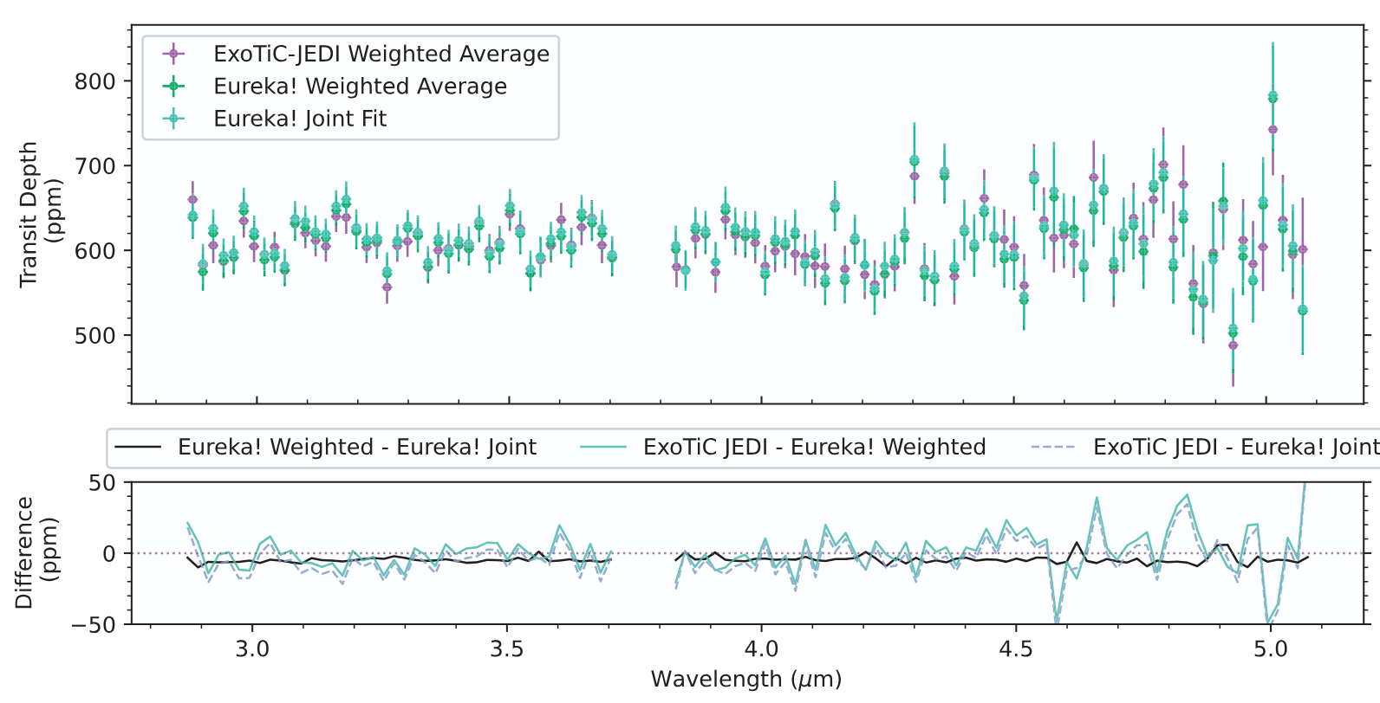
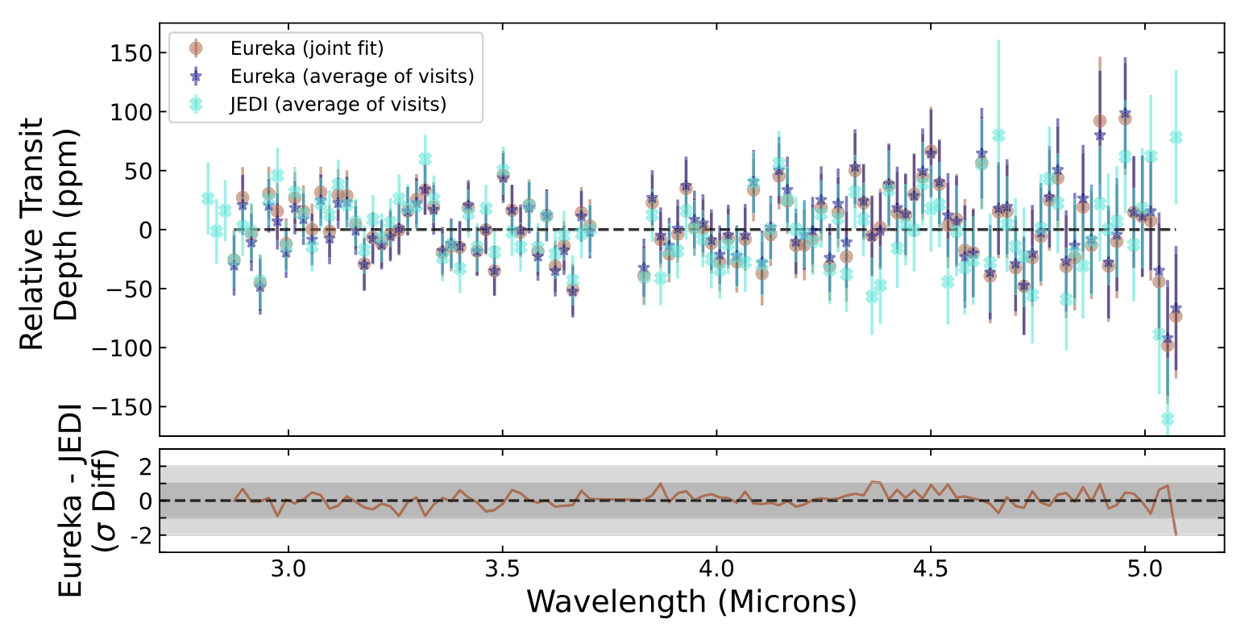
Atmospheric spectra of sub-Neptunes with JWST
Wallack,Aguichine+2024
Alderson,Aguichine+2024
Teske,Aguichine+2025
Alam,Aguichine+2025
Alderson,Aguichine+2025
Scarsdale,Aguichine+2025
COMPASS: largest JWST Cycle 1 program dedicated to exoplanets
Teske+2025
Notes:
I have been invited to join the COMPASS program, which is...
My goal was to interpret the bulk composition of these planets based on their spectra.
So far, 6 spectra have been published, and all of them are featureless. This came out as a big surprise at first, because many expected these sub-Neptune to have hydrogen-rich atmospheres.

Slide 50
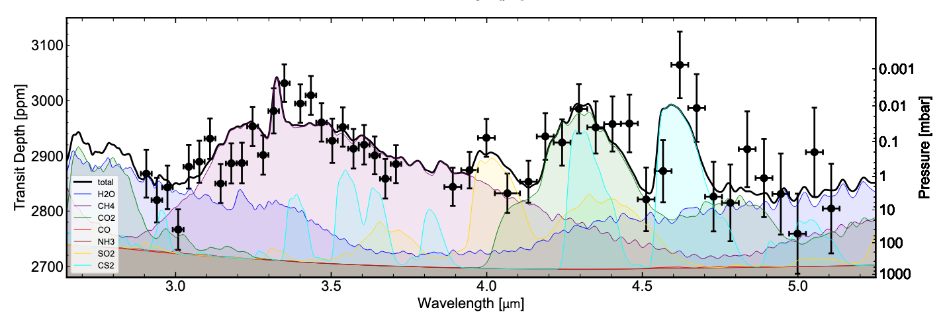
Atmospheric spectra of sub-Neptunes with JWST
CS₂
CH₄
CO₂
H₂O
H₂O
SO₂
Transit spectra of sub-Neptune TOI-270d.
~200x Solar metallicity (50% H₂-He / 50% other)
Benneke+2024
Notes:
Other sub-Neptunes have been observed, such as TOI-270d by Bjorn Benneke.
This spectra has features, but the value of the metallicity aligns with the findings of the COMPASS program.
This suggests that sub-Neptunes are water, or at least volatile, rich!!!
The spectra only provides the composition of the atmosphere, still need to understand if this is compatible with their interiors.

Slide 51
Probing interior processes with JWST
Chemistry at volatile/rock interface – change in atmosphere composition
Funded JWST Cycle 4 proposal.
PI: Natasha Batalha, co-I: Artem Aguichine
Notes:
Back to the case of sub-Neptunes, they are a rich laboratory since

Slide 52
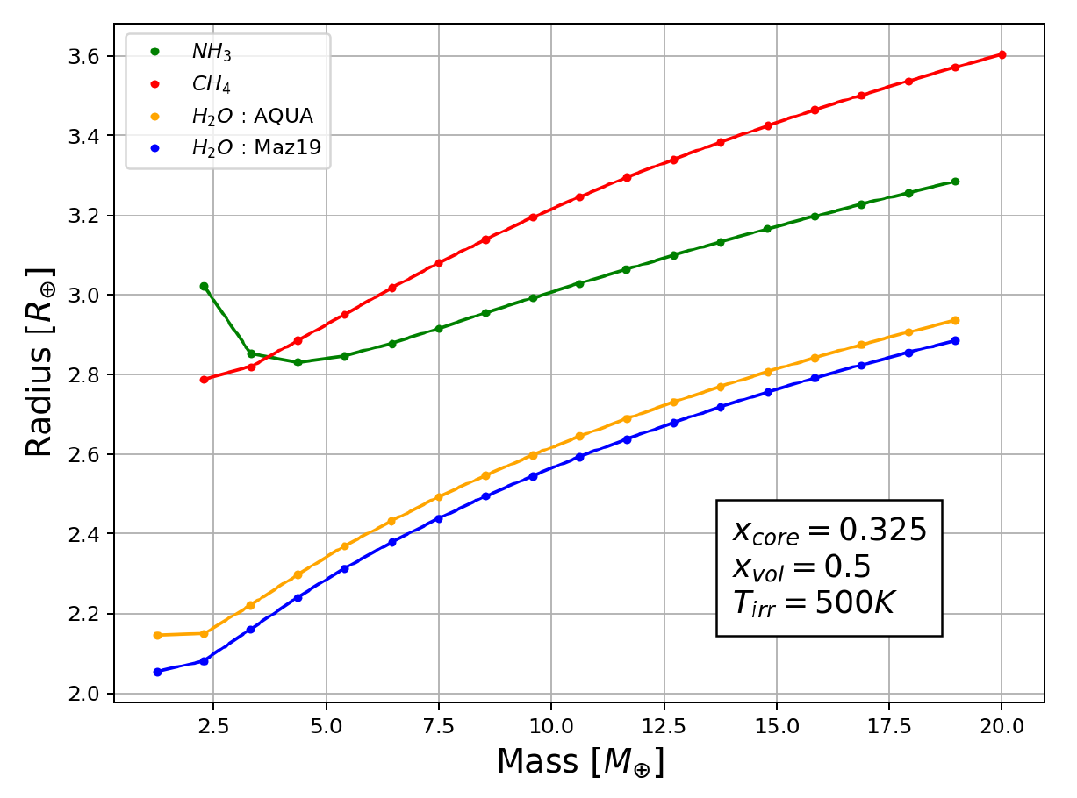



Even more volatiles!
Solar O:C:N = 54:30:16
More extended radius
50% CH₄
50% NH₃
50% H₂O
Emma Postolec
(Master student)
Nadine Nettelmann
Jonathan Fortney
Notes:
We can push this idea further by adding more molecules. This was the project of a master student I co-mentored with Nadine Nettelmann and Jonathan Fortney. This is very much work in progress, but this is the direction we are aiming for.
JF: take out this slide, I have enough mentorship.

Slide 53
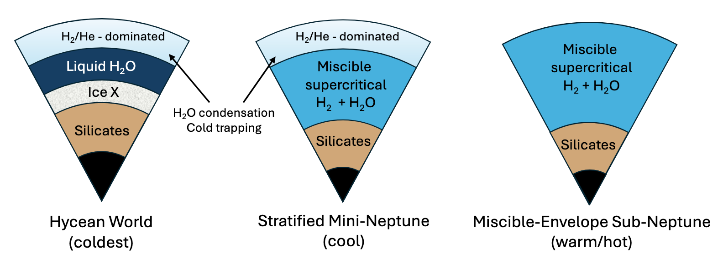
The runaway greenhouse effect
5% of sub-Neptunes:
Water is liquid or solid
Water Worlds
95% of sub-Neptunes:
Water is steam and supercritical
Steam Worlds
Benneke+2024
Notes:
What determines the transition is the insolation, or flux received by the planet.
How do we model this

Slide 54
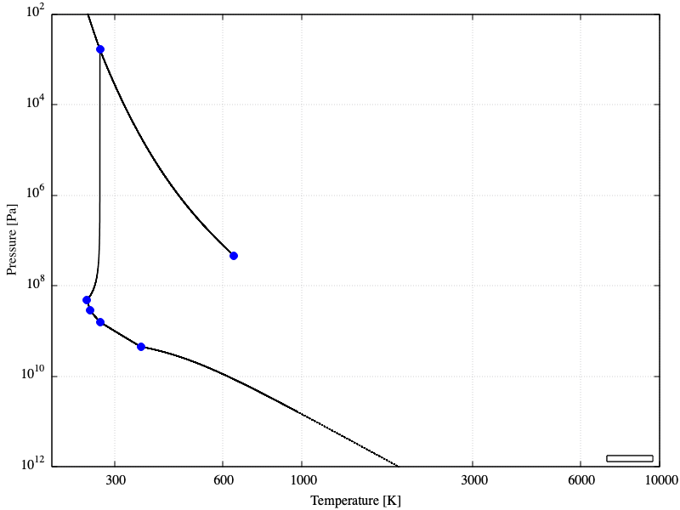
How is water?
Vapor
Dissociated
Ice 1
Pressure [Pa]
Liquid
Supercritical
Ice 3,4,5,6
Ice 7
Plasma
Ice 10
Temperature [K]
Notes:
What determines the transition is the insolation, or flux received by the planet.
How do we model this?

Slide 55
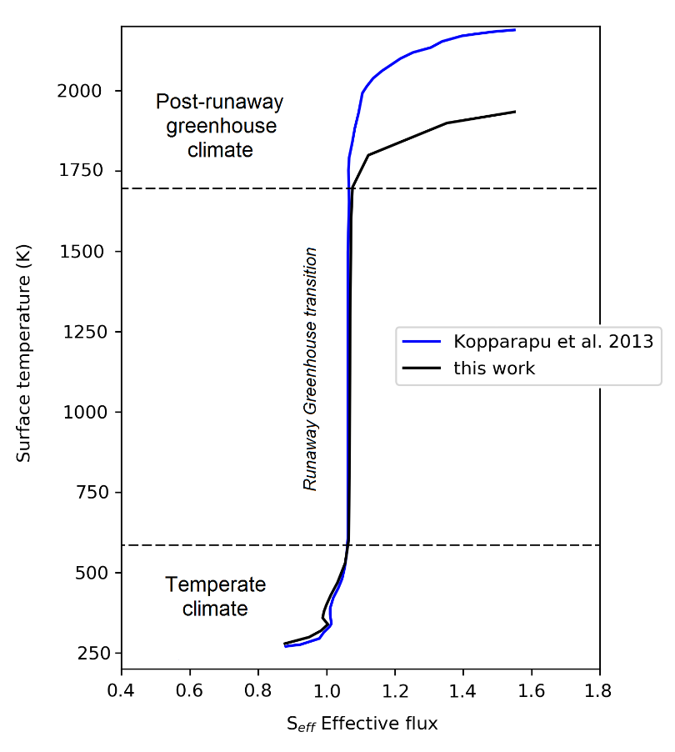
How is water? The runaway greenhouse effect
Vapor
Dissociated
Venus-like
Ice 1
Post-runaway: Venus-like
95% of sub-Neptunes
Liquid
Supercritical
Pre-runaway: Earth-like
5% of sub-Neptunes
Ice 3,4,5,6
Ice 7
Plasma
Earth-like
Ice 10
Turbet+2019
Notes:
What determines the transition is the insolation, or flux received by the planet.
How do we model this?

Slide 56
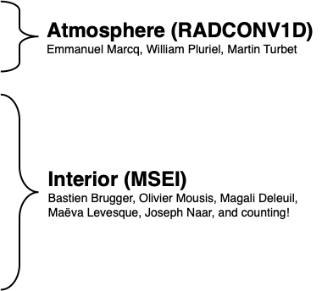
Interior of Irradiated Ocean Planets (IOP)
Irradiated Ocean Planet (IOP) model (Mousis,Deleuil,Aguichine+2020,Aguichine+2021)
Atmosphere (RADCONV1D)
Pure steam atmosphere
Marcq+2019,Pluriel+2019
Pressure [Pa]
Interior (MSEI)
Supercritical H₂O envelop
Earth-like core
Brugger+2016,Brugger+2017
Temperature [K]
Rocky core
Aguichine+2021
Notes:
At such high insolations, most of these exoplanets are most likely in a runaway greenhouse regime, and a steam atmosphere is formed instead.
On this figure, I show adiabats in 5 earth masses spheres made of pure water, and below the steam atmosphere water is in supercritical or plasma state.

Slide 57
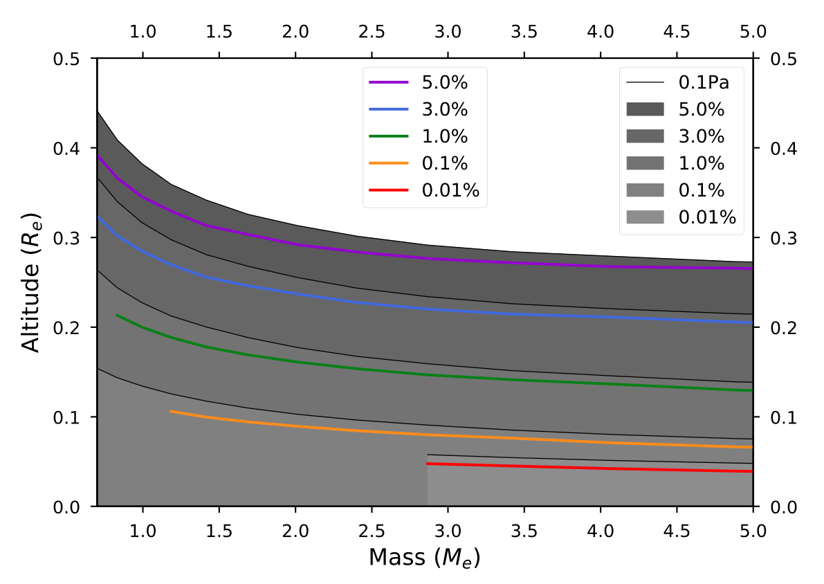
Interior of Irradiated Ocean Planets (IOP)
Irradiated Ocean Planet (IOP) model (Aguichine+2021)
Atmosphere (RADCONV1D)
Emmanuel Marcq, William Pluriel, Martin Turbet
Atmosphere Thickness [R⊕]
Interior (MSEI)
Bastien Brugger, Olivier Mousis, Magali Deleuil
Planet Mass [M⊕]
Vivien+2022
Notes:
At such high insolations, most of these exoplanets are most likely in a runaway greenhouse regime, and a steam atmosphere is formed instead.
On this figure, I show adiabats in 5 earth masses spheres made of pure water, and below the steam atmosphere water is in supercritical or plasma state.

Slide 58
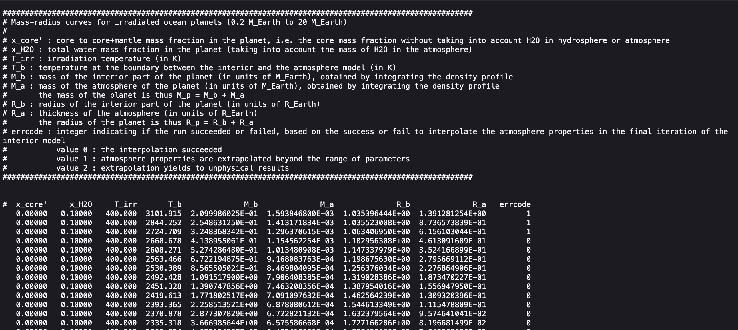

Tabulated MR data
Wallack+2024
Aguichine+2021
model grid
Full range of model output
(+ analytical fit)
smint (Piaulet+2021): MCMC to infer water mass fraction

Slide 59
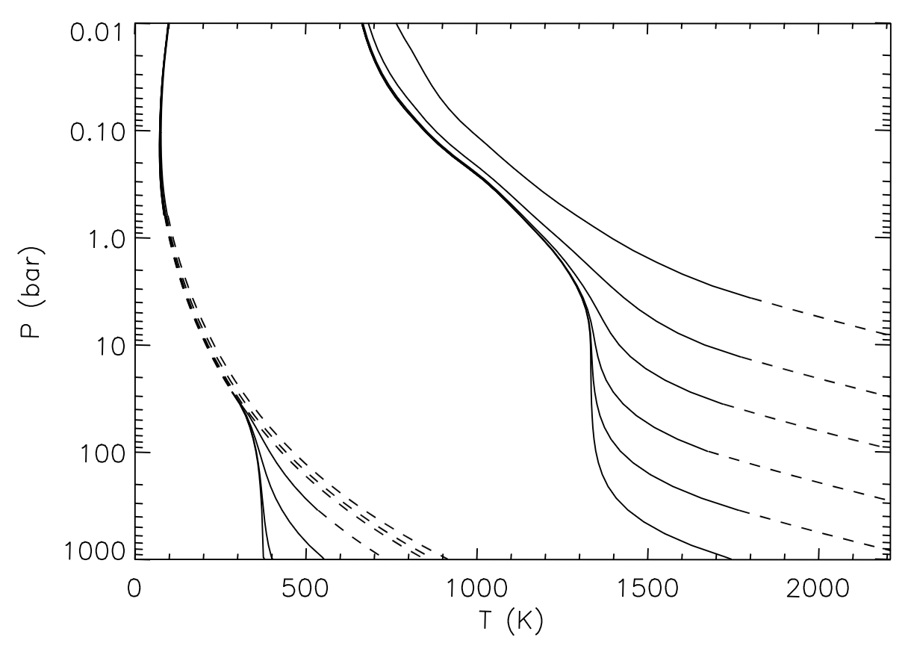

Interior cooling of H/He
Envelope contraction
Cooling of the interior
Fortney+2007
Lopez & Fortney 2014

Slide 60


Interior cooling of water worlds
Nettelmann+2011
(Neptune-like opacity)
Cooling of the interior
Aguichine+2021
(static)
Pressure [Pa]
Cooling of the interior
Aguichine+2024
(evolutionary, in prep)
Pure water atmosphere
Kempton+2023
GJ 1214b (Mp=6.55 M⊕, Rp=2.68 R⊕, Teq=555K, 97% H₂O)

Slide 61

Steam World Evolution (SWE)
Aguichine+2025
Nettelmann+2011
(Neptune-like opacity)
~ GJ 1214b
T_{int} = 40-400 K
100% H₂O
Aguichine+2021
(static)
Pressure [Pa]
Aguichine+2025
Temperature [K]
GJ 1214b (Mp=6.55 M⊕, Rp=2.68 R⊕, Teq=555K, 97% H₂O)

Slide 62
Interior cooling of water worlds
Nettelmann+2011
(Neptune-like opacity)
~ GJ 1214b
T_{int} = 40-400 K
100% H₂O
Aguichine+2021
(static)
Pressure [Pa]
Aguichine+2024
(evolutionary, in prep)
Temperature [K]
GJ 1214b (Mp=6.55 M⊕, Rp=2.68 R⊕, Teq=555K, 97% H₂O)

Slide 63

Interior cooling of water worlds
Different initial entropy
Different water mass fraction
Aguichine+2021 (static)
Aguichine+2024
(evolutionary, in prep)
Water worlds are almost static past ~1 Gyr.
Aguichine+2021 (static)
Aguichine+2024
(evolutionary, in prep)

Slide 64

Interior structure of Earth
Solid core
Liquid core
Lower mantle
Earth’s composition:
32.5% core
67.5% mantle
0.05% water ~ 0%
Crust
Upper mantle
Ocean
Interior structure of Earth to scale
Preliminary Reference Earth Model (PREM, Dziewonsky 1981)
Notes:
First, let’s consider the case of the Earth. On the left cross-section of Earth’s interior, on the right the density profile.
Describe density profile. And then you can see the last pixel corresponding to the ocean on the surface, the water content on Earth is ridiculously small.
This raises the question: what would an Earth analog with more water look like?

Slide 65


Is radius a proxy for composition?
Aguichine+2024, Exoplanets 5 poster
Lichtenberg+2023

Slide 66

Is radius a proxy for composition?
Aguichine+2024, Exoplanets 5 poster
A new EOS for pyrolite, data from Caracas+2024, EOS in Aguichine+2024, Exoplanets 5 poster

